Slide 1
Wellcome to the presentation of shiny app
The project base on summarizing and visurize total and average football action (goal,possession,ontarget,offtarget,red card,yellow card)take place on Football ground for each team when is home and away

Slide 2
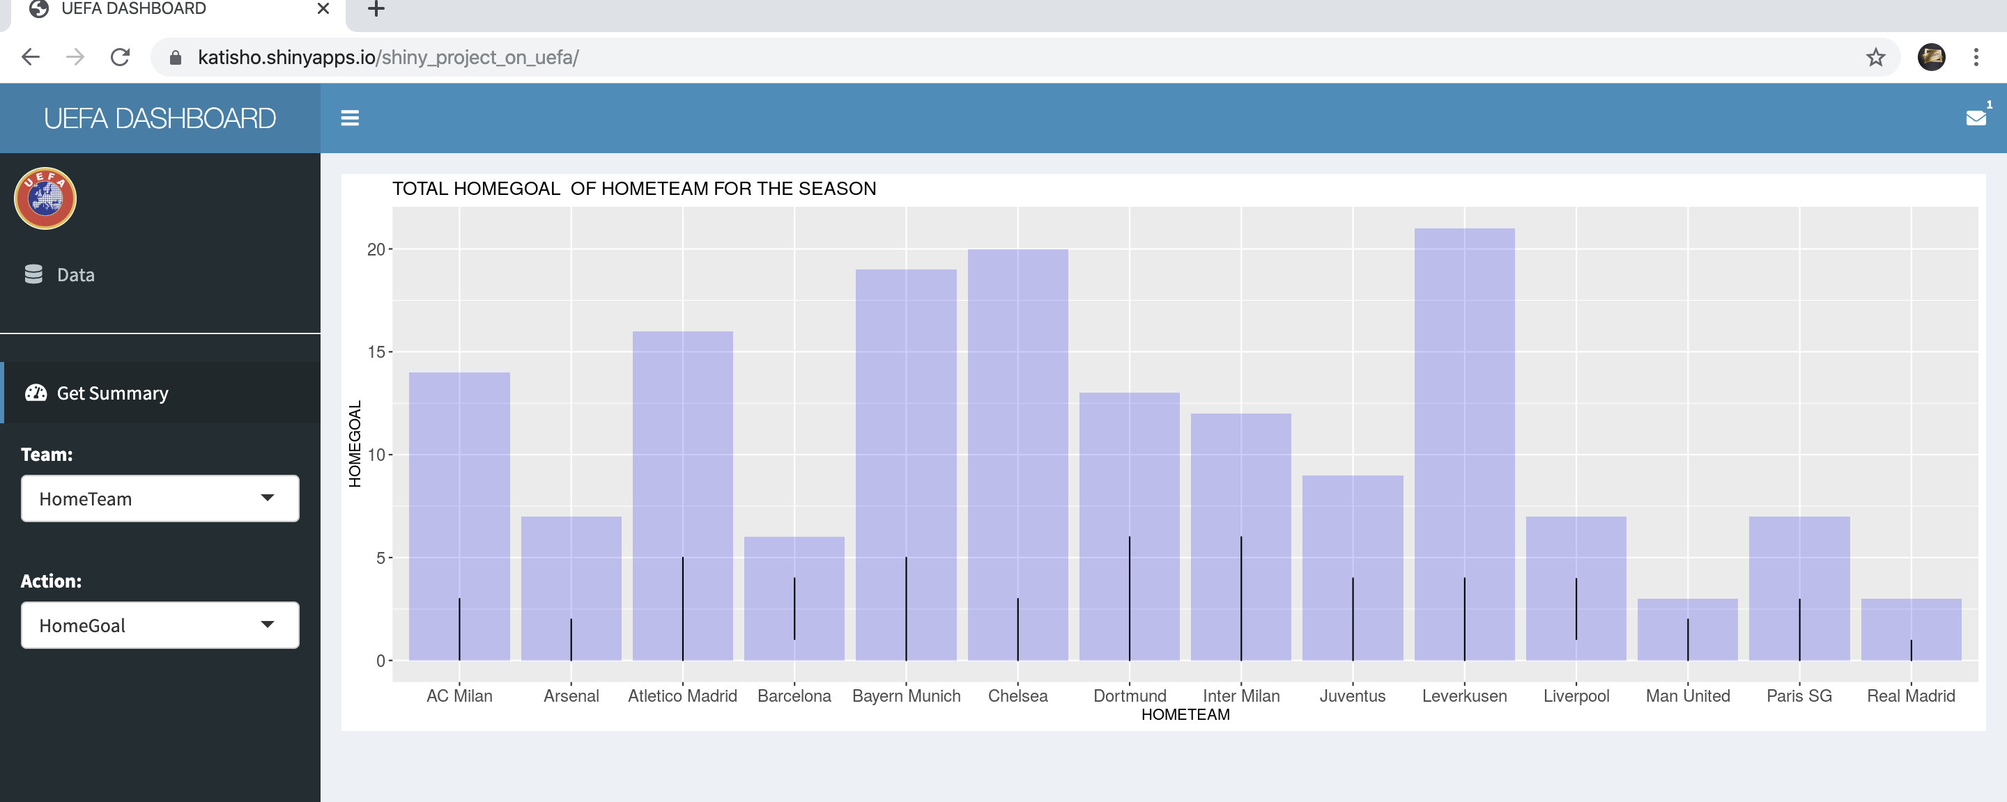
HOME TEAM GOAL FOR DIFFERENT

Slide 3
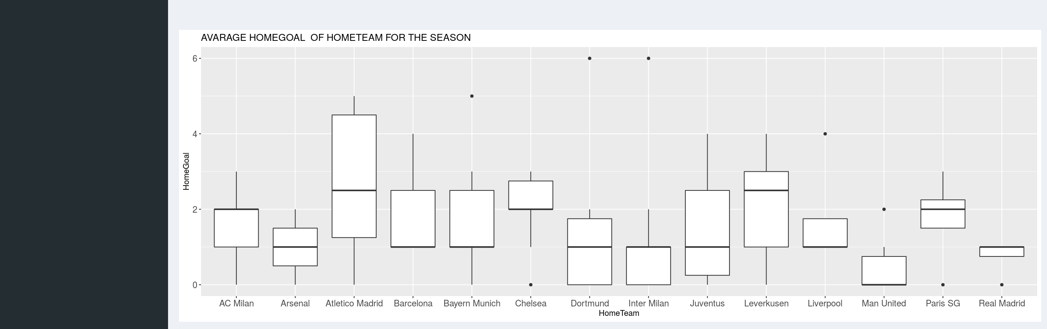
continues AvarAge home goal

Slide 4
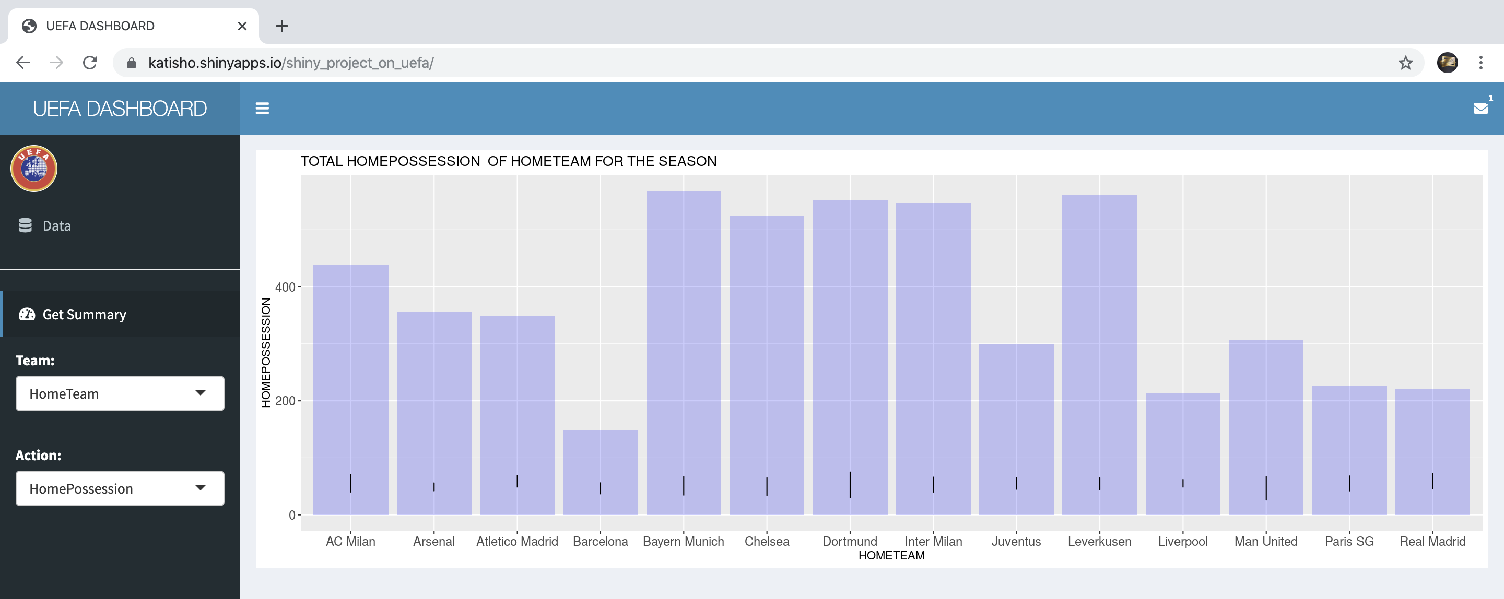
HOME TEAM POSSESSION FOR DIFFERENT

Slide 5
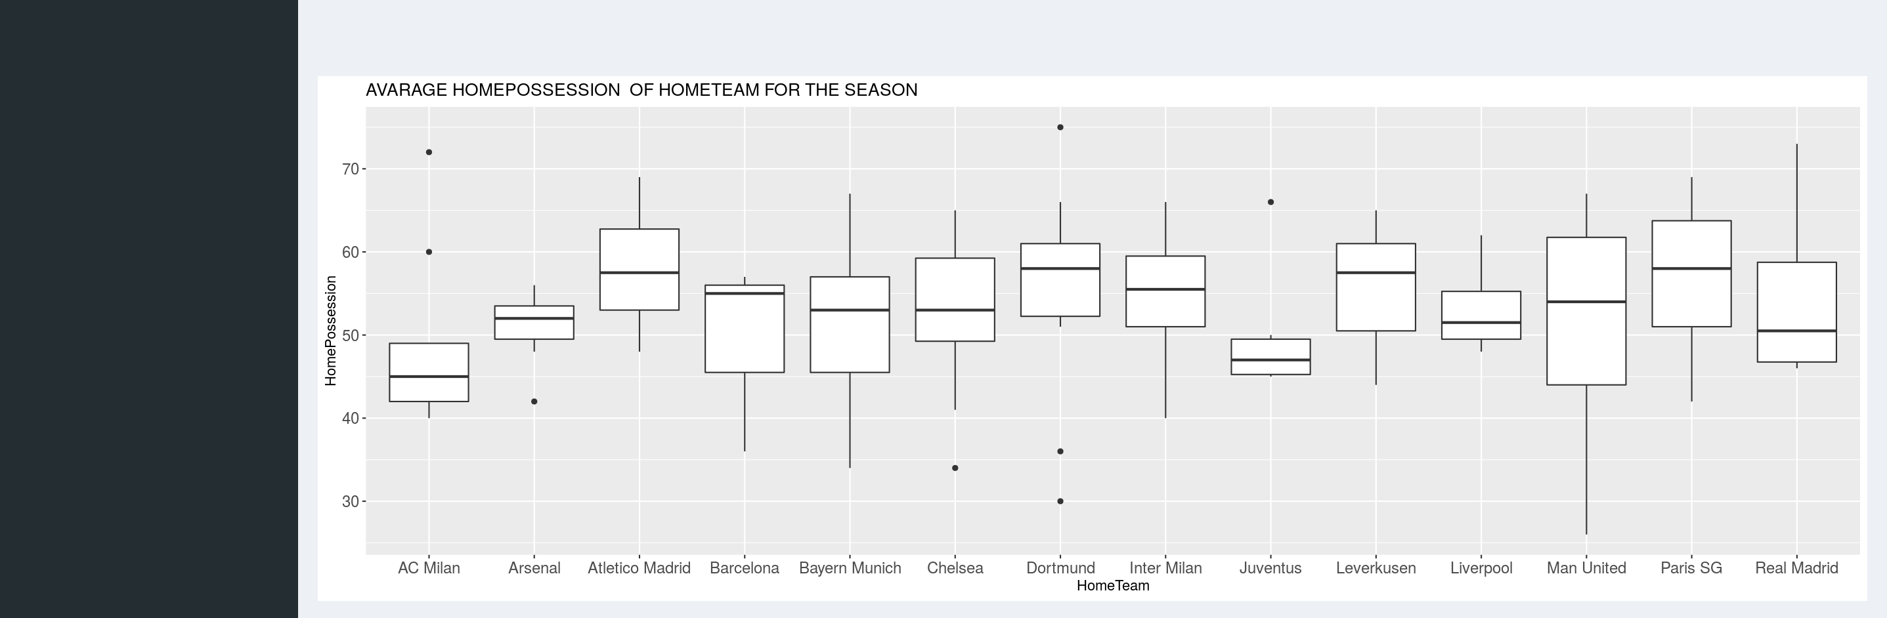
Continue AvarAge Possession goal

Slide 6
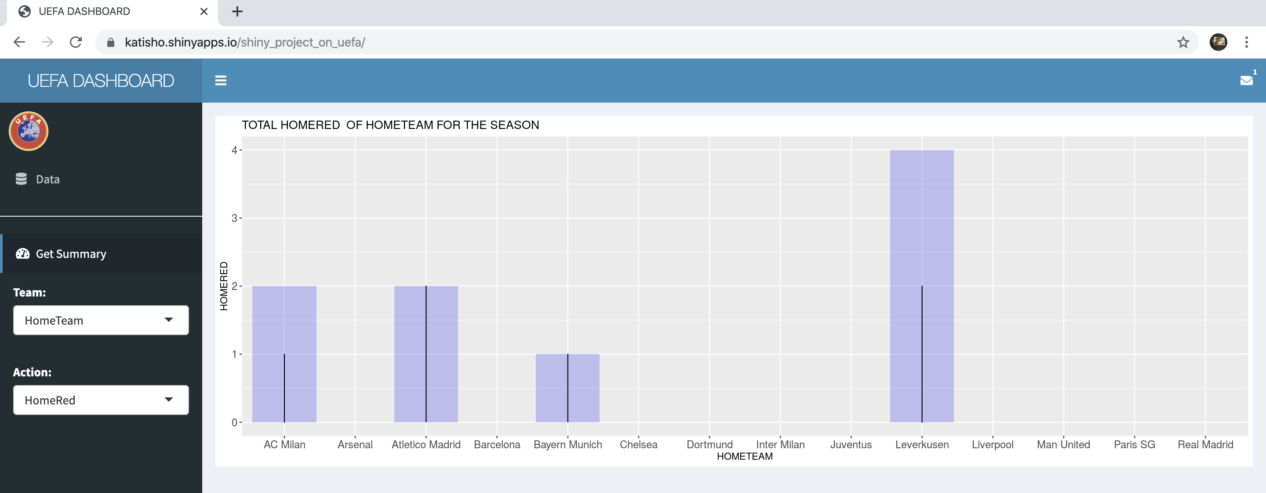
HOME RED CARD FOR DIFFERENT

Slide 7
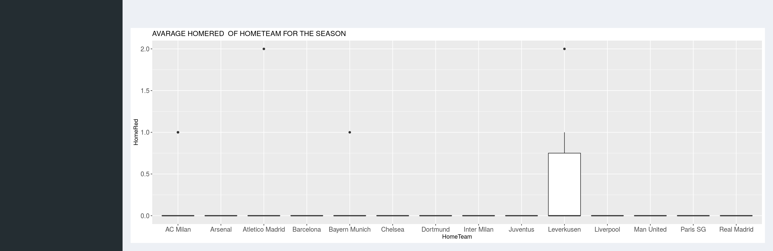
continues AVARAGE RED CARD FOR DIFFERENT

Slide 8
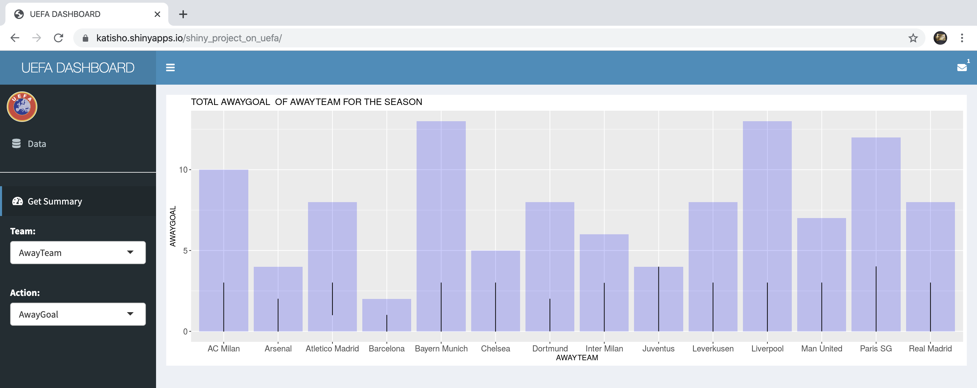
TOTAL AWAY GOAL FOR DIFFERENT

Slide 9
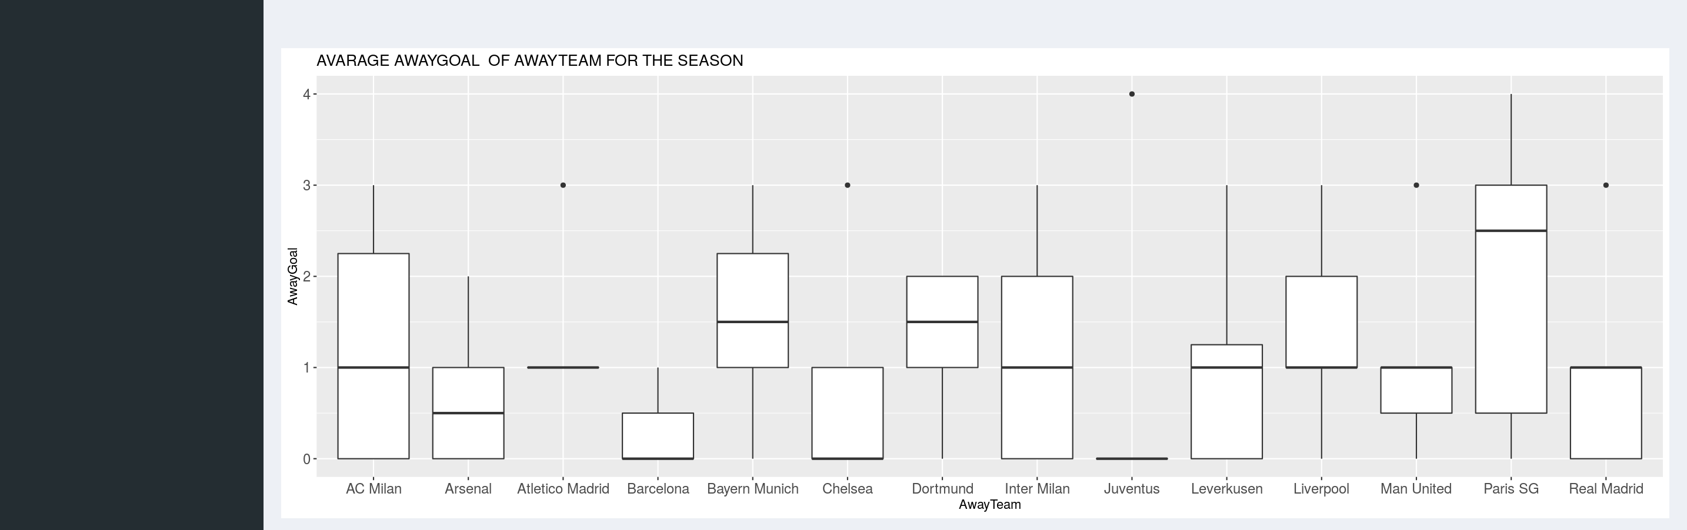
AVARAGE GOAL FOR AWAY TEAM

Slide 10
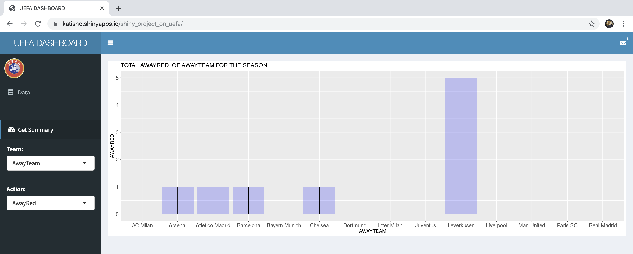
AWAY RED CARD FOR DIFFERENT

Slide 11
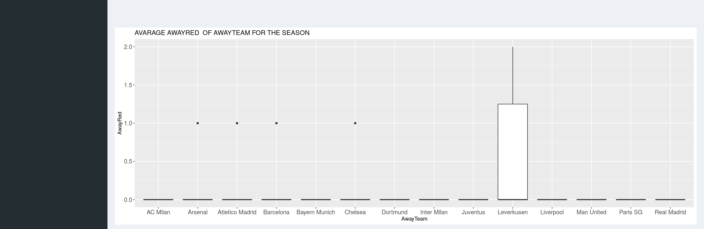
AWAY AVARAGE RED CARD FOR DIFFERENT

Slide 12
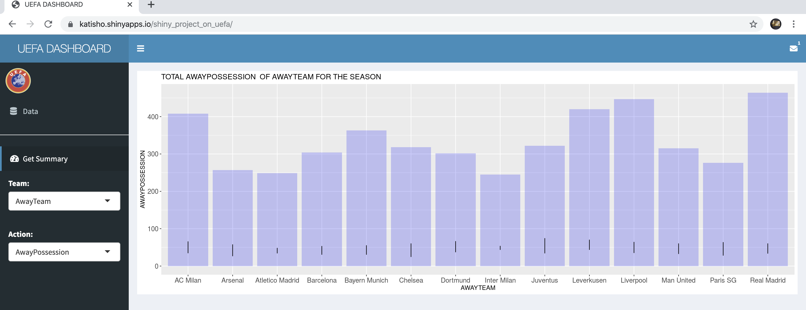
AWAY TEAM POSSESSION FOR DIFFERENT

Slide 13
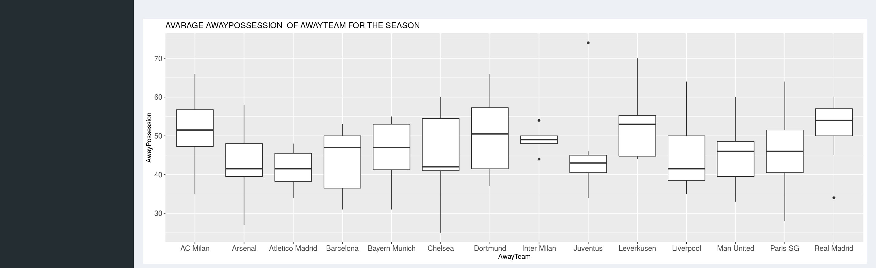
AVARAGE POSSESSION FOR DIFFERENT

Slide 14
Conclusion
Future project: Is to automate the different season for different year
Thanks for listen

