Slide 1
Wellcome to the presentation of shiny app
The project base on summarizing and visurize total and average football action (goal,possession,ontarget,offtarget,red card,yellow card)take place on Football ground for each team when is home and away

Slide 2
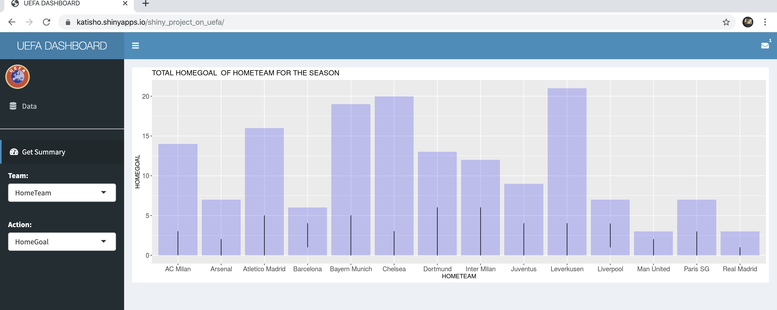
HOME TEAM GOAL FOR DIFFERENT

Slide 3
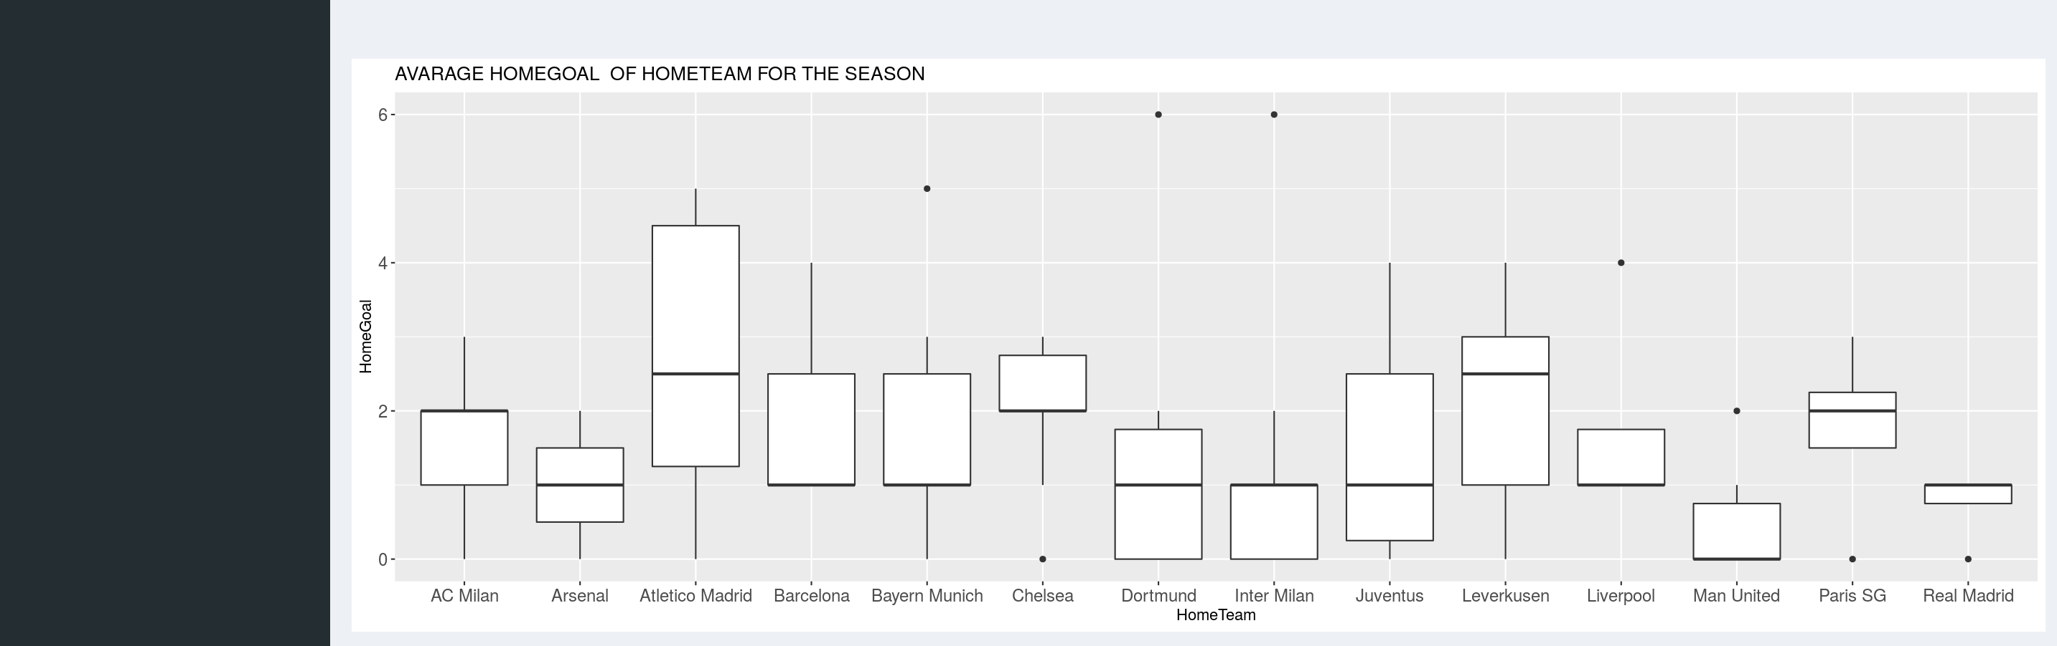
continues AvarAge home goal

Slide 4
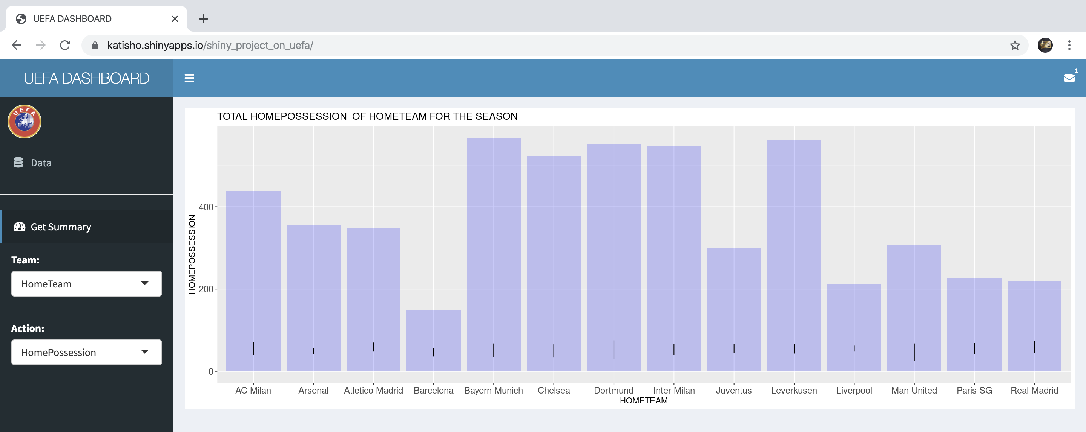
HOME TEAM POSSESSION FOR DIFFERENT

Slide 5
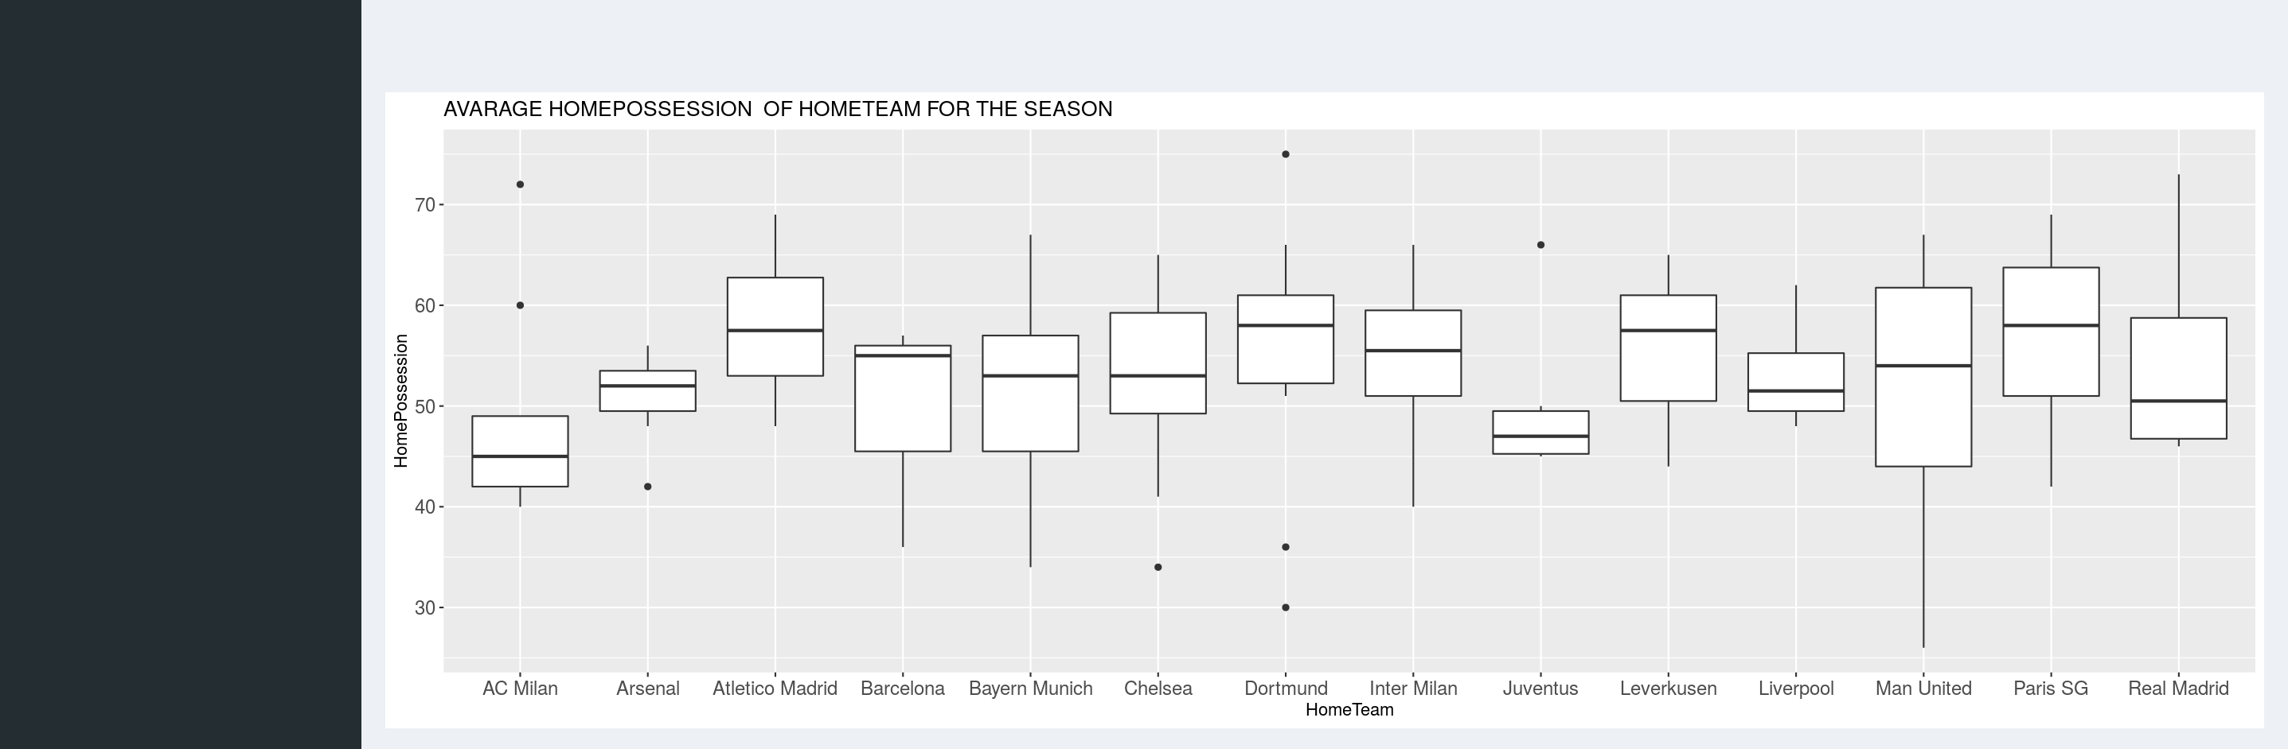
Continue AvarAge Possession goal

Slide 6
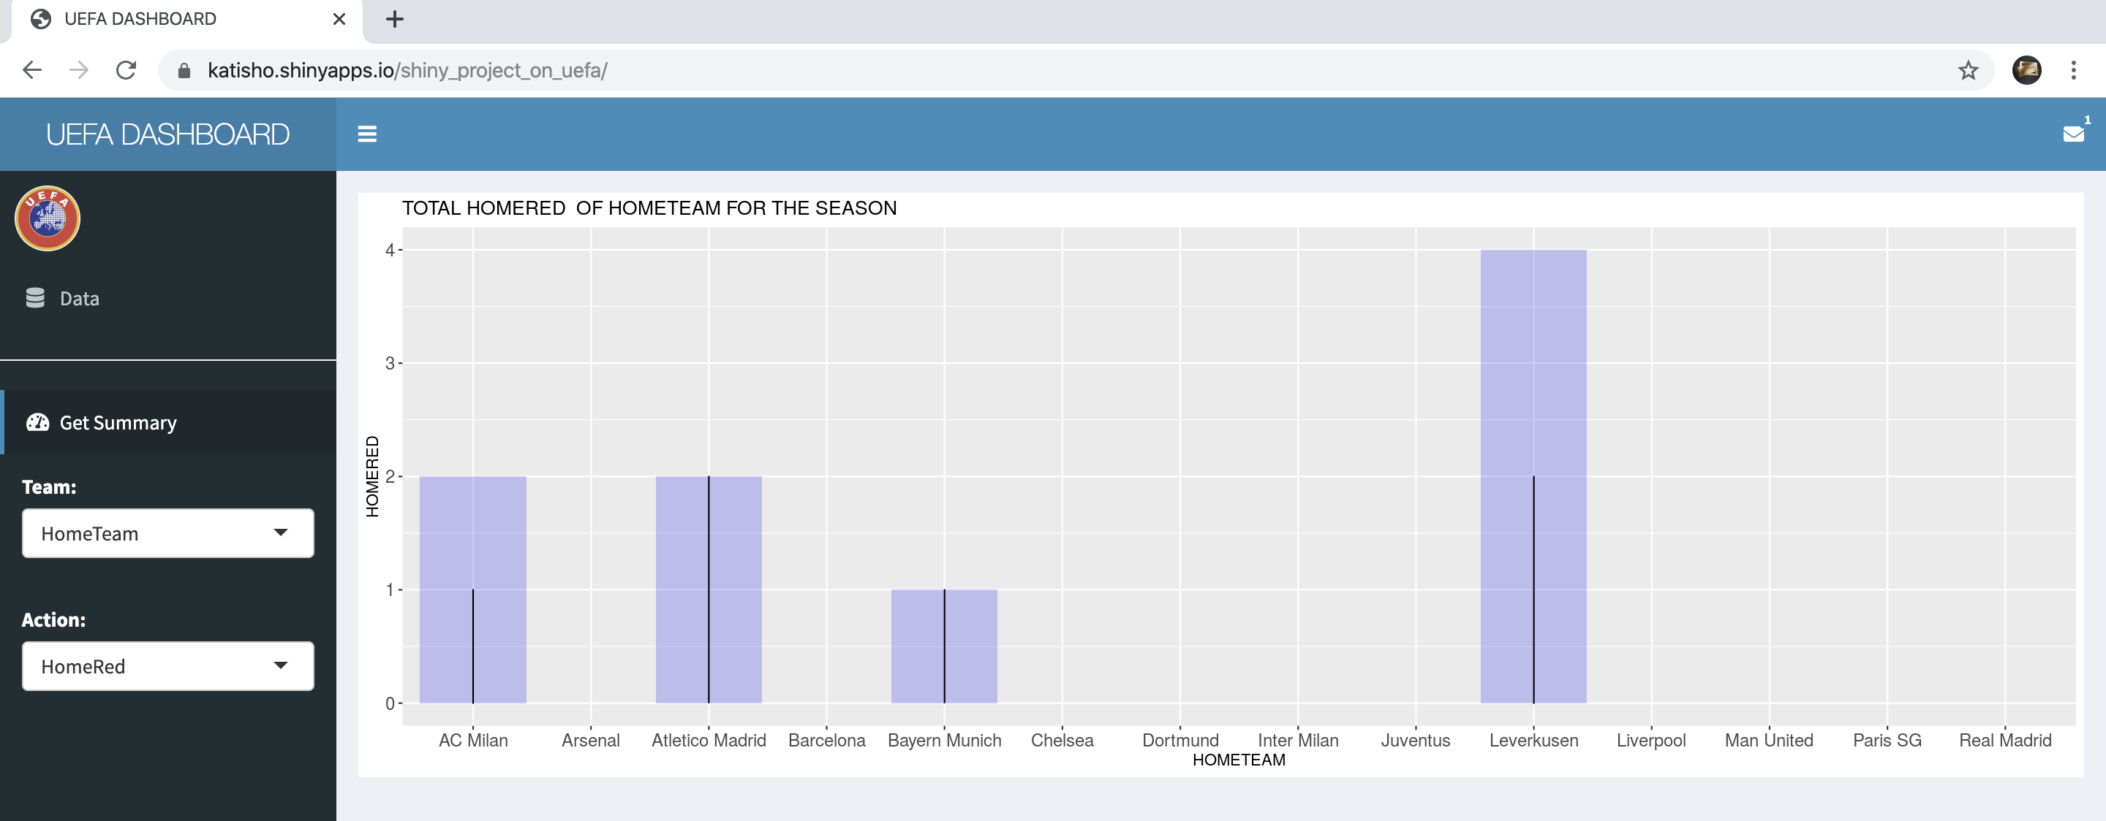
HOME RED CARD FOR DIFFERENT

Slide 7
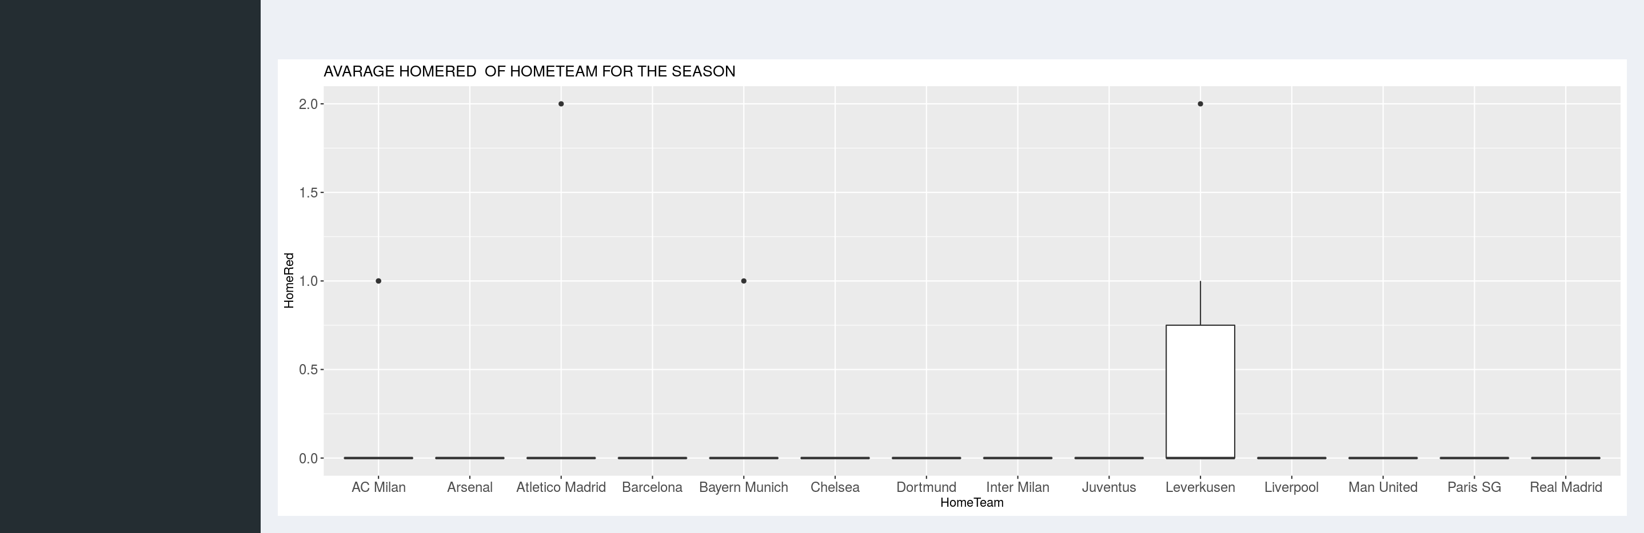
continues AVARAGE RED CARD FOR DIFFERENT

Slide 8
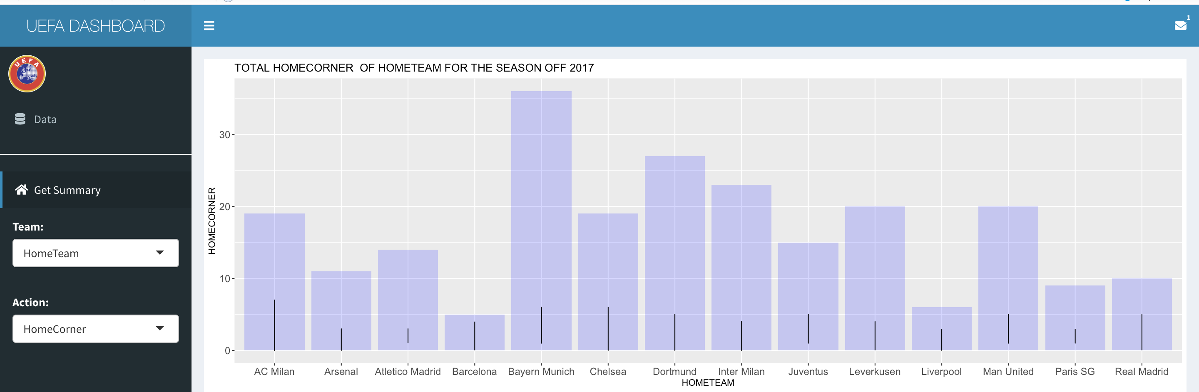
Total corner at home

Slide 9
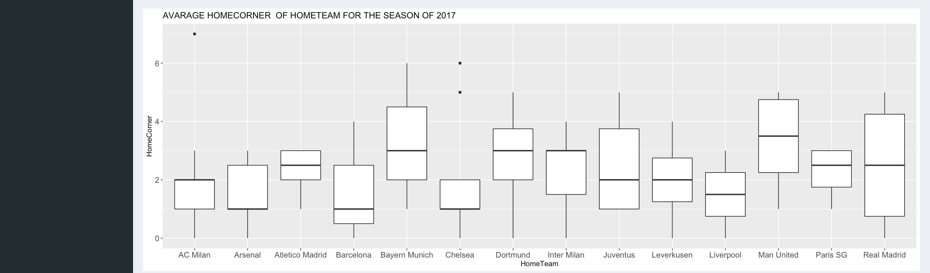
continues Avarage total corner at home

Slide 10
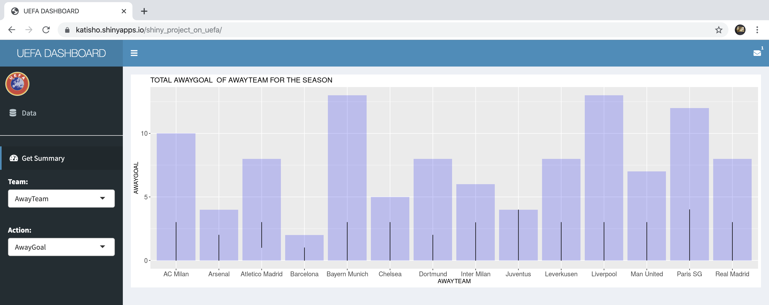
TOTAL AWAY GOAL FOR DIFFERENT

Slide 11
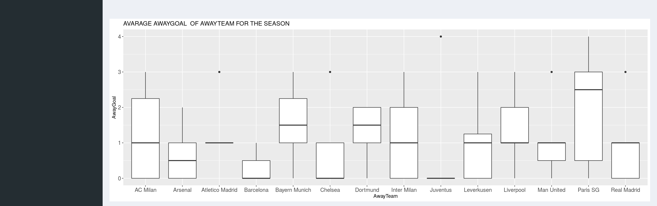
AVARAGE GOAL FOR AWAY TEAM

Slide 12
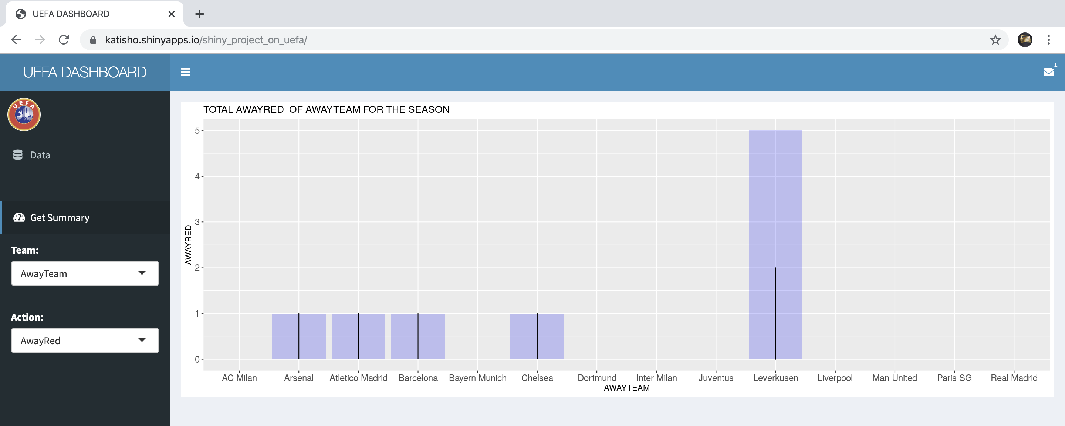
AWAY RED CARD FOR DIFFERENT

Slide 13
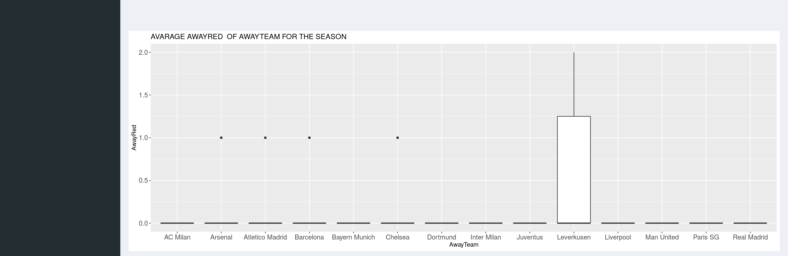
AWAY AVARAGE RED CARD FOR DIFFERENT

Slide 14
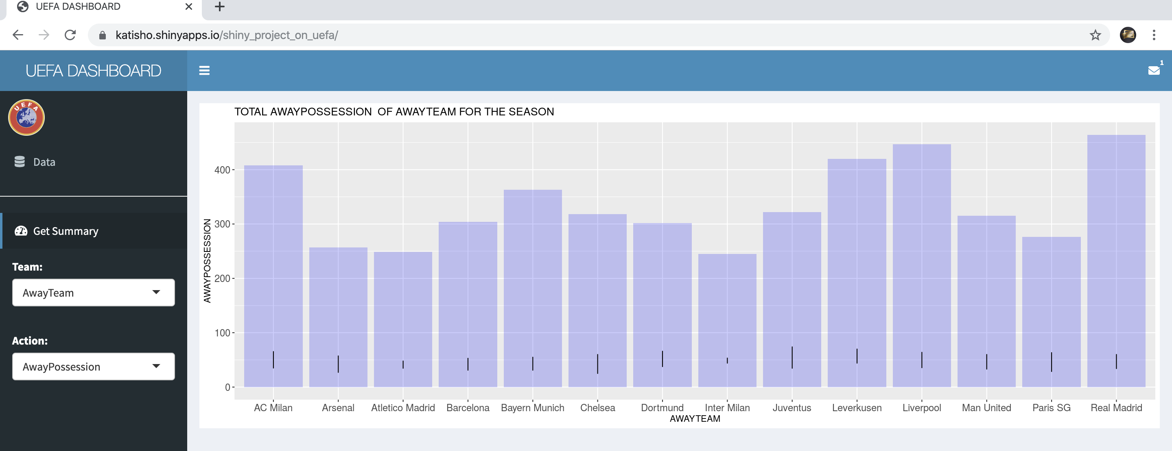
AWAY TEAM POSSESSION FOR DIFFERENT

Slide 15
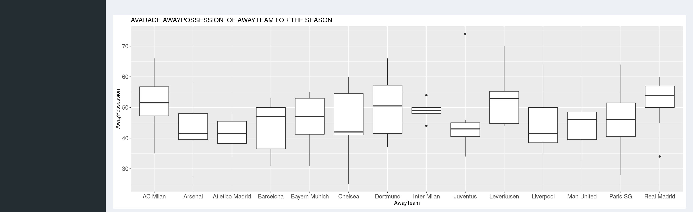
AVARAGE POSSESSION FOR DIFFERENT

Slide 16
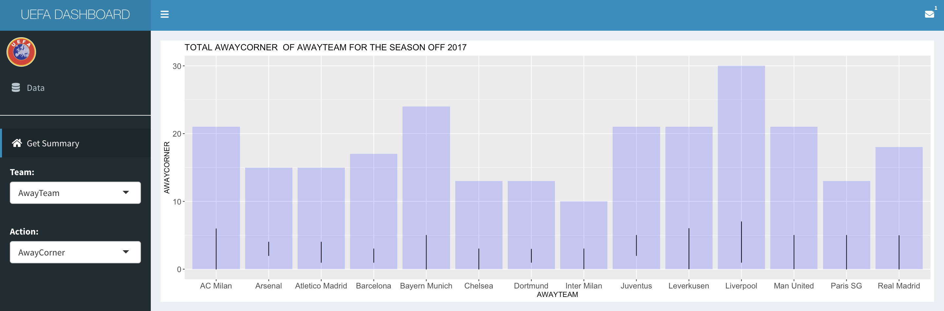
Total corner away

Slide 17
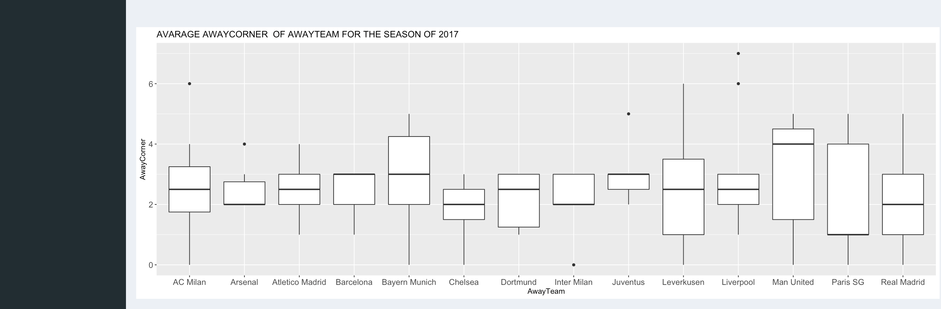
Continues AVARAGE OF CORNER AT AWAY

Slide 18
Conclusion
Future project: Is to automate the different season for different year
Thanks for listen

