Slide 1
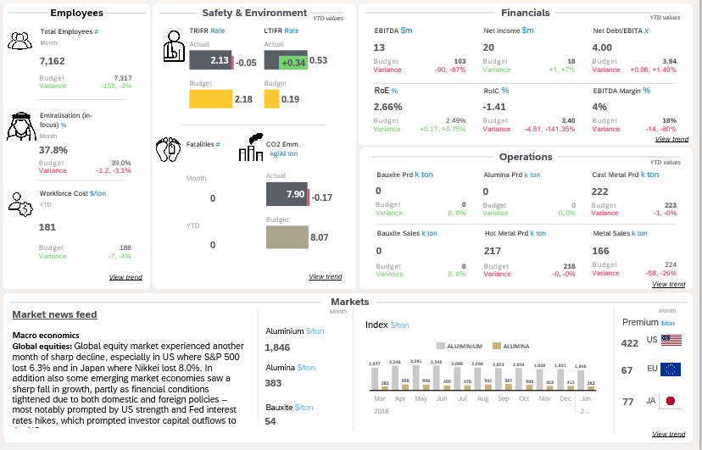
Vie
w trend
View trend
View trend
View trend
View trend
View trend

Slide 2
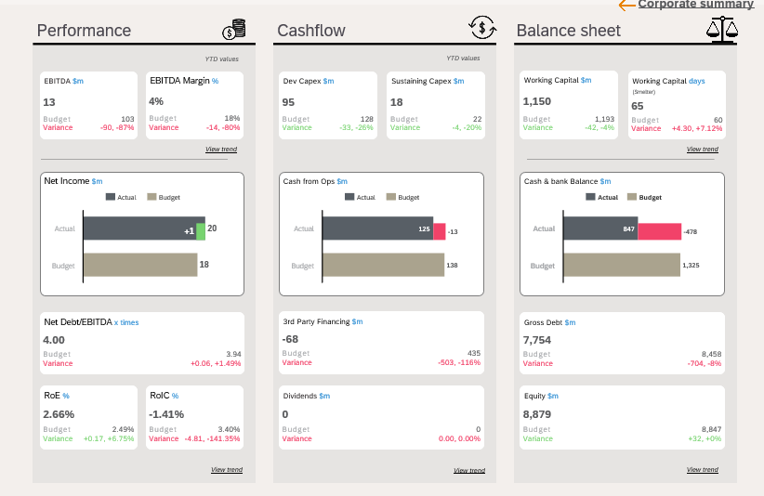
Corporate Summary
View trend
View trend
View trend
View trend
View trend

Slide 3
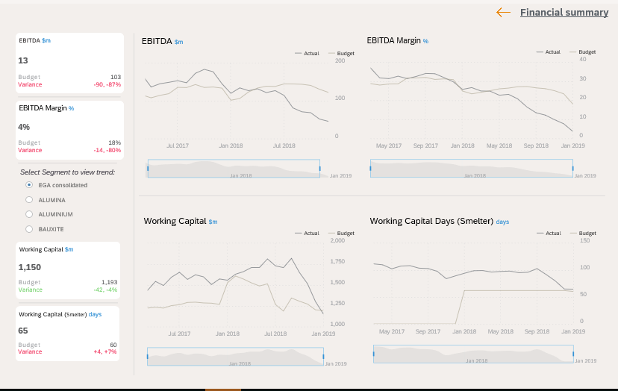
Financial Summary

Slide 4
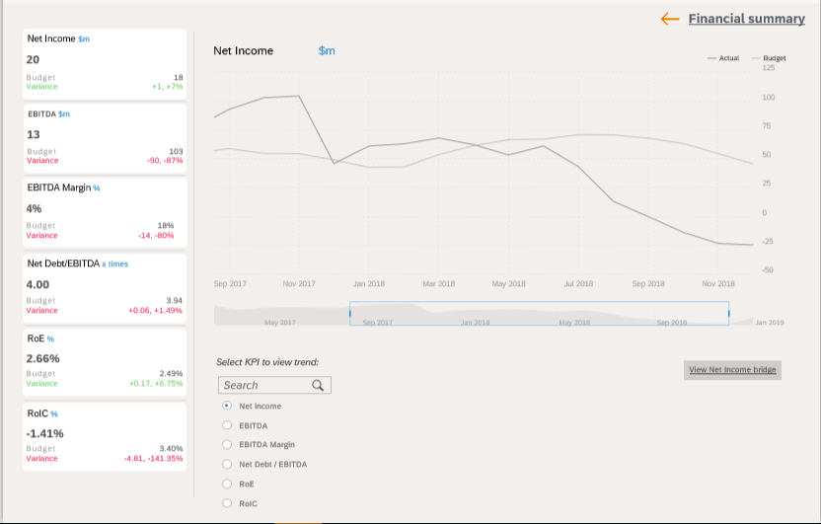
Financial Summary
View Net Income bridge

Slide 5
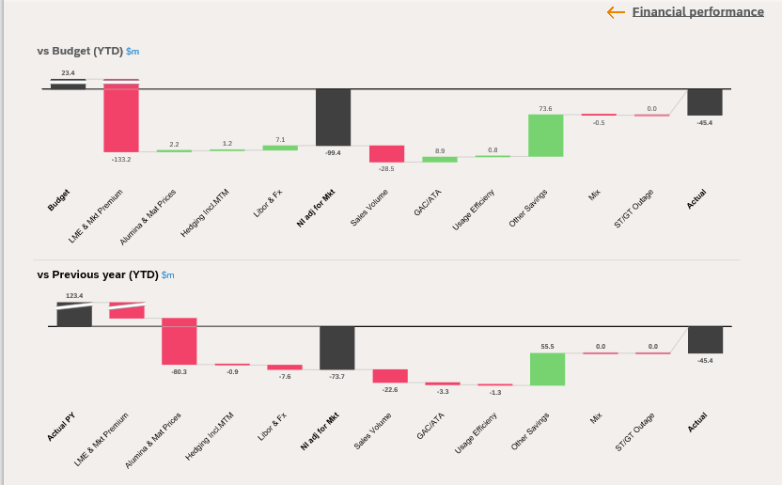
Financial Performance

Slide 6
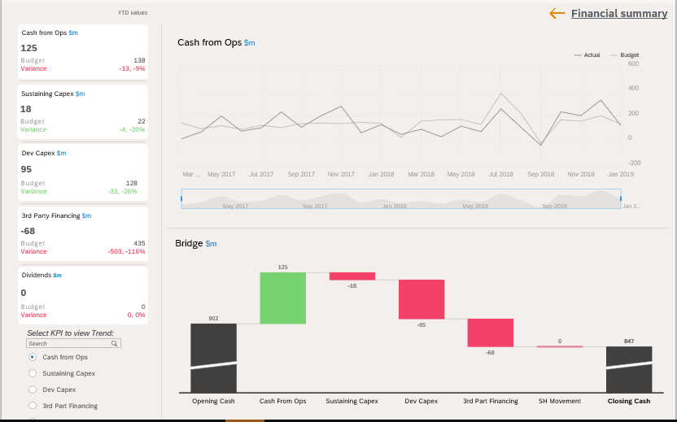
Financial Summary

Slide 7
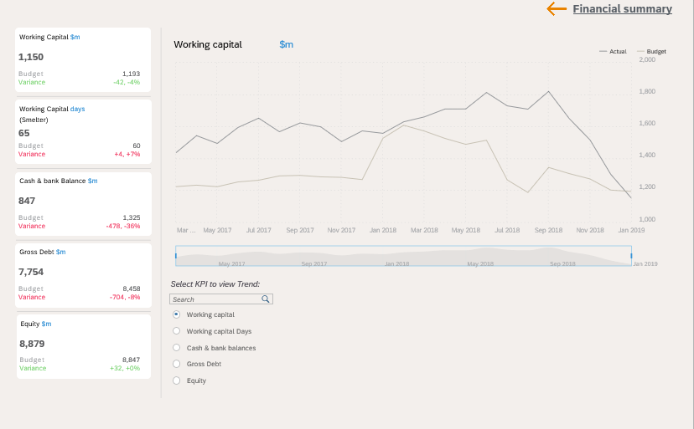
Financial Summary

Slide 8
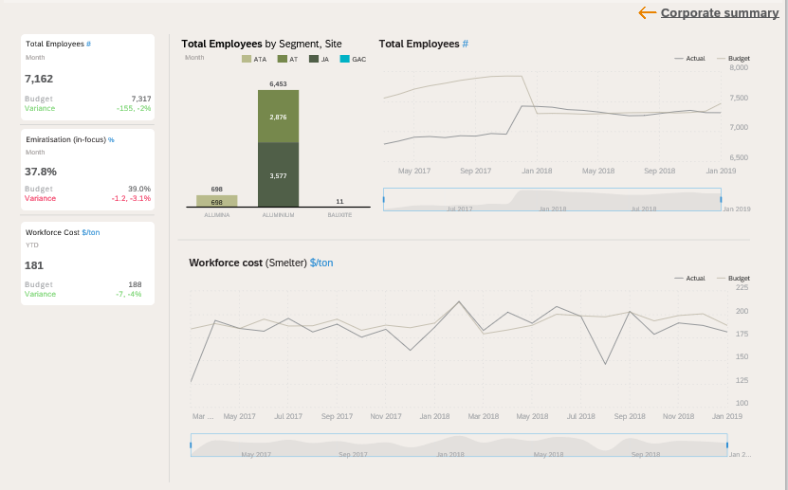
Corporate Summary

Slide 9
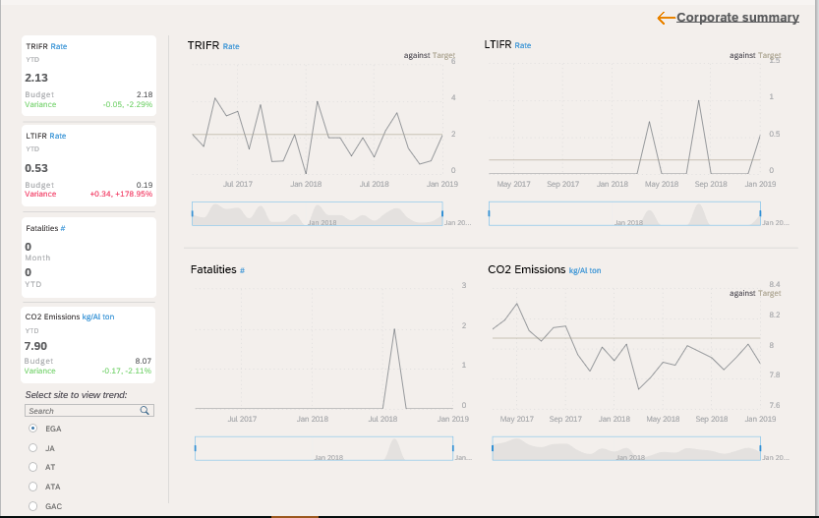
Corporate Summary

Slide 10
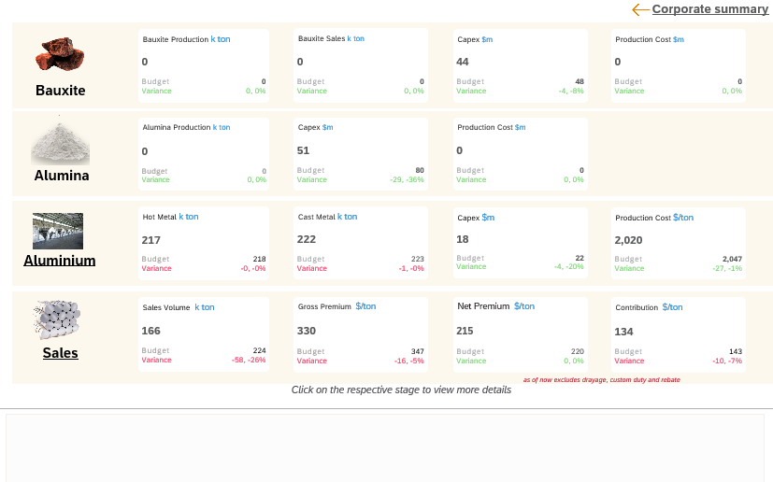
Corporate Summary
Aluminium
Sales

Slide 11
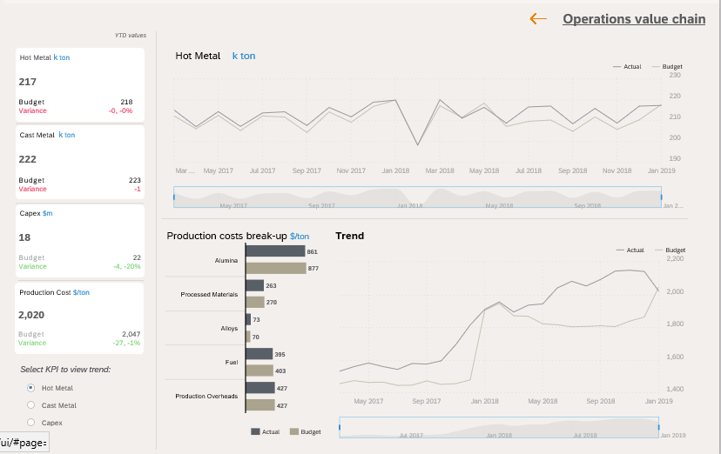
Operations Value Chain

Slide 12
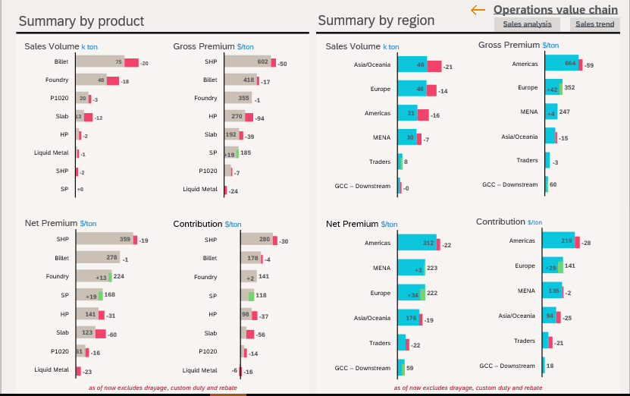
Operations Value Chain
Sales analysis
Sales trend

Slide 13
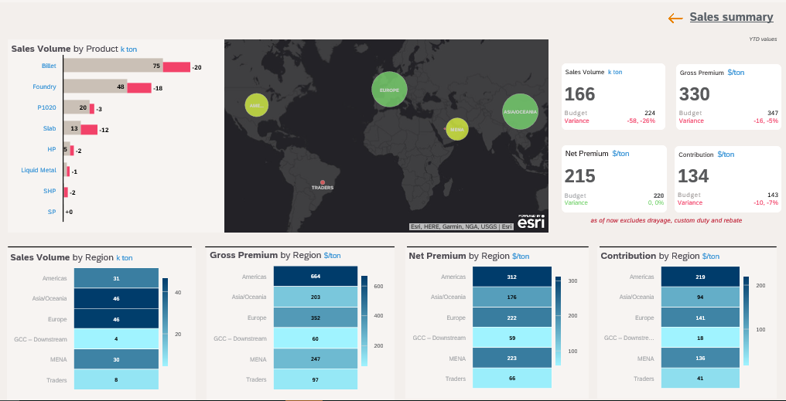
Sales Summary
Prod1
Prod2
Prod3
Prod4
Prod5
Prod6
Prod7
Prod8

Slide 14
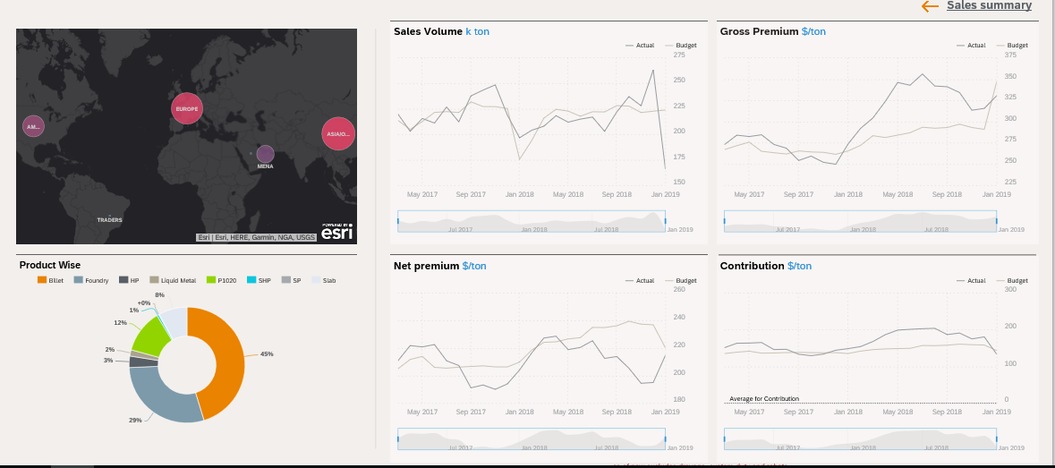
Sales Summary

Slide 15
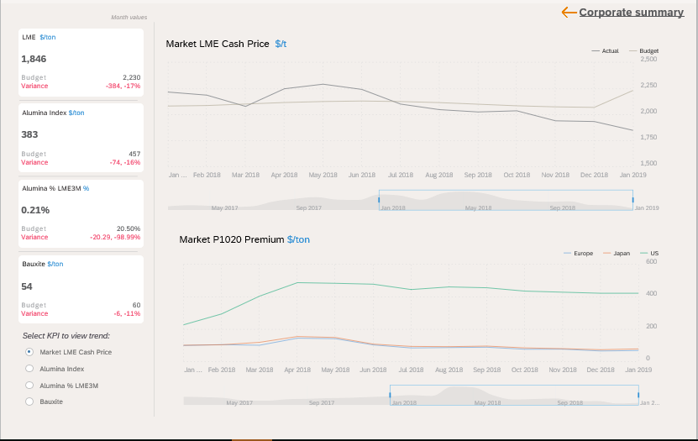
Corporate Summary

