Slide 1


Stock market forecast using time-series Analysis
Project submitted by: nidhi Shukla
Student no: 21071541
Submitted to: ben derric

Slide 2

Objective and Deliverables
The main aim of project is to study and predict European Stock Index specifically FTSE 50 using different time-series models.
Models have been developed using R programming Language. Compiled and executed in Rstudio generating and executable rmd file. An Executable Jupyter Notebook(r-kernel) with proper documentation has also been created. All of these files are available on GitLab

Slide 3
Modeling
DATA PROCESSING AND SPLITTING
Data collection
MODEL BUILDING
TESTING AND EVALUATION
Data preprocessing
Analysis
TRAIN DATA 70%
TEST DATA 30%
ARIMA
NAÏVE
HW
NN
KNN
PROPHET
ACCURACY
OUTPUT MATRIX
TRAINED MODEL
TEST DATA

Slide 4
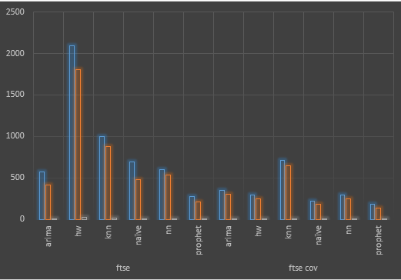

Performance Comparision

Slide 5
Future work and learning outcome
With the advancement of technology and digital media we can fetch sentiment data from Twitter, by incorporating such data in our prediction model we can make our model do fundamental as well as technical analysis, which would generate more accurate results.
Learning is a continuous process that either is acquired by gaining knowledge or by gaining experience.
One can acquire knowledge by reading or by experience. The literature helped me to gain domain insights but while creating the project, Each day during the project development phase was a learning experience. Practically I learned about seasonality, stationarity, ACF, PACF, different parameters used for developing a ts model, creating interactive candle stick charts, zoo charts, ggplots, different accuracy measures, and how they are calculated. Whereas theoretically, I learned about the benefits and limitations of different time series model

Slide 6

Thanks

