Slide 1
CWB-DSA-Module-2
Linked List and Competitive Programming

Slide 2
Create Linked List
struct node * create LL()
{
int data => 4 Bytes
struct node *next => 8 Bytes
}
In C programming, a struct (short for structure) is a user-defined data type that allows you to group variables of different types together under a single name.

Slide 3
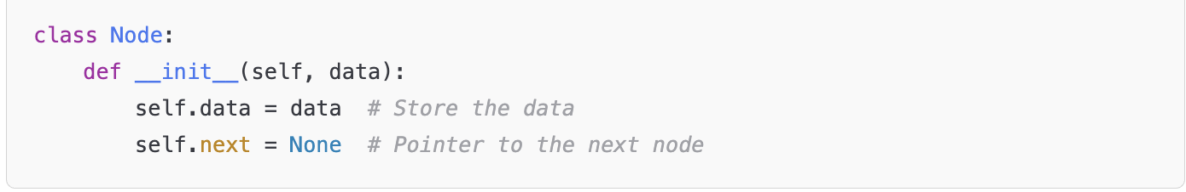
Creating LL in Python
1. Define the Node Class
Each node contains:
Some data
A reference (next) to the next node

Slide 4
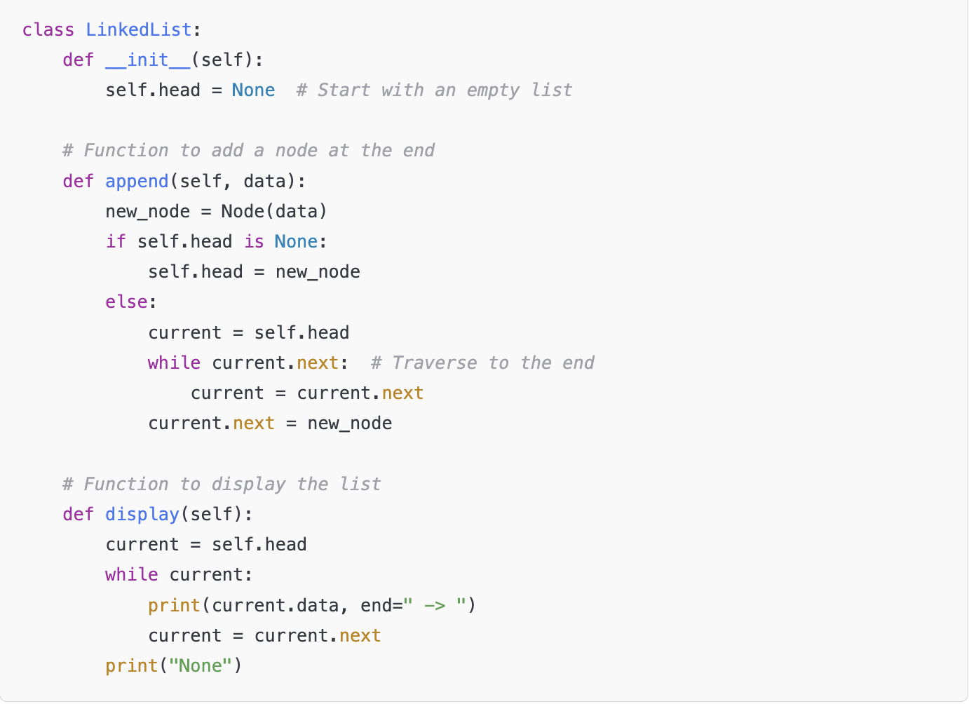
2. Define the LinkedList Class

Slide 5
Programming
You are given an integer array nums. You are initially positioned at the array's first index, and each element in the array represents your maximum jump length at that position.
Return true if you can reach the last index, or false otherwise.
Example 1:
Input: nums = [2,3,1,1,4]
Output: true
Explanation: Jump 1 step from index 0 to 1, then 3 steps to the last index.
Example 2:
Input: nums = [3,2,1,0,4]
Output: false
Explanation: You will always arrive at index 3 no matter what. Its maximum jump length is 0, which makes it impossible to reach the last index.

