Slide 1

Computational Logic Exercises
Module II – Set theory and knowledge graphs
Vincenzo Maltese

Slide 2
Avvisi
Lezione del 3/11 sarà di Q&A, tenuta da Giunchiglia
Potete inviare a lui via email dubbi e\o esercizi che desiderate discutere il 3/11.
Midterm exam 6/11 su piattaforma Moodle
Esame da prenotare su piattaforma ESSE3
Aule A201, A202, B106 con orario di arrivo alle ore 8:00
Durata sarà probabilmente 1h 30m – 1h 40m durata
Avvisare Giunchiglia e la Didattica OnLine se c’è qualcuno che ha bisogni speciali per avere più tempo.

Slide 3
Set theory (I)
The sets A and B consist of numbers from 0 to 9, such that:
A = {4,7,9} B = {1,2,3,4,5}
Illustrate these sets in a Venn diagram.
A
B
7
1
2
4
9
3
5
6
0
8

Slide 4
Set theory (II)
Given the Venn diagram below, say which of the following statements are true.
A is the empty set
4 ∈ A and 4 ∈ B
A ⊆B
0 ∉ A
The universal set U contains all the numbers from 0 to 9
A
B
7
1
2
4
9
3
5
6
0
8
ANSWER: b, d, e

Slide 5
Set theory (III)
Provide 3 examples of relations between people that are (a) symmetric and transitive, and (b) anti-symmetric.
ANSWER:
(a) brother of, colleague of, roommate of;
ANSWER:
(b) parent of, mother of, manager of.

Slide 6
Key questions
What is a knowledge graph from the point of view of the graph theory?
ANSWER: it is a directed labelled graph. Notice that it can be eventually cyclic, according to the phenomenon to be modelled.

Slide 7
Designing knowledge graphs (I)
Represent with a knowledge graph the following model: “Fausto works for the University of Trento, that is located in Italy” and convert it into triples.
Fausto
University of Trento
Italy
worksFor
locatedIn
<Fausto> <worksFor> <University of Trento>
<University of Trento> <locatedIn> <Italy>

Slide 8
Designing knowledge graphs (II)
Represent with a knowledge graph the following linguistic model: “Fausto and Mario work for the University of Trento, that is located in Italy” and convert it into triples.
worksFor
Fausto
University of Trento
Italy
locatedIn
Mario
worksFor
<Fausto> <worksFor> <University of Trento>
<Mario> <worksFor> <University of Trento>
<University of Trento> <locatedIn> <Italy>

Slide 9
Designing knowledge graphs (III)
Represent with a knowledge graph the following linguistic model: “Mario is male and is born on 1969-09-26” and convert it into triples.
gender
Mario
male
1969-09-26
birthDate
<Mario> <gender> <male>
<Mario> <birthDate> <1969-09-26>

Slide 10
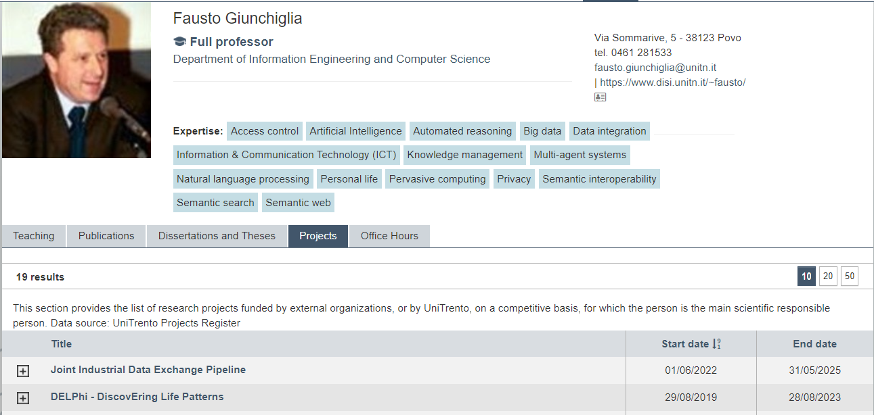
Designing knowledge graphs (IV)
Represent the content of the following webpage as a knowledge graph

Slide 11

Designing knowledge graphs (V)
Represent the content of the following webpage as a knowledge graph

Slide 12
Interpreting knowledge graphs
Given the following knowledge graph, come up with an equivalent representation in natural language.
professor
Fausto
University of Trento
1962
fundedOn
Mario
director
A POSSIBLE ANSWER: The University of Trento was funded on 1962. Fausto is a professor of the University of Trento. Mario is a director of the University of Trento.

Slide 13
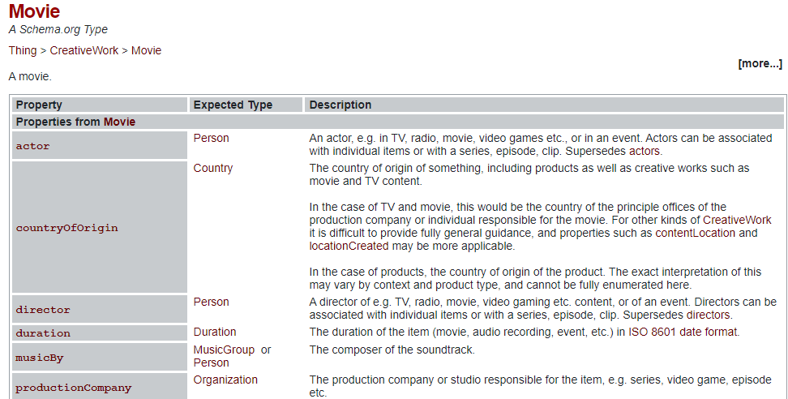
Etype graphs (I)
Schema.org is an example of ETG.

Slide 14
Etype graphs (II)
Provide a graphical representation of the Movie etype as a Knowledge graph.
duration
1
duration
actor
1
n
m
Country
Movie
Person
MusicGroup
1
countryOfOrigin
n
n
n
1
m
m
director
Company
1
productionCompany
n
musicBy

Slide 15
Test yourself (a)
Given the knowledge graph above and their corresponding representation in natural language say if they are mutually consistent and motivate your answer.
professor
Fausto
University of Trento
1962
fundedOn
Mario
director
The University of Trento was funded on 1962. Fausto is a professor of the University of Trento. Mario is a director of the University of Trento.
ANSWER: YES, BECAUSE THERE IS AN EXACT CORRESPONDENCE.

Slide 16
Test yourself (b)
Given the knowledge graph above and their corresponding representation in natural language say if they are mutually consistent and motivate your answer.
professor
Fausto
University of Trento
1962
fundedOn
Mario
director
The University of Trento was funded on 1962. Fausto and Mario work for the University of Trento.
ANSWER: NO, BECAUSE WE DID NOT SPECIFY IN THE GRAPH THE “WORKS FOR” RELATION.

Slide 17
Test yourself (c)
Given the knowledge graph above and their corresponding representation in natural language say if they are mutually consistent and motivate your answer.
professor
Fausto
University of Trento
1962
fundedOn
Mario
director
The University of Trento was funded on 1962. Fausto is a professor of the University of Trento.
ANSWER: YES, IT IS CONSISTENT DESPITE NOT COMPLETE.

Slide 18
Homework (I)
Answer to the following questions
What makes a modelling language formal?
What is the difference between a directed graph and an undirected graph?
Is a knowledge graph the result of a modelling activity?
What exactly do you represent with knowledge graphs?
What are the advantages of a knowledge graph w.r.t. other representations?
In the context of knowledge graphs, what is the difference between an entity type and a data type?
In the context of knowledge graphs, what is the difference between object properties and data properties?

Slide 19
Homework (II)
EXERCISE 1: Represent with a knowledge graph the following model: “University of Trento (officially “Università degli Studi di Trento”) was founded on 1962. Its institutional address is via Calepina, 14 - 38122 Trento. Its web site is https://www.unitn.it/. It is research partner of Fondazione Edmund Mach” and convert it into triples.
EXERCISE 2: Represent with a knowledge graph the following linguistic model: “Alice and Bob both own a Fiat Panda. Alice bought a new one in 2023, while Bob’s was a second hand vehicle from 2013 that he bought in 2018.” and convert it into triples.

Slide 20

Homework (III)
EXERCISE 3: Design a comprehensive knowledge graph from the following models
M1: cure A worked with patient 1 affected by disease X; patient 1 is male
M2: cure A worked with patient 2 affected by disease X; patient 2 is male
M3: cure A did not work with patient 3 affected by disease X; patient 3 is female
EXERCISE 4: Design a comprehensive knowledge graph from the following picture

