Slide 1
The DataScientia Community
Conclusion and call for action

Slide 2
JOIN AS A STUDENT
Join the DS Community
Explore Resources
Join Projects
Support the science and engineering of person-centric data and AI
Participate in the DS community of practice
Attend courses
Deepen your knowledge of person-centric AI
Earn university credits
Navigate around the DS portal for interesting topics
Receive community recognition
Share ideas
Discover what you would like to know more about people, AI and data
Acquire new skills about AI and data
Decide which topic you would like to further specialize about
Go to step one and iterate
Consider starting your own project
Read news and newsletter
Read about AI, data and DataScientia
Sign up to the DS community
Get involved in the DS community
Maybe propose your own discussion group
Interact and invite your colleagues, locally
Join one or more DS discussion groups worldwide
Consider proposing a new project type
Think about how much you really know about AI, data and about they impact your own life, as you use them – possibly unknowingly - online and on your phone
Discover projects and get inspired
Publish your favourite results and ideas on your DS community page
Build your own DS community page

Slide 3
JOIN AS A PARTNER
START
Use the DS online material to know more about the DS Community
INCUBATION
Select the area(s) which are closer to your interests in education, research and innovation
Run projects and involve local participants (e.g. 1K people subscribed to the DS Community)
Share data, software and systems
INDEPENDENT OPERATION
Incorporate and manage DS platforms (e.g., LKC website and LiveLanguage Catalog)
Activate one or more projects (e.g., tasks in languages or personal data) in Education, or research or innovation, alone or in collaboration with the other DS partners
Create your own local DS node
Sign the DS Memorandum of Understanding (MoU)
Get involved in partner-level discussion groups
Join worldwide education, research or innovation DS projects
Participate in and use DS events to get in contact with the other DS partners which are closest in interest with you
Use your portal to advertise, locally and globally, all the relevant for your information, as created by you or others in the DS portal
Invite your students and staff to join and get involved in the DS community (see previous page)
Develop your own institution portal on the DS portal.
Create a DS joint lab
Grow your own community, locally and globally
Sign DS Agreement (IPR copyright on data and mechanisms for data distribution,…)
Become an official DS partner
Get involved in the management of DS worldwide
Select your DS reference person
Write joint papers

Slide 4
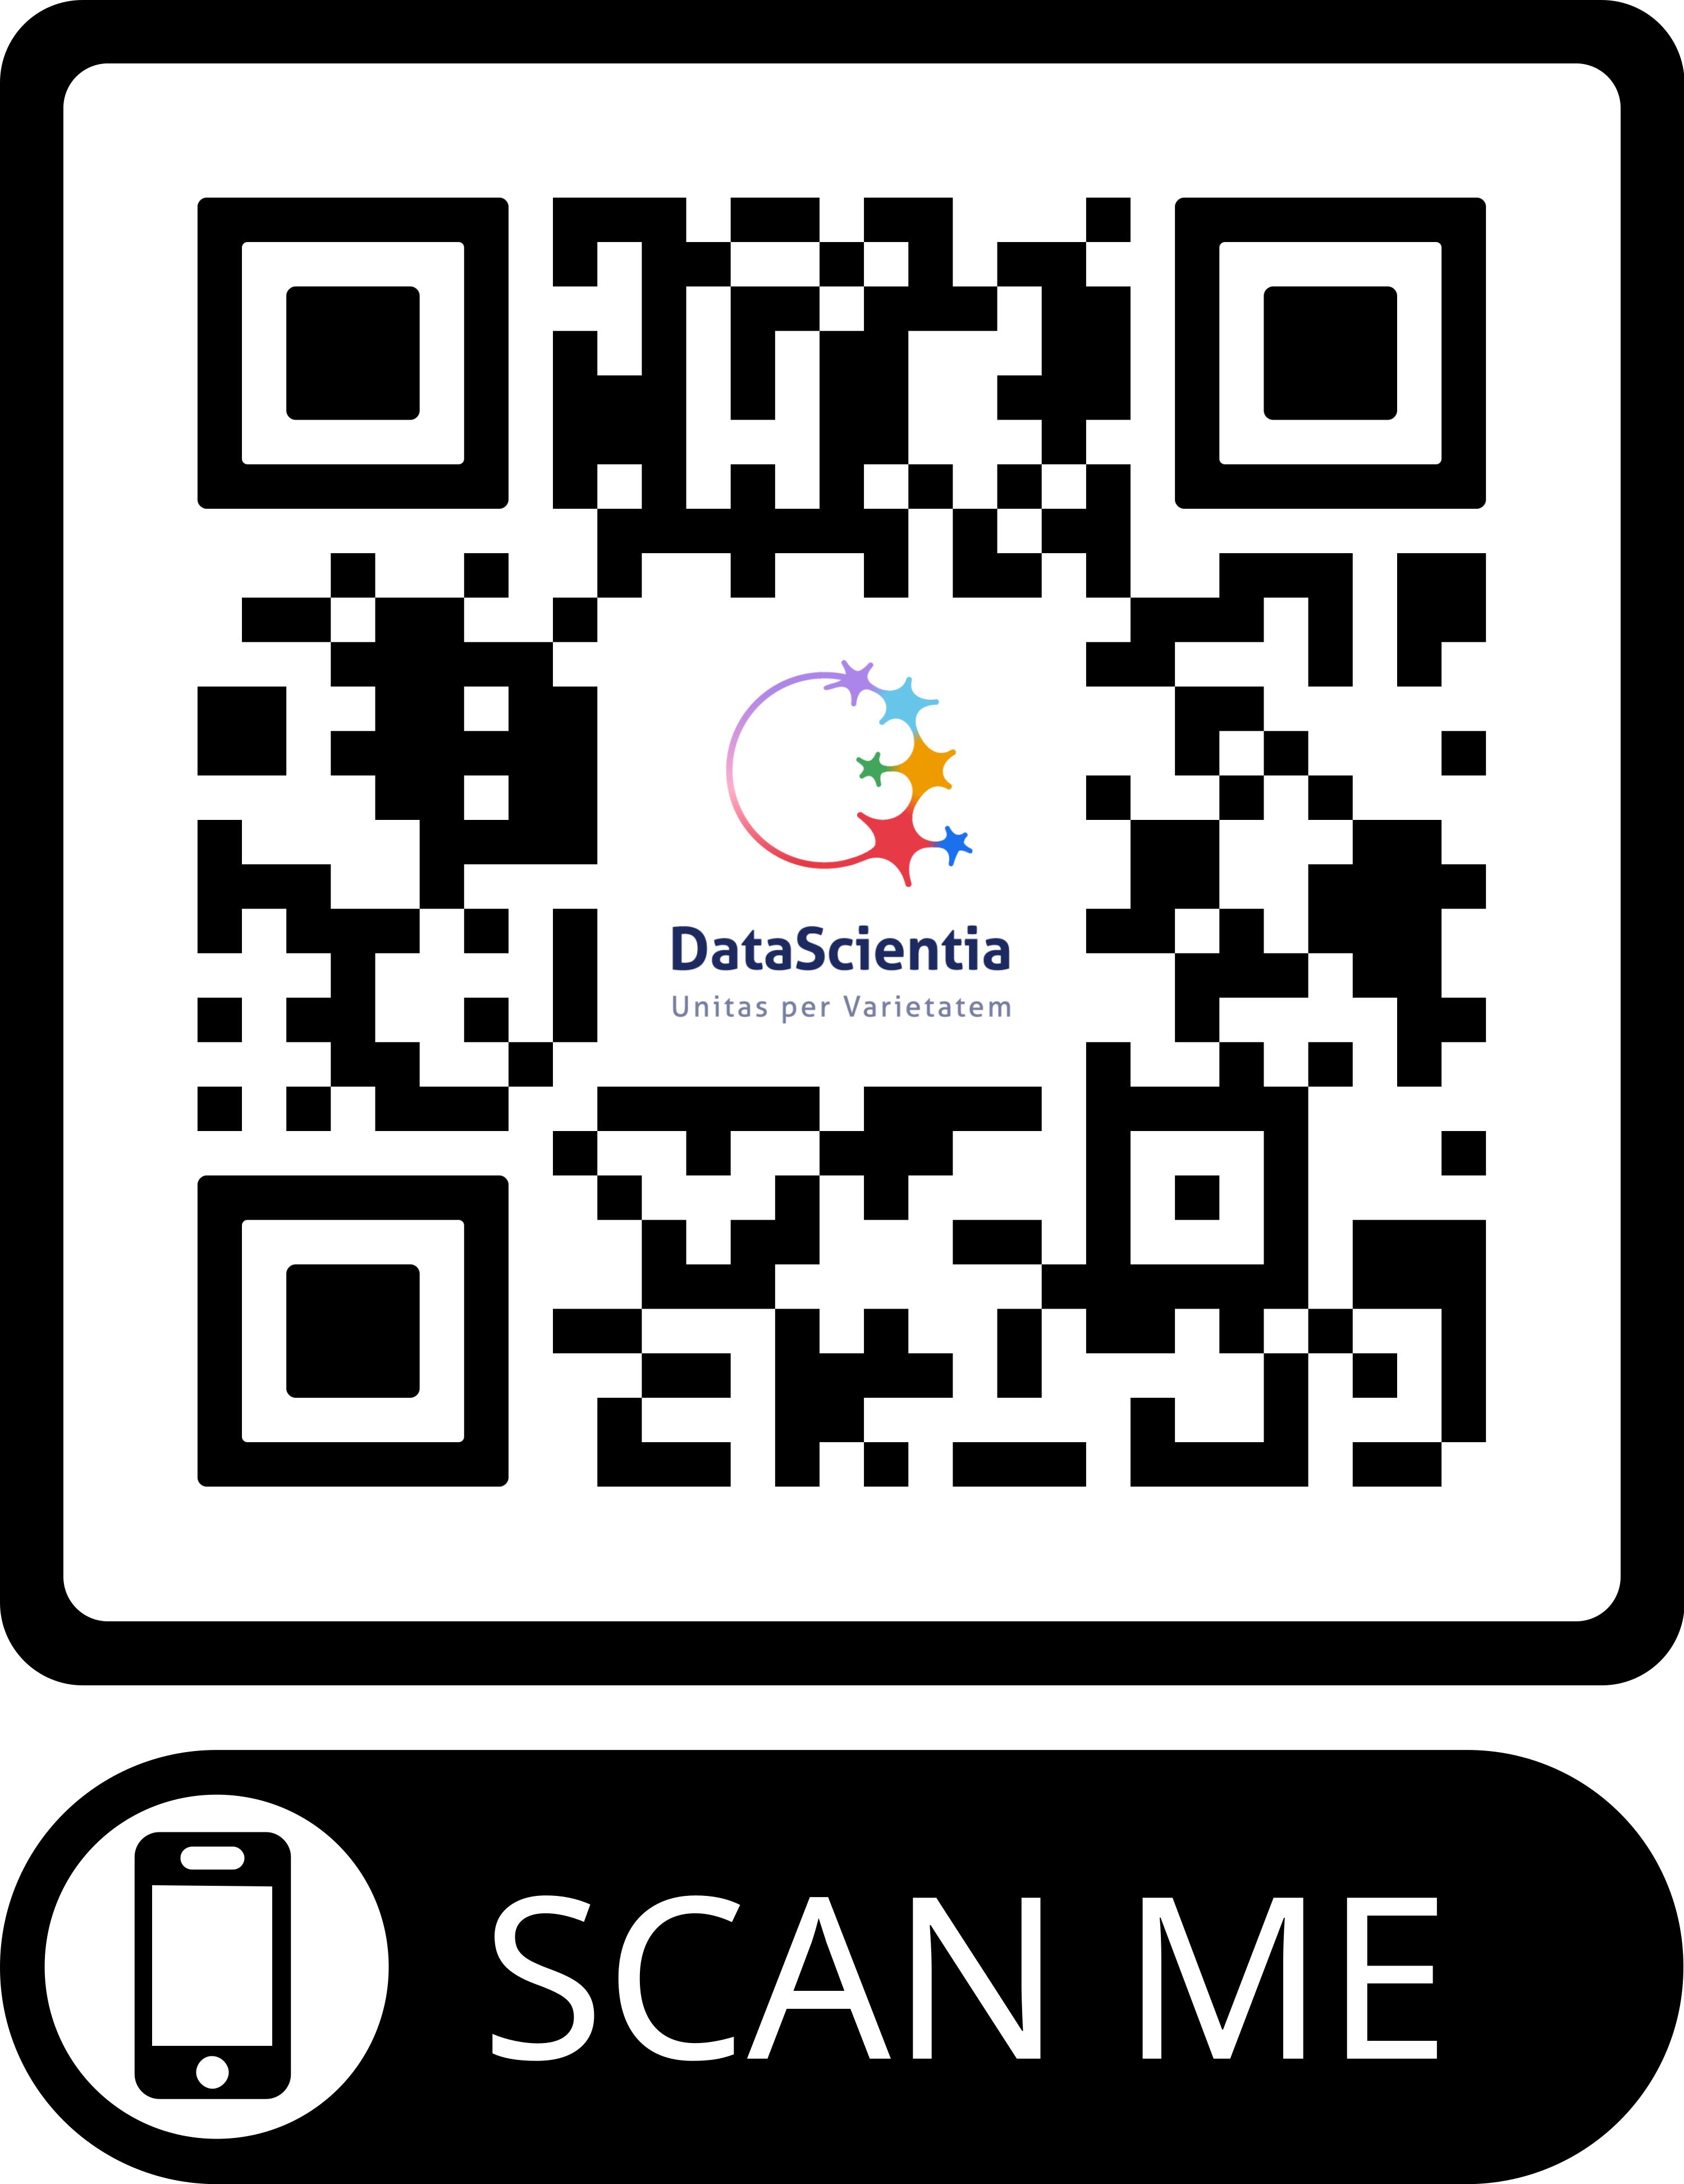
JOIN THE DS COMMUNITY TODAY!
Access the community platform at:
https://ds.datascientia.eu/community/welcome
Contact us:
Fausto.giunchiglia@unitn.it
Matteo.busso@unitn.it
[ Community QR Code here]

