Slide 1
EMPLOYEE ATTRITION presentation

Slide 2
1.1. How many employees left the company?
SELECT COUNT(ATTRITION)
FROM EMP_ATTRITION
WHERE ATTRITION = 1
There are about 237 employees who left the company.

Slide 3

1.2. Attrition count by Department or Job Role.
SELECT DEPARTMENT, COUNT(ATTRITION) AS 'TOTAL_ATTRITION'
FROM EMP_ATTRITION
WHERE ATTRITION = 1
GROUP BY department
133 employees working on Research & Development department left the company followed by 92 employees working on Sales department.

Slide 4
1.3. Average Monthly Income of employees.
SELECT AVG(MonthlyIncome)
FROM EMP_ATTRITION
The average monthly income of employees is $6502

Slide 5

1.4. Average Age of employees who left vs. stayed.
(SELECT ATTRITION, AVG(AGE) AS AVG_AGE_EMPLOYEES
FROM EMP_ATTRITION
WHERE ATTRITION = 1
GROUP BY ATTRITION)
UNION
(SELECT ATTRITION, AVG(AGE) AS AVG_AGE_EMPLOYEES
FROM EMP_ATTRITION
WHERE ATTRITION = 0
GROUP BY ATTRITION);

Slide 6
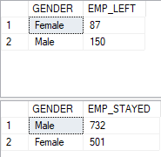
1.5. Gender-wise distribution of attrition.
(SELECT GENDER, COUNT(ATTRITION) AS EMP_LEFT
FROM EMP_ATTRITION
WHERE ATTRITION = 1
GROUP BY GENDER)
(SELECT GENDER, COUNT(ATTRITION) AS EMP_STAYED
FROM EMP_ATTRITION
WHERE ATTRITION = 0
GROUP BY GENDER)
From the table, we can say that almost double number of males left the company as compared to females. There is a possibility of inequality or discrimination practices in the company.

Slide 7
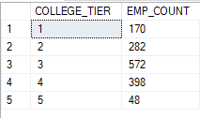
1.6. Count of employees by Education level.
SELECT EDUCATION AS COLLEGE_TIER, COUNT(EMPLOYEECOUNT) AS EMP_COUNT
FROM EMP_ATTRITION
GROUP BY EDUCATION
ORDER BY EDUCATION

Slide 8
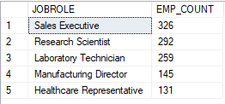
1.7. Top 5 job roles with the most employees.
SELECT TOP 5 JOBROLE, COUNT(EMPLOYEECOUNT) AS EMP_COUNT
FROM EMP_ATTRITION
GROUP BY JOBROLE
ORDER BY EMP_COUNT DESC

Slide 9
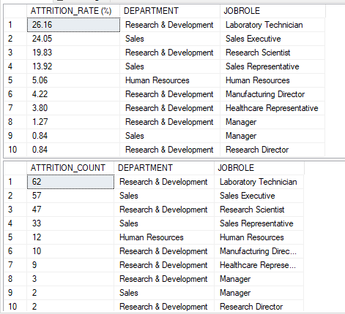
2.1. Attrition rate (%) by Department and Job Role.
The attrition rate of about 26% is observed on employees working as a Laboratory Technician in the Research & Development department following 24% working on Sales department. There is little to no significance on employees working at a senior position as a Manager and Research Director.

Slide 10

2.2. Average Years At Company for attrited vs. retained employees.
CODE:
(SELECT AVG(TOTALWORKINGYEARS) AS AVG_WORKING_YEARS, ATTRITION
FROM EMP_ATTRITION
WHERE ATTRITION = 1
GROUP BY ATTRITION)
UNION
(SELECT AVG(TOTALWORKINGYEARS) AS AVG_WORKING_YEARS, ATTRITION
FROM EMP_ATTRITION
WHERE ATTRITION = 0
GROUP BY ATTRITION)

Slide 11

2.3. Do employees with OverTime have higher attrition rates?
SELECT COUNT(OVERTIME) AS EMP_WORKING_OVERTIME, ATTRITION FROM EMP_ATTRITION
WHERE OVERTIME = 1
GROUP BY ATTRITION
ORDER BY EMP_WORKING_OVERTIME
There is a strong influence of employees working overtime on the attrition of about 127 employees.

Slide 12
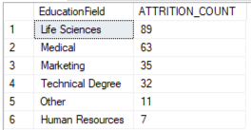
2.4. Which Education Field has the highest attrition?
SELECT EducationField, COUNT(ATTRITION) AS ATTRITION_COUNT
FROM EMP_ATTRITION
WHERE ATTRITION = 1
GROUP BY EDUCATIONFIELD
ORDER BY ATTRITION_COUNT DESC
From the following table we can say that employees who graduated from Life Sciences and Medical have the highest attrition rate indicating the possibilities that the job role may not match with their area of expertise. Rest of the Education Field have shown little to no impact on attrition rate.

Slide 13
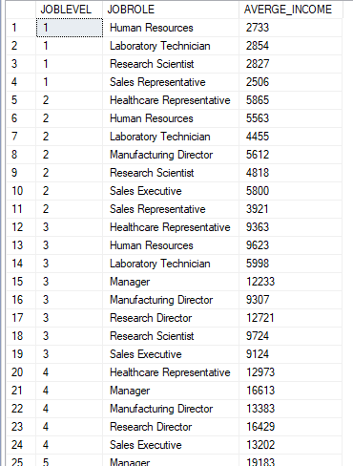
2.5. Average income by Job Level and Job Role.
SELECT JOBLEVEL, JOBROLE, AVG(MONTHLYINCOME) AS AVERGE_INCOME
FROM EMP_ATTRITION
GROUP BY JOBLEVEL, JOBROLE
ORDER BY JOBLEVEL, JOBROLE

Slide 14
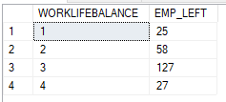
2.6. Most common Work Life Balance rating for those who left.
SELECT WORKLIFEBALANCE, COUNT(ATTRITION) AS EMP_LEFT FROM EMP_ATTRITION
WHERE ATTRITION = 1
GROUP BY WORKLIFEBALANCE
ORDER BY WORKLIFEBALANCE
The following table shows feedback of employee rating from 1 to 5 star regarding work life balance. It seems like there is no such effect of it on employee attrition.

Slide 15
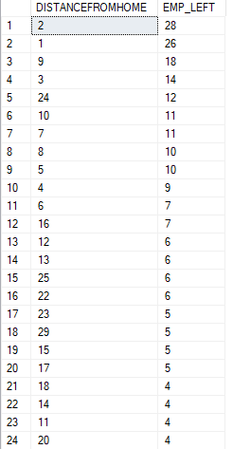
2.7. Does distance from home affect attrition?
SELECT DISTANCEFROMHOME, COUNT(ATTRITION) AS EMP_LEFT
FROM EMP_ATTRITION
WHERE ATTRITION = 1
GROUP BY DISTANCEFROMHOME
ORDER BY EMP_LEFT DESC
From the table, we can say that there is a significance of traveling distance on employee attrition. Employees living at a distance from 9 to 24 miles have shown signs of leaving the company.

Slide 16
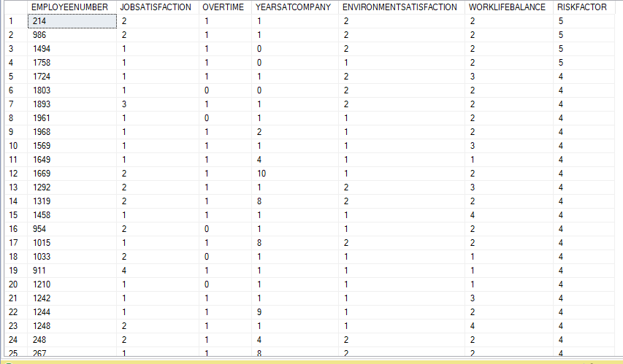
3.1. Create a risk score using multiple factors (Over Time, Job Satisfaction < 3, Years At Company < 2)
We can say that employees who have witnessed overwork, less job satisfaction and no work-life balance are at the highest risk of leaving the company. Some of the employees had mediocre environment satisfaction but were not satisfied with their job role and had experienced overwork in the company.

Slide 17

3.2. Use WINDOW FUNCTIONS to rank departments by attrition rate.
From the above table we can say that about 92 employees left the company from Sales department. Attrition rate of about 20% is from Human Resources department and 13% from Research & Development department.

Slide 18
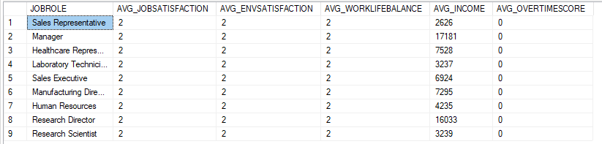
3.3 Pivot the dataset to show average scores for satisfaction, balance, income, etc. per Job Role.
After executing the above table, we can say that average score for environment, job satisfaction and work life balance is equal and has no effect on overtime.

Slide 19
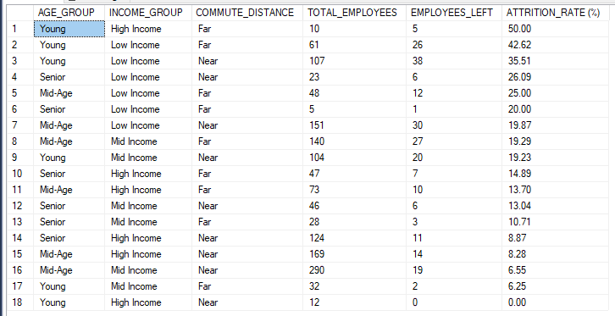
3.4. Find employee segments with the highest attrition risk using grouped attributes.
From the above table we can say that employees belonging to ‘Young’ age group tend to leave the company as compared to other age group because of low income and commute distance.
A significant amount of senior and mid-age employees left the company as well because of low income.

Slide 20
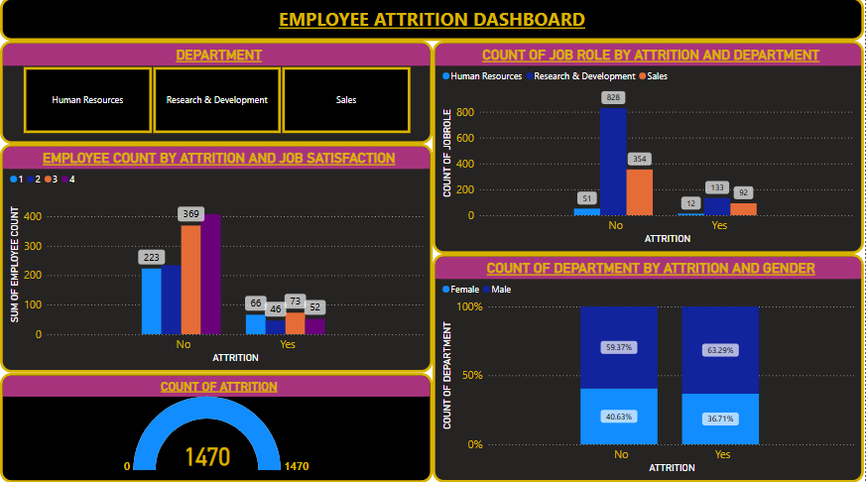
POWER BI DASHBOARD
The following dashboard includes various charts showcasing the influence of attrition on various fields such as department and job role.

Slide 21
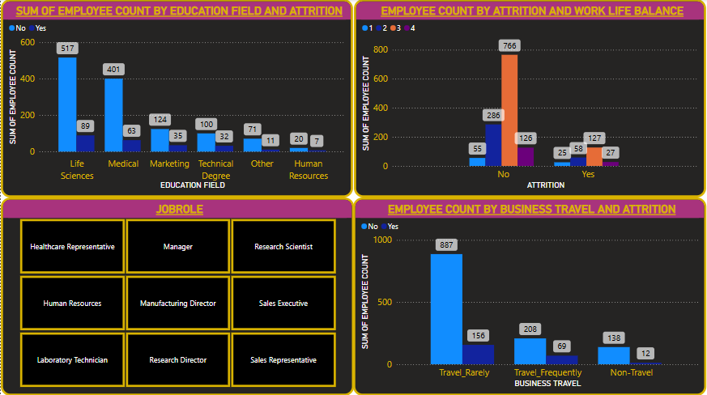
POWER BI DASHBOARD

