Slide 1
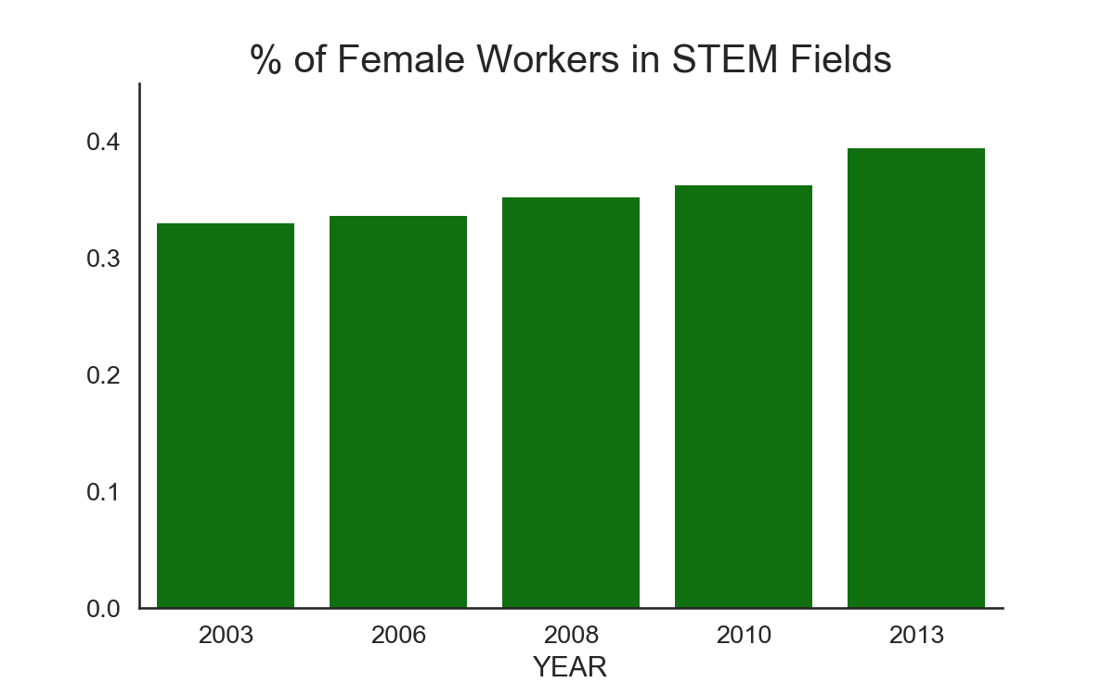
Women In STEM
Shuojia Shi
Springboard Data Science Career Track

Slide 2
Outlines
Motivation. Potential Clients.
Data Source and Wrangling
Explorative Data Analysis
Women participation in STEM
Unemployment and gender pay gap
Women in STEM in job fields.
Statistical Analysis— is it statistically significant?
Classification
Feature selection
Predict salary levels
Predict principal job fields
Summary

Slide 3
Motivation & Potential Clients
It is reported that half as many women are working in STEM jobs¹. It is also reported that women make 78 cents for every dollar men make².
Questions I would like to answer:
How many women are actually in STEM workforce?
Does the gender pay gap change over the years?
How do race/job fields affect the gender gap?
Can we predict the salary level for women STEM workers?
Can we recommend a job field for a certain individual? …
As a woman in STEM field myself, I am intrinsically interested in these problems.
Potential clients:
Women majoring in STEM or preparing themselves into STEM jobs.
Career building websites such as Linkedin.com and CareerBuilder.com.
Universities and higher education institutes.
Media and Journalists
http://www.esa.doc.gov/sites/default/files/womeninstemagaptoinnovation8311.pdf
http://money.cnn.com/2016/04/12/pf/gender-pay-gap-equal-pay-day/index.html

Slide 4
Data Source and Wrangling
Survey data from IPUMS Higher Ed https://highered.ipums.org/highered/
Leading surveys for studying the science and engineering (STEM) workforce in the United States.
Data include National Surveys of College Graduates (NSCG) and Doctorate Recipients (SDR)
The relevant variables such as demographic, education and employment were chosen with the available samples between 2003 and 2013.
Filter columns with mostly missing data.
Final data size: 478747 entries and 47 columns (175.3+ MB).

Slide 5

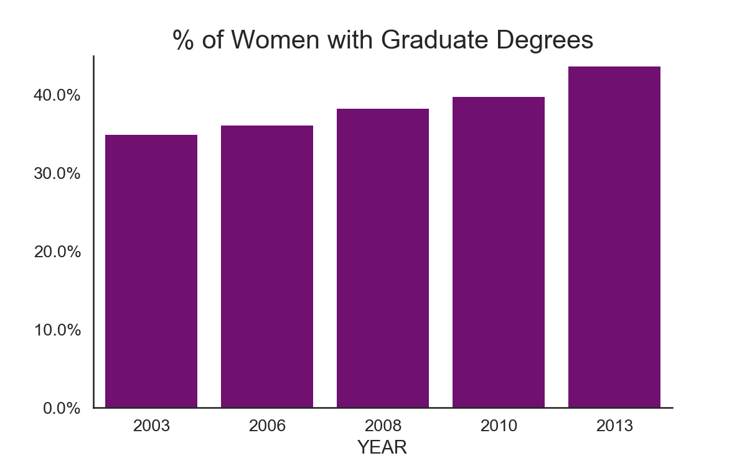
Explorative Data Analysis Women participation in STEM
Bar plot on the left: women made up 33% of the STEM workforce in 2003.
That number rises steadily over the next ten years with a jump from 2010 to 2013, as the percentage rose to almost 40%!
We see a similar trend in the % of women with graduate degrees in the bar plot on the right.

Slide 6
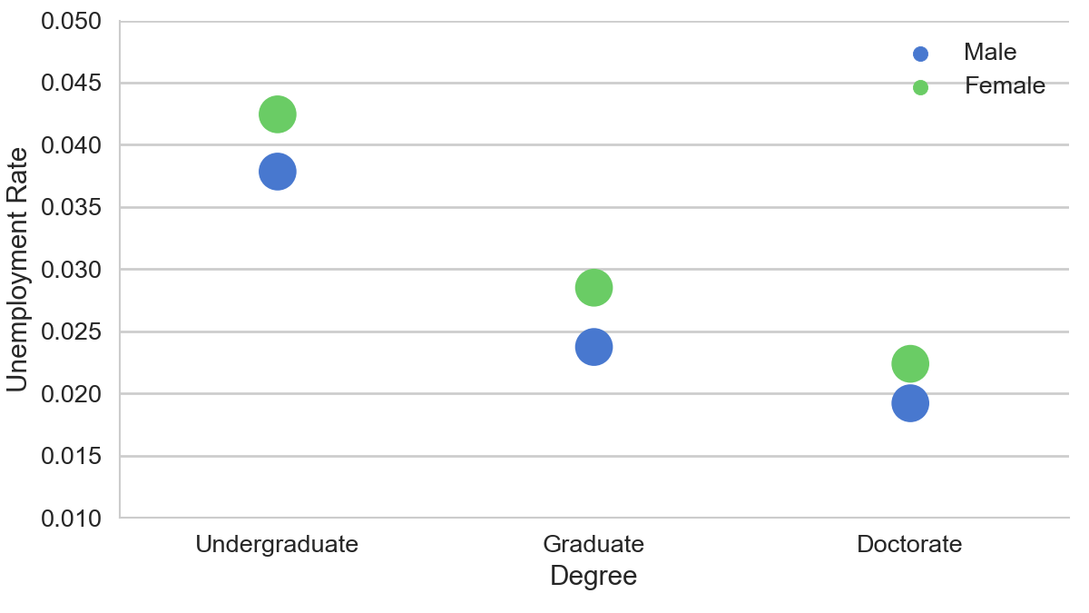
Explorative Data Analysis Gender unemployment gap
Unemployment rate trending down with higher education degrees.
Men has slightly lower (1%) unemployment rate than women.
The gender unemployment gap shrinks with higher education degrees.
Note the rate here only consider individuals that are in labor force.

Slide 7
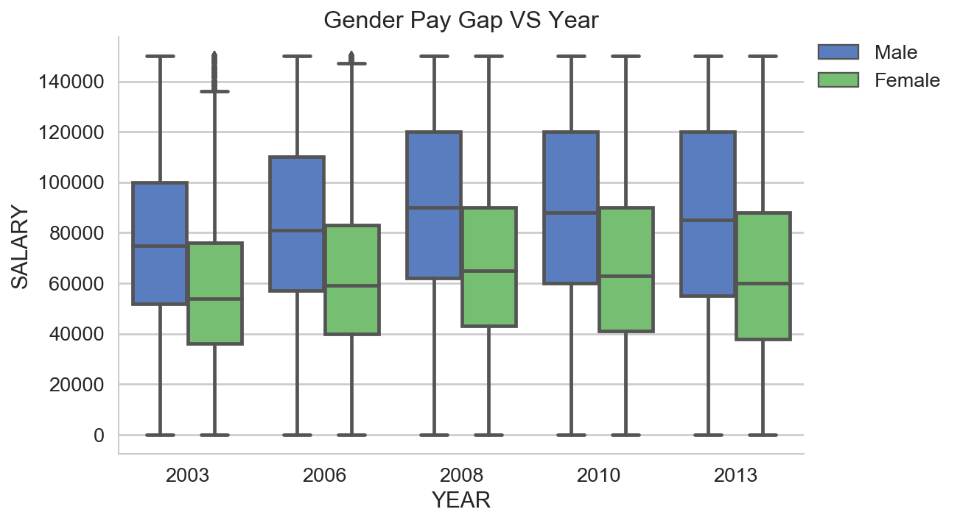
Explorative Data Analysis Gender pay gap (2003 to 2013)
Women have come a long way but are still not at parity. We have seen women's increased education and workforce participation. But women makes consistently 30% less than men!
There is NO shrinking trend in the gender pay gap over the years.
The mean wages increased from year 2003 to 2008. Then we see a small decrease from 2008 to 2013. This makes sense considering the financial crisis in 2008.

Slide 8
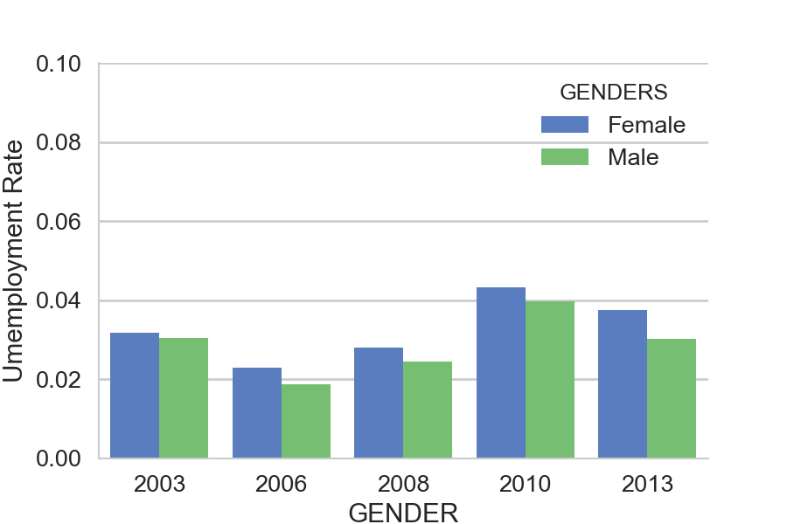
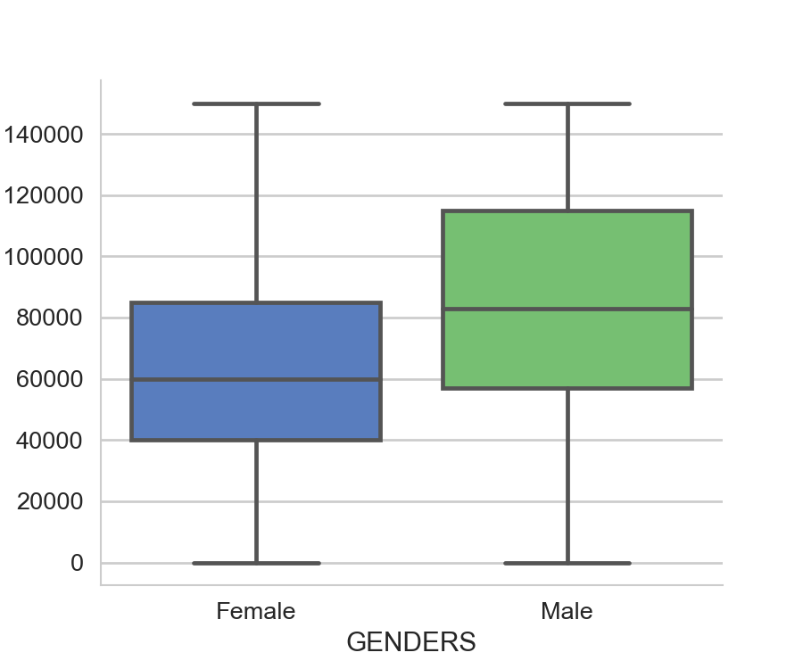
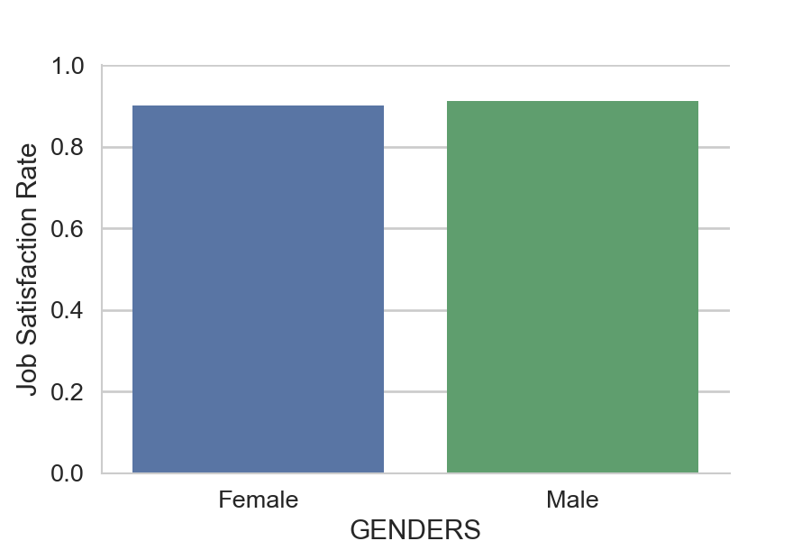
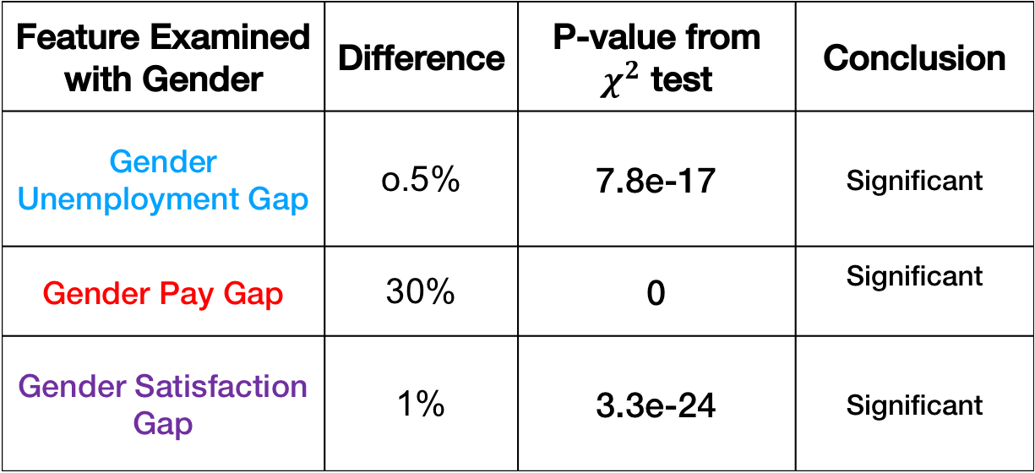
Statistical Analysis
Gender makes a difference in STEM workforce, statistically.
Gender Unemployment Gap
Gender Pay Gap
Gender Job Satisfaction Gap
Feature Examined with Gender | Difference | P-value from $χ^{2}$ test | Conclusion
Gender Unemployment Gap | o.5% | 7.8e-17 | Significant
Gender Pay Gap | 30% | 0 | Significant
Gender Satisfaction Gap | 1% | 3.3e-24 | Significant

Slide 9
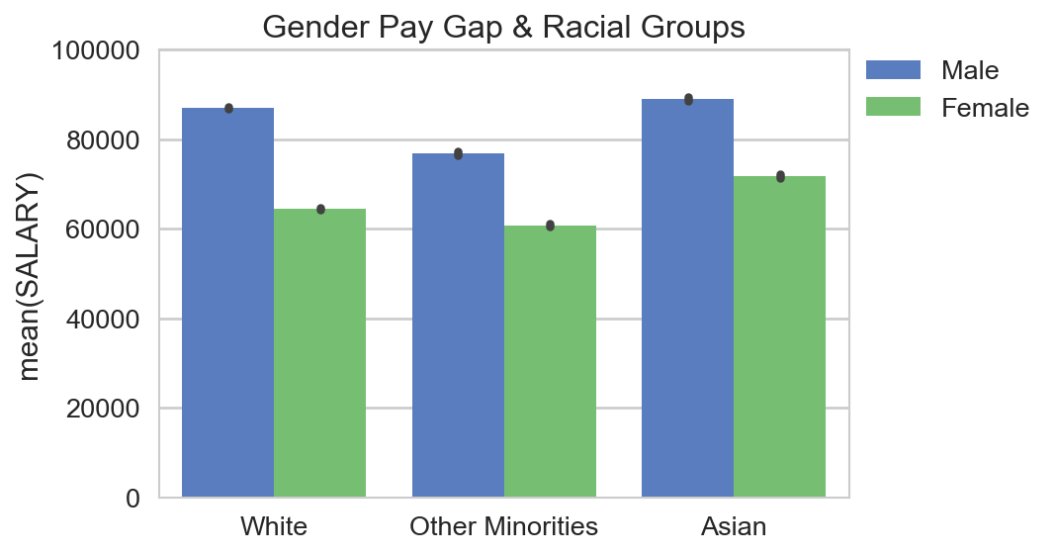
Explorative Data Analysis Gender/race pay gap
The pay gap between men and women exist in all race groups.
For every dollar Asian men make, Asian women make 81 cents. For every dollar white men make, white women make 74 cents. For every dollar other minorities (include black, Hispanic, and etc.) men make, women in the same group make 79 cents.

Slide 10
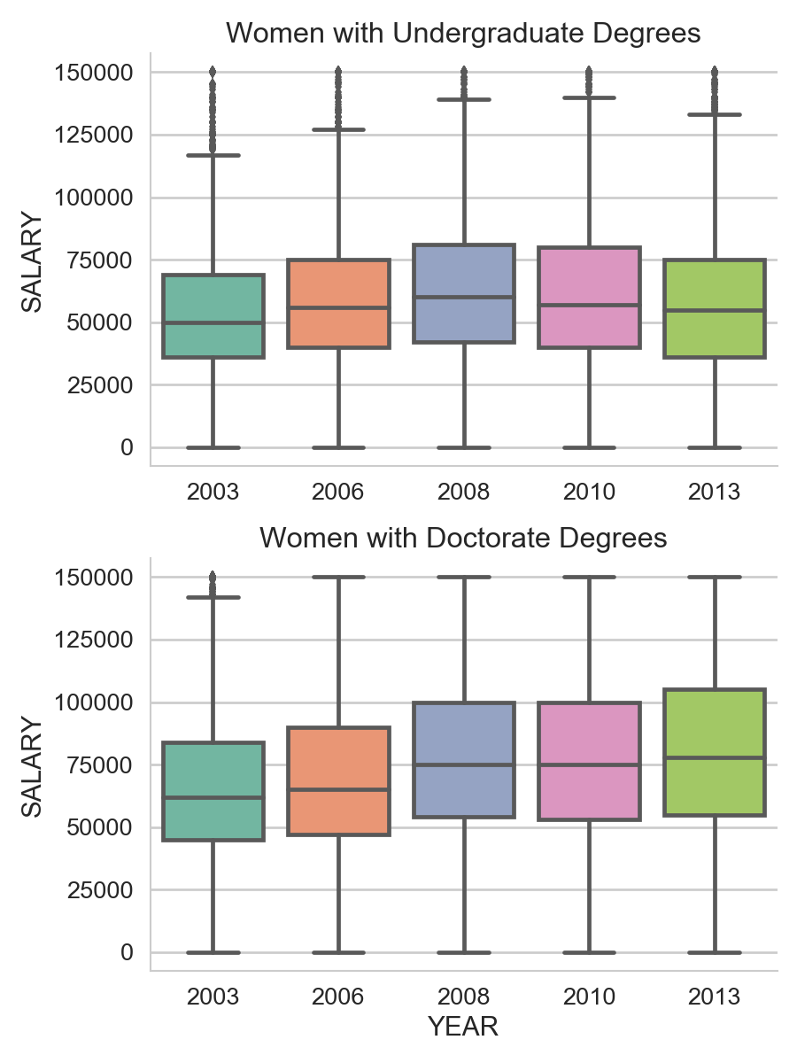
Explorative Data Analysis Women In Education Level Groups
The plot on top presents the quantiles of the salaries for women with undergraduate degrees. It clearly indicates the trending down after year 2008.
The plot on the bottom shows salaries for women from the doctorate group. Big difference! This median wage and quantiles kept increasing after 2008, even though the increase from 2008 to 2010 is minimal!
Median wage for women doctors is 20% higher than that of women with undergraduate degrees. This difference is even larger after 2008.

Slide 11
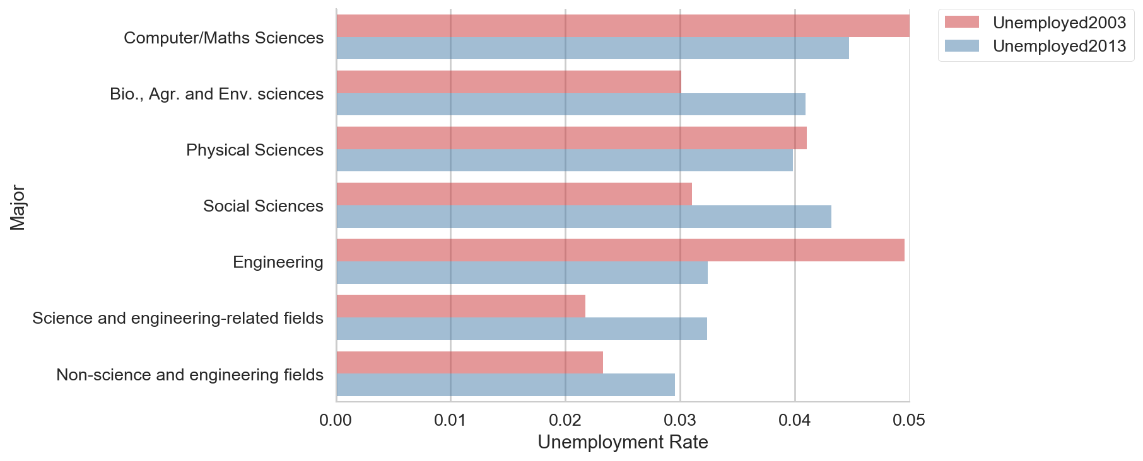
Explorative Data Analysis Fields of major– women unemployment rate
The plot of female unemployment rate for field of major groups in 2003 and 2013 can give us some insight what majors are having a better performance in job placement.
There is a significant decrease in the unemployment rate for the female engineering group (from 5% to 3%).
Fields saw a larger increase of unemployment rate: social sciences, bio and life sciences, and other science and engineering related fields.

Slide 12
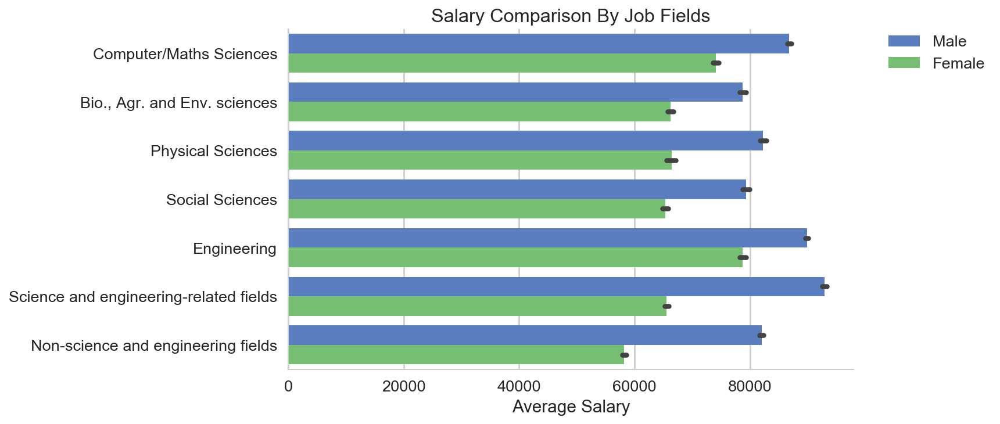
Explorative Data Analysis Principal job fields - gender pay gap
The job fields that have the least pay gap between men and women are: engineering, computer/Maths sciences and bio/life sciences.
Engineering field gives the best compensation to their female employees compared with other jobs. And women in non-science and engineering field reports lowest income averagely.
Non-science and engineering fields has the largest gender pay gap. The field group contains job title such as 'Management' and 'Administration'. This could be indicating the even more severe gender disparity in these positions.

Slide 13
Classification
Predict Salary Level (>=60k or <60k)
Prepare target and feature columns
Train test split &
Under Sampling
Feature selection ($χ^{2}$ and t test)
With 𝞪=0.01
Feature selection (𝝌^𝟐 and t test)
With 𝞪=0.01
Parameter Optimization (Cross-validation)
Classification with test data
Model Comparison
Switch ML model

Slide 14
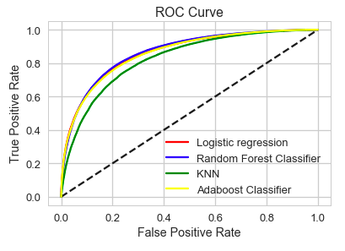
Classification
Predict Salary Level
Model | Accuracy score on train | Accuracy score on test
Logistic Regression | 0.782 | 0.815
Random Forest Classification | 0.784 | 0.825
KNN | 0.745 | 0.800
Adaboost | 0.779 | 0.813
Random forest ranks first among the classification models. It gives 0.78 accuracy score in predicting the salary level for full time STEM workers. Considering this survey data is missing location information for privacy reasons, this is a very encouraging score.
ROC curve indicates similar result. KNN gives the worst performance among models tested.
From the coefficients of attributes by logistic regression, we the top 5 attributes positively contributing the high salary level are size of the employers (>5000 employees), professional or doctorate degrees.
If a recommendation system is to be built, the job location could be associated with the cost of living and added to the model for a more tailored result.

Slide 15
Classification
Predict Principal Job Field
Use only pre-employment portion of the survey data.
Similar data process as the classification of salary level.
Binarize the target column so there are n classification given n principal job fields.
Choose random forest and loop through the n principal job fields.
Field | Accuracy score on train | Accuracy score on test
Social and related scientists | 0.908 | 0.905
Physical and related scientists | 0.887 | 0.889
Engineers | 0.878 | 0.878
Biological, agricultural and other life scientists | 0.872 | 0.876
Computer and mathematical scientists | 0.797 | 0.798
Science and engineering related occupations | 0.744 | 0.746
Non-science and engineering occupations | 0.721 | 0.722

Slide 16
Classification
Predict Principal Job Field
Accuracy score with two tiers:
Tier I: Accuracy score > 0.85, social scientists, physicist, engineers, and bio/life scientists.
Tier II: Accuracy score < 0.8, computer and maths scientists, other STEM or non STEM related occupations.
Top coefficients of logistic regression shows field of major and level of degree play important roles. Makes sense!
The classification used pre-employment data. It could give reference for women majoring in STEM to prepare themselves into STEM jobs.
Together with the salary level prediction, the classification could be a part of the recommendation system for career building websites.

Slide 17
Summary
Women show increased education and workforce participation in STEM.
Gender DOES make a difference in STEM workforce. We looked at the gender unemployment gap, gender pay gap. Women expect higher unemployment rate and consistently make 30% less than men!
The gender gaps are statistically significant.
Using random forest classifier, the salary level prediction report an accuracy score of 0.785 even though the survey data is missing location information. The prediction of principal job fields give an average of 0.85 accuracy score!
Machine learning models give reference for women majoring in STEM to prepare themselves into STEM jobs. The classifications produced in this project could be a part of the recommendation system for career building websites.

