Slide 1
CUDA

Slide 2
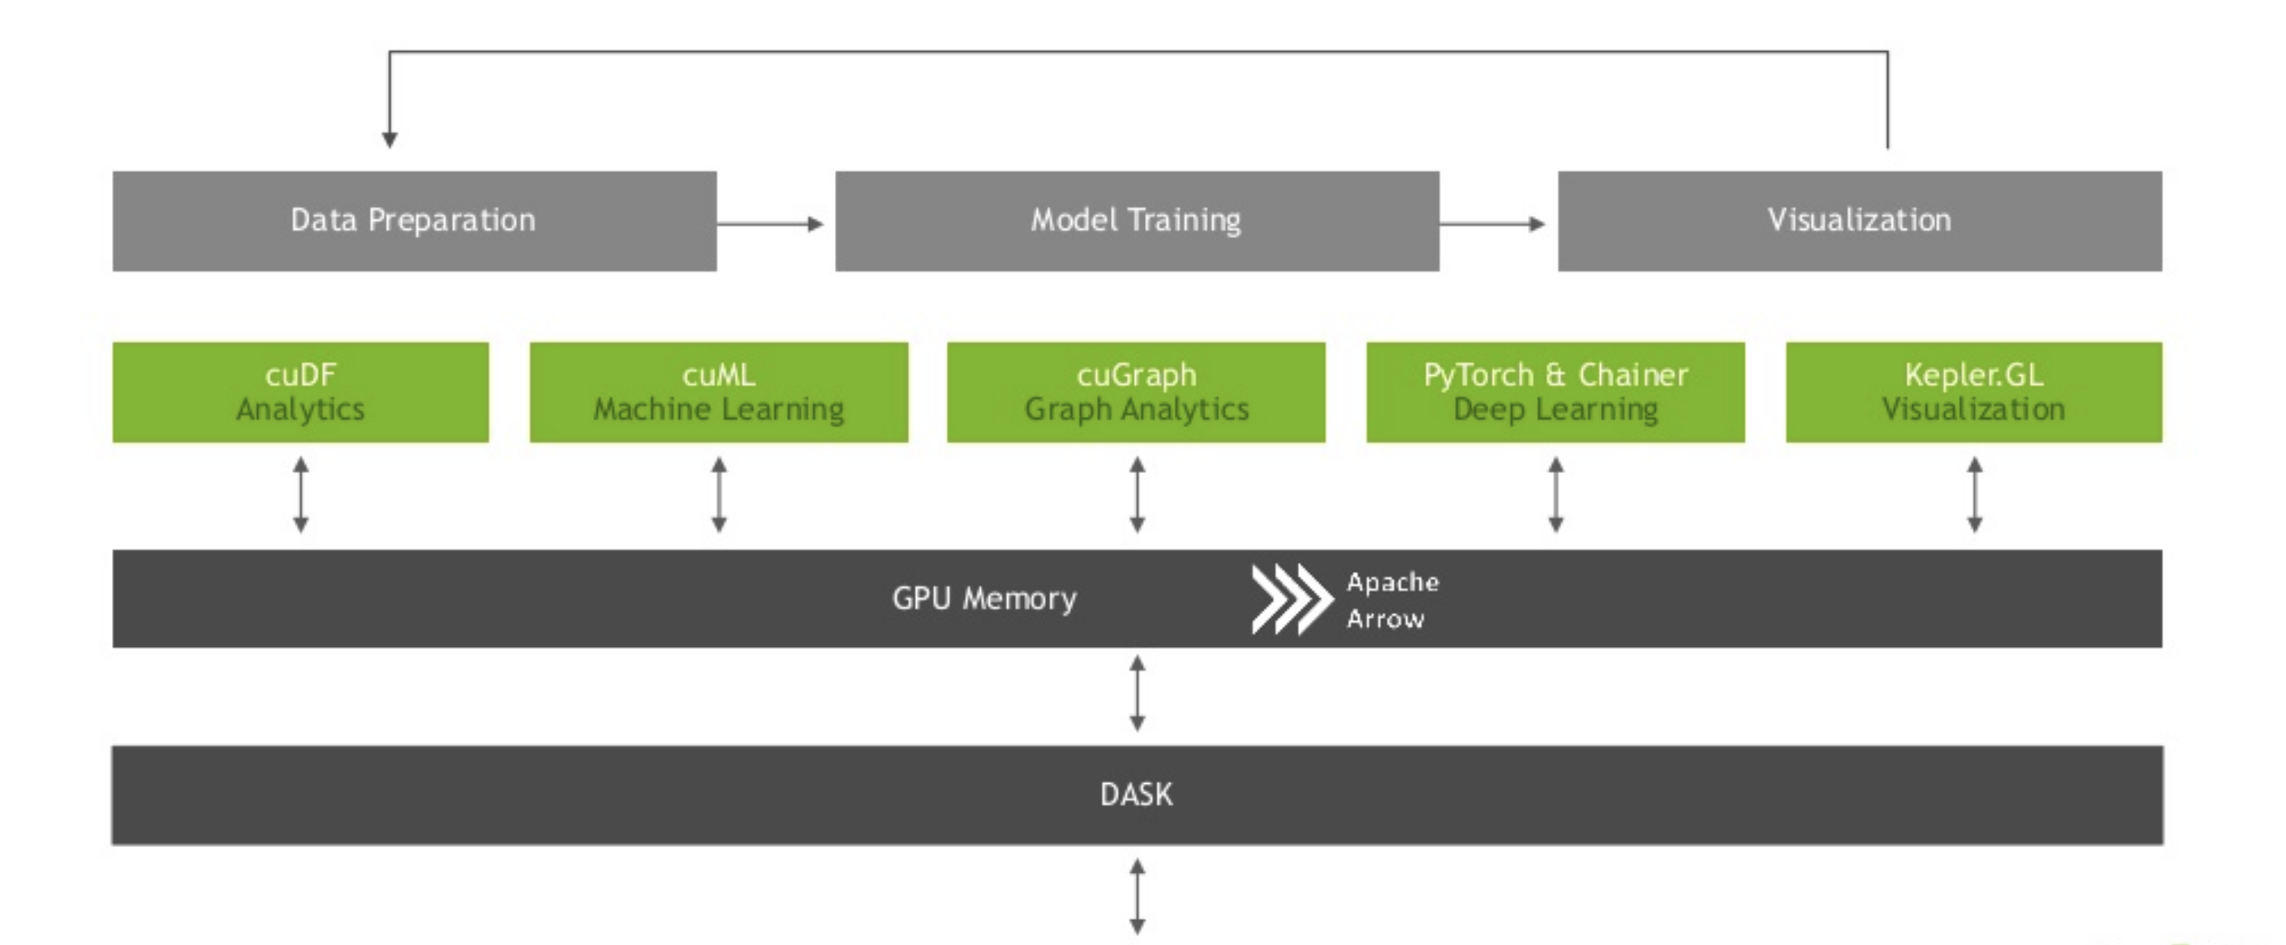
Rapids Architecture
Notes:
Computationally unified data architecture
1. All the data manipulation and ETL process in CuDF
2. ML algorithms and model development using CuML
3. Graphing and related topological functions in CuGraph
4. NN,LSTM based models in PyTorch and Chainer
Apache Arrow(at the root for memory storing approach).Facilitates quick access to data across platforms
Dask based approach to execute logics/models on multiple GPUs

Slide 3
CuDF
Pandas like approach
Major pitfalls:
    Memory bound(kernel crashing)
    Optimization requirements
    No support for multiple keys
    No support for re
Notes:
x.memory_usage(deep=True)
1. Approach quite similar to Pandas
ETL e.g.
1. Reading
2. Sorting
3. Group BY
4. Writing
Numerical Capabilites
1. UDFs’
2. vectorized and apply
String Capabilites:
1. Support strings via nvstrings,no support for re package.Using str(Stringmethod)
2. Using contains,replace,extract
Looping constructs and conditional expressions remain the same.But optimization required in using looping constructs and in cases when the search space is huge.

Slide 4
CuML
Sklearn like approach
Pitfalls:
    No support for feature selection or feature clustering

