Slide 1

Touch Stone for insights
From unstructured Complaint data
26/02/2016

Slide 2
Topics
Problem Statement
How would this help?
How did we do it?
Sample data
Demo
What’s Next?

Slide 3
Problem Statement
Get Meaningful insights from complaints data.

Slide 4
How would this help
For Government Bodies
Integrated Dashboard on complaints pertaining to multiple Bangalore Civic Bodies (like BBMP, BESCOM, etc.)
Voice of citizen
For Citizen
Neighborhood Scoring
Transparent Governance

Slide 5
How did we do it?

Slide 6
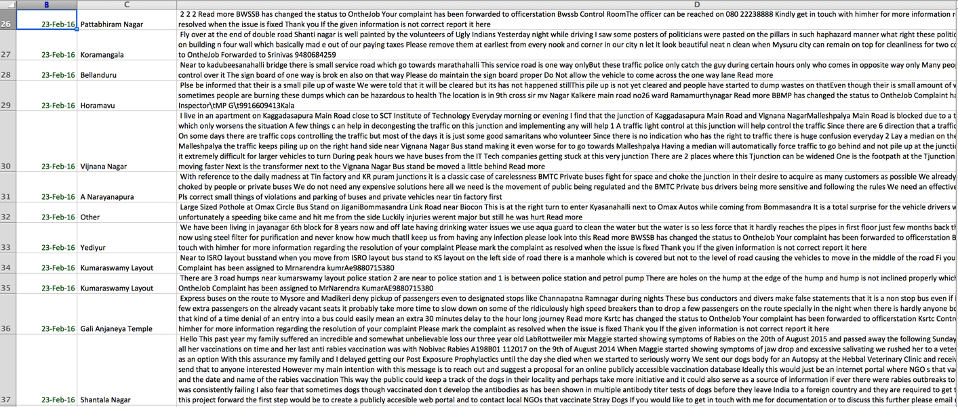
Sample Data

Slide 7
Demo

Slide 8
What’s Next?
Integrate structured/un-structured data from any application/web/social/survey
Alert concerned officials on pre-defined threshold limits on complaint category
Integrated platform for recording and tracking complaints

