Slide 1
Predicting if aircraft crash has fatalities or not
Yunjin Bak

Slide 2
Background
Aviation travel has increased dramatically over the last couple of decades
It is important to find out significant factors that could predict if fatality occurs in an aircraft crash
The results may help to prevent or minimize accidents, which can save lives

Slide 3
DATA
Acquired from National Transportation Safety Board
Information from 1962 to Feb, 2019 about civil aviation accidents and incidents
Data have 32 variables and 162,800 data points

Slide 4
Goal
Predict successfully whether the crash is fatal or not
Compare between the models, and find out the best model
Examine which variables are important for the prediction

Slide 5
Preprocessing
9 out of 32 variables which have over 50 % of missing values were excluded in features
Then, missing values were dropped

Slide 6
Exploratory Analysis
Aircraft crashes from 1962
1
Notes:
I investigated each feature, and also did feature engineering

Slide 7
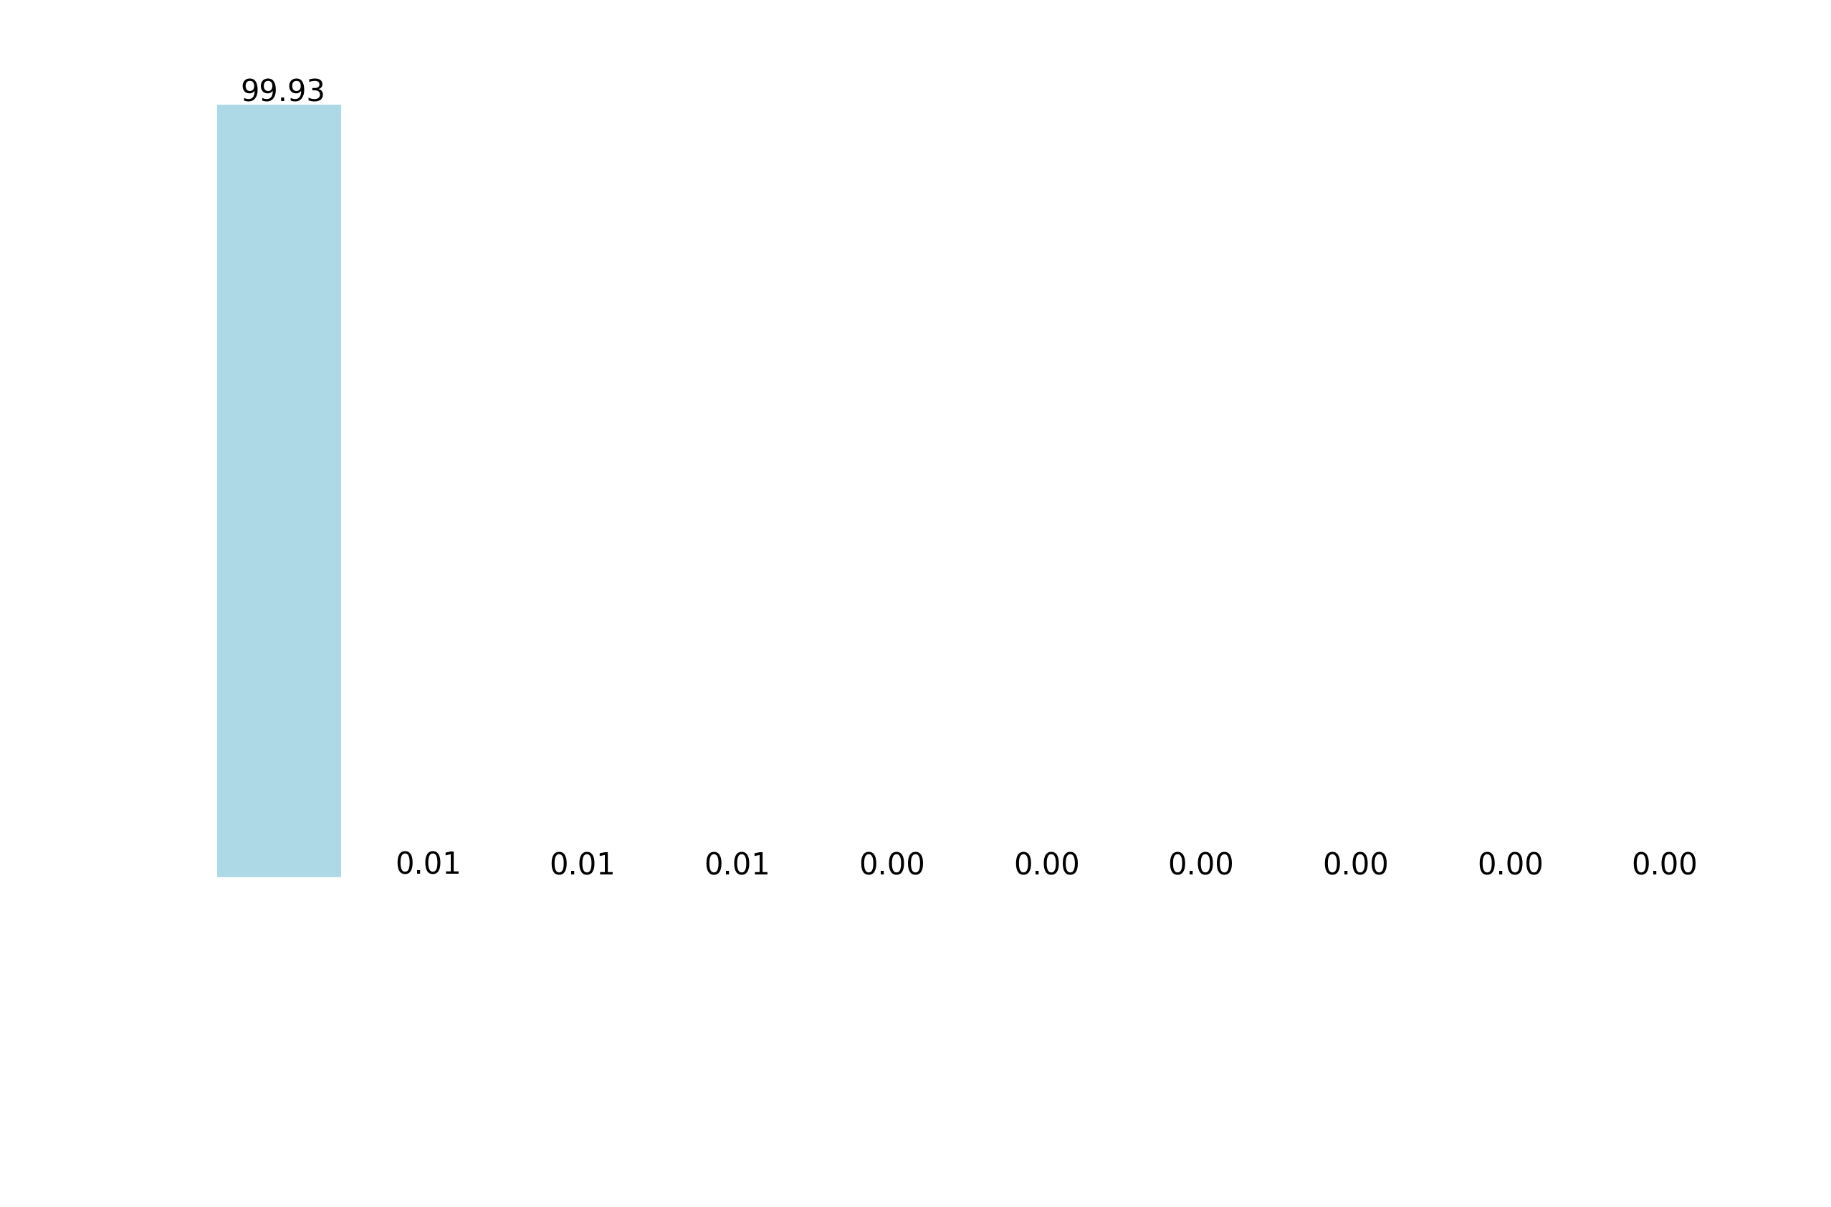
Country
Over 99% of the data are the crash that happened in the US.
The data from other countries were excluded for further analysis.

Slide 8
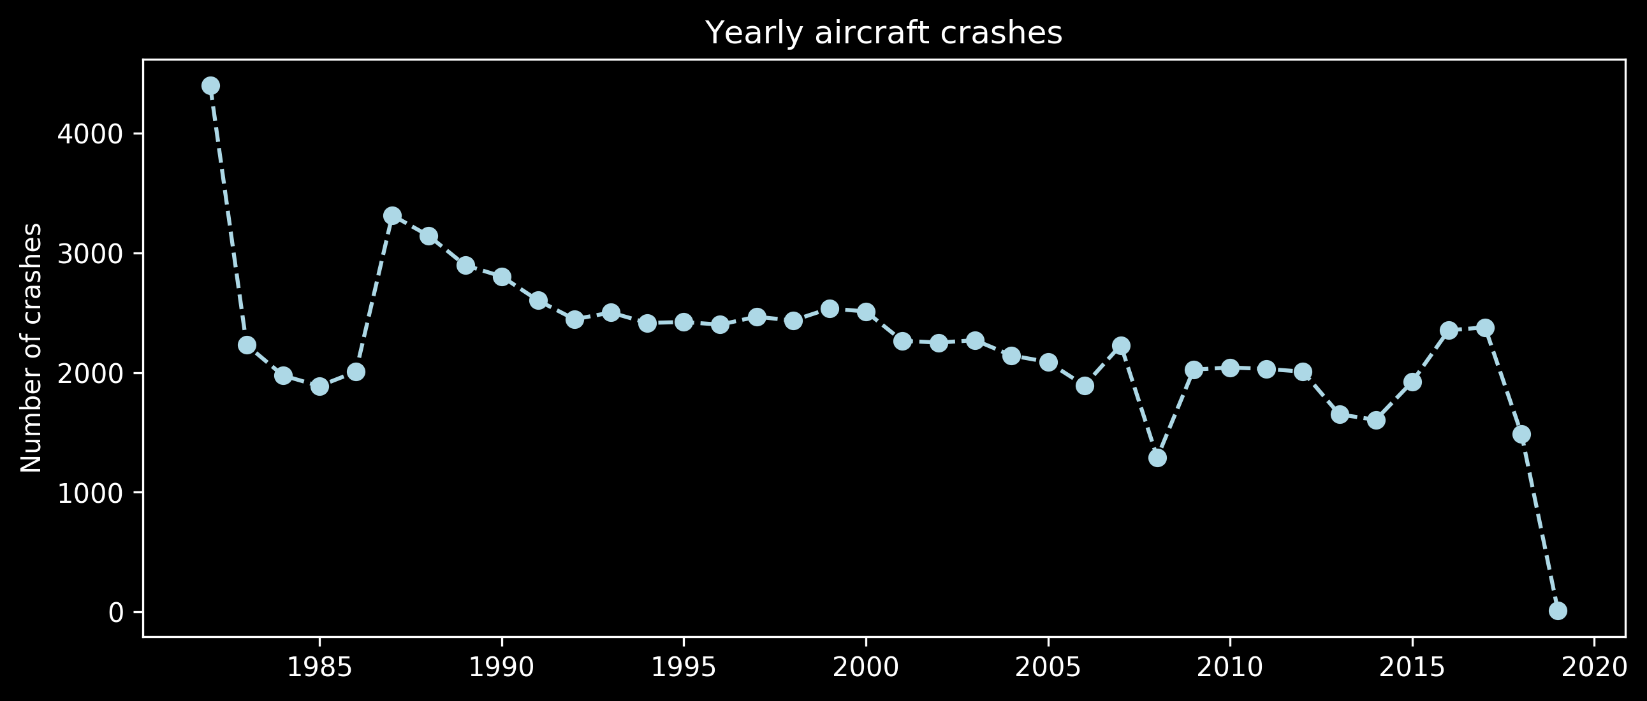
Event Date (Year)
The trend for yearly aircraft crashes looks random.
Notes:
The yearly trend seems arbitrary

Slide 9

Event Date (Month)
Air crashes tend to occur mostly during the summer.
This might be due to high demand on air travel during summer months.
Notes:
Additional investigation would be possible with data on the number of flights.

Slide 10

Event Date (Day of Week)
Air crashes occurred on Wednesday the most.
This also may be due to more flights on middle of week.
Monthly and daily crashes were only included, since year information is not suitable for predicting future aviation crashes.
Notes:
주말에 더 많을 수도 있다. 비행 수 정보가 있으면 확인할 수 있을 것

Slide 11
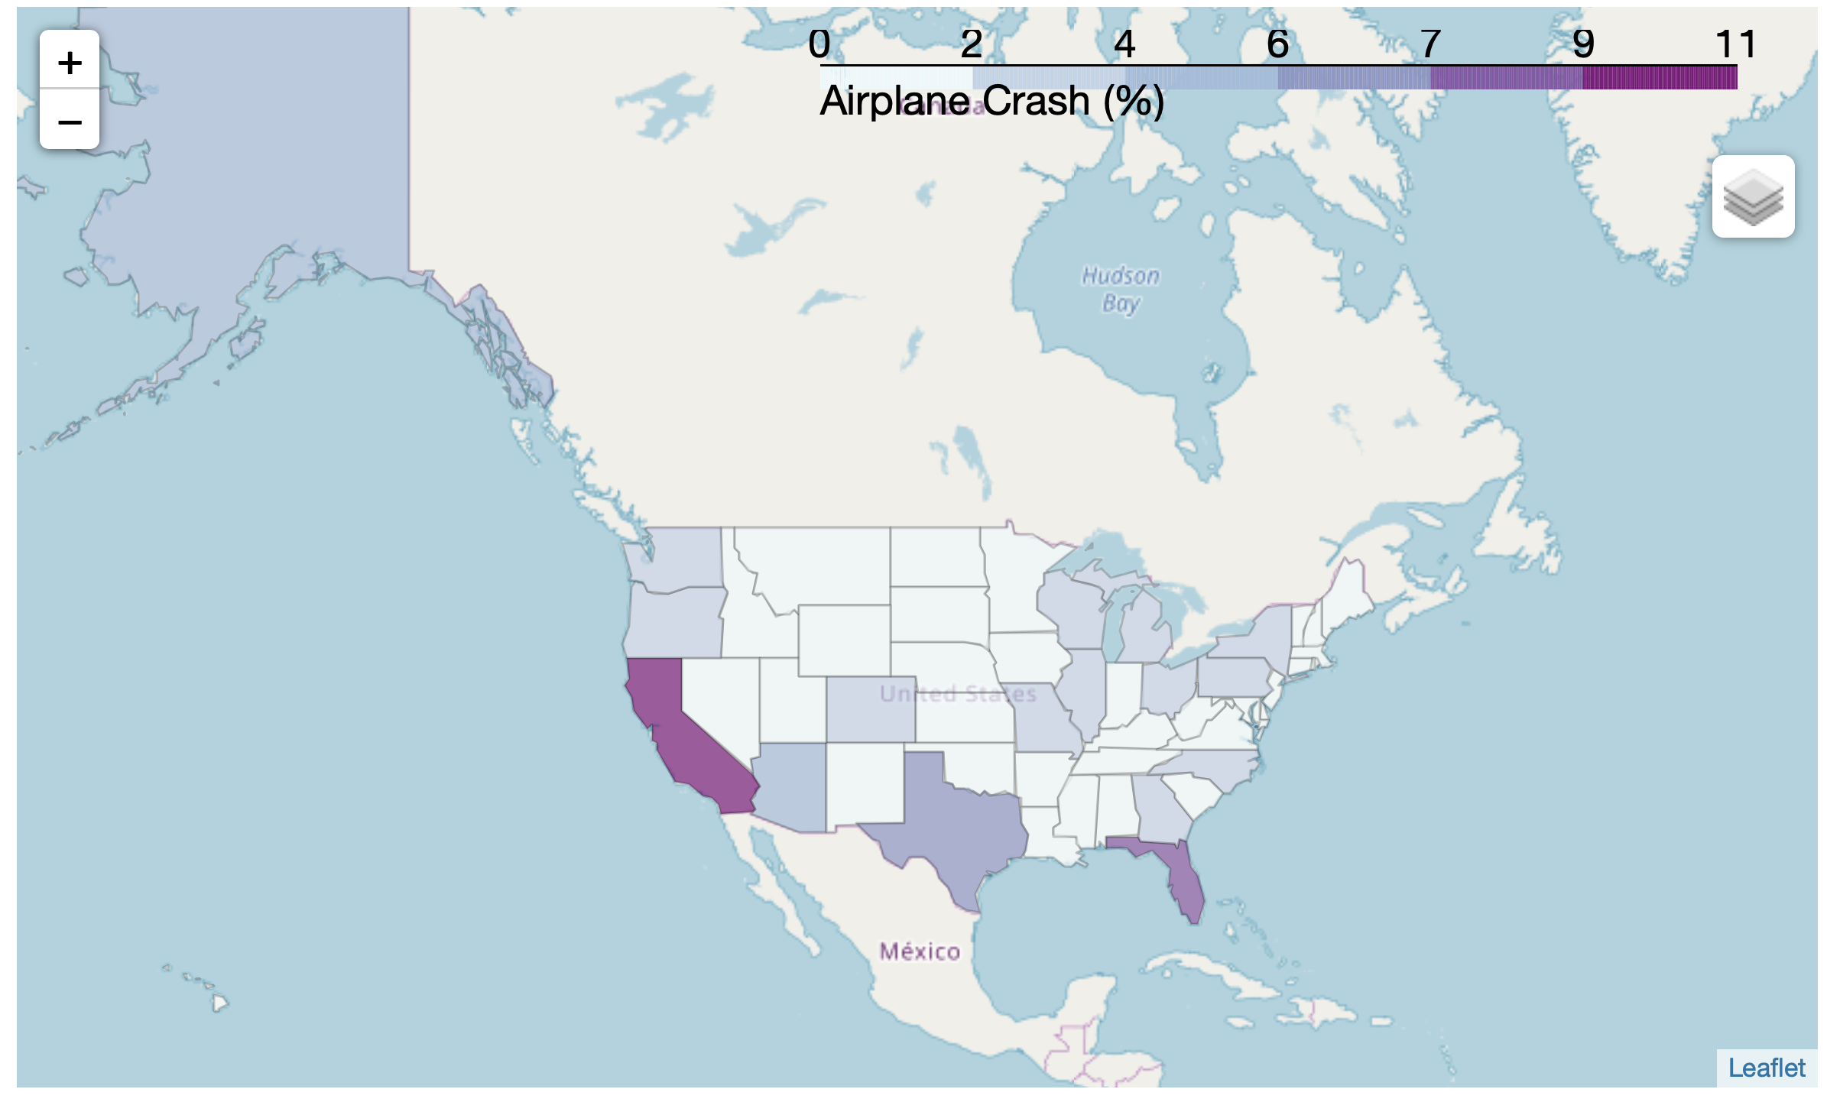
Location (States)
California has the most airplane crashes, and Florida is the next.
In order to reduce dimension in states variable, states were divided into 4 categories.
Notes:
Folium module was used.
Chrolopleth

Slide 12

Location (States)
West has the most frequent number of crashes

Slide 13
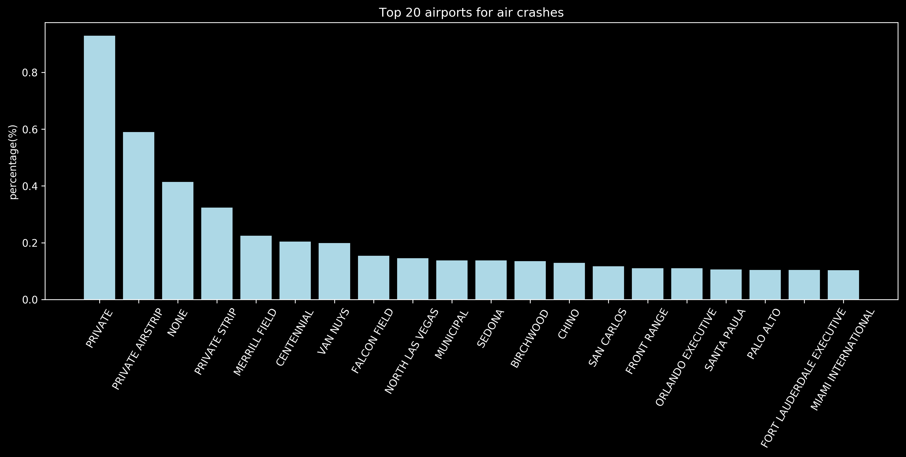
Airport
Aircraft crashes occurred in private airport the most
The feature was simplified as ‘private or public’
Notes:
세개가 다 똑같은 걸 가르키는 것 언급

Slide 14

Aircraft Damage
Most of crashes resulted in substantial damage of aircraft
This variable was excluded because of target leakage
Notes:
Since it already knows the actual outcomes, the model’s results will be unrealistically accurate for the training data, like bringing an answer sheet into an exam.
This information can be obtained only after crash, so It is not interesting at all when if this variable is the most important feature

Slide 15
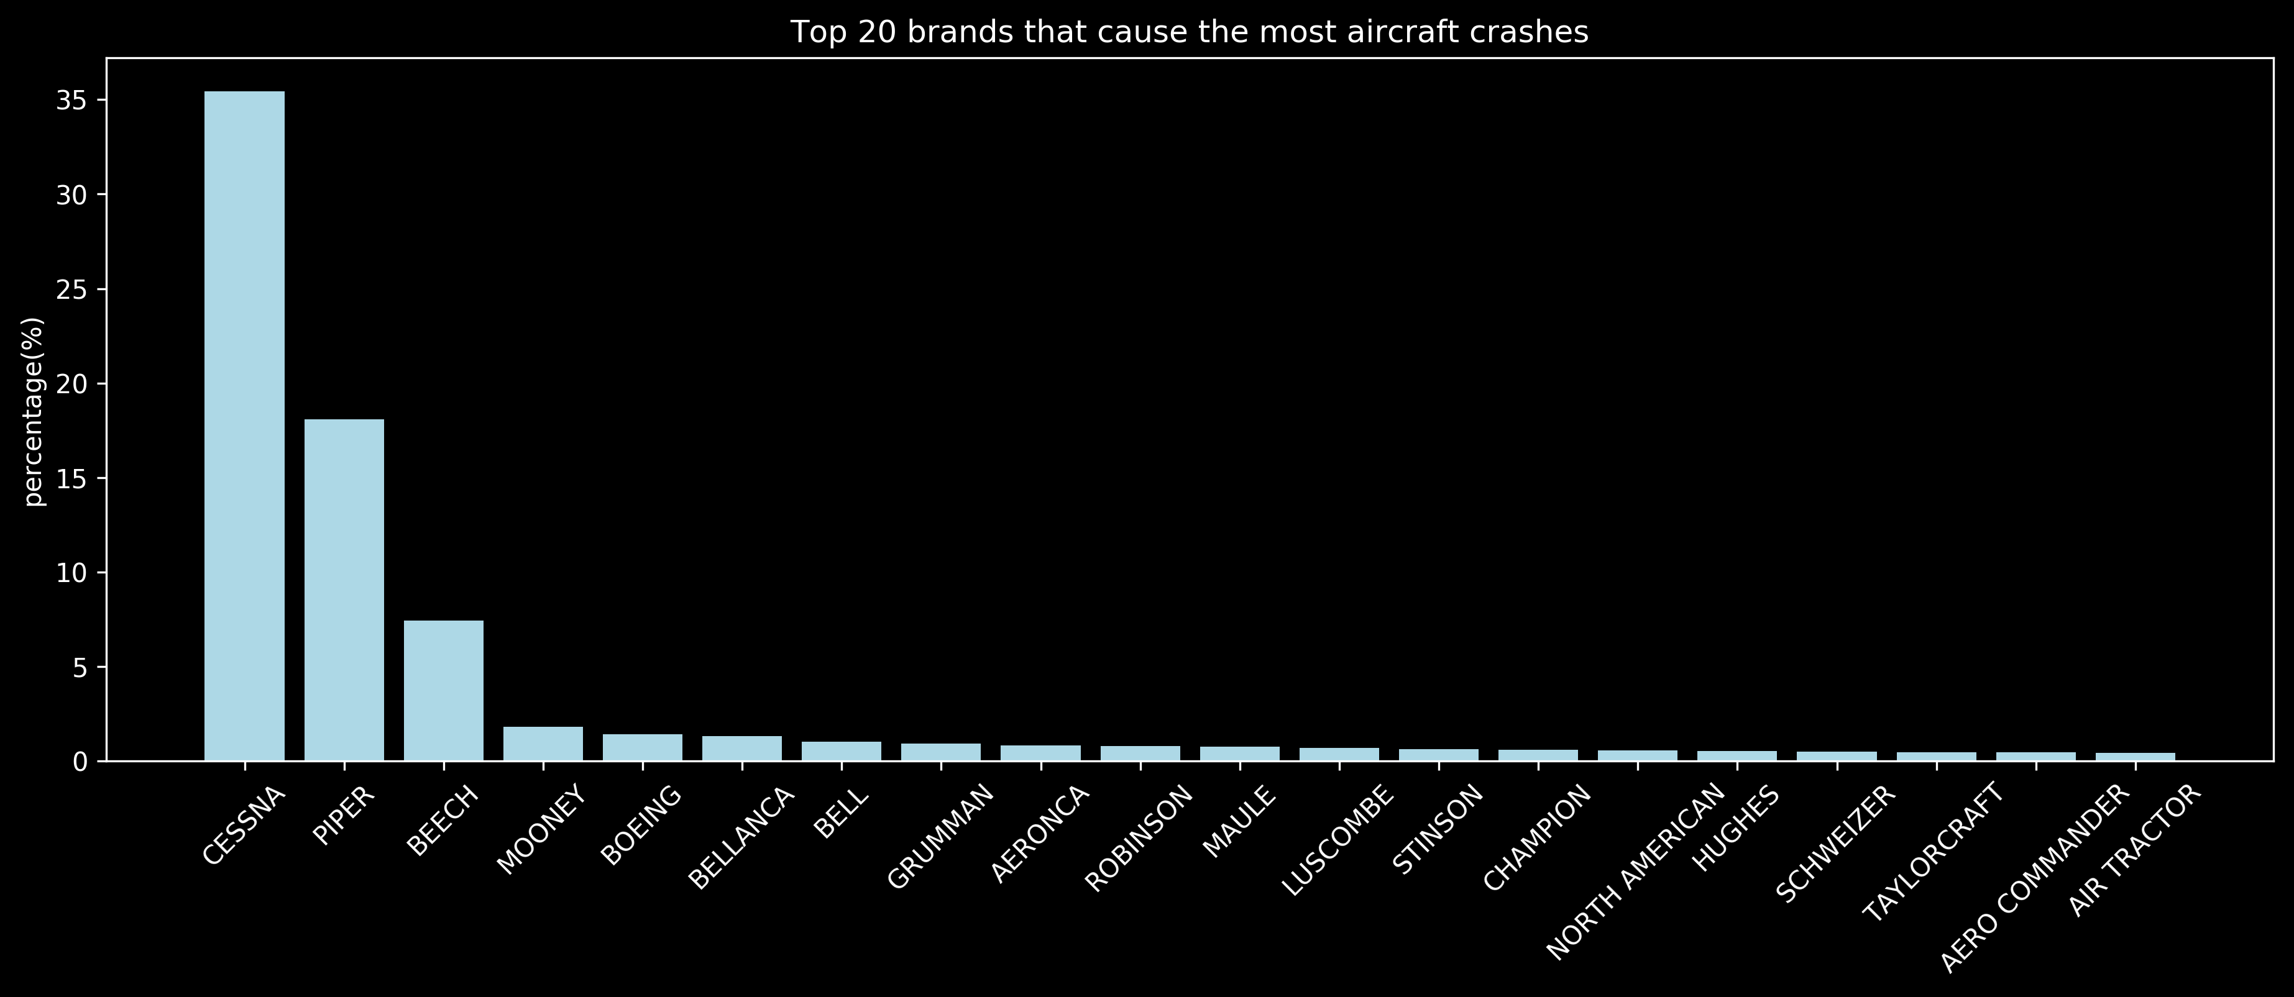
Brands
Top 3 brands (Cessna, Piper, Beech) take over 50%
To reduce the levels, brands were categorized into 4 different values (Cessna, Piper, Beech, Others).
Notes:
Recategorize Commercial or private aircraft

Slide 16
Amateur Built & Number of Engines
Amateur Built
Whether aircraft is a homebuilt (Y/N)
No 75376
Yes 9348
The Number of Engines
The number of Engines
1 | 72102
2 | 11499
3 | 451
0 | 363
4 | 307
18 | 2
Notes:
most of crashes were caused by aircraft which was not a home built
the crashes happened the most with the airplane which has single engine

Slide 17

Engine Type
Over 90% of crashes were caused by planes with reciprocating engine
The reason for this might be that this engine is the most common type
Notes:
- reciprocating engine, also often known as a piston engine, is typically a heat engine (although there are also pneumatic and hydraulic reciprocating engines) that uses one or more reciprocating pistons to convert pressure into a rotating motion.

Slide 18

Purpose of Flight
Purpose of flight was re-categorized into 3 values (Personal, Instructional, Other)

Slide 19

Weather Condition
Most of crashes occurred when there is sufficient visibility
It might be due to less number of flights in IMC condition
VMC : Visual Meteorological Condition
IMC : Instrument Meteorological Condition
Notes:
- conditions in which pilots have sufficient visibility to fly the aircraft

Slide 20
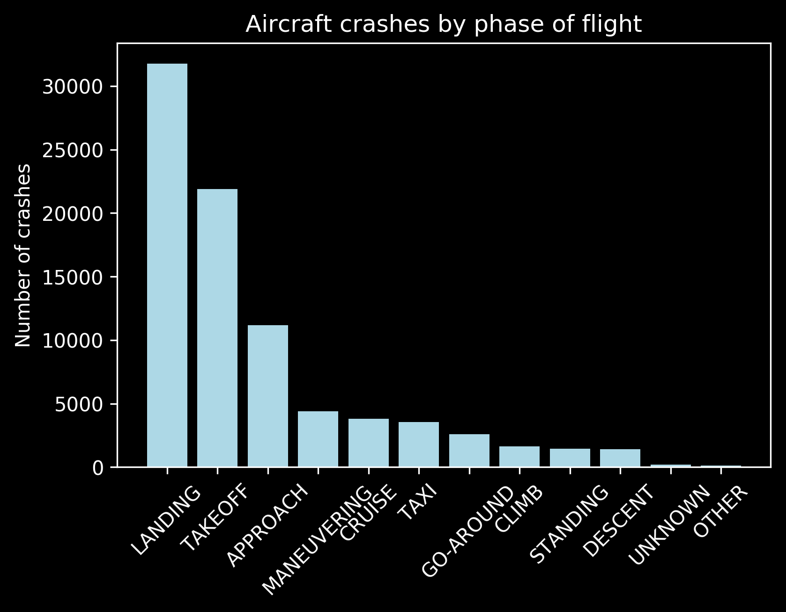
Broad Phase of Flight
Most of crashes occurred during landing phase

Slide 21
Outcome Variable : Injury Severity
Fatal / non-fatal
In order to solve class imbalance problem, Down Sampling was performed
Fatal | 11558
Non-Fatal | 72258
Notes:
The number of data points from majority class, non-fatal were matched to the number of minority class, fatal.

Slide 22
Classification
Let’s play with different models
2
Notes:
Let’s do classification

Slide 23
Model Comparison
10 features (1 numerical, 9 categorical)
KNN, Random Forest, Gradient Boosting, SVM, and Logistic Regression were used and compared.

Slide 24
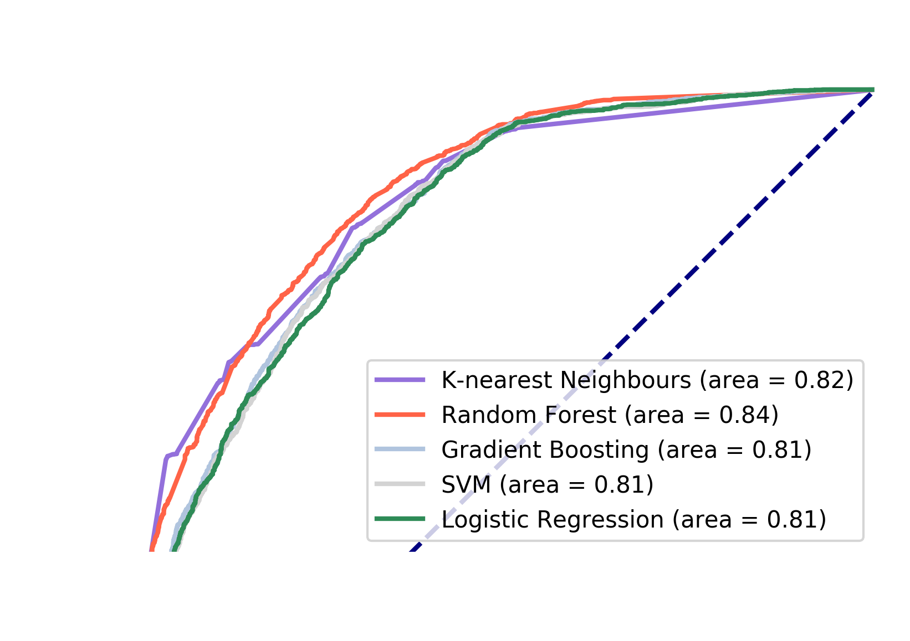

Model Comparison
Obtained AUC value using cross validation
Random Forest performed the best
Notes:
All models resulted in over 80 % auc scores.
Random forest performed the best, and its auc score is almost 85%

Slide 25
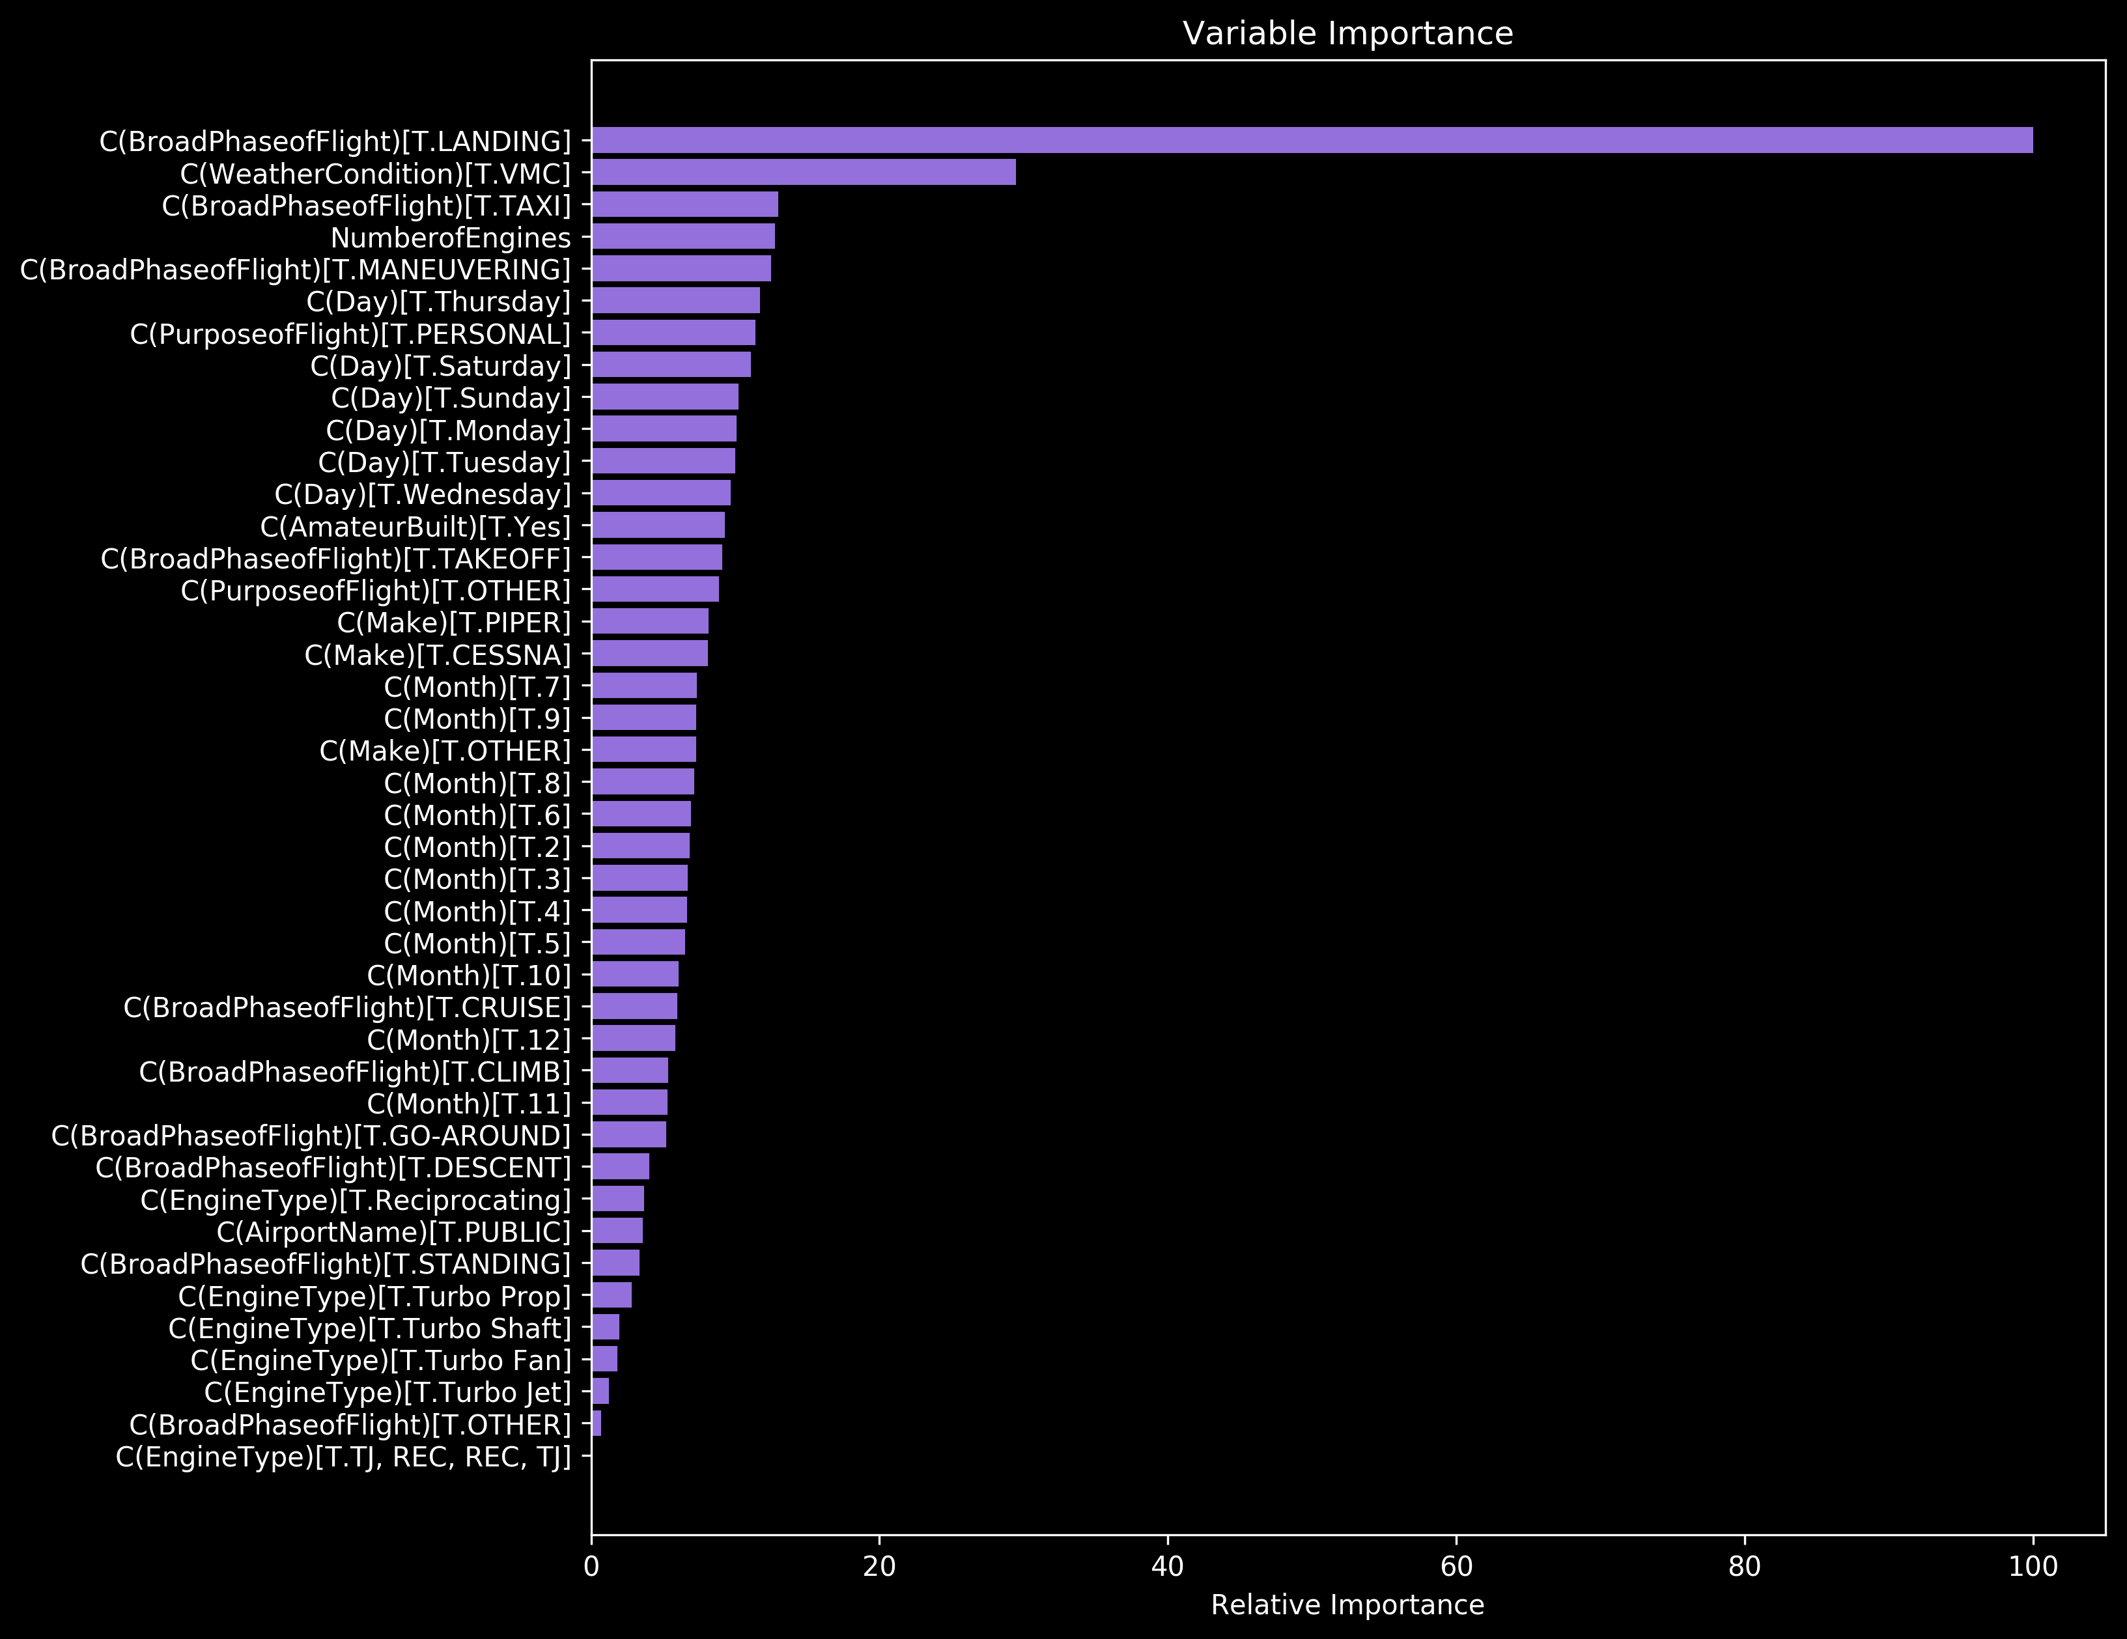
Feature Importance
Obtained from Random Forest model
Top 3 : Landing, VMC (Good weather), Taxi

Slide 26
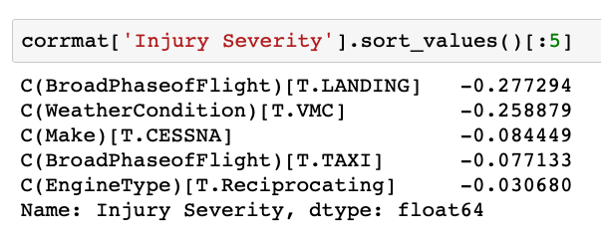
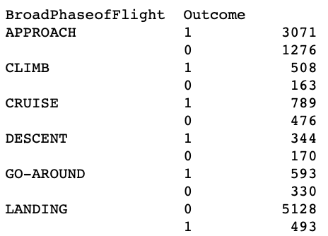
Feature Importance
Landing has negative correlation with outcome variable
VMC feature could be interpreted intuitively
Notes:
When we see the correlation value, interpretation is not intuitive because the most important feature, landing has negative correlation with outcome variable.
This result shows fatal crashes happens more during other than landing phase.
However, as you can see in the figure below, landing has the most crashes when we collapes and sum outcome variable but most of crashes are non fatal.
Actually landing phase means airplane is almost on the ground, so even if crash occurs, it might not be that risky.
because for example when crash happens during approach, the airplane runs into the terrain, and it might lead to way more serious crash.
The second most important feature is a good weather condition,

Slide 27
Conclusion
All 5 models showed over 80 % AUC score
Random Forest performed the best with about 85 % accuracy
Landing phase and good weather condition were the most important features
Notes:
To sum up,

Slide 28

THANKS!
Any questions?
You can find me at
github.com/datasciyj
yunjin.bak1@gmail.com

