Slide 1
DataSeries: an efficient, flexible data format for trace storage and analysis
Eric Anderson <eric.anderson4@hp.com>, et. al.
HP Labs

Slide 2
Overview
Archival structured trace format
  Column and row format
  Range scans
  No overwrites, possible appends
Lesson learned
Ongoing directions
  Updates
  Improved parallelism

Slide 3
Six properties
Storage efficiency
  Store ~300 billion records in ~3TB
  Techniques: delta-coding, duplicate string elimination, generic compression
Access efficiency
  Cost of access approx. (cast) + dereference
  Techniques: Accessors that cache offsets, C++ templates

Slide 4
Six properties
Flexibility
  No effect from adding/removing un-accessed fields
  Able to store multiple “tables” in one file
  Techniques: accessors transparently adjust offsets, files divided into typed extents
Self-description
  Metadata description should be part of files
  Techniques: types described in XML, extra fields for additional information, e.g. units for timestamps

Slide 5
Six properties
Usability
  It should be easy to write analysis
  Techniques: auto-code generator, sundry generic programs
Integrity
  Archival data lasts for decades
  Techniques: self-contained files, embedded checksums

Slide 6
Does it work?

Slide 7
Case study: Ellard/Harvard NFS traces
Text trace format
  Beginning of line fixed fields
  Rest of line optional tagged fields
Results:
  Smaller files: 0.76x the size of originals
  Reduced cpu usage: 24-27x less cpu time for analysis
  Faster analysis: 76x-107x faster (latter with 1.14x larger files) measured on 4 core opteron
  Few hours to write initial conversion; ~1 week to handle all the special cases

Slide 8
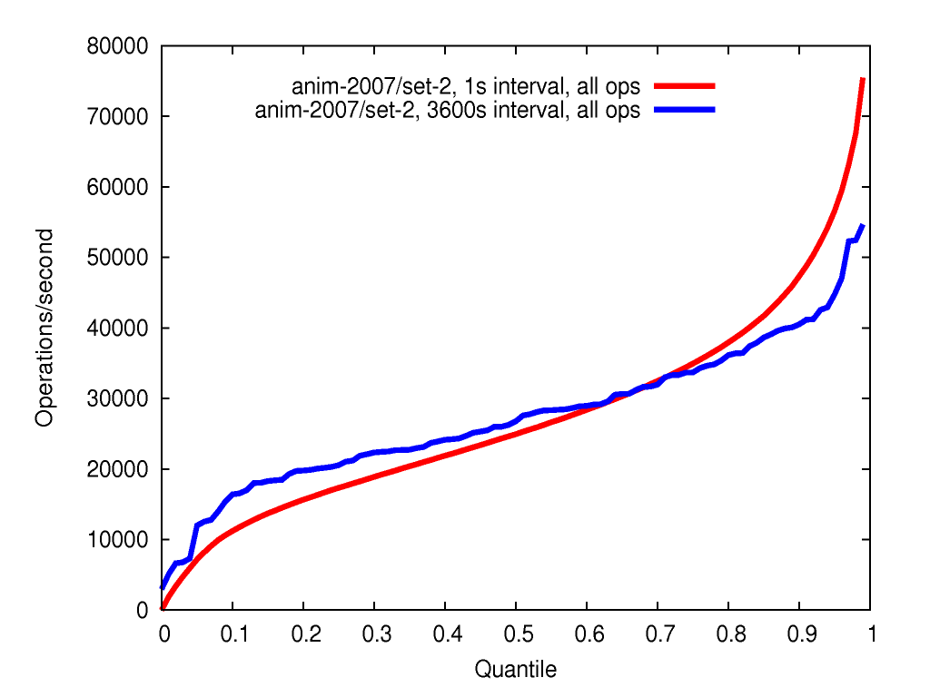
Case study: Animation NFS traces
Converted directly to DataSeries
~50 billion rows/dataset
794GiB compressed (gzip)
~4 hours to analyze one set
Computing a cube with approximate quantiles

Slide 9
Case study: NFS traces
Ellard/Harvard traces:
  Text file format, perl analysis tool
  Smaller files: 0.76x the size of originals
  Reduced cpu usage: 24-27x less cpu time for analysis
  Faster analysis: 76x-107x faster (4 cores)
  Initial converter: few hours, ~1week for undocumented bits
Animation traces:
  Converted directly to DataSeries from packet captures
  ~50 billion rows/dataset
  794GiB compressed (gzip)
  ~4 hours to analyze one set
  Computing a cube with approximate quantiles

Slide 10
Case study: 1998 World Cup web traces
Custom binary format (4 32-bit ints, 4 bytes)
Results:
  Initial files: 0.979x smaller; optimized: 0.929x smaller
  Analysis: 1.04x less cpu, 2.60x faster
  optimized: 1.17x less cpu, 3.46x faster
  Original analysis used slow fread, byte-swap, non-integrated decompression
  DataSeries limited by inefficient compiler (g++-3.4 on RHEL4 – 1.5x abstraction penalty)

Slide 11
Lessons learned?

Slide 12
Got many things right
Achieved the properties
Stable, but extendable file format (from ~2001)
Remarkable amount of flexibility
  Block I/O, process traces, NFS, LSF jobs scheduler, e-mail, system call, AOL, file metadata, et. al.
Quite well tuned
  Interface encourages efficient analysis

Slide 13
Got some things wrong
“nullable” fields default to not-null
Checksums chosen poorly
  Too fast to be high quality (crc32, bob-jenkins)
  Too slow to be left on all the time (~500MB/s)
Storing full extent name in each extent ➔ high per-extent overhead
Specifying compression types rather than intent leads to poor choices

Slide 14
Some things unclear
Recently added support for extent-type versioning
  Major + minor, major ➔ incompatible, minor ➔ upwards compatible
  Could instead have people write converters
Dealing with time is tricky
  Doubles have insufficient precision
  128 bit floating point? Enough precision, big and slow
  Raw format? more precision (2⁻³²s), but somewhat odd
  Leave it up to the user:
    Add units and epoch
    Special accessor that can convert

Slide 15
Future directions

Slide 16
Supporting updates
Representation:
  Store base table + sorted updates
  Unsorted updates in memory
Range scan covers base, updates and all of unsorted
Perform intermittent merges to improve efficiency
Developed by SIMPL IM team (Alistair Veitch, Brad Morrey, Craig Soules, Kim Keeton)
~10x faster than a commercial database

Slide 17
Improving parallelism
Have parallel read and write, but not queries
First unordered multi-core transforms
Then multi-core sort
Next multi-node transforms and sort
Challenge: network bandwidth
  Analysis run at 100-200MB/s/core
  8 cores ➔ 800-1600 MB/s >> 1GbE
  Odd result: full exchange → 1 node ≈ 16 nodes
Developed by Tomer Shiran (+ Jay Wylie, Joe Tucek)

Slide 18
Conclusions
If you’ve got trace data, use DataSeries
For extended features, talk to the listed people
Open source release:
http://tesla.hpl.hp.com/opensource/
Internal version control:
http://usi.hpl.hp.com/viewmtn/

