Slide 1
Capture, conversion, and analysis of an intense NFS workload
Eric Anderson
HP Labs
aka Industrial strength NFS tracing

Slide 2
Industrial strength NFS tracing
Wanted to collect customer NFS traces
Applying existing techniques failed
Going to explain how we did it
  Many incremental improvements
  Need most of them
  Details in paper
Summary:
  If you take traces, re-read the paper, apply the lessons
  Our workload is quite different from previous ones

Slide 3
Why do we take traces?
Understand “real” workloads
  How many operations occur?
  How big are the files?
  How cacheable are they?
  How sequential are the accesses?
  What trends are present?
Evaluate new systems
  Figure out new possible designs
  Estimate performance on “real” workloads

Slide 4
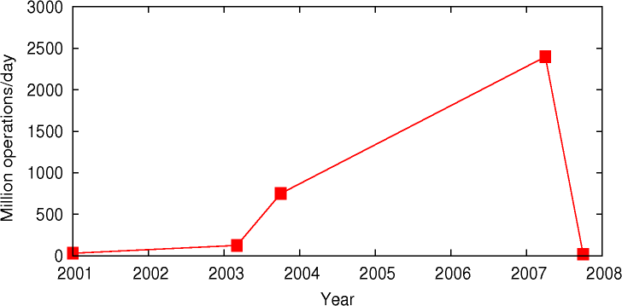
Why new traces?
us
Complete bunk
us
Existing tools insufficient → Develop new ones
Workloads highly variable → Collect many more traces

Slide 5
Improved tools

Slide 6
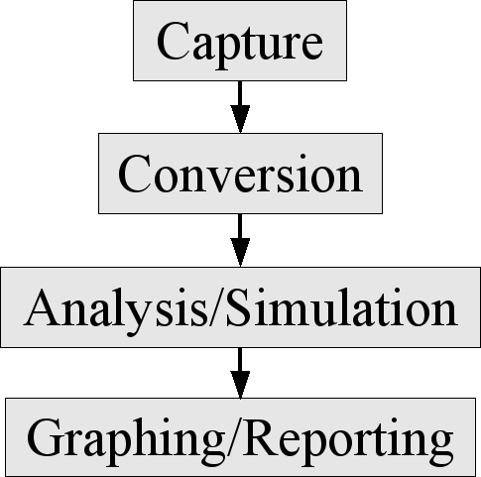
Overall trace analysis process
environment → raw form
raw → cooked
cooked → data
data → information
Details in paper Tools, traces are open source

Slide 7
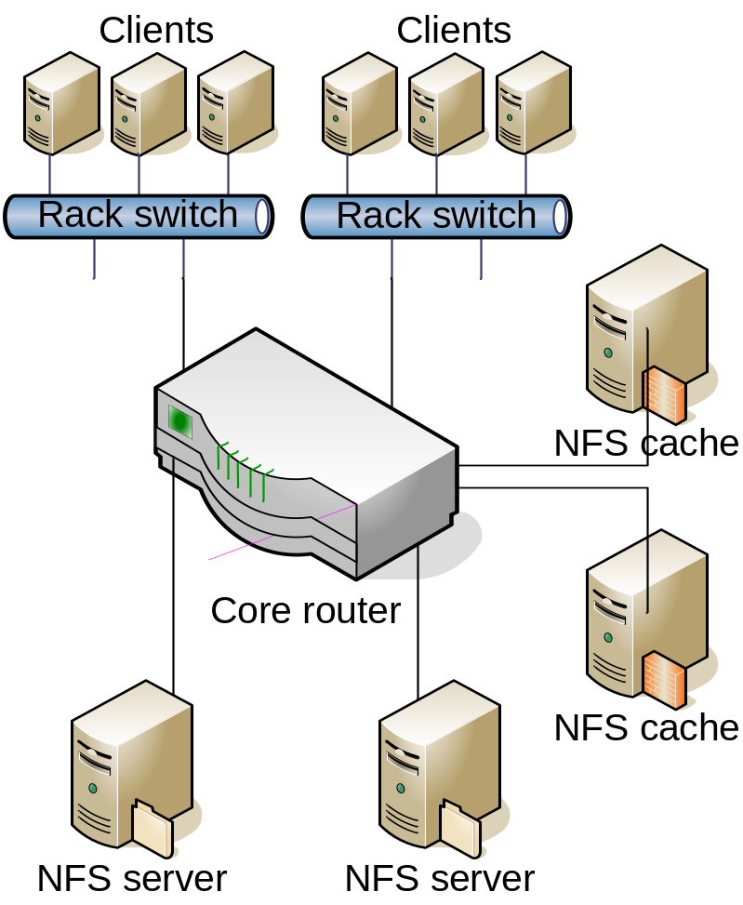
The customer
Feature animation (movie) company
  Read models, textures, animation curves
  Write intermediates and pictures
  ~3 years/movie
Dramatis personae:
  Thousands of clients (render-farm)
  Tens of NFS servers
  Twenties of NFS caches
  Many rack switches
  Few core routers

Slide 8
Capture (2003)
Challenge:
  Non-intrusive data capture
  Parse readdir, etc.
  Enable offline conversion
  NFS traffic bursts >1Gbit/s
  Prefer long capture times (days)
Solution:
  Port mirroring on switch
  Full packet capture
  Capture to parallel JBOD
  Special Linux-specific capture tool (lindump)
  Dynamic compression via tmpfs buffer

Slide 9
Capture, improved
2004: new switches with smaller buffers
→ 10Gb/s network interface card
In-driver packet capture (driverdump)
2007: sustained 5Gb/s
→ Special capture card (endacedump)
Integrated dynamic compression

Slide 10
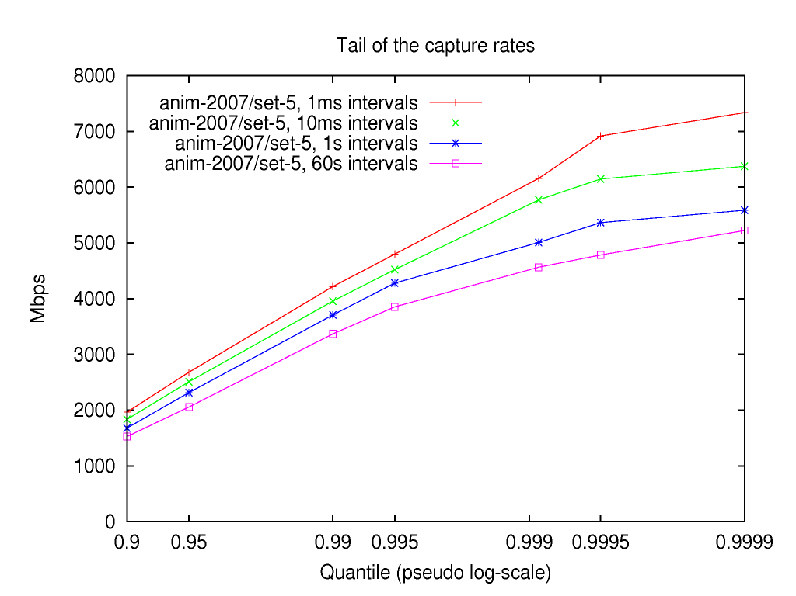
Capture: observed rates
Measured workload is bursty
Capture tool can sustain 5Gb/s
Capture tool can burst up to 7.5Gb/s

Slide 11
Capture: discussion
No more papers reporting packet drops
Expected data rate, available resources
<1Gbit/s
< 3Gbit/s,
Kernel hacker
<10Gbit/s,
Capital budget
Use lindump
(2003 tool)
Implement driverdump
(2004 tool)
Purchase endacedump
(2007 tool)

Slide 12
Conversion
Challenge:
  Flexible logical representation
  Efficient physical representation
  Rapid trace conversion
  Trace anonymization
Solution:
  Relational data model, multiple tables
  DataSeries structured serial data format
  Two-pass parallelism
  Reversible encryption

Slide 13
Analysis techniques
Challenge:
  Huge (50 billion row) data sets
  Large intermediates
  Many possible grouping options
  Bursty, non-normally distributed data
Solution:
  Custom DataSeries analysis
  Streaming analysis
  Develop efficient data cube
  Use approximate quantiles

Slide 14
Graphing/Reporting techniques
Challenge:
  Moderate-size summary data
  Many possible graphs
Solution:
  Store data in SQL database
  Select with mercury-plot
Example mercury-plot command:
plot quantile as x, value as y from nfs_hostinfo_cube
where operation = 'read' and direction = 'send'

Slide 15
Collect more traces

Slide 16
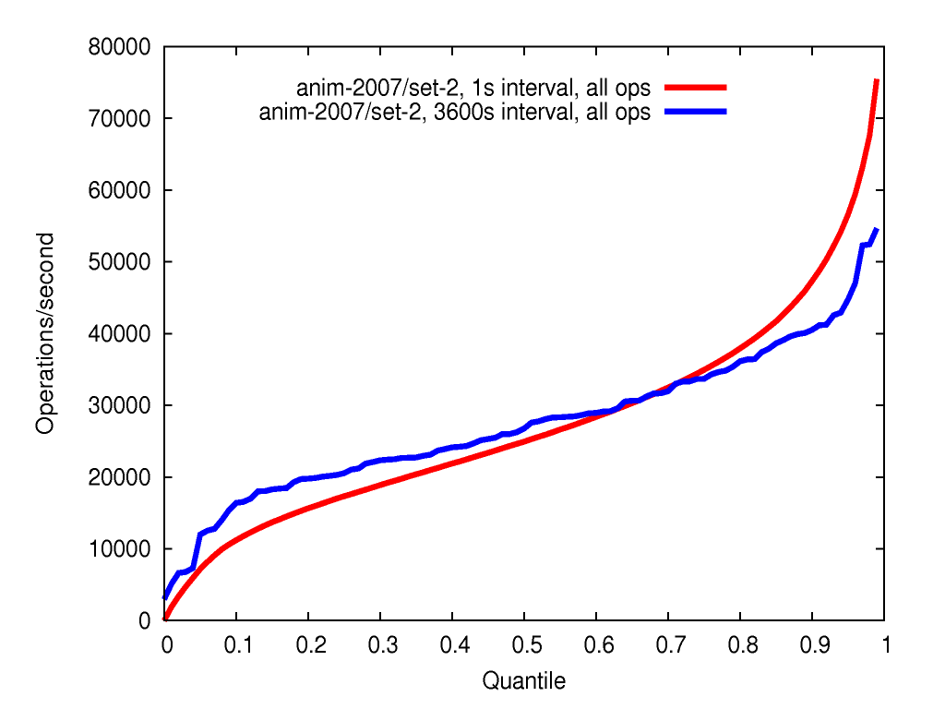
Analysis: distribution of operation rate
Shows NFS-level burstiness
Validates use of quantiles rather than mean and stddev
1hr rate > 1s rate
1hr rate < 1s rate

Slide 17
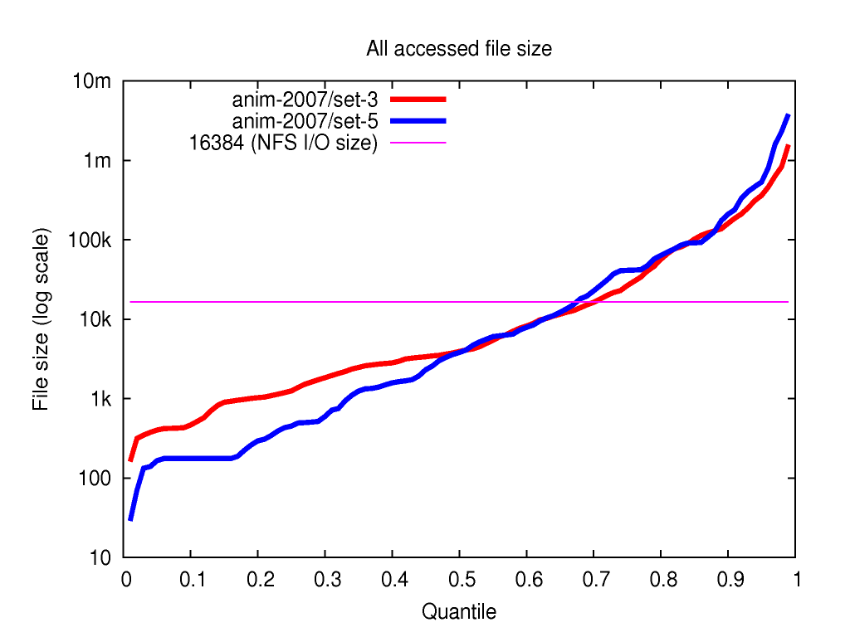
Analysis: distribution of file sizes
Each accessed file counted once
Most files are small
Moderately wide size distribution
Horizontal line is NFS read and write size

Slide 18
Analysis: reads in a single group
<30s
>30s
read
read
read
read
read
File A
Group 1
Group 2
Each group is the set of reads with a maximum inter-read gap of 30 seconds

Slide 19
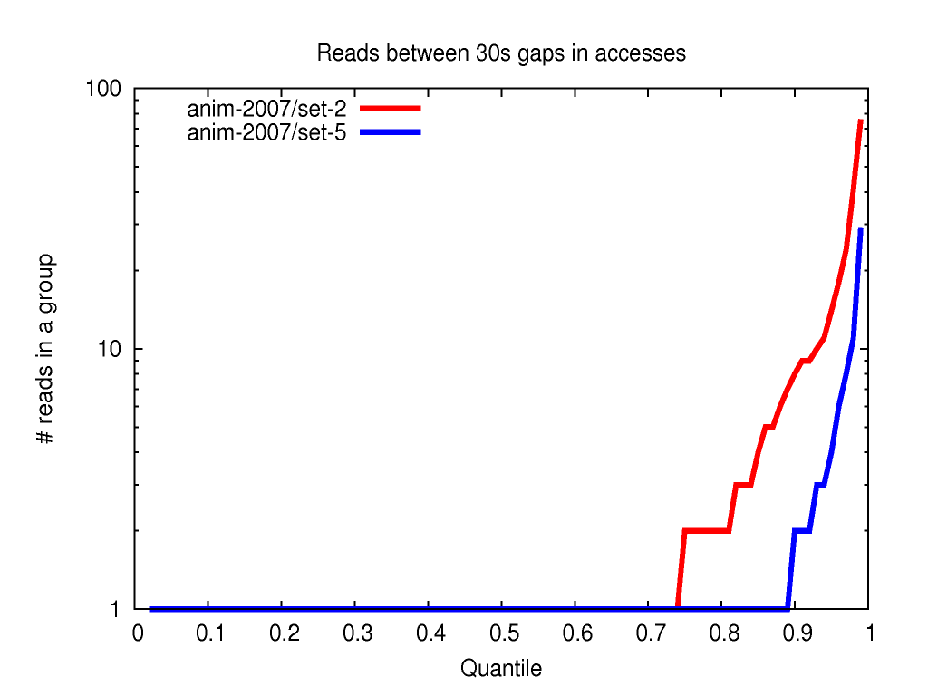
Analysis: reads in a single group
Most I/Os all alone
Side effect of many small files.
Occasional large groups (~100 I/Os)
Need cross-file prefetching

Slide 20
Conclusion
Capture techniques
→ no more packet loss
Conversion and analysis techniques
→ handle huge datasets on moderate hardware
Workload is very different:
  Very intense
  Small files
Much more detail and discussion in paper
Tools and traces open source

Slide 21
Questions?
Author/Speaker: eric.anderson4@hp.com
Software: http://tesla.hpl.hp.com/opensource/
Datasets: http://apotheca.hpl.hp.com/pub/datasets/animation-bear/
http://iotta.snia.org/traces/list/NFS
Tracing BoF: 8:30-9:30 pm, San Francisco A

