Slide 1
DataSeries:
Fast, efficient trace file storage and analysis
Eric Anderson
HP Labs

Slide 2
Overview
Background
Generic programs
Internal improvements
Type-specific programs
New data

Slide 3
Background
DataSeries: trace storage and analysis.
  Relational data model (typed columns)
  Ordering is preserved
  Designed for long-term storage (built in checksums)
  Replacement for srtLite (cello trace format)
Substantial (2-100x) analysis speedup
Moderate space improvements (1.3-10x)
http://tesla.hpl.hp.com/opensource/ BSD license

Slide 4
Generic programs
A generic program is one that can operate on any type of DataSeries file
dsrepack – take 1..m inputs, produce 1..n outputs
  Preparation for distribution, conversion for fast analysis
dsstatgroupby – poor man’s SQL select
  Simple analysis, basic or quantile statistics
dstypes2cxx – boilerplate generation
  For making it easier to build DataSeries programs

Slide 5
Type-specific programs: SRT
srt2ds:
  Multi-version converter
  Convert time to absolute
  Lots of hacks to deal with minor differences in versions
  Batch-parallel module for bulk processing
cmpsrtds:
  Compare an srt and DS file
  Verify correct conversion

Slide 6
Type-specific programs: Ellard-NFS
Four parts:
  Ellardnfs2ds: convert Ellard text format to ds
  Ds2ellardnfs: convert ds back to Ellard text format
  Ellardanalysis: subset of the analysis in nfsscan
  Batch-parallel/ellardnfs2ds: bulk processing
Results:
  Smaller files: 0.76x the size of originals
  Reduced cpu usage: 24-27x less cpu time for analysis
  Faster analysis: 76x-107x faster (latter with 1.14x larger files) measured on 4 core opteron
  Few hours to write initial conversion; ~1 week to handle all the special cases

Slide 7
Type-specific programs: HP-NFS
nettrace2ds:
  Support for both endace and pcap input formats
  Parses more fields in NFS operations
  Multiple input file processing to eliminate edge effects
  Batch-parallel module for bulk processing
nfsdsanalysis:
  Analysis program for above DS converted files
  Most analysis disabled because they are untested

Slide 8
Type-specific programs: VFS (FUSE)
Inline logging to DataSeries of FUSE information
First attempt to use DataSeries for logging
No measurable overhead
  Well within experimental error
  Tested with a commercial customer’s workload
  Used format designed for writing – translate to analyze
  With detailed tracing of the FS layer (>50 million events/node/hr) only get 2% overhead
Simple analysis to count events, compare two traces.

Slide 9
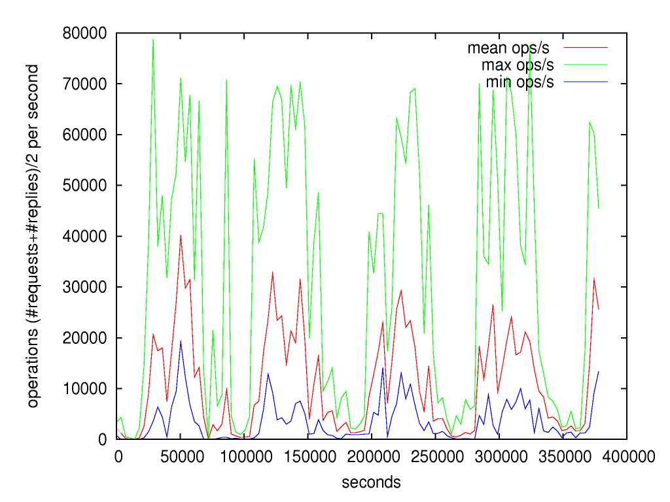
HP-NFS example Data
2003-2004 NFS traces at feature animation company (0.5TB)
2006-2007 traces in progress(3+TB)
LSF (batch cluster) metadata from 1997-present
Link to traces from DataSeries page
Ops/s for 60s intervals, then min/avg/max over 1 hour. animation-bear/nfs-1/set-18

Slide 10
Conclusion
Useful tool for storing and analyzing traces
Potential interesting research problems
  Performance robustness of parallel programs
  Parallelizing analysis
Available from: http://tesla.hpl.hp.com/opensource/
Link to data from there
Will be on SNIA IOTTA site: http://iotta.snia.org/

