Slide 1
DBT Best Practice
L’oreal

Slide 2
DBT Flow
Layers
DBT Tests for Unique and Not Null
Landing
Staging
Core-Dimensional tables
Core-Fact tables
Publish
Source Freshness

Slide 3
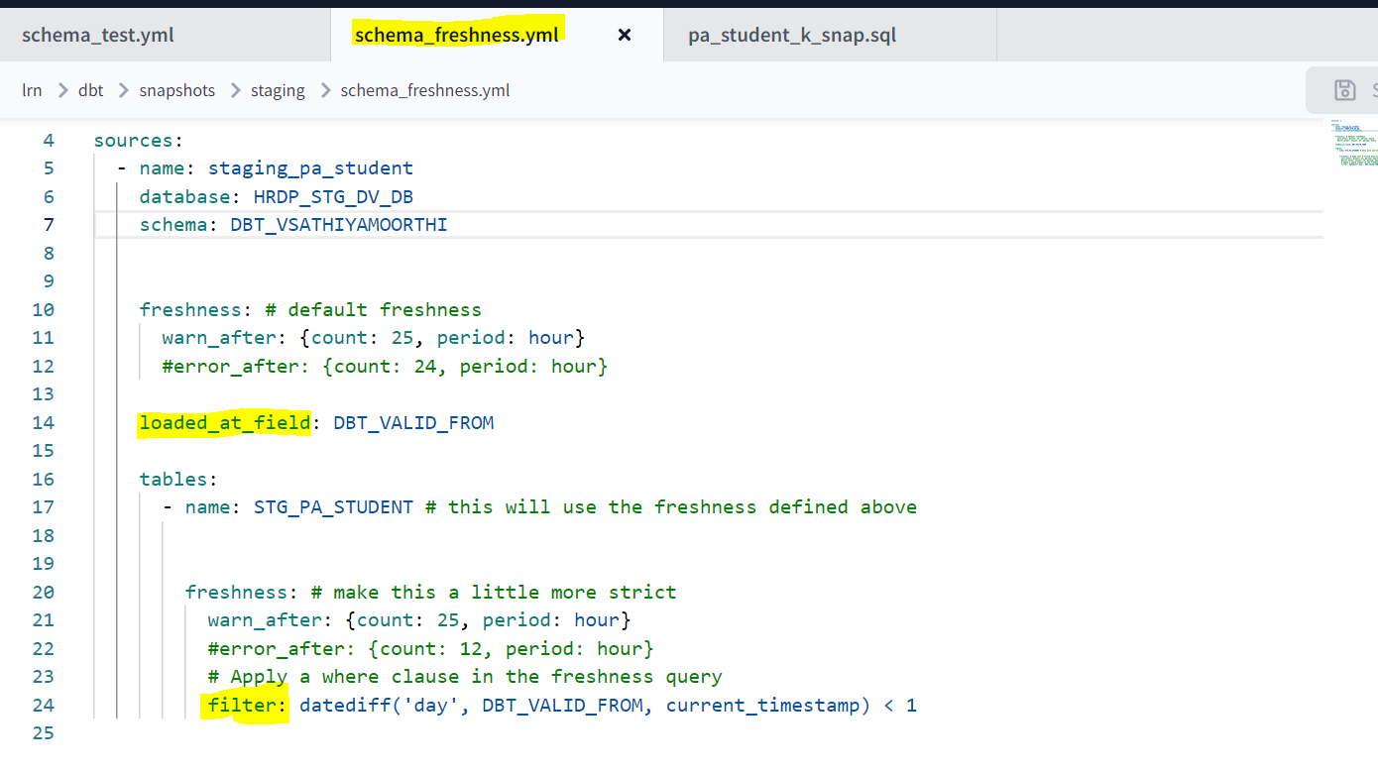
DBT Source Freshness
The source freshness is implemented in the PA_STUDENT staging table to see whether the table is daily updated with delta records. Here we have two options for failure, whether it has to abort or warn. We show warning in the below examples.

Slide 4
DBT Standards & Guidelines
IDE Developer Schema
In development, dbt will build your models into a schema with this name. This schema name should be unique to your personal development environment and should not be shared by other members of your team.
Command to run automatic dependency
As per our requirement, dbt will automatically handle the dependency using lineage by below command
Dbt build – model name
Dbt run – folder name (this will run all the models under this folder which helps in parallelism)
Dbt run –s m1 m2 m3 (In case we need some manual dependency, in that scenario we must use this command instead of multiple dbt run commands)

Slide 5
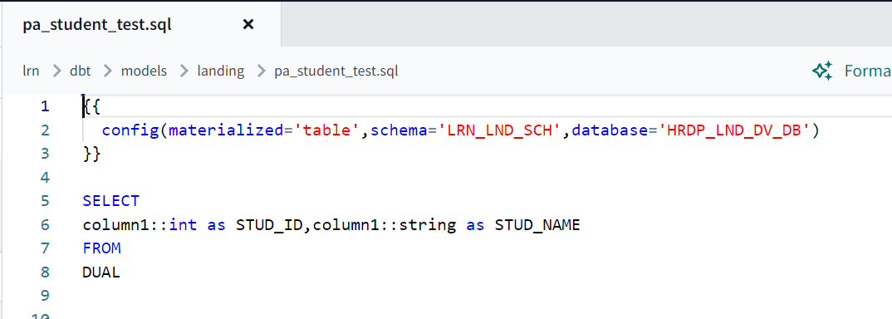
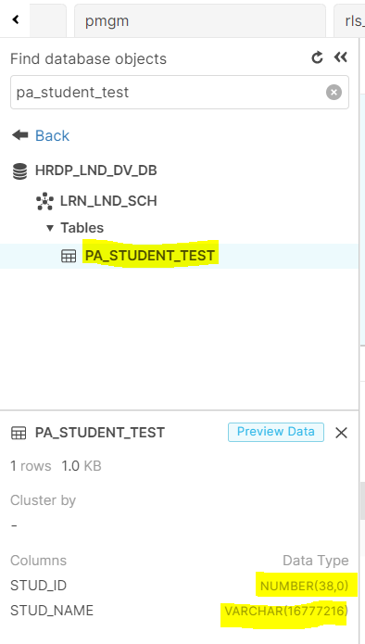
Landing table creations
Going forward we will create the model like below snippet using the dual table and this can be run in all the region from DBT jobs will create tables in all the regions.

