Slide 1
DBT
L’oreal

Slide 2
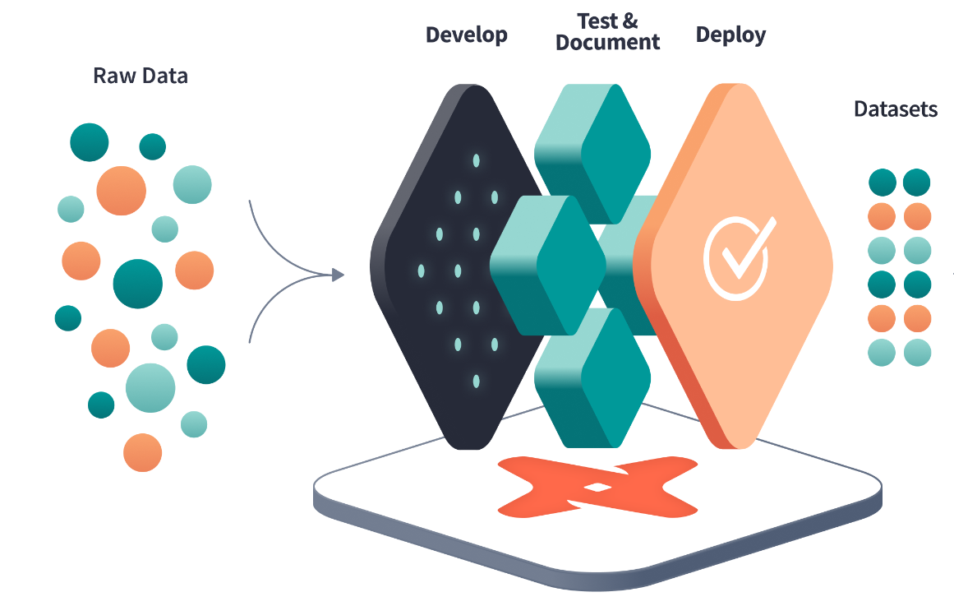




WHAT IS DBT?
dbt (Data Build Tool) is an open-source Python application that uses modular SQL queries to allow data engineers and analysts to transform data in their warehouses

Slide 3
DBT Layers
How we implemented in our project
DBT Tests for Unique and Not Null
Landing
Staging
Core-Dimensional tables
Core-Fact tables
Publish
Source Freshness

Slide 4
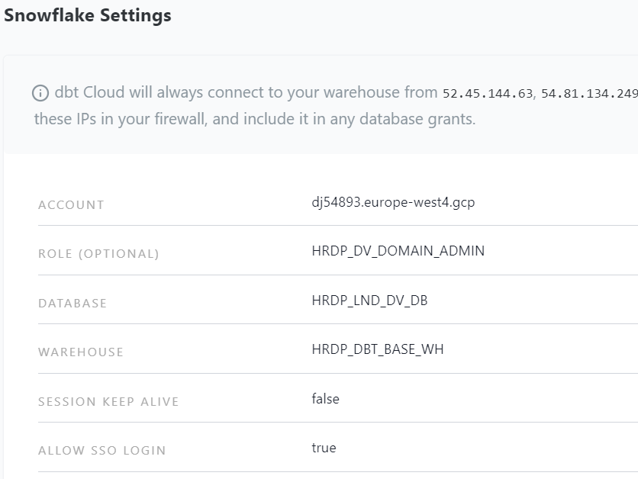
Project Setup
Create a Connection
dbt Cloud uses this connection to connect to your database when running jobs and transformation queries.

Slide 5
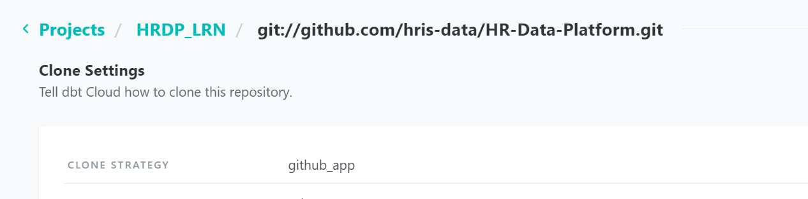
Project Setup cont’d…
Connect a Repository
dbt Cloud plugs directly into your version control system (GitHub, GitLab, BitBucket, etc) to pull the latest version of your dbt project.

Slide 6
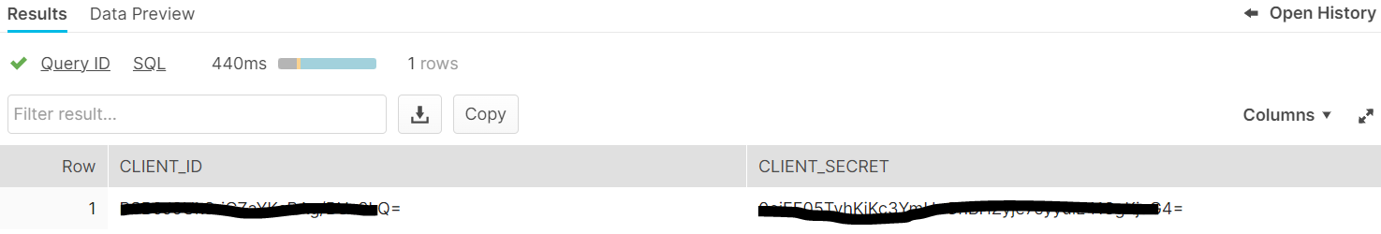
Snowflake OAUTH
CREATE OR REPLACE SECURITY INTEGRATION DBT_CLOUD
TYPE = OAUTH
ENABLED = TRUE
OAUTH_CLIENT = CUSTOM
OAUTH_CLIENT_TYPE = 'CONFIDENTIAL'
OAUTH_REDIRECT_URI = 'https://YOUR_ACCESS_URL/complete/snowflake'
OAUTH_ISSUE_REFRESH_TOKENS = TRUE
OAUTH_REFRESH_TOKEN_VALIDITY = 7776000;
Create a Security Integration

Slide 7
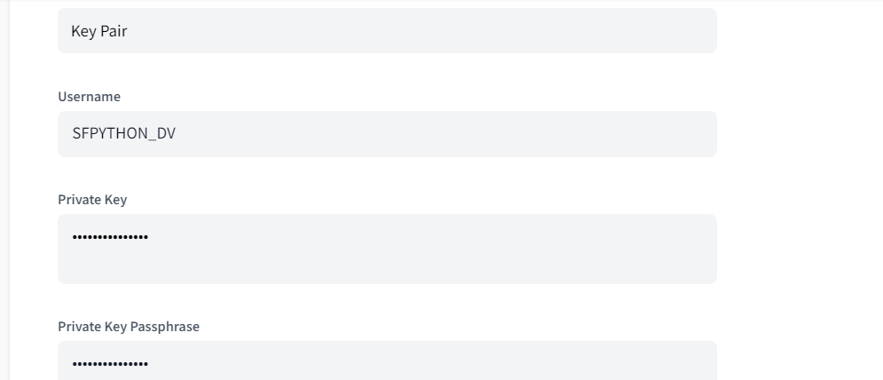
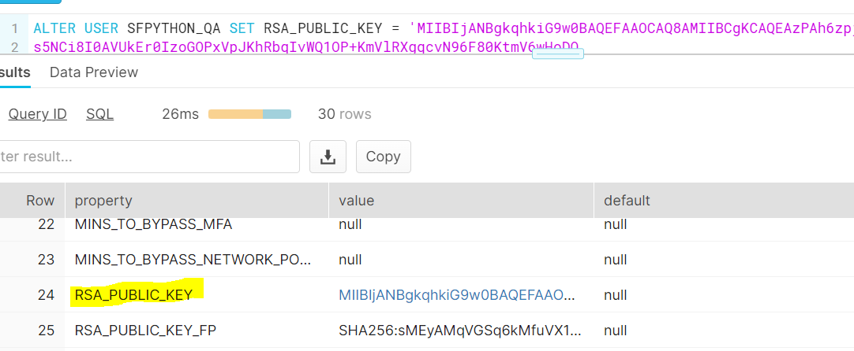
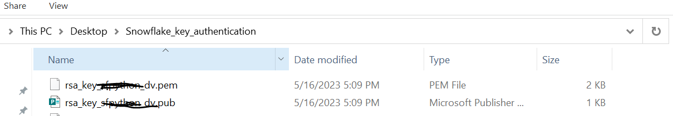
Deployment Key Pair Authentication
Generate and store the Public and Private keys securely
Assign the Public Key to a Snowflake User

Slide 8
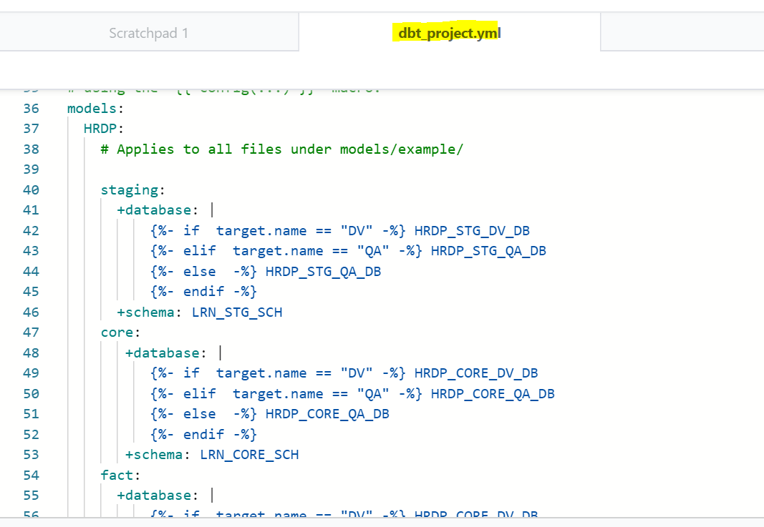
Project YAML
Every dbt project needs a dbt_project.yml file — this is how dbt knows a directory is a dbt project. It also contains important information that tells dbt how to operate on your project.

Slide 9
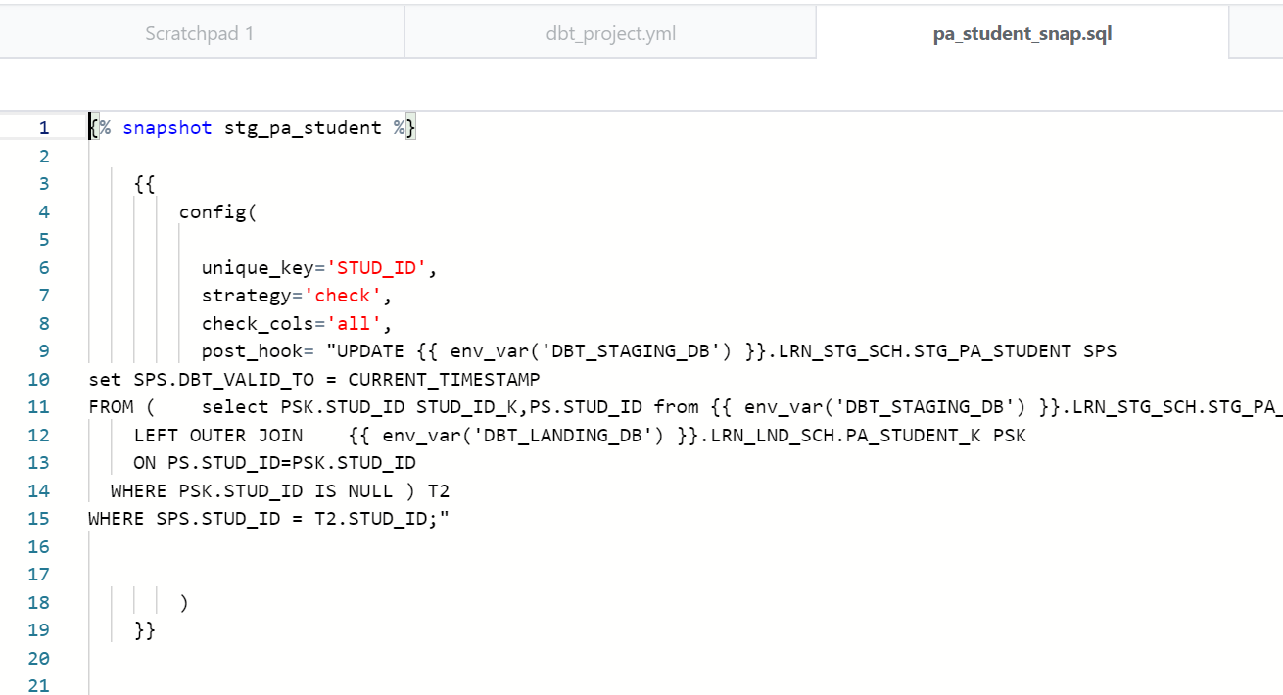
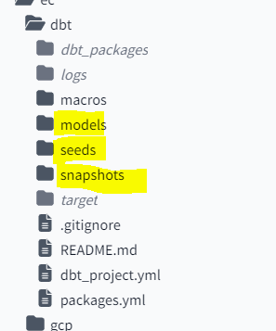
Folder Structure
SNAPSHOT
Snapshot is taken care of SCD Type 2 by having additional audit columns like DBT_VALID_FROM, DBT_VALID_TO
Using this Snapshot, the transformation from landing to staging load is maintained
Landing layers are truncate and load and in staging layer the historical records are available.

Slide 10
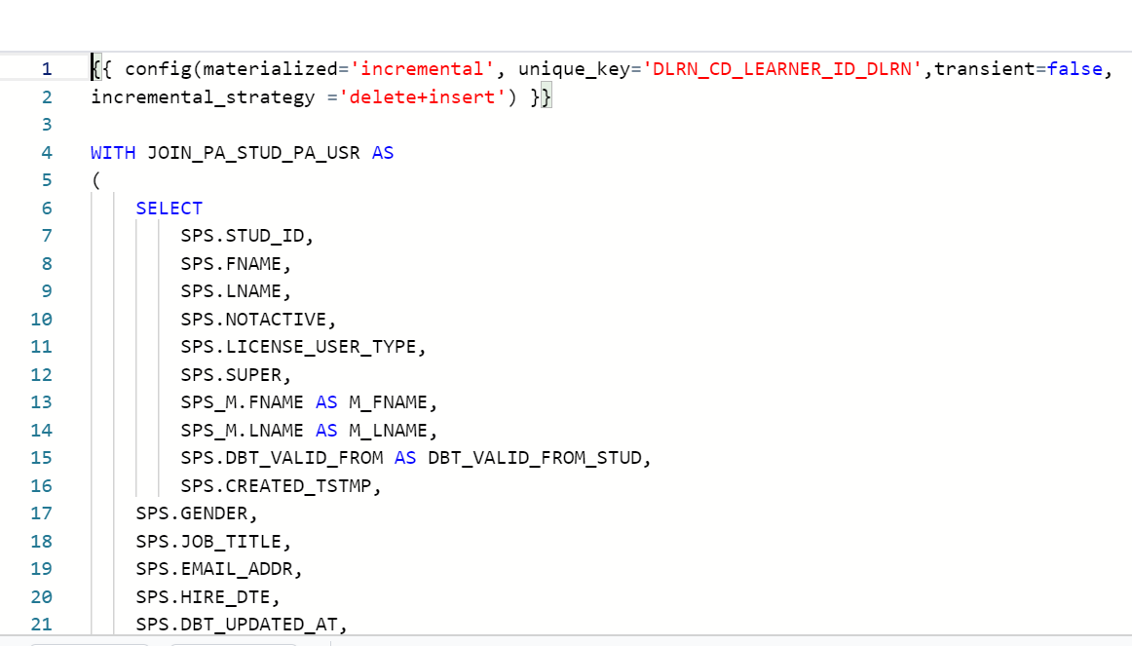
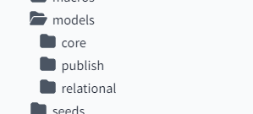
Folder Structure cont’d…
Models
Using Model folder, the transformation from Staging to Core is maintained
In core layer, the flow from staging tables to dimensional tables and dimensional tables to Fact tables are maintained using job dependency.
All the dimensional tables are SCD Type 1 and it is handled by incremental option.

Slide 11
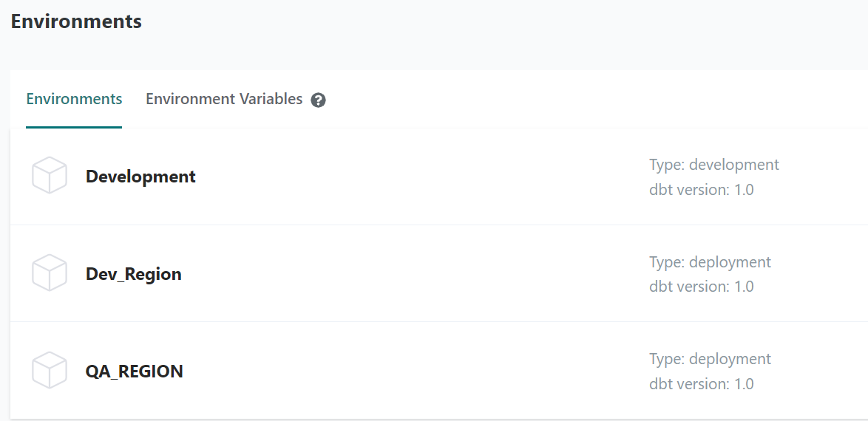
Environments
In software engineering, environments are used to enable engineers to develop and test code without impacting the users of their software.
“Production” (or pd) refers to the environment that end users interact with, while “development” (or dv) is the environment that engineers write code in. This means that engineers can work iteratively when writing and testing new code in development, and once they are confident in these changes, deploy their code to production.

Slide 12
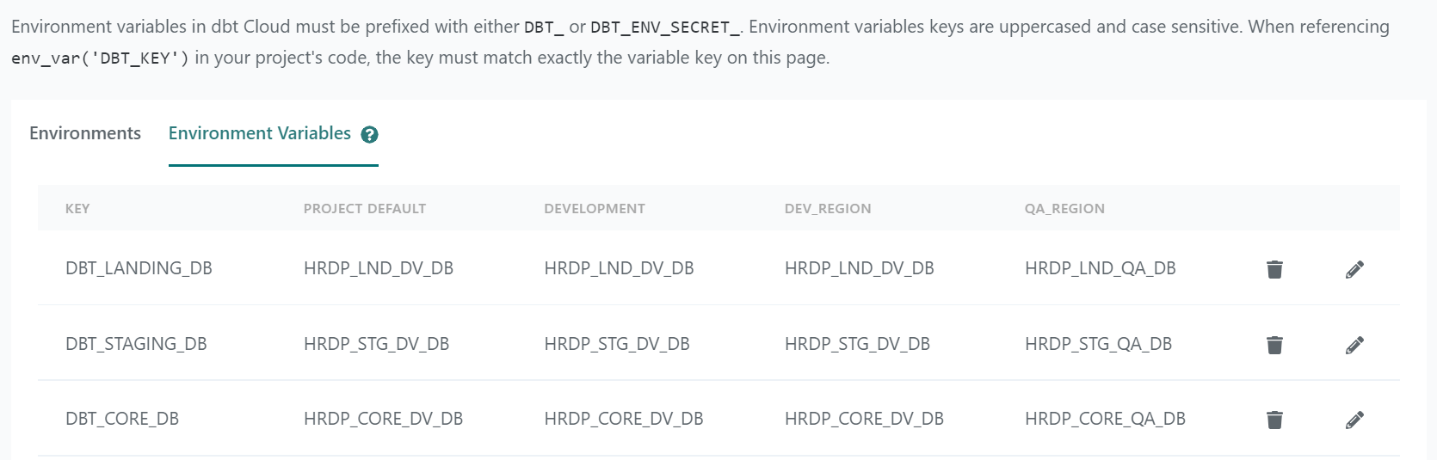
Environment cont’d…
Environment Variables
The env_var function can be used to incorporate Environment Variables from the system into your dbt project.

Slide 13
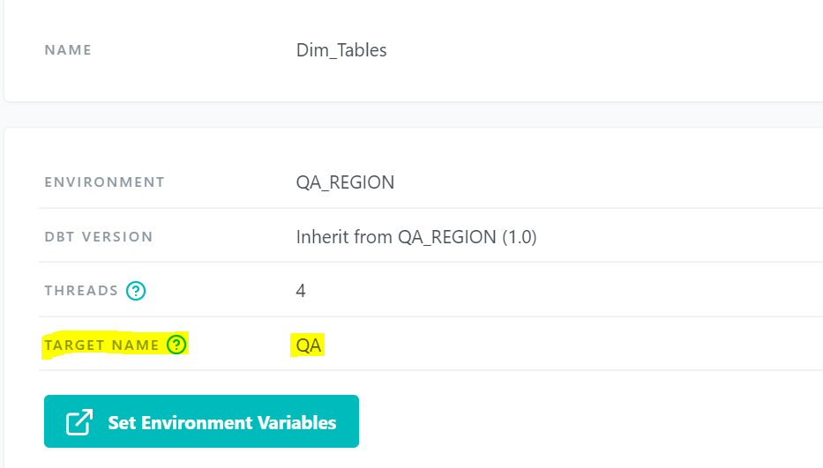
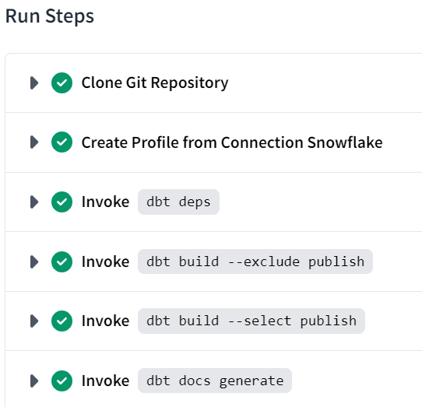
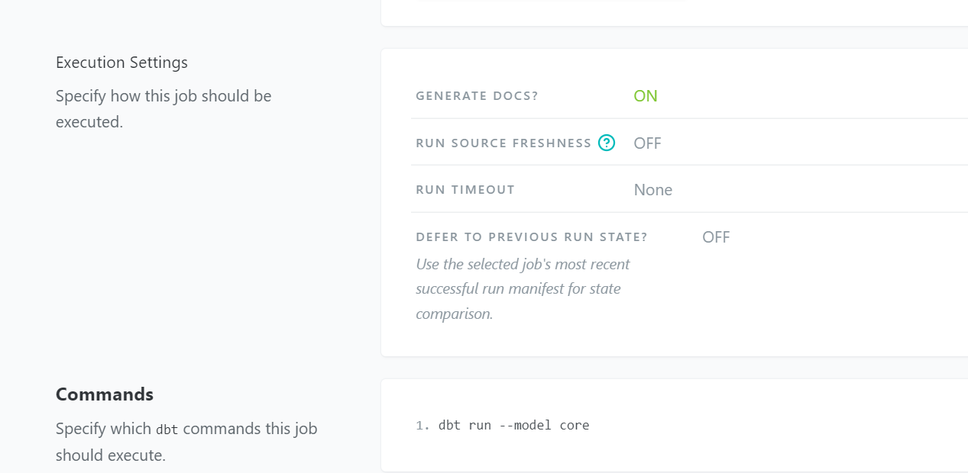
JOBS
Jobs are a set of dbt commands that you want to run on a schedule

Slide 14
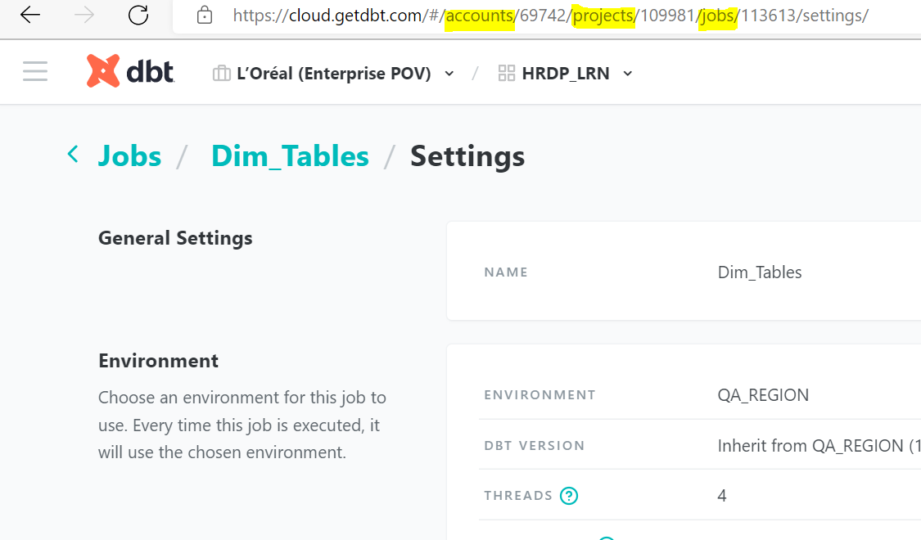
Jobs Cont’d…
The created Jobs are triggering from Apache Airflow using the below ID’s
Account ID
Project ID
Job ID

Slide 15
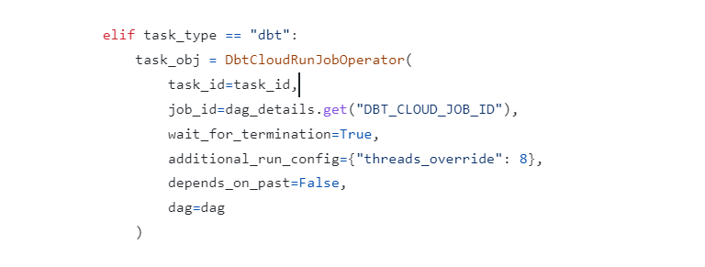
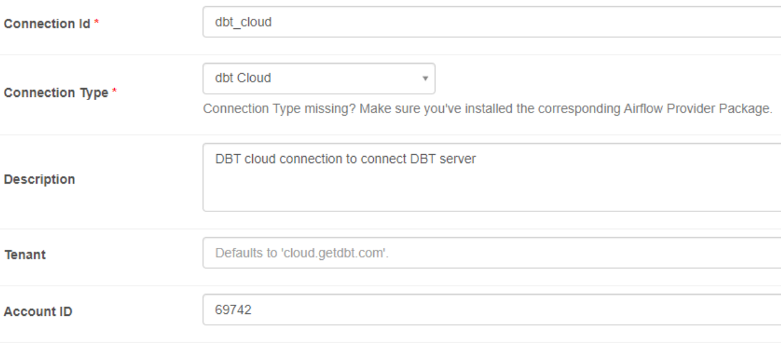
Airflow calling DBT Operator

Slide 16
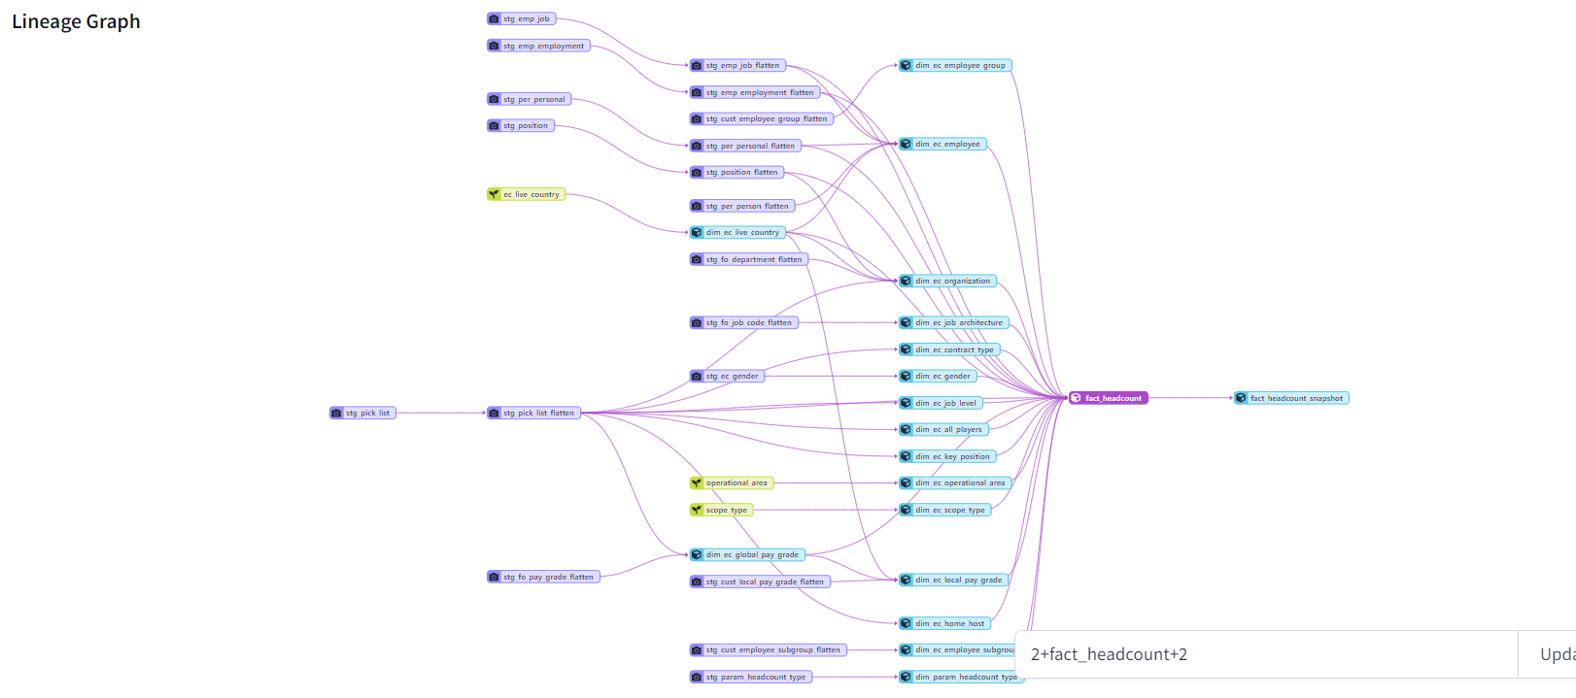
DBT Lineage
With the help of lineage dbt is capability of find the dependency automatically

Slide 17
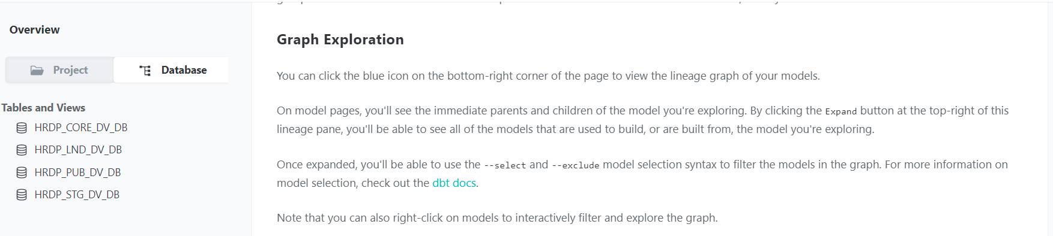
DBT Docs
Welcome to auto-generated documentation for your dbt project! With project tab, Database tab and lineage graph.

Slide 18
Thank you

