Slide 1

BROOKLYN & QUEENS
Rental Statistics

Slide 2
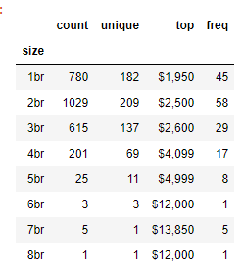
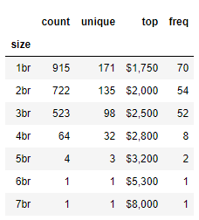
Goal: Is Brooklyn or Queens a better deal for renters?
Brooklyn- $2963 Average Price
Queens- $2175 Average Price

Slide 3
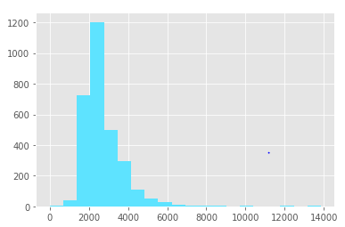
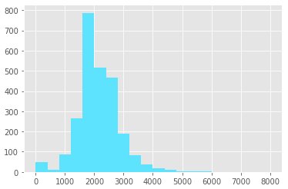
GRAPH Of Price Distribution
Brooklyn
Queens

Slide 4
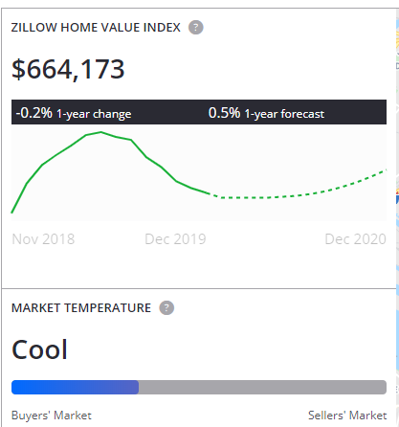
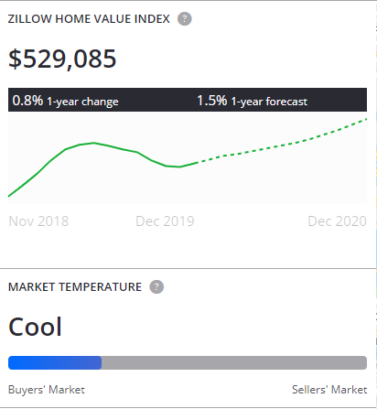
Zillow Price Data Brooklyn vs. Queens
Brooklyn
Queens

Slide 5
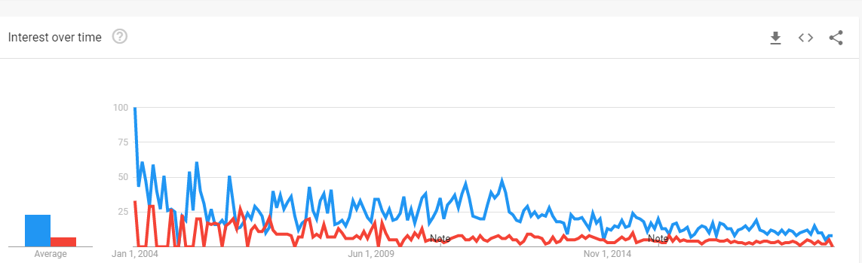
Google Trends Brooklyn (Blue) Vs. Queens (Red). Last Convergence April 2016

Slide 6
Conclusion
Brooklyn- 224 payments to buy (8.5% more expensive)
Queens- 243 payments to buy
Brooklyn is better place to rent:
Better value than Queens because buying expensive.
Brooklyn Median prices going up faster. 2.67 vs. 2.10 since 2003.
https://www.millersamuel.com/charts/brooklyn-housing-market-average-sales-price-unadjusted/
https://www.millersamuel.com/charts/queens-housing-market-median-sales-price-v-average-sales-price/

