Slide 1
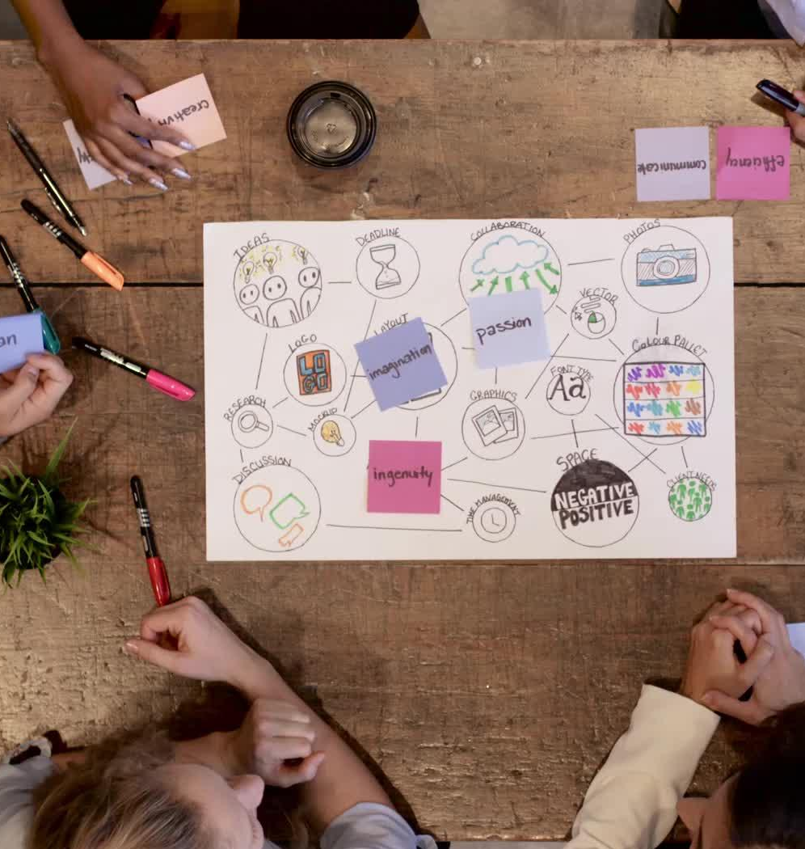
CampusTix Final Report
CCNY - CSC 336
By: Team 1234
Bryan Dong, Sushanta Sapkota, Joseph Helfenbein, Pragyam Tiwari, Sajid Patwary, Tanvir Islam

Slide 2

Demo Agenda
10-12 minutes
1. Agenda
2. Introduction/brief Job Delegation and Team Work
3. Use Cases/Actions
4. Landing Demonstration
5. User Action Demonstration (following #3)
6. Stored Procedures Demonstration
7. 2NF Relational Model Diagram (final)
8. Takeaways from the project with practical database implementation
9. Extra Credit Work
10. Questions and Examination
11. Submission and Grading

Slide 3




Introduction
We are Team 1234, who worked together to complete this project.
E-Campus: A ticket selling platform for organizations on college campuses.
Vite+React, Node.js, Java, postgresql (neon), Docker, Google Cloud
A simple percent fee for every ticket sold

Slide 4
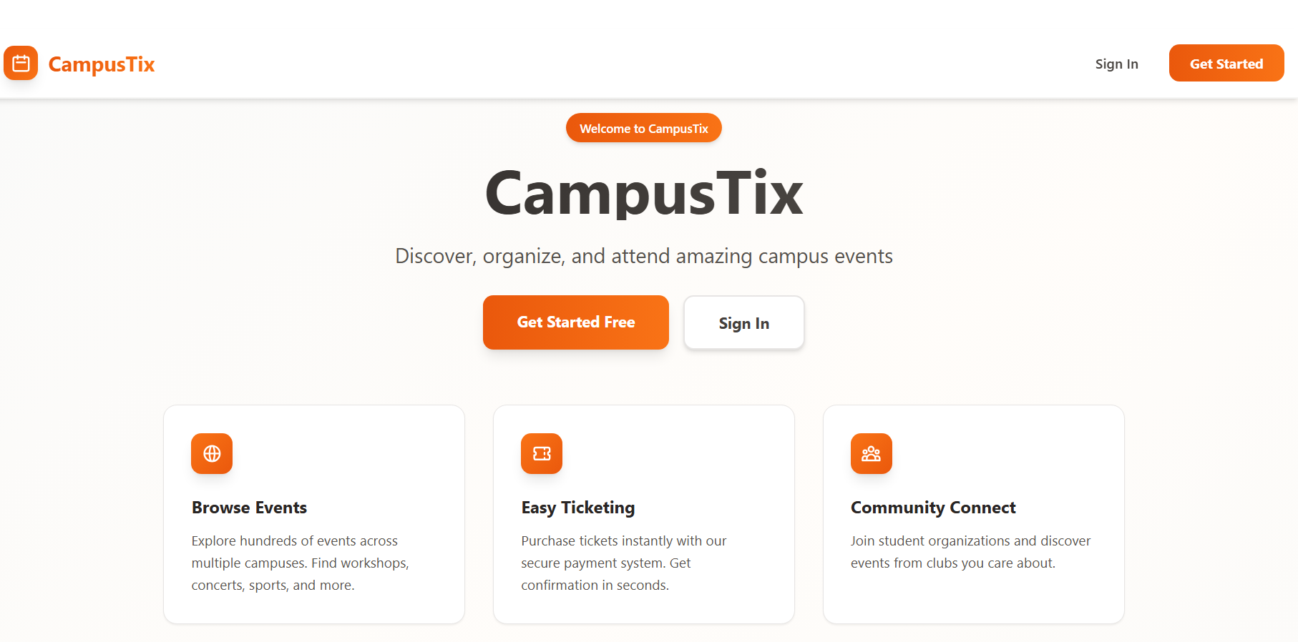
CampusTix Landing Page

Slide 5
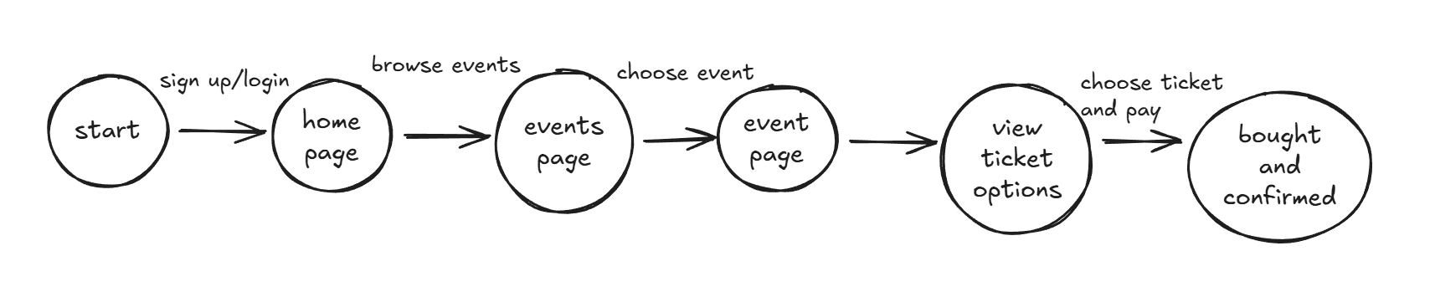
Buying Ticket Use Case
This use case shows how a customer/student can buy a ticket for an event, which is how we, the app owners, will be generating revenue.
We will now show this use case on the web application.

Slide 6
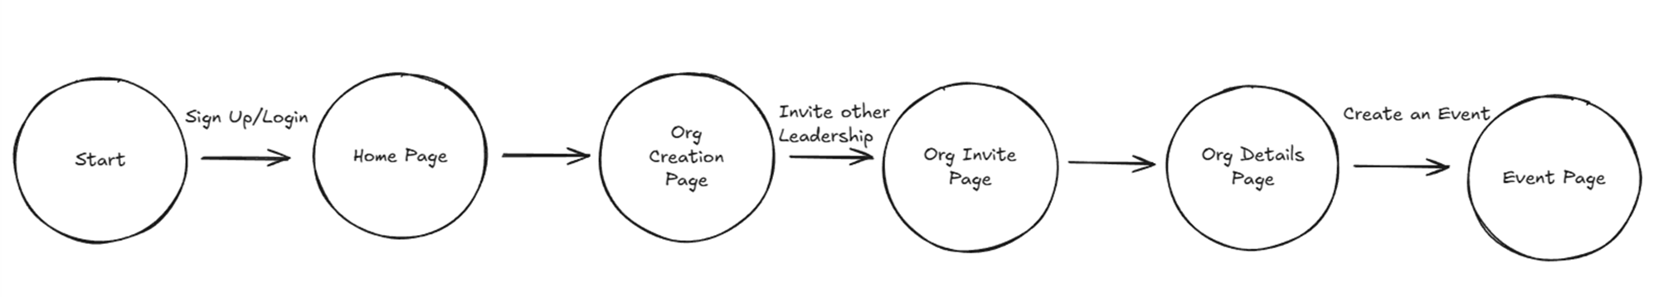
Creating Organization Use Case
This use case shows how an organization can be created within our application by some students. This newly formed group of students can then create events and sell tickets, generating revenue for their organization and our application.
We will now show this use case on the web application.

Slide 7
User Action Demo (i think this is error in the format because we have already done this above)
DEMO Live one valid user action within the project, such as registration, purchasing, or interacting with the recommendation engine, highlighting the user experience and functionality. (via such as Web Page, App UI, Jupiter Editor, Visual Studio, Java IDE)

Slide 8
Revenue Demo from App
We will now show the simulated revenue projections based on how the application’s potential earnings may look if it was deployed and promoted to colleges.

Slide 9
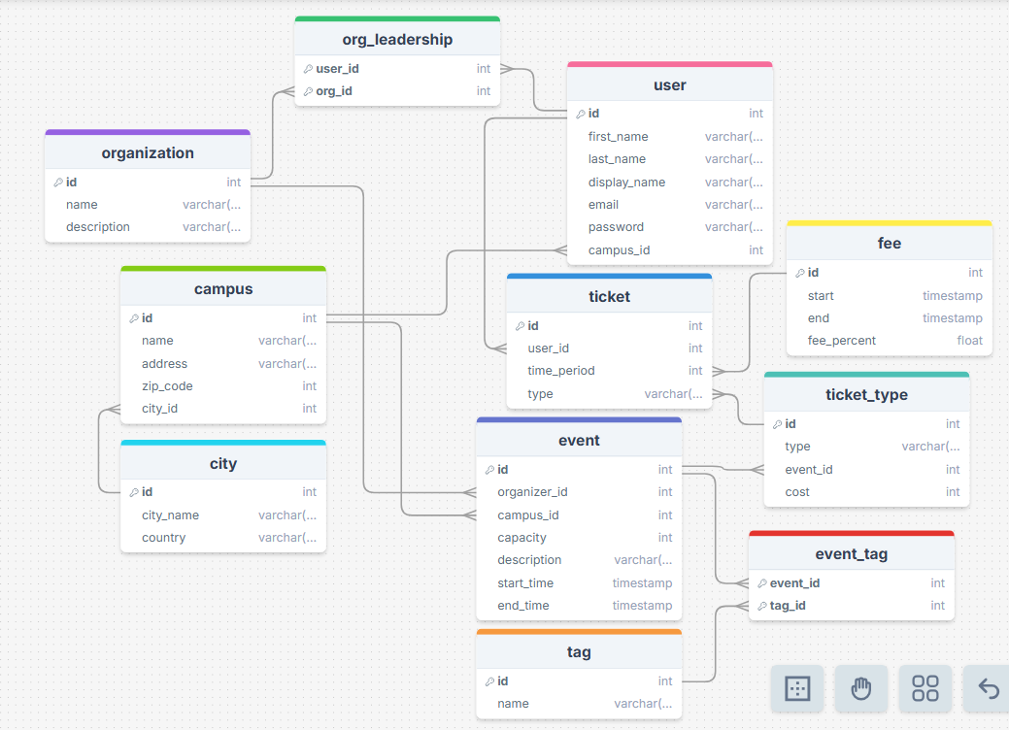
2NF Relational Model Diagram
This is our updated relational model diagram. The biggest change is the addition of a fee table, to showcase how the application will earn money. This fee table allows us to implement a different policy for fees taken for specific reasons like a promotional period.

Slide 10
Stored Procedures Demonstration
get_user_ticket_count: This stored procedure allows us to have only one place for the code, which can be easily modified, making it easier for us to modify the code if we potentially evolve the schema in the future.
get_event_analytics: This stored procedure has the above benefit and also allows us to do all the statements of the functionality in a simple line, making our code more understandable.
Other stored procedures: delete_event_cascade, get_tickets_sold, check_event_capacity, purchase_ticket, register_user, add_org_leader, etc
Notes:
Go to showcase their use

Slide 11
Takeaways
During this project, we used Google Cloud Pub/Sub along with websockets in our application. This combination of new features allowed us to develop our application to be more advanced, having closer functionality to actual enterprise applications, rather than more simplistic student projects that might refresh the page for every update, no matter how small. This use of this technology was useful not just for the application, but for us to learn about real world development practices.

Slide 12
Extra Credit Work
Docker: We containerized our frontend and our backend, standardizing our web application for local and cloud use.
Hosted on Google Cloud: The frontend and backend are hosted as 2 separate Google Cloud Services. We also utilized Google Cloud Pub/Sub for real time functionality, connected to a websocket on the backend.
AI integration: User can describe an event via text and then have the AI select, based on that description, specific details of the event like name, description, tags, and time as specified by the user prompt.

Slide 13

Questions and Examination
Any Questions?
Notes:
Allocate 5-8 minutes for questions and examination to address any queries or concerns from the audience.

Slide 14
Submission for Grading
Submit your full project, incl. Diagram, Stored Procedures, Application, UI, Power Point for Demo, Via Github Classroom
Cut Off Time midnight before your presentation.

