Slide 1

SnapEats
A Local Restaurant Ordering
and Delivery System
CCNY - CSC 336 Intro to Database System
Group 3363
Fatoumata Drammeh
David Girgis
Md Mamun
Oumar Kante
Qiuming Wang
Xinhang Yang

Slide 2




Introduction
Team Member
SnapEats Business Idea and Services
Full Tech Stack
Profit Model

Slide 3
Team Member
Front End
Xinhang Yang
Oumar Kante
Md Mamun
Back End
Qiuming Wang
Fatoumata Drammeh
David Girgis

Slide 4
SnapEats Business Idea and Services
Problem:
Local Restaurants often lack the digital infrastructure to manage online orders efficiently.
Solution:
Create an affordable, centralized system that connect customers, restaurants, increasing revenue and operational efficiency.
Concept:
An ordering and delivery platform designed for local restaurants where customers can place food orders online, restaurants manage menus and orders.

Slide 5







Full Tech Stack
1
Front End
2
Back End
3
Database
4
Collaboration Tools

Slide 6
Profit Model
Take rate: SnapEats earns 10% of each order’s total value (platform fee).
Scope: Applies to all restaurants and all successful orders (pending/confirmed/completed; cancelled excluded).
Tracking: Profit = Order Total × 10%, stored and visualized in the Revenue Report dashboard.
Views: Filterable by time (week/month/season/year) and by restaurant; exportable to CSV for finance.
Data flow: Frontend checkout → Orders & OrderItems in MySQL → Revenue Report aggregates and charts profit.

Slide 7
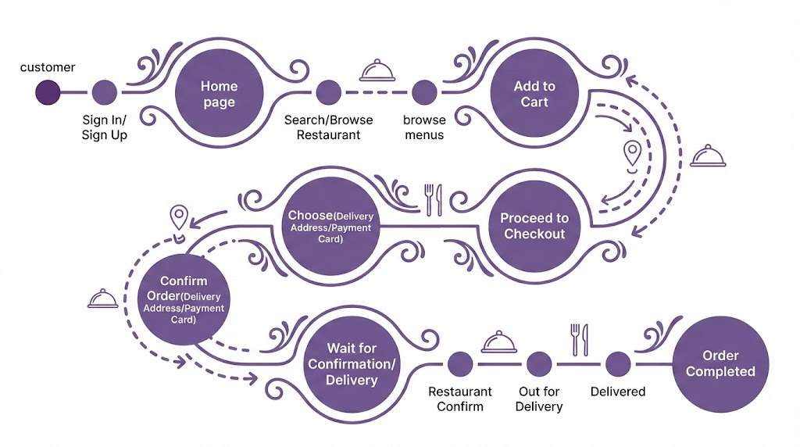
User Journey 1
Customer User Journey

Slide 8
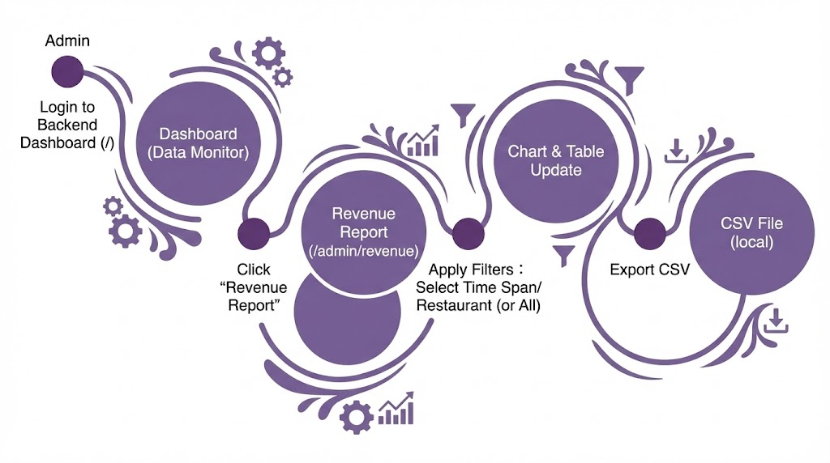
User Journey 2
Admin User Journey

Slide 9
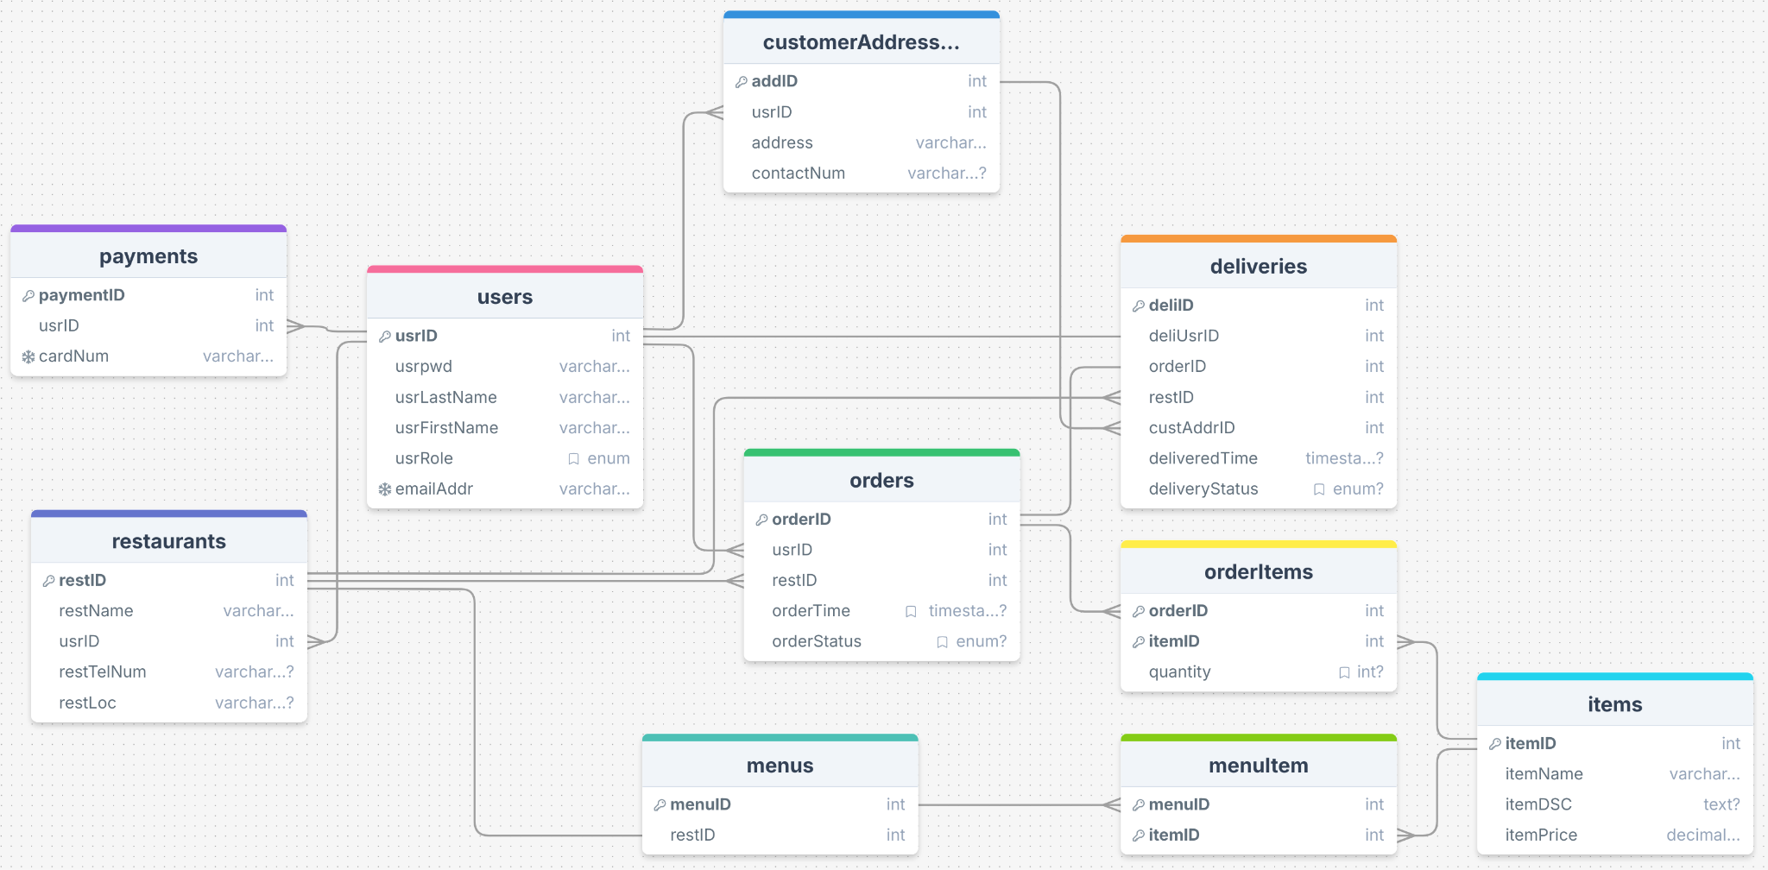
2NF Relational Model Diagram

Slide 10
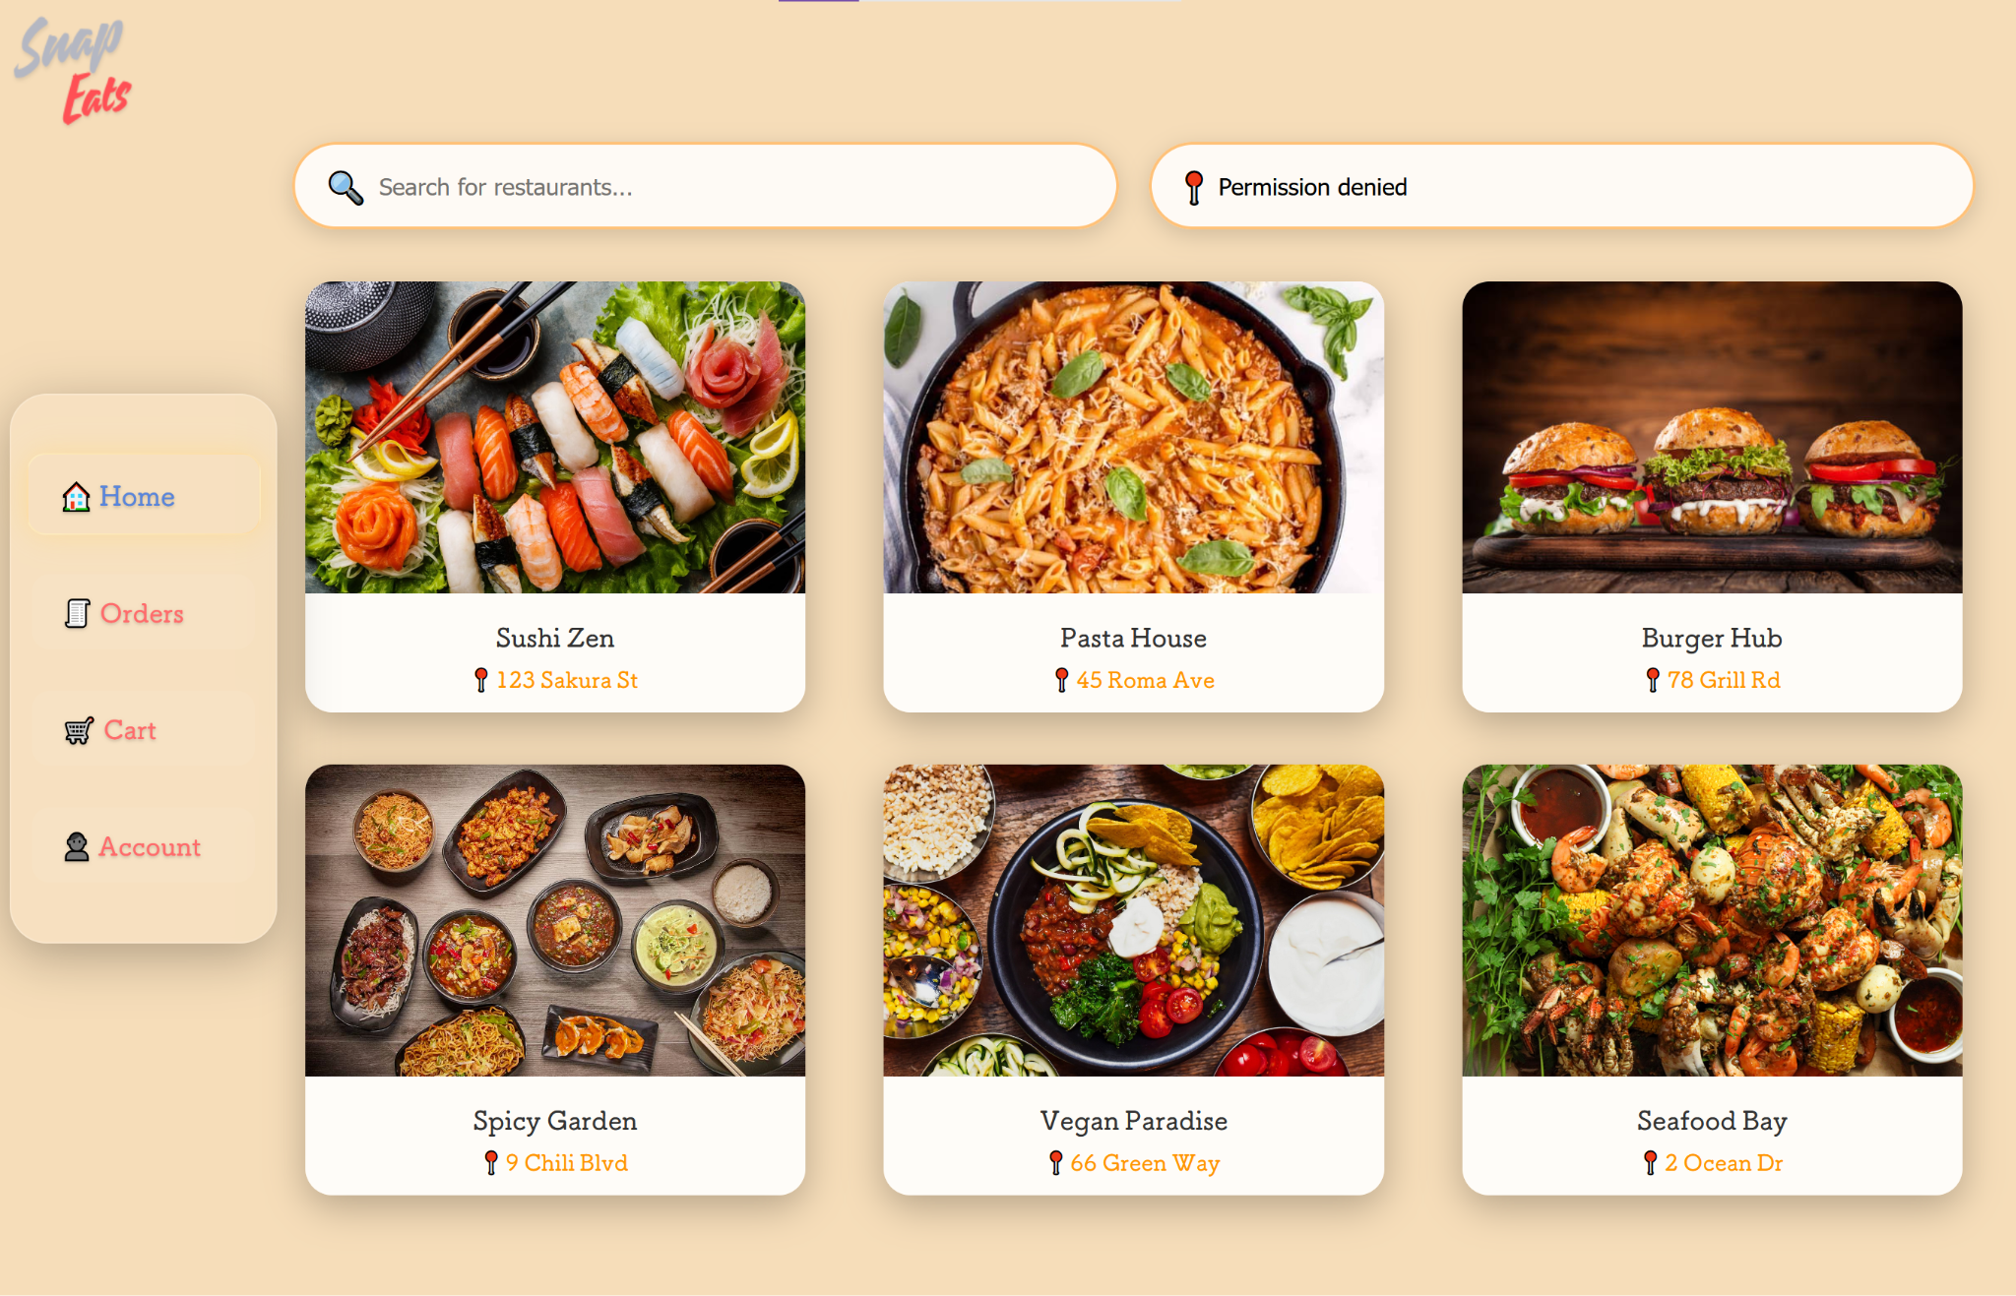
Landing Page Demo

Slide 11
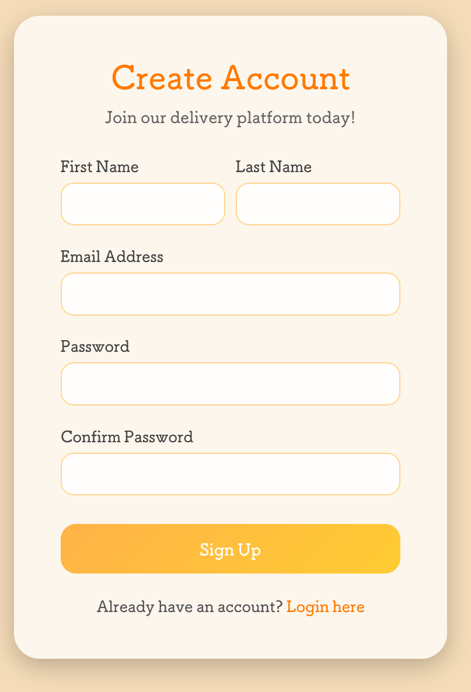
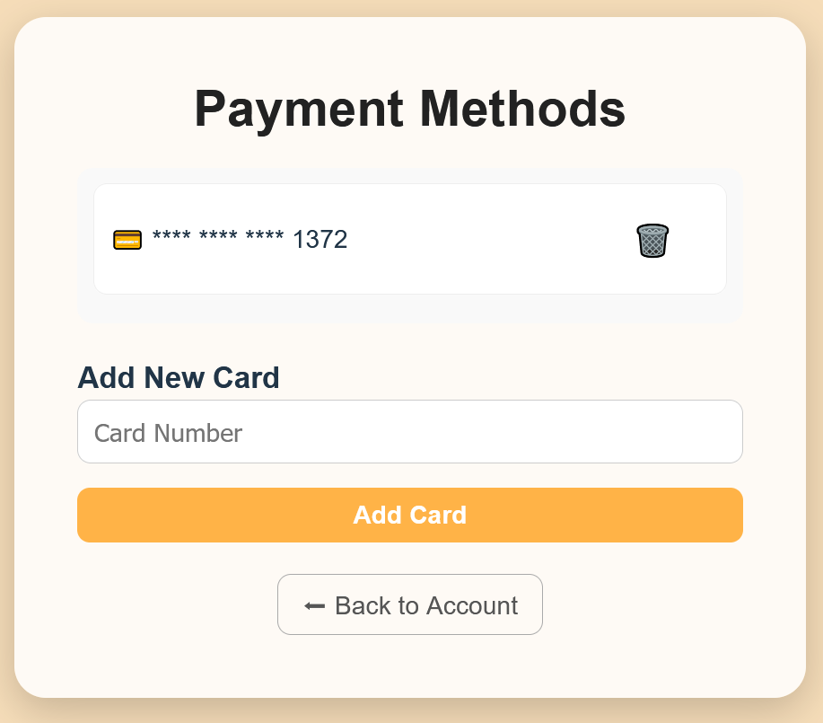
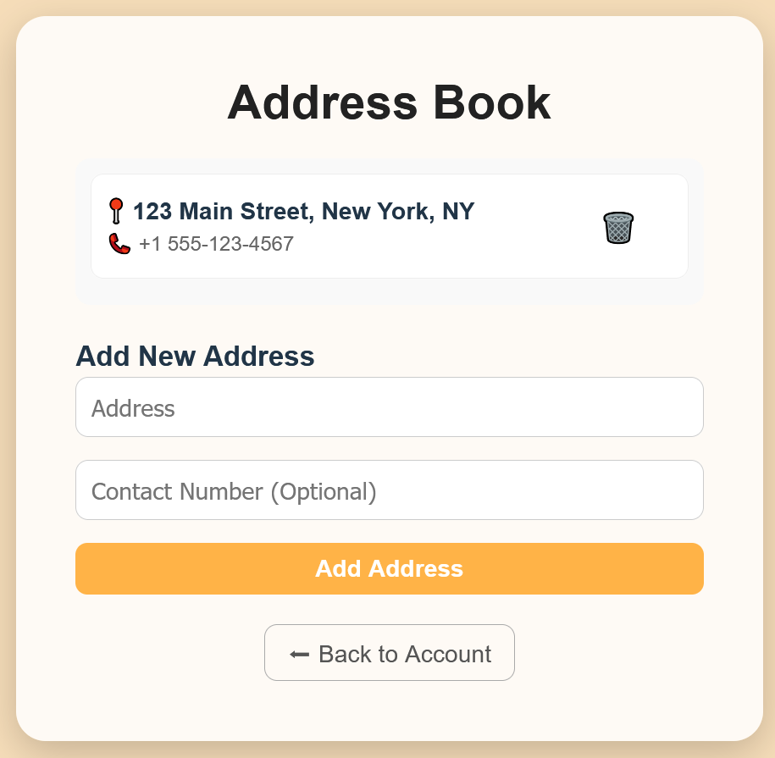
User Action Demo
Customer Sign Up, Add Delivery Address & Payment Card

Slide 12
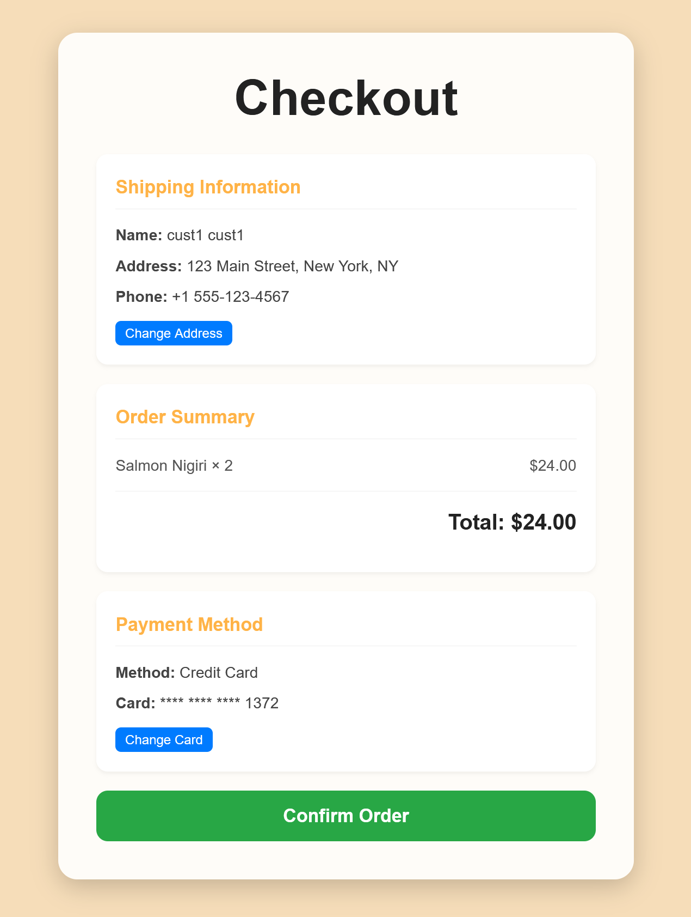
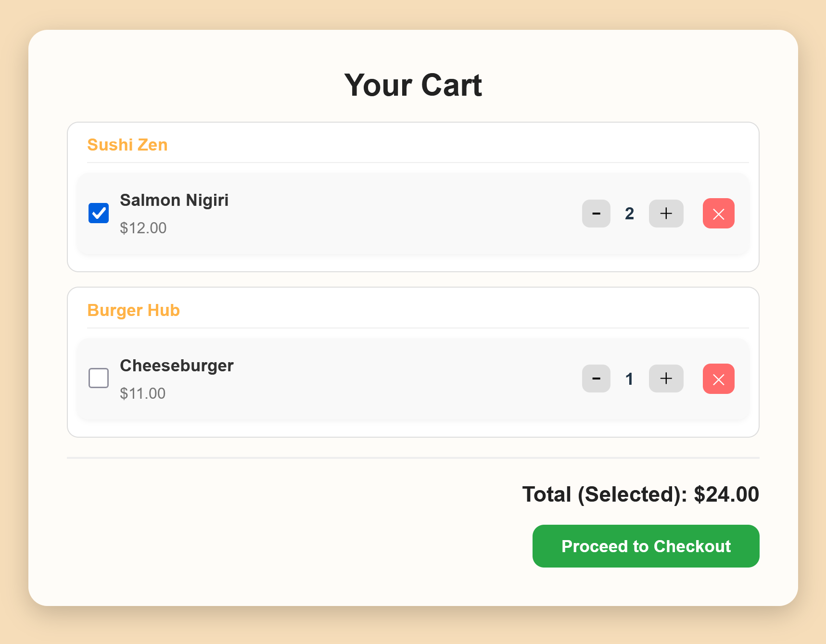
User Action Demo
2. Customer Add Dish(es) to Cart & Check out

Slide 13
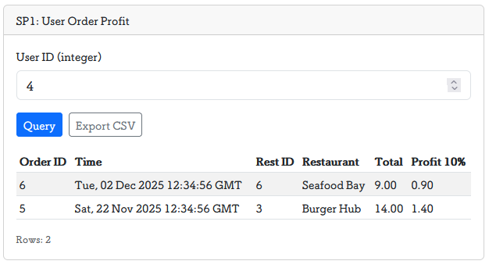
Stored Procedures Demo
Stored Procedure 1: sp_user_order_profit
Purpose: For a given user, return every non-cancelled order with its total amount and the platform profit (10% of the order total).
Inputs: pUserId (INT)
Output fields: orderID, orderTime, restID, restName, totalAmount, profit (10%)
Why it helps: Encapsulates multi-table aggregation in the DB, reducing duplicate SQL in the app and cutting round-trips/compute on the backend.

Slide 14
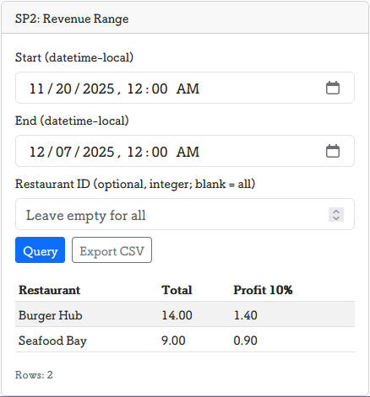
Stored Procedures Demo
Stored Procedure 2: sp_revenue_range
Purpose: Aggregate total revenue and platform profit (10%) over a date range, optionally filtered by a specific restaurant.
Inputs: pStart (DATETIME), pEnd (DATETIME), pRestId (INT, nullable for “all restaurants”)
Output fields: restName, totalAmount profit (10%)
Why it helps: Centralizes time-window + restaurant-level reporting logic; lets the DB do the heavy aggregation, which improves performance and keeps reporting logic consistent across the app.

Slide 15
Takeaways
New technology used this project/semester
Docker
One definition, run anywhere, same environment
Dependency isolation
Demo-friendly
Gains from the Dynamic Database Project
Moving from hardcoded data to live MySQL with CRUD (Create, Read, Update & Delete) (users, restaurants, menus, orders, address book, payments) clarified relational design: PK/FK integrity, JOIN-based views, and how ENUM status drives UI logic (e.g., cancellable only when pending/confirmed).
Seeing the Admin dashboard and Revenue Report update instantly after frontend actions cemented the “single source of truth” concept.

Slide 16
Extra Credit Work

Slide 17
Thank You
Questions & Examination

