Slide 1

TicketR
Team : 4343
(Linwei, Shaeem, Miad, Firda, Nischal, Mohmed)
11/3/2025

Slide 2
IDEA?
TARGET?
WHY INVEST?
A system for campus events
Sell tickets
Create events
Generate attendance
Review Revenue Report
Event related activities
Campus organizations
Visitors
Students
Growing Market with Increased Demand:
Student events, Greek life
New students every year
Ai chat box
Efficient
Revenue:
Promotions/Advertising
Licensing
Take % of ticket sales

Slide 3
How to Profit
Charge Organization for renting an event page base on their attendees from this program.
Provide campus related ads, or event sponsorships.
Recommendation spots for hosts, such as top events.
Large events, holiday discount, encourage more ticket purchases, and event page rentings.
Take 5-10% of ticket sales
VIPs, regular users can have early register spot for event, whereas hosts can have better analysis on attendees.

Slide 4
User Journey
BROWSE
Homepage
AI CHATBOT
SIGN UP/ LOG IN
BROWSE EVENTS
SELECT EVENTS
Enter
ADD TICKET
TO PROFILE
(SIGN IN OR SIGN UP) SELECT PAYMENT
Digital Ticket
Pay and Confirm

Slide 5
ADMIN/ EVENT HOST JOURNEY
BROWSE
Homepage
(SIGN UP/LOG IN) PROFILE
Enter
SIGN UP/ LOG IN
Create a Event
AI CHATBOT
Event State
CHECK
Confirm and Post
EVENT DETAIL

Slide 6
The Stack
Frontend: React for user interface for students, organizers, and admins.
Backend: Python (Flask) for the API layer that connects the frontend to the database.
Database: MySQL for storing persistent data for Users, Events, and Attendance.
Deployment: Docker for containerize each service for easy deployment.
Reporting: Excel for generate attendance, ticket sales, and revenue summaries.

Slide 7




Full Stack Web Development
FRONTEND
(client side)
BACKEND
(server side)
React.js
server
Python
database
MySQL

Slide 8
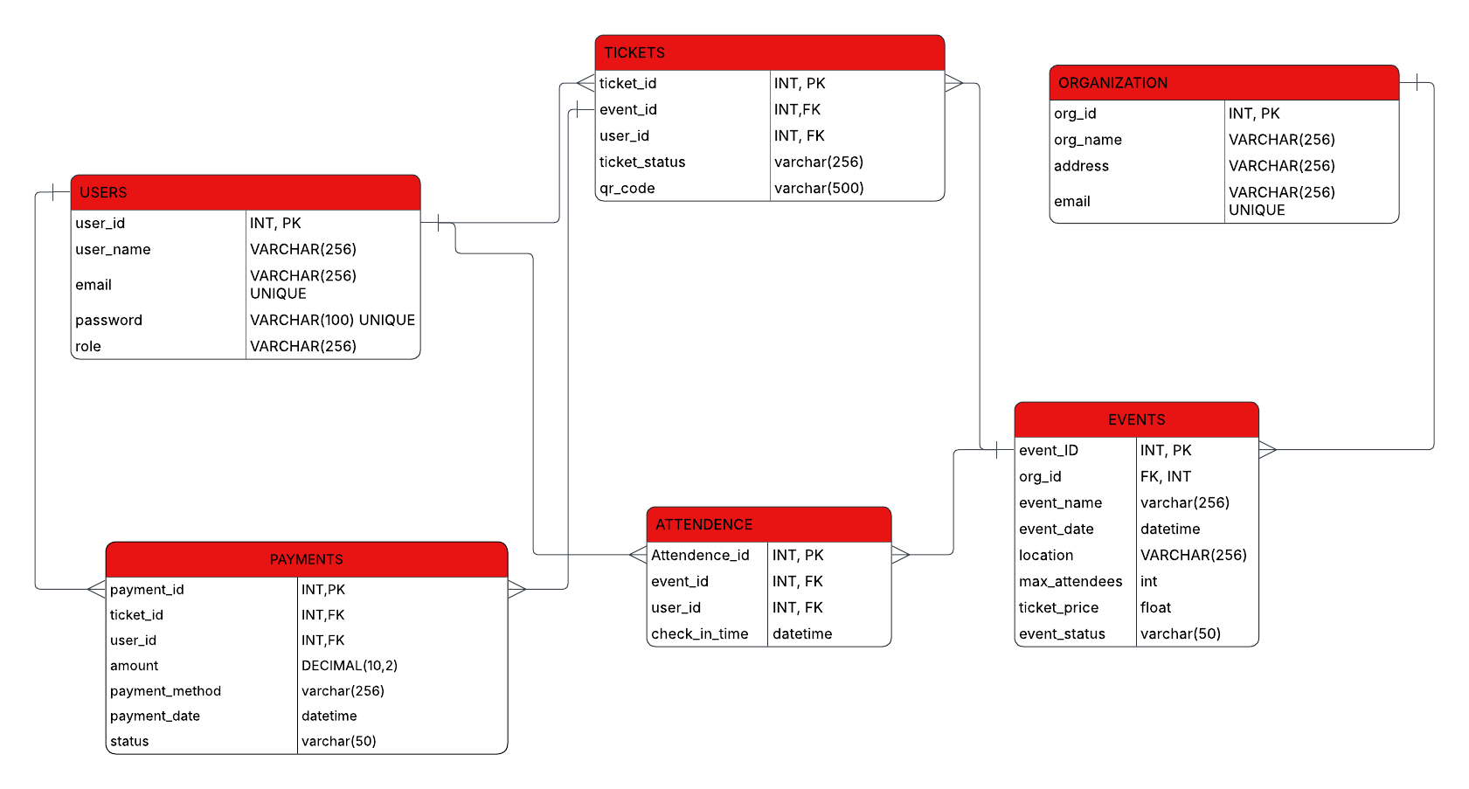
Relational Diagram

Slide 9
Database Entity Relationship
USERS to TICKETS (One-to-Many)
EVENTS to TICKETS (One-to-Many)
USERS to ATTENDANCE (One-to-Many)
ORGANIZATIONS to EVENTS (One-to-Many)
EVENTS to ATTENDANCE (One-to-Many)
USERS to PAYMENTS (One-to-Many)
TICKETS to PAYMENTS (One-to-Many)

Slide 10
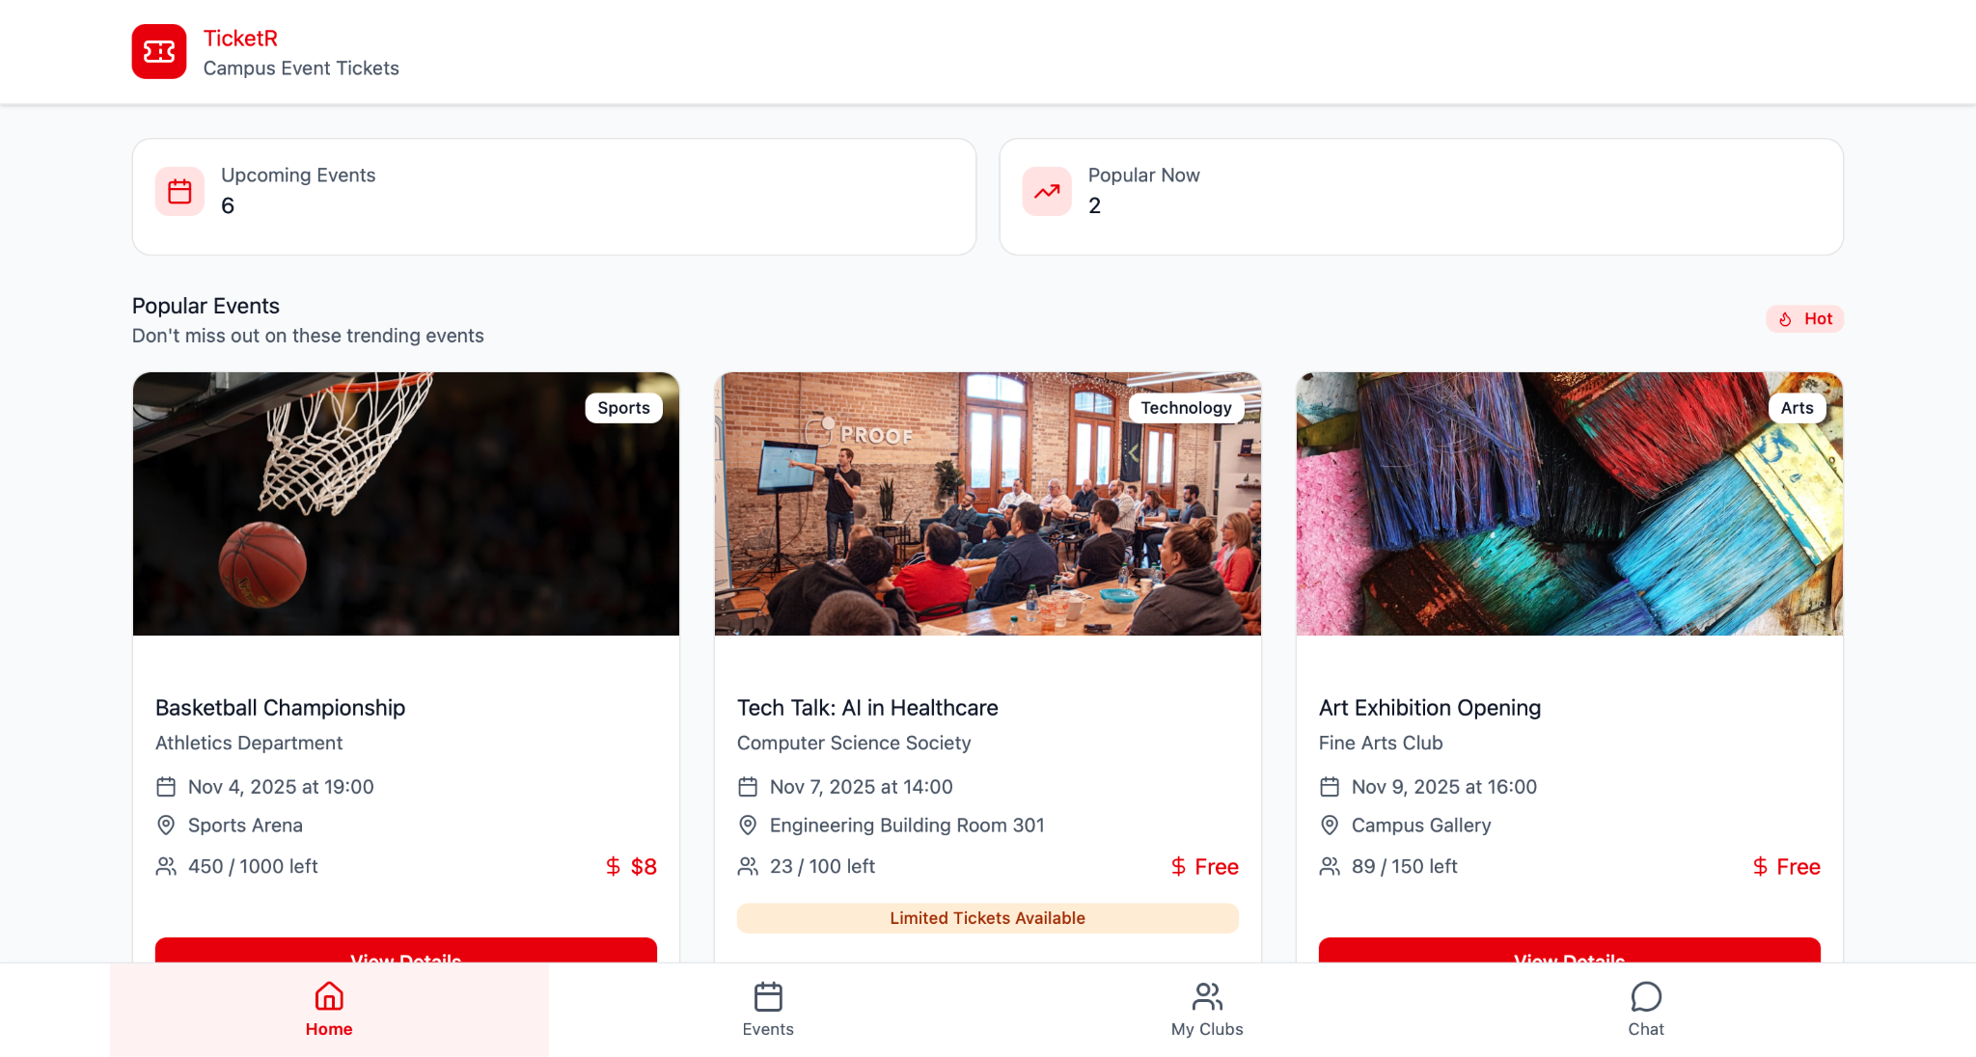
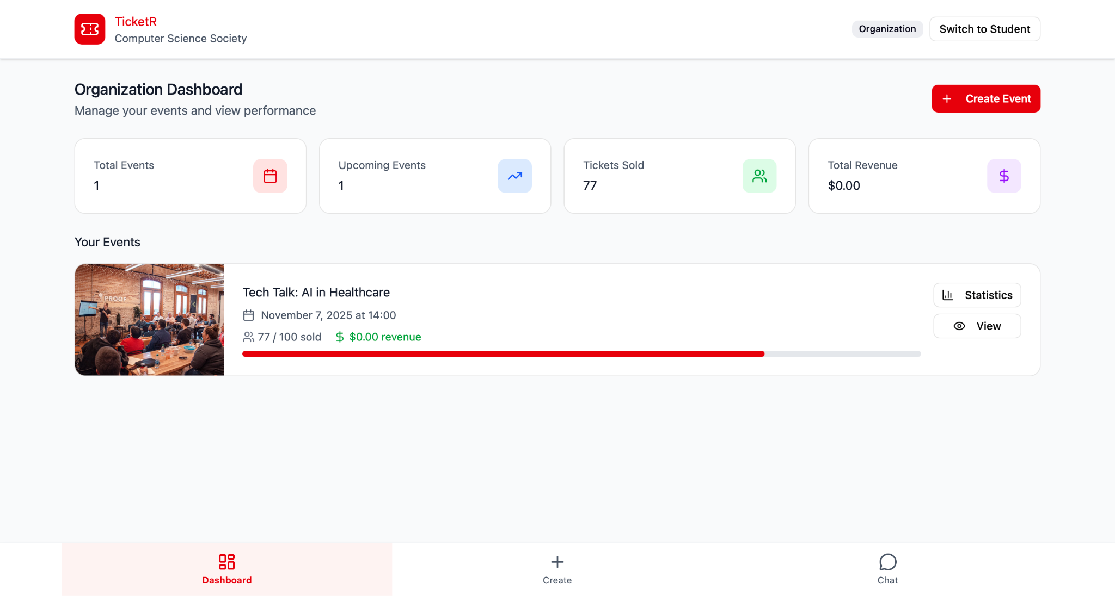
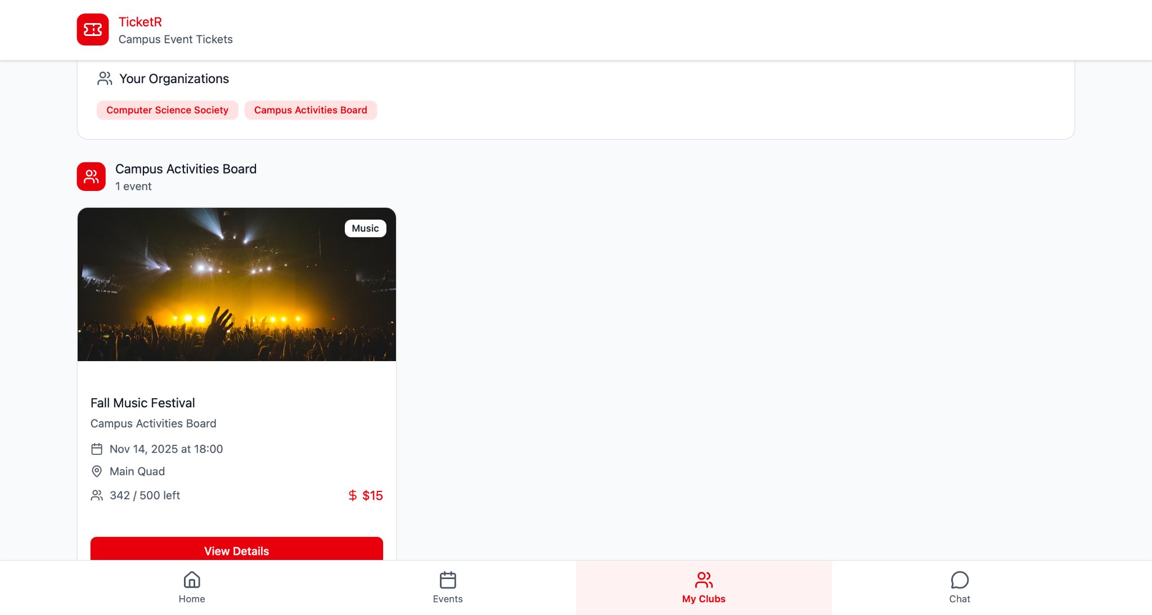
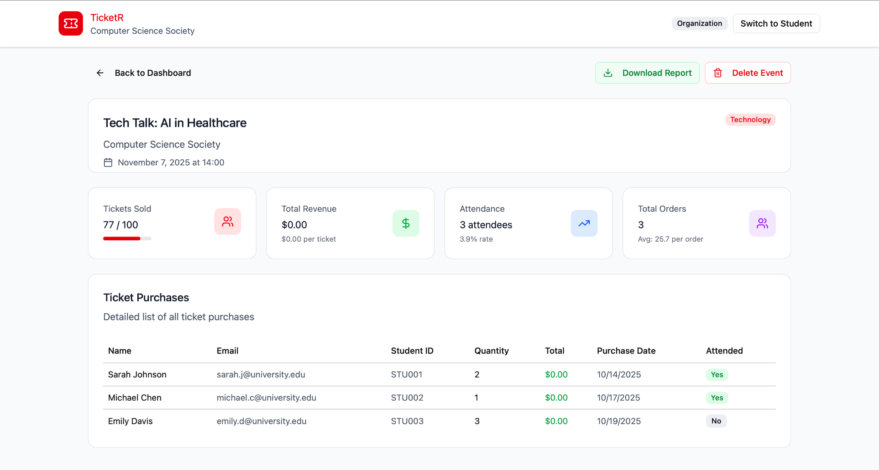
Prototype
Student POV
Organization POV

Slide 11
Roles
Mohmed Bemat: Backend
Shaeem Rockcliffe: Database (Fullstack)
Mohammed Miad: Frontend, can help with backend
Linwei Zheng: Backend and Database
Farida Balogun: Database and Backend
Nischal Thapa: Frontend, can help with backend and database

Slide 12
Q&A

