Slide 1
Price Scout
BUY NOW
Final Demo
BUY NOW
BUY NOW
By Team Aspirationless
BUY NOW

Slide 2
Agenda
01
02
03
04
05
06
Intro + Project Overview
System Architecture
Feature Demo + Use Cases
Reporting
Collaboration & Teamwork
Conclusion

Slide 3
01
Project Overview

Slide 4

Our Team
Billy Yang
Edison Florian
Tahsina Khan
Ethan Ngheim
Justin Orellana
Fardin Khandaker

Slide 5

What is Price Scout?
Our business plan outlines the strategy for Price Scout, a web-based platform that empowers consumers to find the best deals online by comparing product prices across multiple retailers in real-time. Our mission is to simplify online shopping and help everyday consumers save money without the hassle of jumping between websites.
Through our intuitive product search, affiliate integrations, and price comparison interface, we aim to revolutionize how users discover and decide on purchases. With increasing demand for cost-conscious shopping tools, and few direct competitors offering a fully integrated multi-vendor comparison engine, we believe Price Scout stands out as a timely, scalable, and impactful solution.

Slide 6





Tech Stack

Slide 7
Profit Model
Price Scout generates revenue through affiliate commissions, ads, and optional subscriptions.
Affiliate Links
Ad Revenue
Subscription Plan
We partner with online retailers (like Amazon, Walmart, etc.) and earn a small commission every time a user clicks a link and makes a purchase.
Banner and product-based ads are shown to free users. We get paid per view (CPM) or per click (CPC).
Users can pay a small monthly fee to remove ads. All core features mostly remain the same — it’s just a cleaner experience.

Slide 8
Profit Model
Clicks Product
Affiliate Revenue
User
Sees Ads
Ad Revenue
Subscribes
Subscription Revenue

Slide 9
System Architecture
02

Slide 10
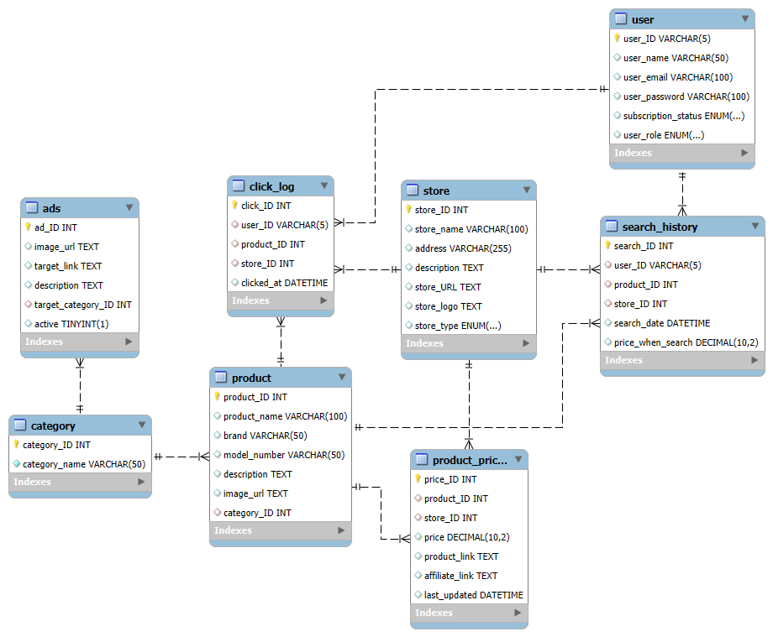
Relational Model Diagram

Slide 11
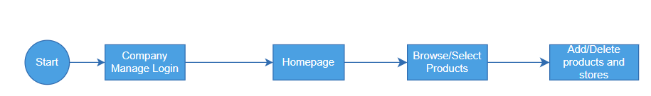
User Journey #1

Slide 12
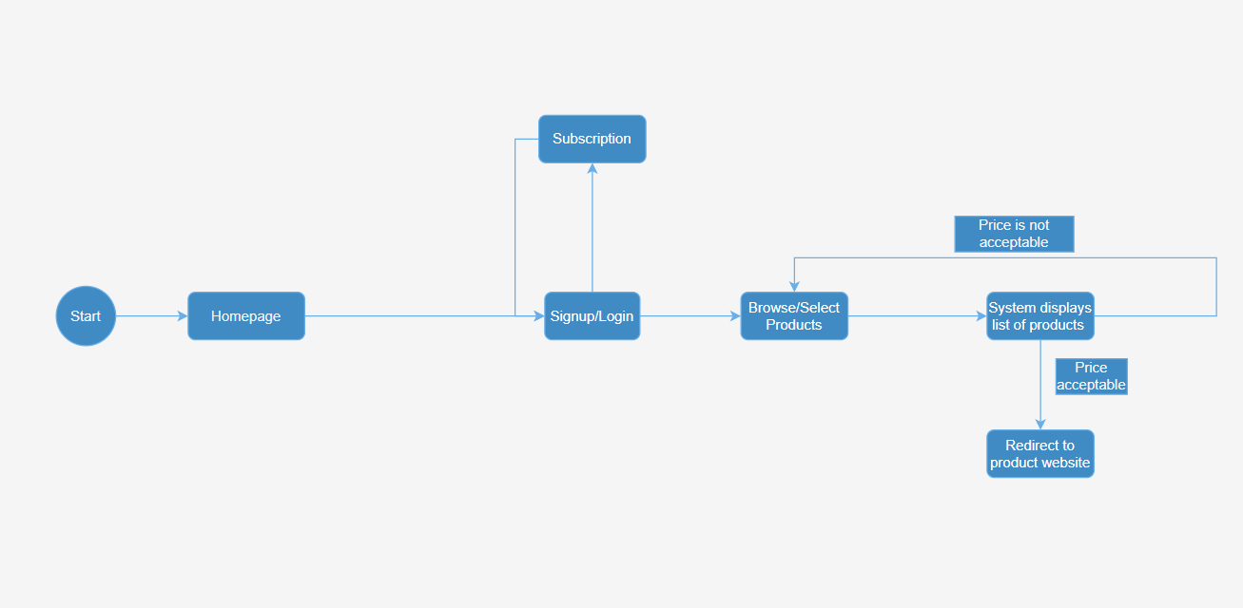
User Journey #2

Slide 13
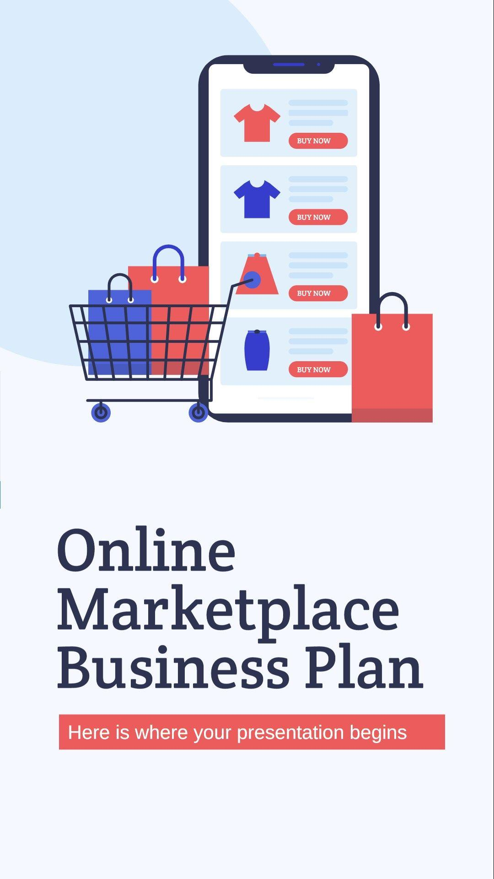
Reporting Demo
03

Slide 14
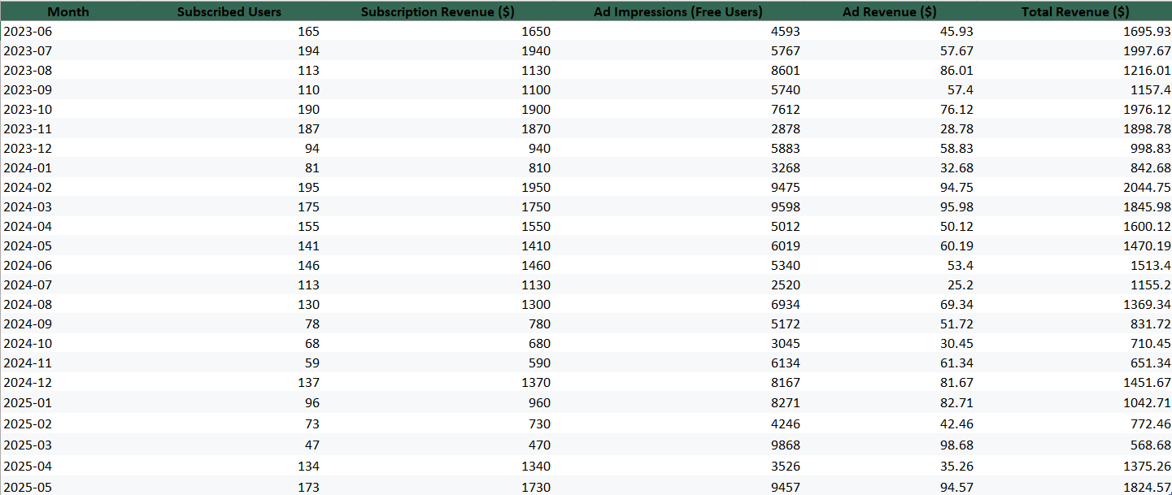

Slide 15
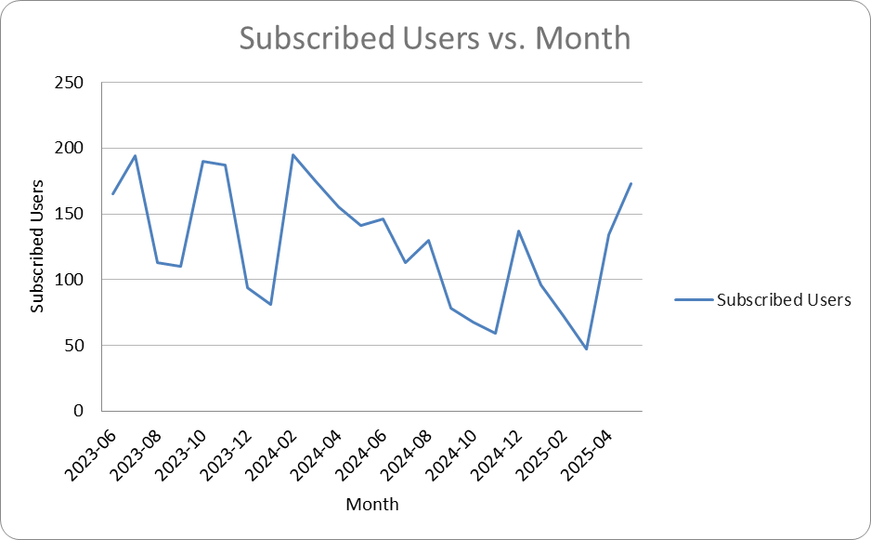
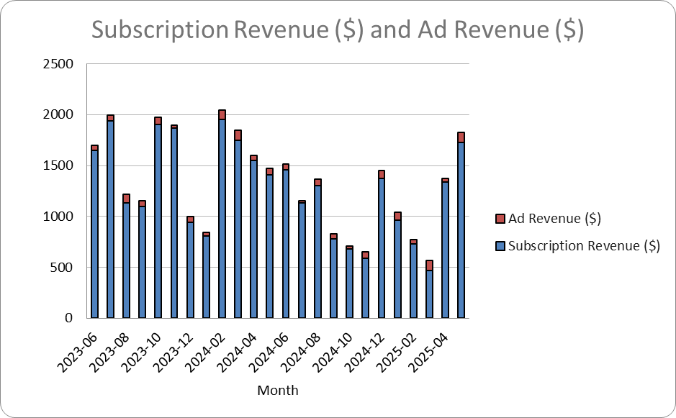

Slide 16
Teamwork & Collaboration
Divided responsibilities equally across frontend, backend, database, and presentation roles
Used GitHub for code collaboration and version control, with individual branches per developer. Some members contributed code or documentation that was integrated through a shared branch managed by Ethan to streamline merging and avoid conflicts
Maintained consistent communication, coordinated tasks and tracked progress through a shared Discord server and live editing sessions
Held frequent meetings on Discord to develop data modeling, business reports, and project presentations + created structure outlines on Google Docs
Worked through integration challenges in the final stretch to merge features and polish the UI

Slide 17
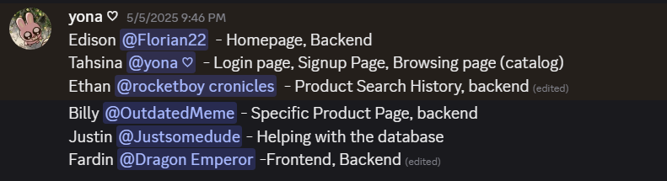
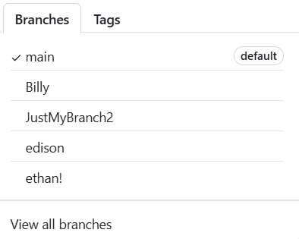
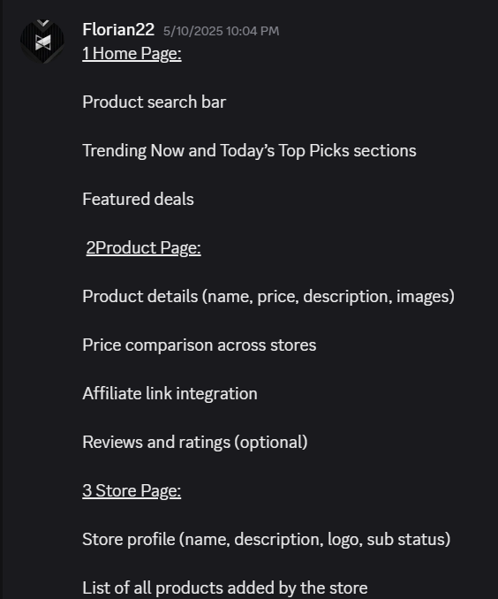
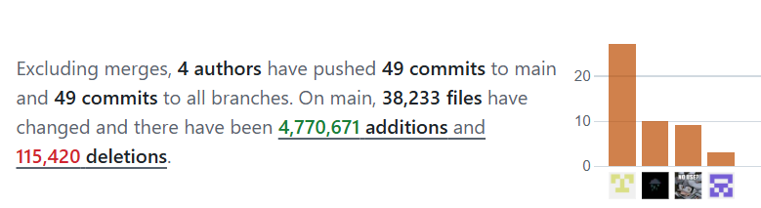
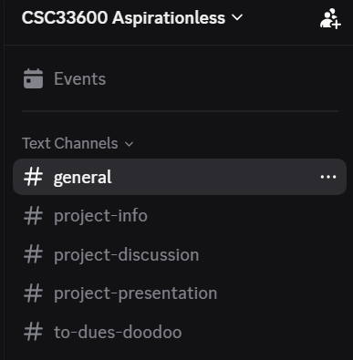
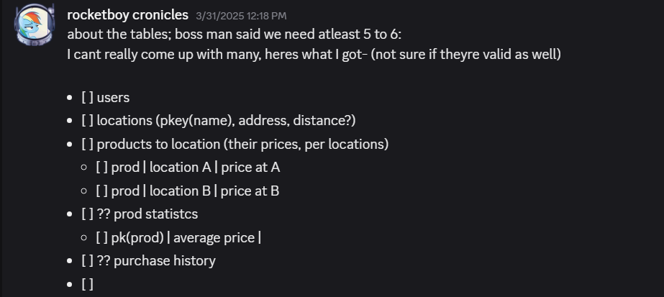
Teamwork & Collaboration

Slide 18
Thanks!
Do you have any questions?

Slide 19


