Slide 1
Price Scout
Presented by Aspirationless
Justin, Ethan, Edison, Tahsina, Billy, Fardin
4/1/25
Notes:
April Fools, this will never be a thing. haha…jk

Slide 2



What, Who, How and Why
WHAT IS THE IDEA? Help consumers save money, by finding the cheapest offer of a product across different companies.
WHO NEEDS IT? The everyday consumers; searching for cheaper groceries, home goods, or any product purchasable online.
WHY WILL an investor WANT?
To gain multiple income streams, affiliate marketing and ads.

Slide 3
WHAT IS THE IDEA?
Provide users with filter to compare the prices of certain products across several online stores.
Convenience the online shopping experience, by creating a hub that contains similar products across multiple websites.

Slide 4
WHO NEEDS IT?
The everyday consumer searching for a cheaper deal.
Let’s say:
groceries, who sells cheaper eggs: Target or Walgreens?
devices, who sells the cheaper printer: Amazon or Best Buy?

Slide 5
Why will investors be interested?
A centralized e-shop that can compare product prices, has the potential for a large user base.
As an investor you’ll continuously receive a percentage of the earnings that we receive from the advertised, affiliated products.
And as a company, affiliation would promote your products with the cheapest offer.
WHY WILL an investor WANT TO Invest in YOUR APPs, or your Data, or business
Notes:
By centralizing the shopping experiences we expect a high potential user base, based on convenience and cheap prices.

Slide 6
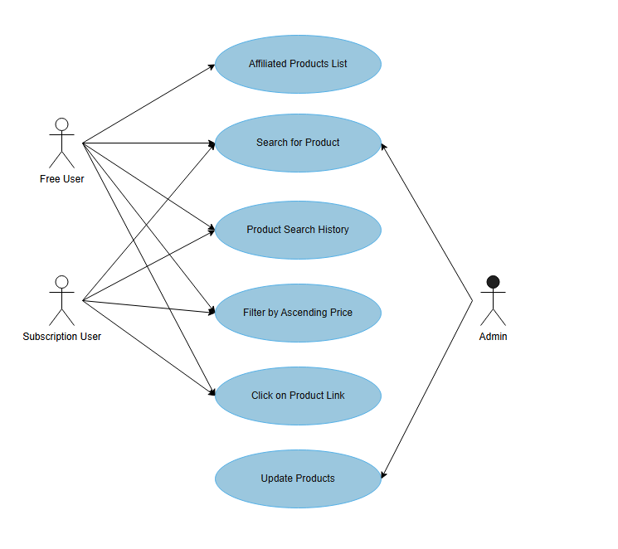
Use Case Diagram
Notes:
search for product and we display a list of the product in order of price.

Slide 7
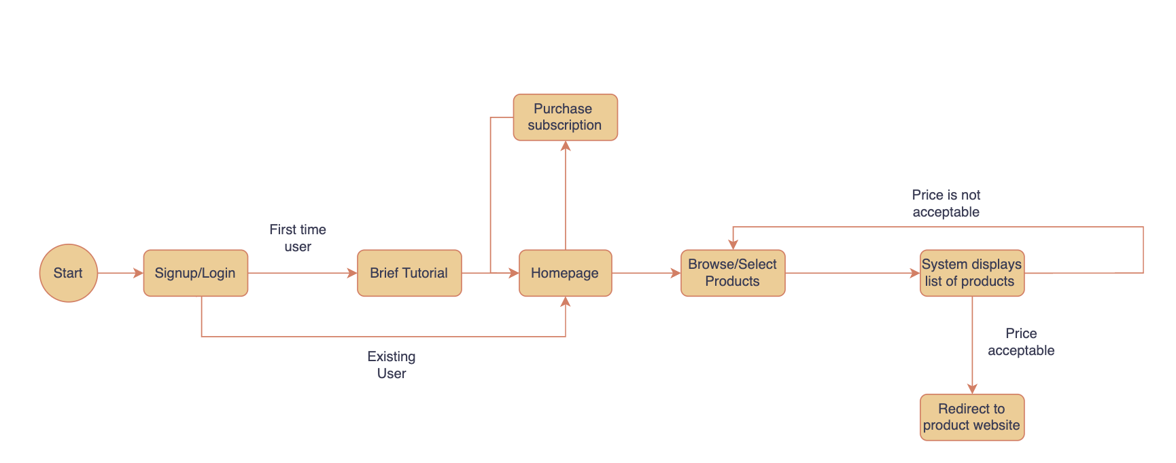
User Journey: Search for a product

Slide 8
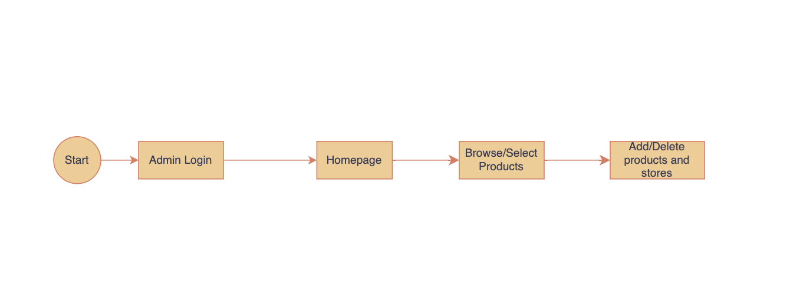
User Journey: Admin Account managing Products

Slide 9

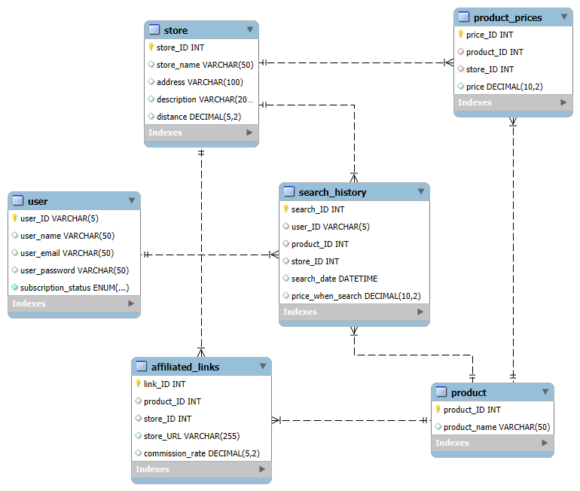
The Data
Data Modelling Diagram

Slide 10



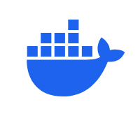
The Stack
Front End: React.js
Back End: Node.js
Database: MySQL
Once projects works locally, transition to Docker and deploy it on a hosted server

Slide 11
Monetization
Affiliated Products:
Contract with companies to affiliate links on their products. So we are monetized when a user clicks on our link to visit their website.
As a free user: Ads Ads
The app will display multiple ads of products we have affiliated links for.
As a subscription user:
Replace ads with a monthly subscription fee.
The quality of the app will not be affected, just removes the ads.
The affiliation of product links will remain

Slide 12
Member Roles
Front End
Ethan N.
Tahsina K.
Back End
Billy Y.
Edison F.
Database
Justin
Fardin
Notes:
Very nice

Slide 13
Q&A
Notes:
???

