Slide 1
SMART FINDER
BY: Hamim Choudhury, Eduardo Torres, Sahaf Khan, Kevin Budzinski, Kenneth Romero, Alexis Juarez

Slide 2
Agenda
Smart finder is a our web application that helps users discover and compare sandwich prices at local New York City delis. We allow users to submit, review and brows deli listings and provided different tiers of subscriptions.Our goals are to help users find affordable sandwich options nearby and allow deli owners/businesses to promote their offerings. 1. Map Based Searching 2. Favorites, Reviews, & Photos 3. Price Listings & Crowd-Sourced Menus

Slide 3
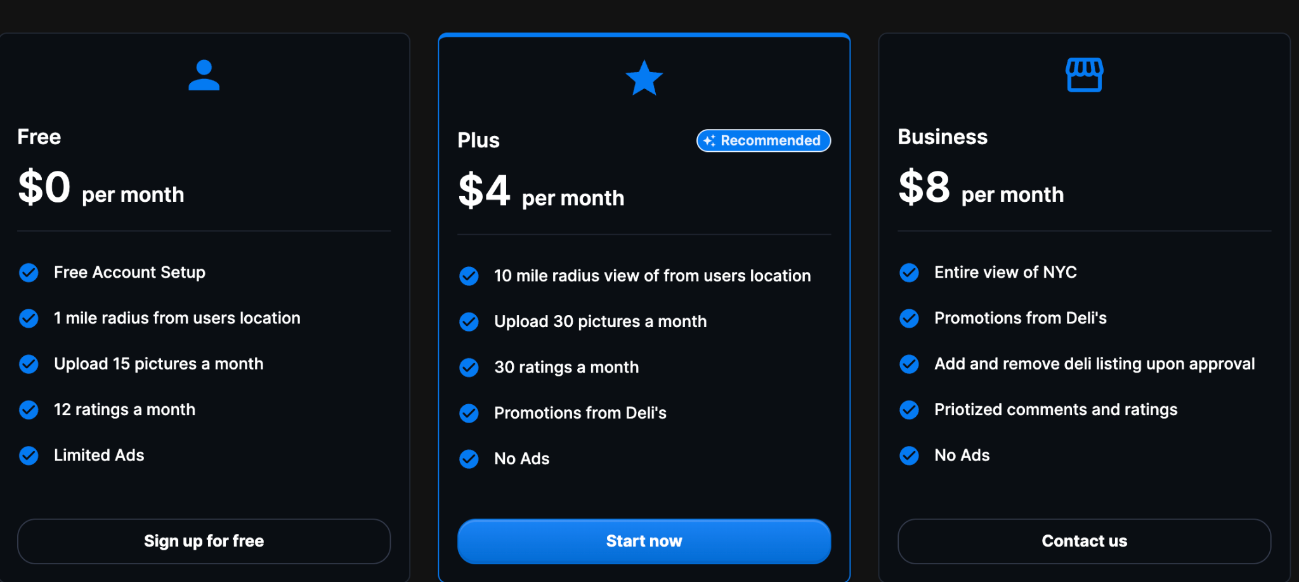
Services

Slide 4
Tech Stack
Frontend: React.JS, Next.JS ,MUI
Backend: Node.JS, Javascript, GoogleAPIs, NYC Open Data API
DataBase: MySQL
Authentication: StackAuth
Dashboard: Tableau

Slide 5
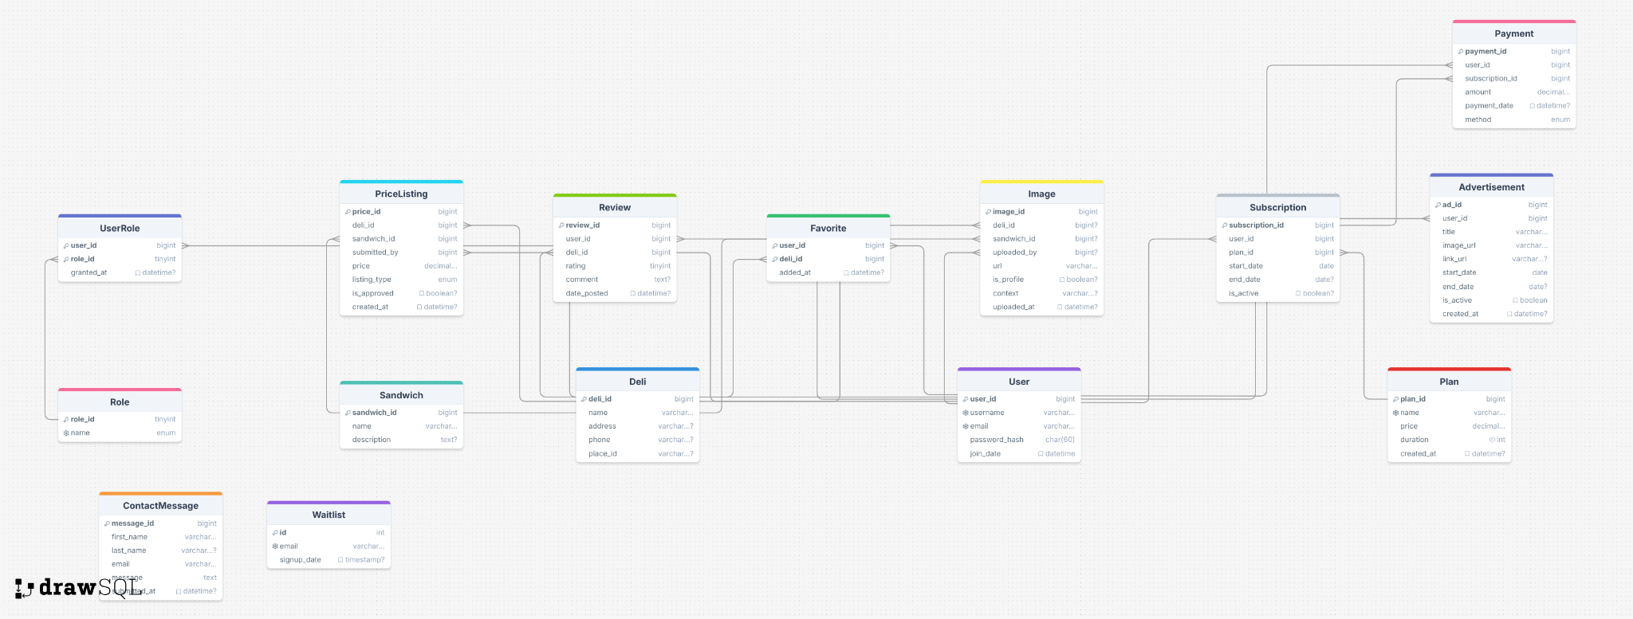
2NF Relational Model Diagram
2nf-Diagram

Slide 6
Reporting Demo

Slide 7
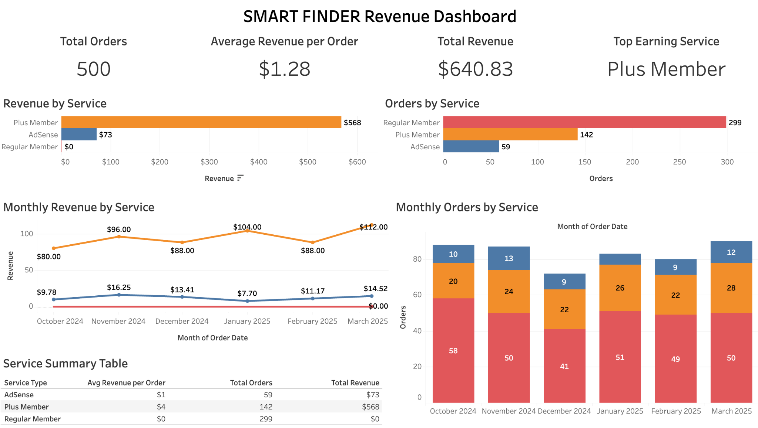

Slide 8
Stored Procedures Demonstration

Slide 9
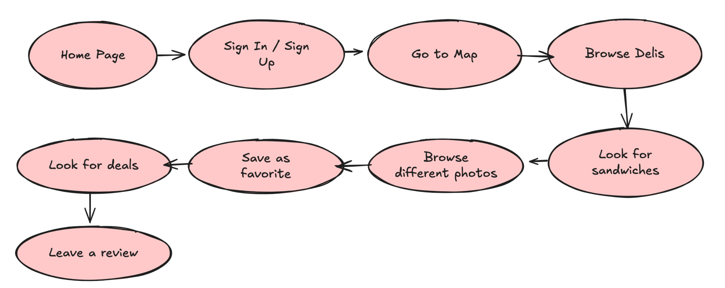
Use Case (using User Journey with Diagram)

Slide 10
Job Delegation and Team Work
Hamim | Alexis | Kenneth
Initially set up the project and began working on the frontend. | Had a major impact on the frontend, created all of the other static pages | Huge emphasis on the backend, was in charge of the database as well.
Moved on to the database and backend. Created the map page using Google Maps API. | Created the contact form, user dashboard, and made changes to all other pages. | Set up the database, created the admin dashboard, and helped to create the APIs to connect to the database.
Created some of the api/route.js files for contact page, AI, favorites, reviews.
Sahaf | Kevin | Eduardo
Focused on the frontend, helped to create pages with Alexis. | Was in charge of the data visualization. | Helped on the backend and made sure that the authentication worked.
Worked on the deli pages (Remove, Add, Pricing). | Used Tableau to showcase revenue and helped Kenneth with dashboard. | Helped Hamim with the map logic and implementing markers and windows.

Slide 11
Extra Credit Work
A user-friendly web UI with a UX-focused approach.
Implementing a dynamic reporting system using Tableau.
Added AI capabilities within the application.
Incorporated APIs (NYC Open Data & Google Maps) and Authentication (StackAuth) https://public.tableau.com/app/profile/kevin.budzinski/viz/RevenueReport_17471544962600/Dashboard1

Slide 12
Project Demo

Slide 13
THANK YOU

