Slide 1
Docker
By: Marina Morcos, Patience D. A. Izere, Justin O., Kasia Windett, Sanskriti Khadka, Sri Subramanian

Slide 2
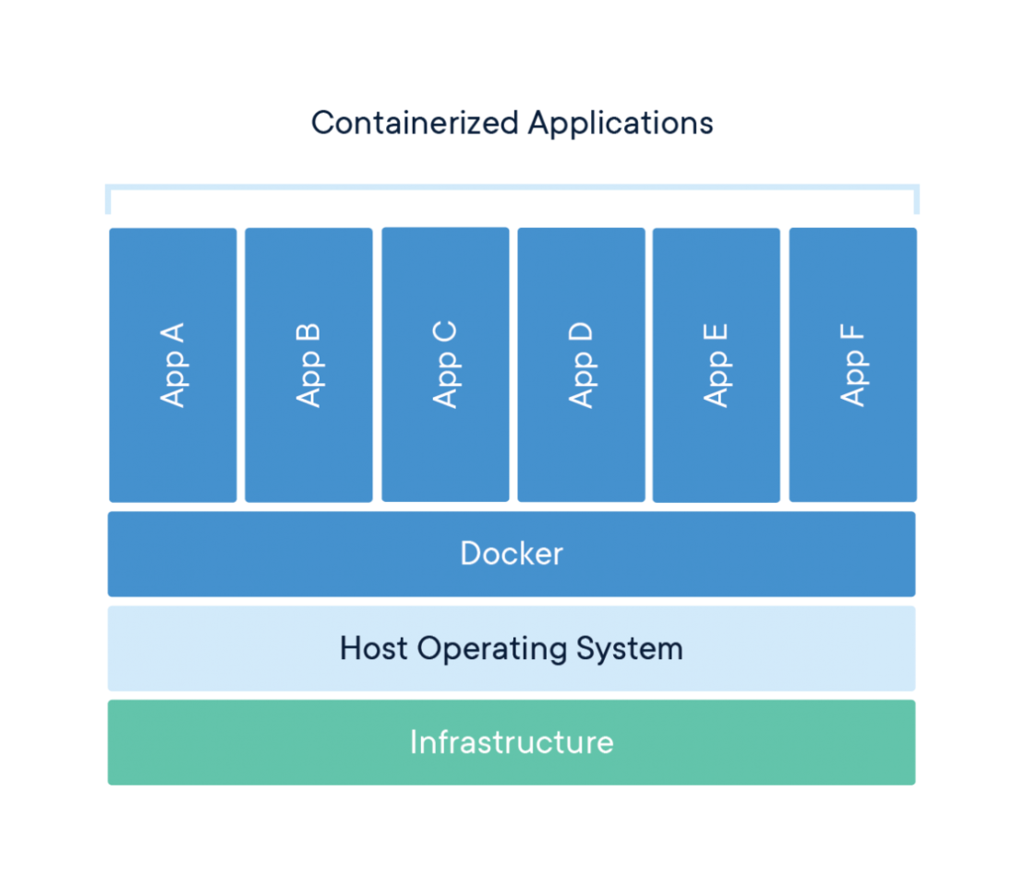

What is Docker?
Docker is a platform that uses OS-level virtualization to deliver software in packages called containers. Think of containers as lightweight, self-contained boxes that bundle everything your code needs to run.
Your Code
Python, R, or any programming language
Libraries
Pandas, Tidyverse, and other dependencies
System Tools
Everything needed to run your environment

Slide 3

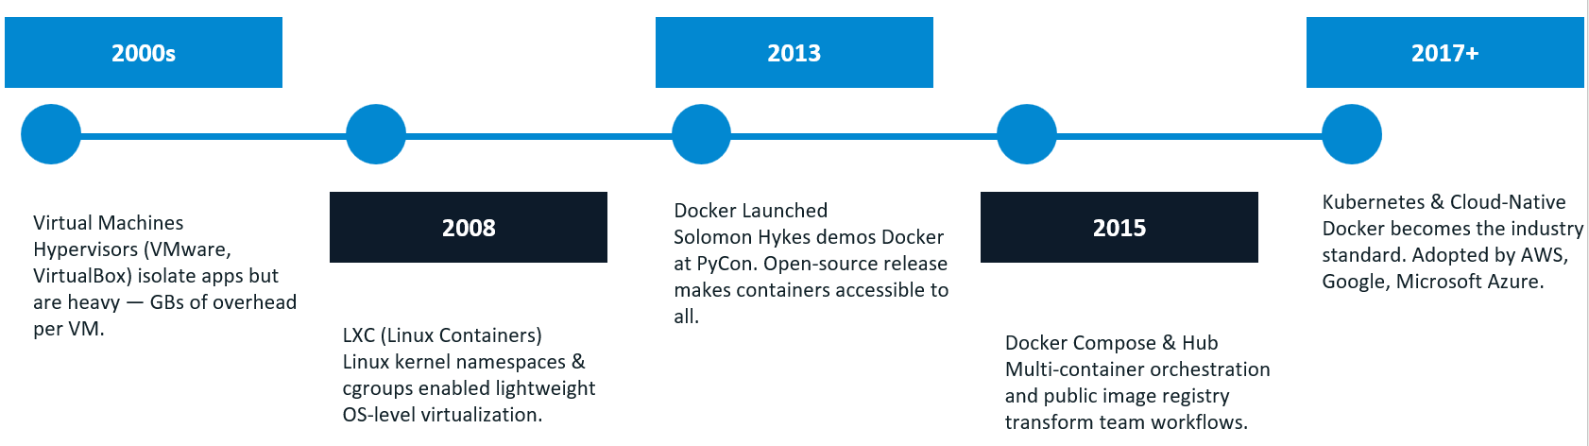
History & Evolution: From VMs to Containers
The Old Approach: Virtual Machines
Virtual Machines simulate an entire computer, including a full guest operating system.
Large size (often multiple GBs)
Slow startup times
High CPU and RAM usage
The Modern Approach: Docker Containers
Introduced in 2013, containers share the host OS kernel and package only the application and required libraries.
Lightweight (MBs instead of GBs)
Starts in seconds Efficient resource usage

Slide 4
Technical Overview: Images vs. Containers
Understanding Docker terminology is key to mastering containerization. Here's a helpful metaphor to clarify these concepts:
Concept | Metaphor | What It Actually Is
Dockerfile | The recipe card | A text file with step-by-step instructions to build your environment
Image | The prepared meal kit | A static, read-only blueprint containing your OS, languages, libraries, and code
Container | The cooked meal | A live, running instance of an image that you can interact with
Docker Hub | The cookbook library | A cloud registry where images are stored, shared, pushed, and pulled

Slide 5
Local Install vs. Docker
The difference between traditional local installations and Docker containers is dramatic:
Feature | Local Install | Docker
Setup Time | Hours - manual installs & configuration | Seconds - run container in one command
Consistency | Different on every machine | Same environment everywhere
Portability | Hard to move projects | Runs on any system with Docker
Cleanup | Leaves config files and dependencies | Remove container in one command

Slide 6





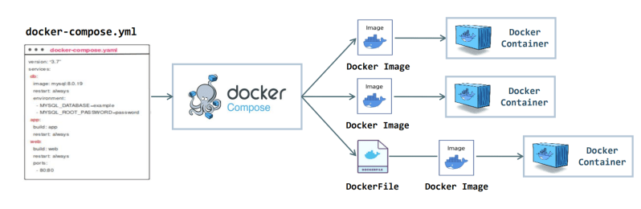
Docker Compose
Tool for running multiple services as one application
Manages containers using one configuration file
One File
docker-compose.yml defines all services.
One Command
docker compose up starts everything.
Auto Networking
Containers communicate automatically.
Scalable
Run multiple instances of services.
Our project requires a pipeline with multiple components:
API Data Extraction
Python ETL Processing
Database Storage
Tableau Visualization
Step 1: Build Image
Step 2: Define Services
Step 3: Launch System
Step 4: Manage Services
Docker Compose ensures all components run together consistently for every team member.

Slide 7
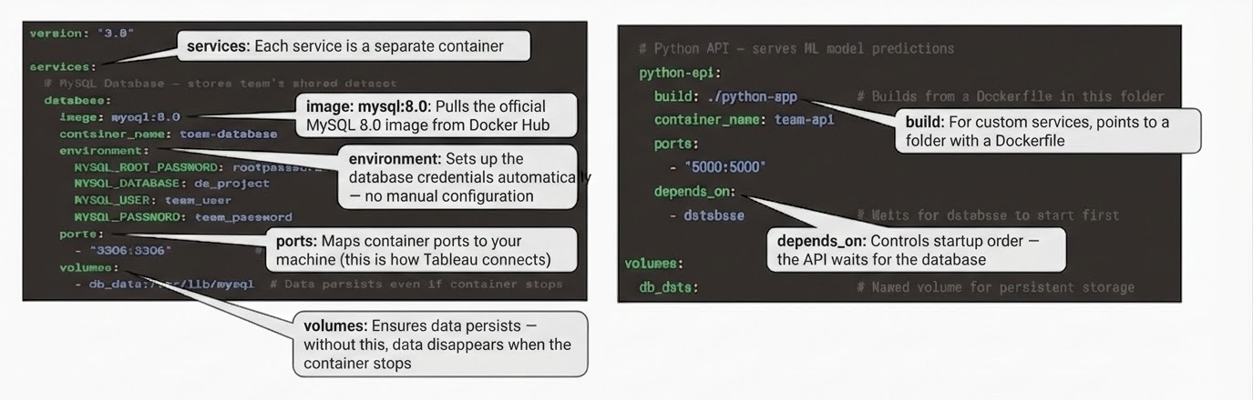
Docker Compose: The `compose.yml` File
The heart of a multi-container Docker application is the compose.yml file (formerly docker-compose.yml). This YAML file defines how your application's services, networks, and volumes are configured and interact.

Slide 8
Docker Commands
docker build
Builds a Docker image from a Dockerfile
When creating an application container
1
docker run
Runs a single container from an image
For simple or one-off containers
2
docker compose build
Builds all services defined in docker-compose.yml
When preparing a multi-container application
3
docker compose up
Starts all services in the application stack
To launch the full system
4
docker compose up -d
Runs containers in the background
When running services without blocking the terminal
5
docker compose stop
Stops all running containers
When shutting down the application
6

Slide 9

Tableau with Docker
Two ways Docker comes in handy with Tableau:
Tableau Cloud or Tableau Server
Docker containers can connect to Tableau Cloud or Server to extract, transform, and load data for visualization.
TabPy (a bridge between Tableau and Python)
Use Docker to containerize TabPy, enabling Tableau to execute Python scripts directly in calculated fields.

Slide 10
Docker with Tableau Cloud vs Tableau Server
Feature | Docker + Tableau Cloud | Docker + Tableau Server
Maintenance | Low | High (server upkeep)
Data Refresh Method | Bridge or API from Docker Services | Direct Connection from Docker containers
Security Control | Tableau manages | Direct managing
Docker Purpose | Data pipelines | Pipelines + infrastructure around server

Slide 11




TabPy: Tableau Python Server
TabPy allows Tableau to execute Python scripts, bringing advanced analytics directly into your dashboards. Here's how it works:
Launch TabPy Container
Start your Docker container with the TabPy server running.
Connect Tableau Desktop
Configure Tableau Desktop to point to the running TabPy container.
Embed Python Script
Write your Python script directly within a Tableau calculated field.
Instant Results
Inside the container, TabPy runs the code, generates a prediction or cluster, and sends the result back to the chart instantly.

Slide 12

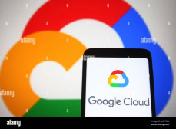

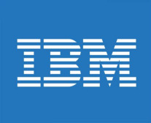


Industry Relevance & Recommendations
Key Industry Use Cases
Docker's versatility has made it a cornerstone in modern software development and research:
Cloud & DevOps: Used in cloud computing and CI/CD pipelines.
Academic Use: Ensures projects run the same across different systems.
Our Recommendation
We recommend utilizing Docker within your projects to significantly enhance collaboration and reproducibility.
Use Docker to share both code and environment.

Slide 13


Docker: Advantages & Considerations
Consistency
Eliminates "works on my machine" issues.
Efficiency
Lightweight, uses fewer resources than VMs.
Rapid Deployment
Containers launch in seconds.
Isolation
Prevents application conflicts.
Portability
Runs anywhere with Docker.
Learning Curve
New concepts (images, Dockerfiles, CLI).
Security
Shared host OS kernel can expose all containers.
Orchestration
Complex for many containers (e.g., Kubernetes).

Slide 14
Thank You!
Questions & Answers

