Slide 1
DATA SCIENCE CONSULTING
Industries LLC 4219
Fahad Faruqi, Ali Mohamed, Md Omit,​ Evan Perez, Jennifer Saeteros, Tak Kit Yeung
10/28/24 (2nd group)

Slide 2
AGENDA

Slide 3


OUTLINE
Introduction
Methodology
Data Collection/Model
Business Intelligence

Slide 4
INTRODUCTION AND PROBLEM STATEMENT

Slide 5
4219 INDUSTRIES LLC
About Us
We are a data science consulting company specializing in predicting the trajectory of trends. Our expertise is rooted in the knowledge and skills gained from The City College of New York, where our team members have focused on computer science and computer engineering.

Slide 6
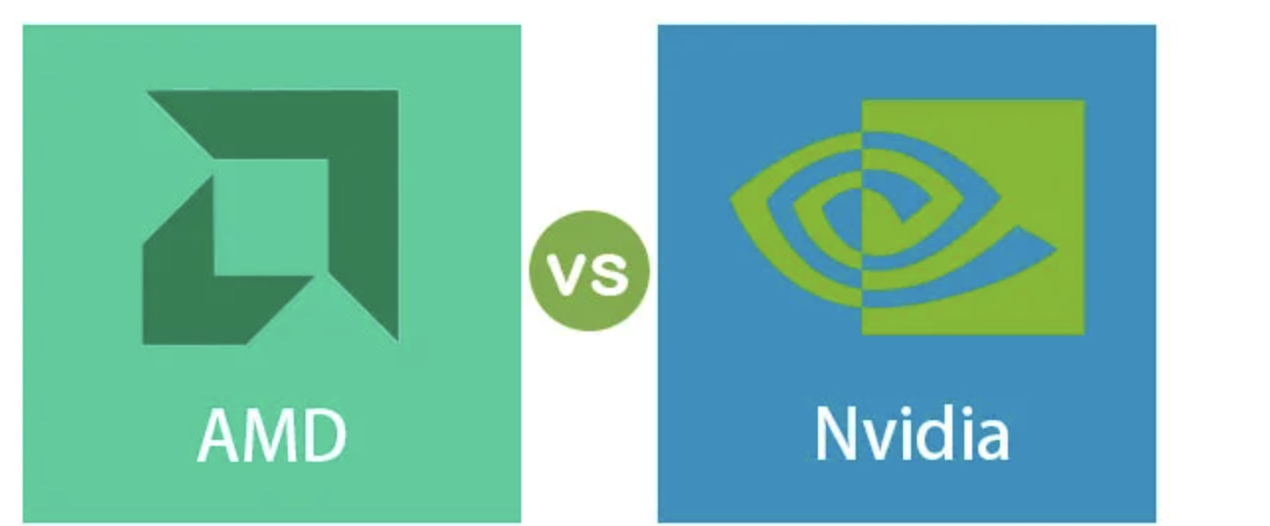
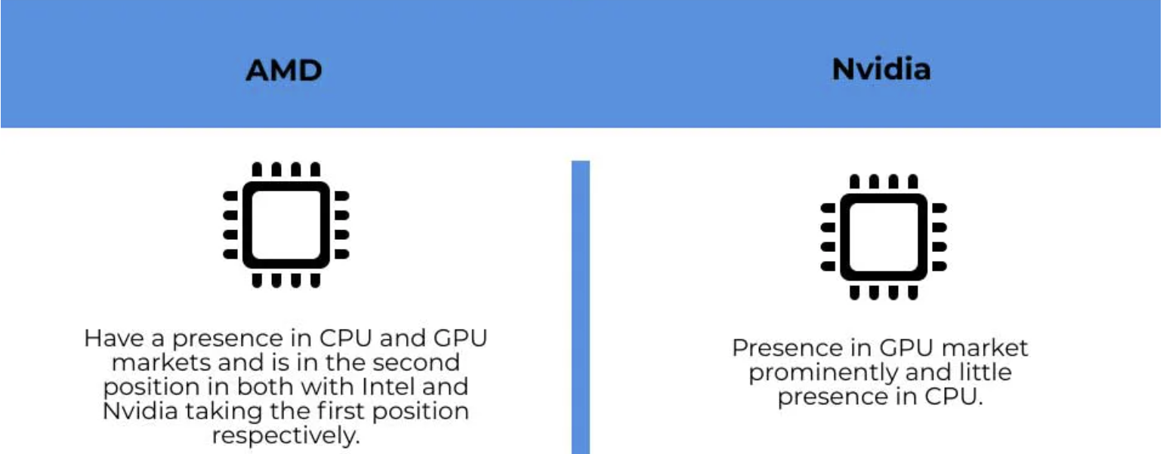
Introduction

Slide 7
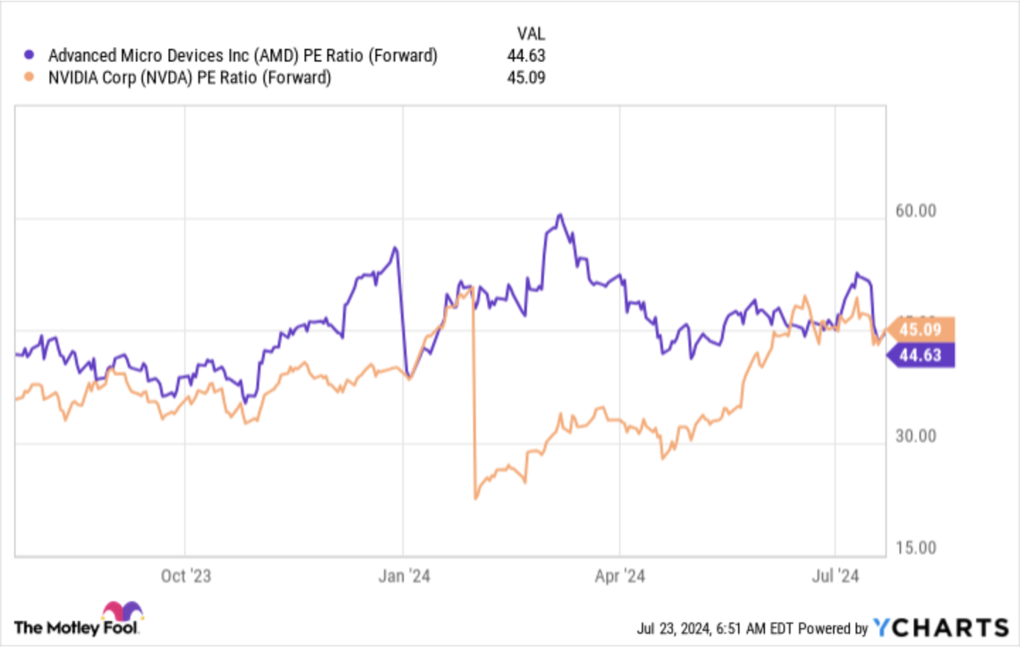
Question: Should investors invest in Nvidia or AMD?
THE PROBLEM

Slide 8
METHOD AND PROCESS

Slide 9
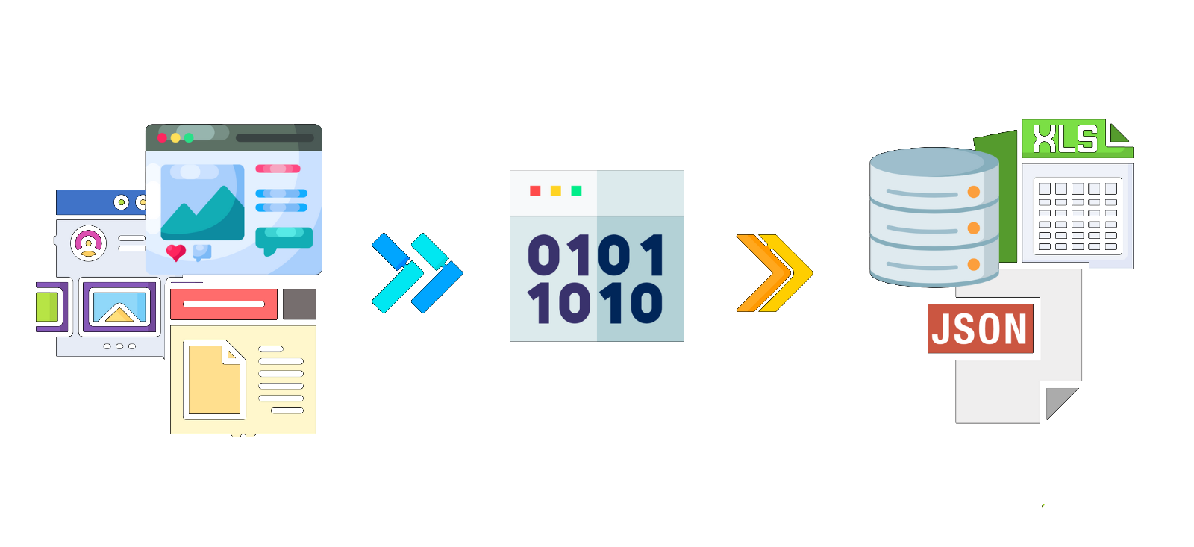

Web Scraping

Slide 10
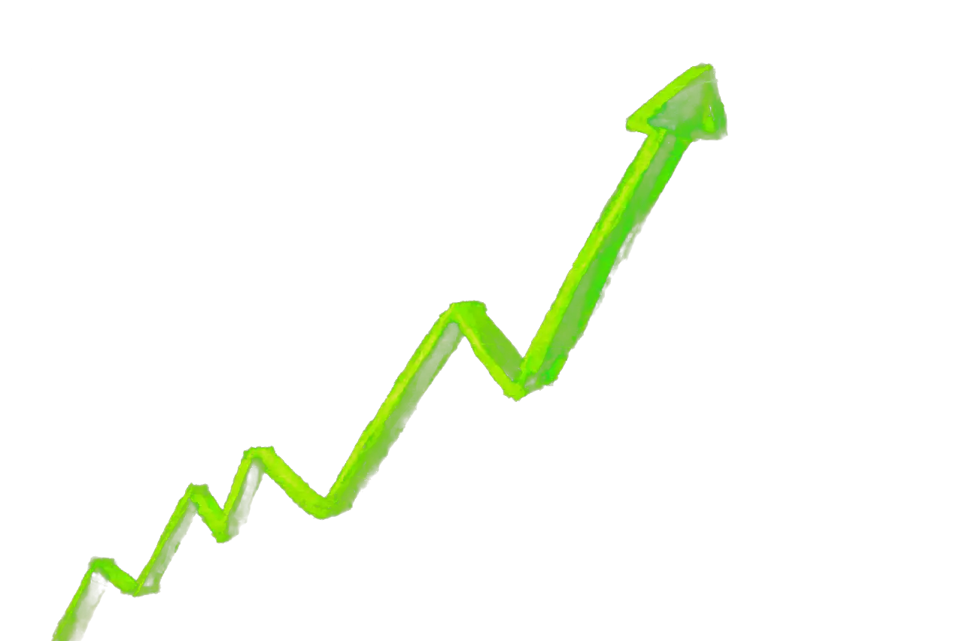

Polygon.io

Slide 11
METHODOLOGY
Data collection methodology:
Polygon API
Financial Data
Web Scraping (curl)
has been tested on the NYT
Data Manipulation
NLP Sentiment Analysis model on new articles
Regression model on data points of stock prices at different times
Perform exploratory data analysis (EDA) using data visualization and SQL
Visualize data using seaborn and matplotlib

Slide 12
DATASET

Slide 13
DATA COLLECTION
We will collect our data using Polygon.io’s API.
We can access Polygon’s Flat Files as well as querying their database for historical price data, earnings growth, market sentiment and cap as well as technical indicators like RSI on Nvidia and AMD.
We can scrape the web and gather data directly from NASDAQ as well as sites such as CSIMarket.com using Python and BeautifulSoup (bs4).
BeautifulSoup helps us in extracting clean data and lets us obtain data points like forward P/E ratios, dividend rates, etc. which we will use to form insights and guide investors into making the best decision.

Slide 14
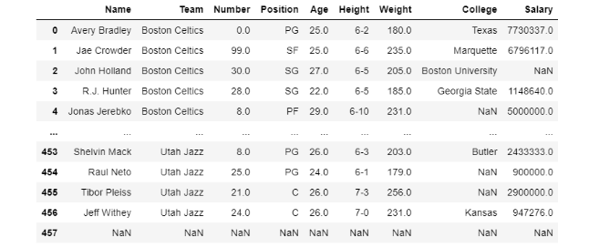
Polygon API
Example: NBA csv file into pandas
# import pandas module
import pandas as pd
# making dataframe
df = pd.read_csv("nba.csv")
# output the dataframe
print(df)
The Flat Files provided by Polygon API contains .csv files which we will make into Pandas dataframes using Python and its libraries.

Slide 15
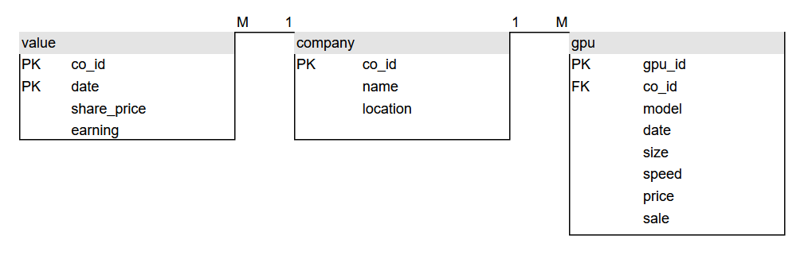
THE DATA MODEL
Comparison of GPU Companies’ Performance

Slide 16
BUSINESS INTELLIGENCE

Slide 17
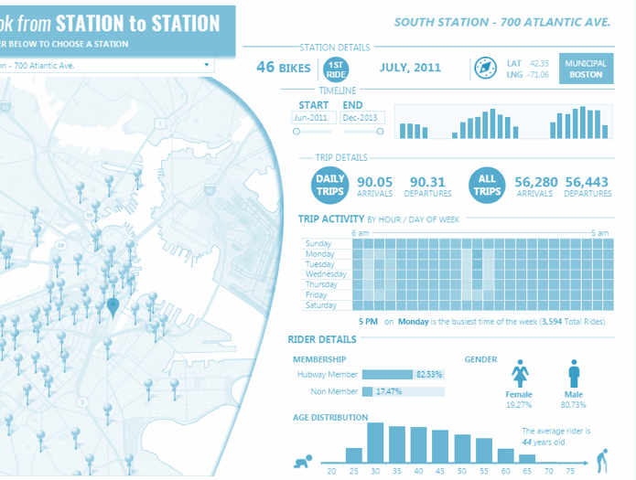
WHAT ARE THE METRICS/CHARTS
Business intelligence combines a broad set of data analysis applications designed to meet different information needs.

Slide 18
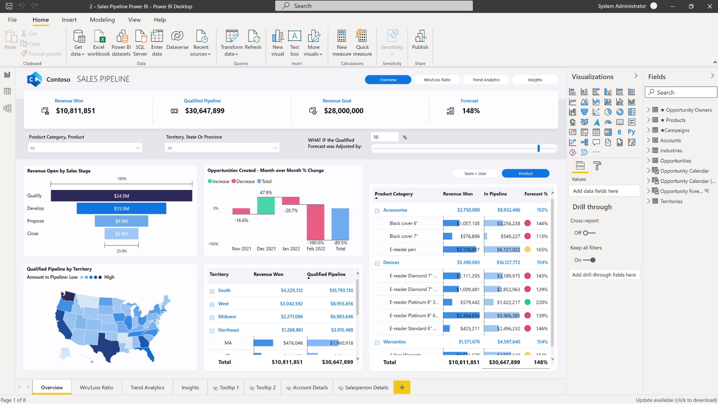
Data Visualization
We can use Microsoft Power BI Desktop
1.Connect to data, including multiple data sources.
2.Shape the data with queries that build insightful, compelling data models.
3.Use the data models to create visualizations and reports.
4.Share your report files for others to leverage, build upon, and share.

Slide 19
APPLICATION STACK

Slide 20






THE STACK
Front End
Back End
Server | Database
Dashboard | Deployment

Slide 21
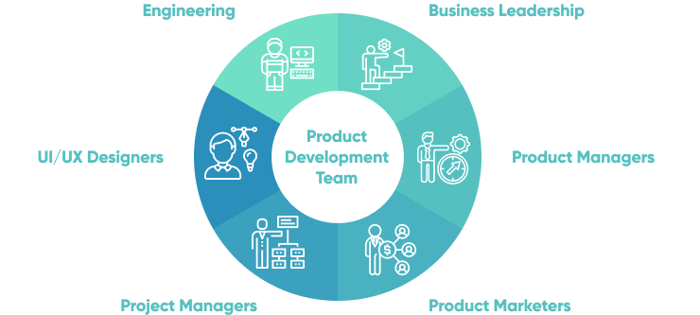
MEMBER ROLES

Slide 22
Q&A

