Slide 1
Data Science Consulting
Presented by {Team Name, Name of student}
Date {}

Slide 2
Agenda

Slide 3



Outline Option 1
WHAT IS THE Problem? What is the unknown? Why is the A-B product interesting, Different?
WHO NEEDS IT? Who is the stakeholder? What is your proposed process
What is your proposed solution? How to measure your success creterias? what sort of analysis/learning/statics are you performing?

Slide 4
Outline 2
Introduction
Methodology
Data
BI
Appendix

Slide 5
Introduction and Problem Statement

Slide 6
Your Company/Team/Industry #1
City College Ads Tech Universe is a cutting-edge digital marketing company focused on optimizing short video ad campaigns across major social media platforms using the latest advancements in data science and machine learning. Our mission is to revolutionize the way social influencers and brands reach their target audiences by providing data-driven insights and high-performance ad strategies.
At City College Ads Tech Universe, we specialize in A/B testing across platforms like TikTok, Instagram, YouTube, and more. Through our advanced machine learning algorithms, we analyze audience behavior, engagement metrics, and conversion rates to determine which ad creatives, messaging, and formats work best. Our platform not only tracks real-time performance but also evolves with changing trends, ensuring that your ad strategies stay ahead of the curve.
But we don’t stop there—our proprietary AI recommendation engine goes beyond standard analytics. By predicting future consumer preferences and identifying emerging market trends, City College Ads Tech Universe delivers unparalleled insights that empower influencers to craft resonant content, brands to amplify their message, and ultimately drive growth.
Whether you're a rising influencer looking to build your digital presence or a brand ready to unlock new heights, our customized advertising strategies will transform your campaign performance. Our technology does the heavy lifting, enabling you to focus on what matters most—creating impactful, authentic content

Slide 7
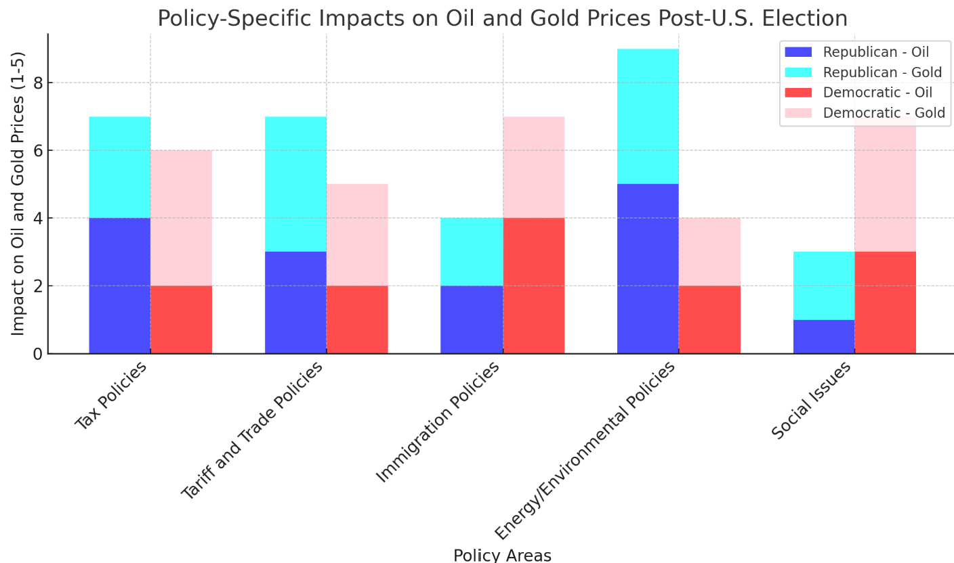
(Consulting Project Title:Forecasting Oil and Gold Price Movements Based on U.S. Presidential Election Outcomes and Policy Debates)
The prices of oil and gold are highly sensitive to global political and economic events, including U.S. presidential elections. Key policy changes driven by the political party in power can significantly impact global markets, and investors need accurate insights into how these commodities will respond immediately following the election. This project seeks to predict how oil and gold prices will trend depending on whether the Republican Party or the Democratic Party wins the 2024 U.S. presidential election.

Slide 8
Introduction and Problem #2
Project background and context
Space X advertises Falcon 9 rocket launches on its website with a cost of 62 million dollars; other providers cost upward of 165 million dollars each, much of the savings is because Space X can reuse the first stage. Therefore, if we can determine if the first stage will land, we can determine the cost of a launch. This information can be used if an alternate company wants to bid against space X for a rocket launch. This goal of the project is to create a machine learning pipeline to predict if the first stage will land successfully.
Problems you want to find answers
What factors determine if the rocket will land successfully?
The interaction amongst various features that determine the success rate of a successful landing.
What operating conditions needs to be in place to ensure a successful landing program.

Slide 9
Method and Process

Slide 10
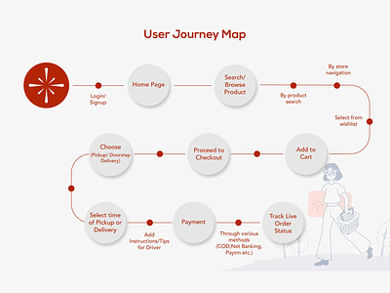
How (describe functional requirement/story telling/Our Approach)
Example: How are you going to get the data, where are you storing them, how are you extracting them, how are you cleaning, how are you visualize, how can stakeholder use and see it

Slide 11
Methodology
Executive Summary
Data collection methodology:
Data was collected using SpaceX API and web scraping from Wikipedia.
Perform data wrangling
One-hot encoding was applied to categorical features
Perform exploratory data analysis (EDA) using visualization and SQL
Perform interactive visual analytics using Folium and Plotly Dash
Perform predictive analysis using classification models
How to build, tune, evaluate classification models

Slide 12
DataSet

Slide 13
Data Collection
The data was collected using various methods
Data collection was done using get request to the SpaceX API.
Next, we decoded the response content as a Json using .json() function call and turn it into a pandas dataframe using .json_normalize().
We then cleaned the data, checked for missing values and fill in missing values where necessary.
In addition, we performed web scraping from Wikipedia for Falcon 9 launch records with BeautifulSoup.
The objective was to extract the launch records as HTML table, parse the table and convert it to a pandas dataframe for future analysis.

Slide 14
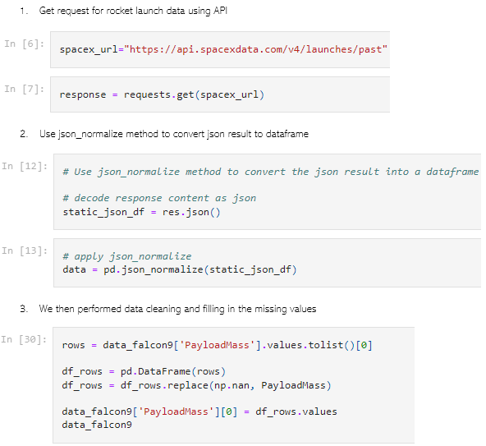
Data Collection – SpaceX API
We used the get request to the SpaceX API to collect data, clean the requested data and did some basic data wrangling and formatting.
The link to the notebook is https://github.com/chuksoo/IBM-Data-Science-Capstone-SpaceX/blob/main/Data%20Collection%20API.ipynb.

Slide 15
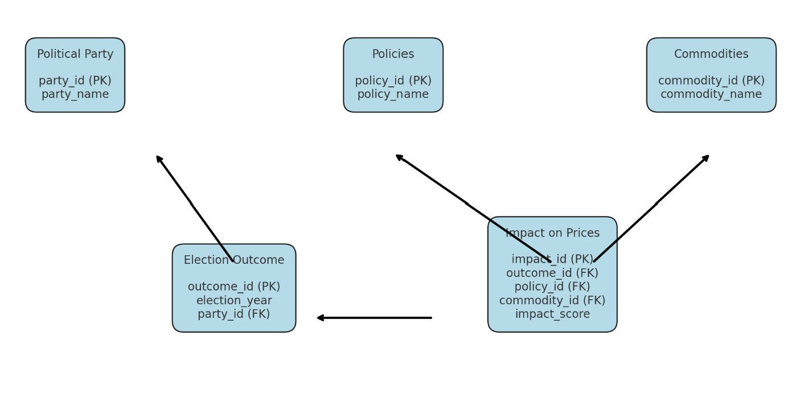
The Data MoDEL
(Class diagram or Object Diagram is fine but if using UML or Data modeling preferably in at least normalized to 2NF , and it must use a joint table for many to many relationships https://www.youtube.com/watch?v=UrYLYV7WSHM
https://youtu.be/fOmH3-pWGCQ?si=2fN9PQ_q-gckGmOe
)

Slide 16
Business Intelligence

Slide 17
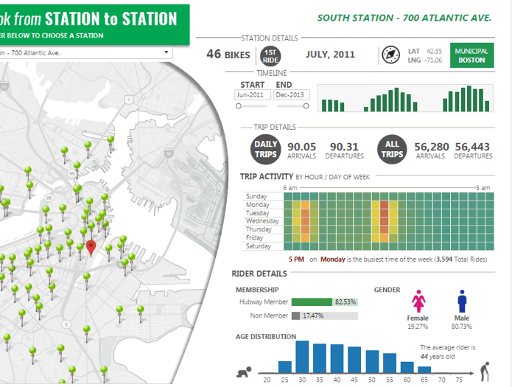
What are the metrics/charts
Describe how you will fill your Business Intelligence Dashboard

Slide 18
Application Stack

Slide 19
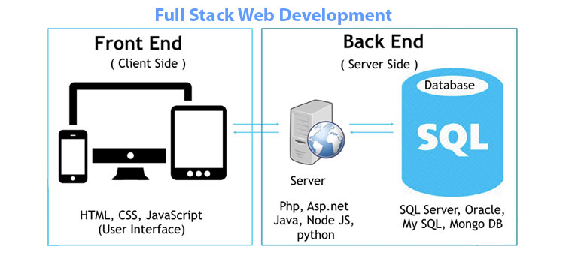
The Stack

Slide 20
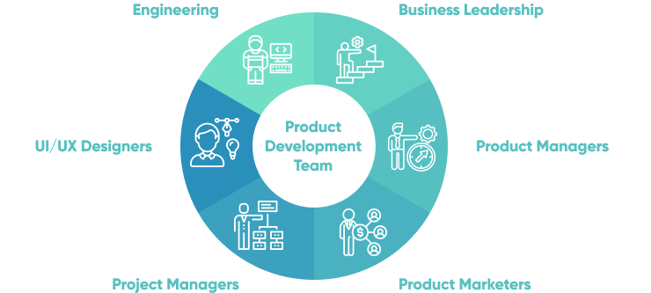
Member Roles

Slide 21
Q&A

