Slide 1
Semiconductor Analysis
Presented By SmallData

Slide 2
What is our problem?

Slide 3
01
Data Exploration
03 Visualizations
02
The process
04 TAbleau + Streamlit
Using various tools to extract the information
Presenting the data in Tableau and Matplotlib
Technical work of cleaning
Showcasing our B.I Dashboards

Slide 4
1. Data Exploration
Collecting our data

Slide 5

Data Exploration
Data Retrieval:
P/E Ratio
Dividend Yield
Market Cap
Other Metrics:
Current Price
Market Cap
52 week high and low
Sector

Slide 6
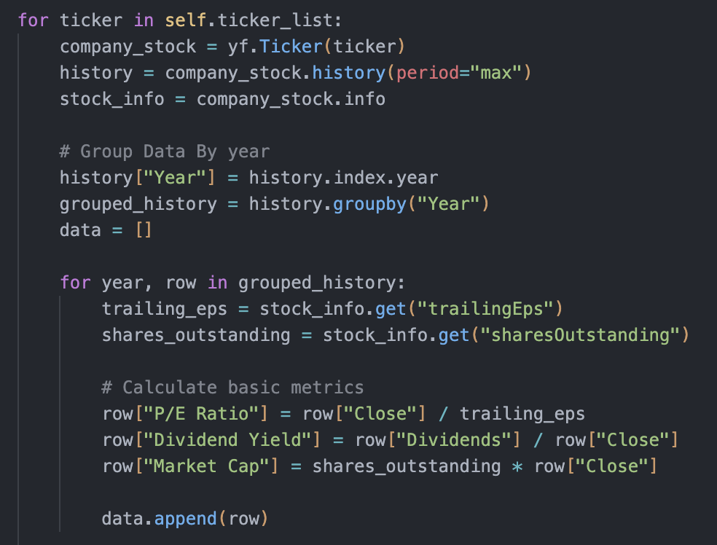
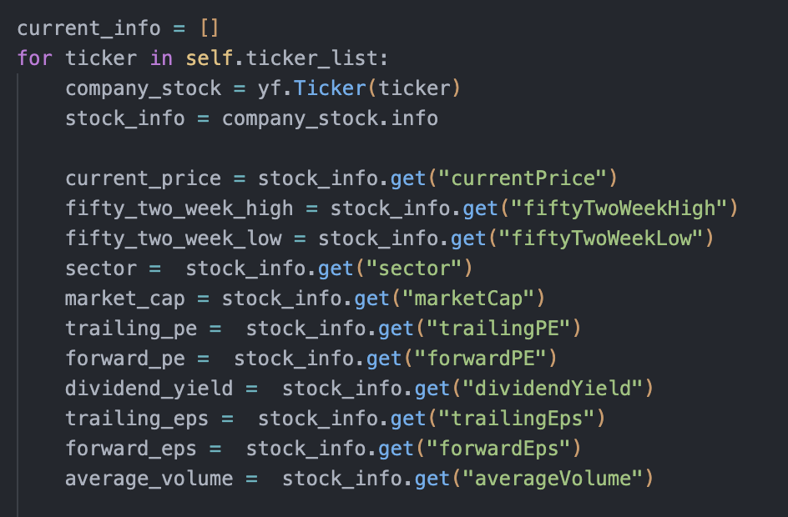
Data Exploration
Retrieving Past Data
Retrieving Current Data

Slide 7
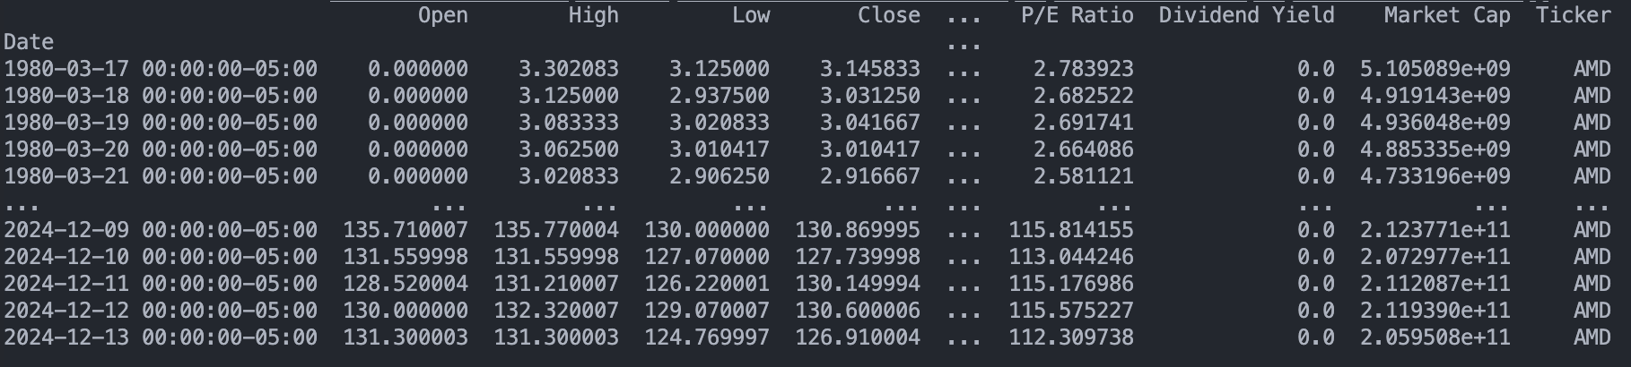
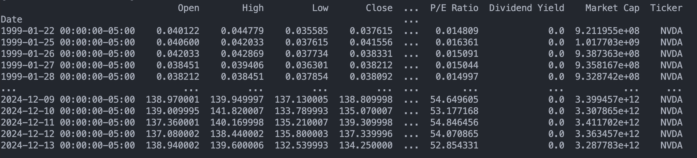
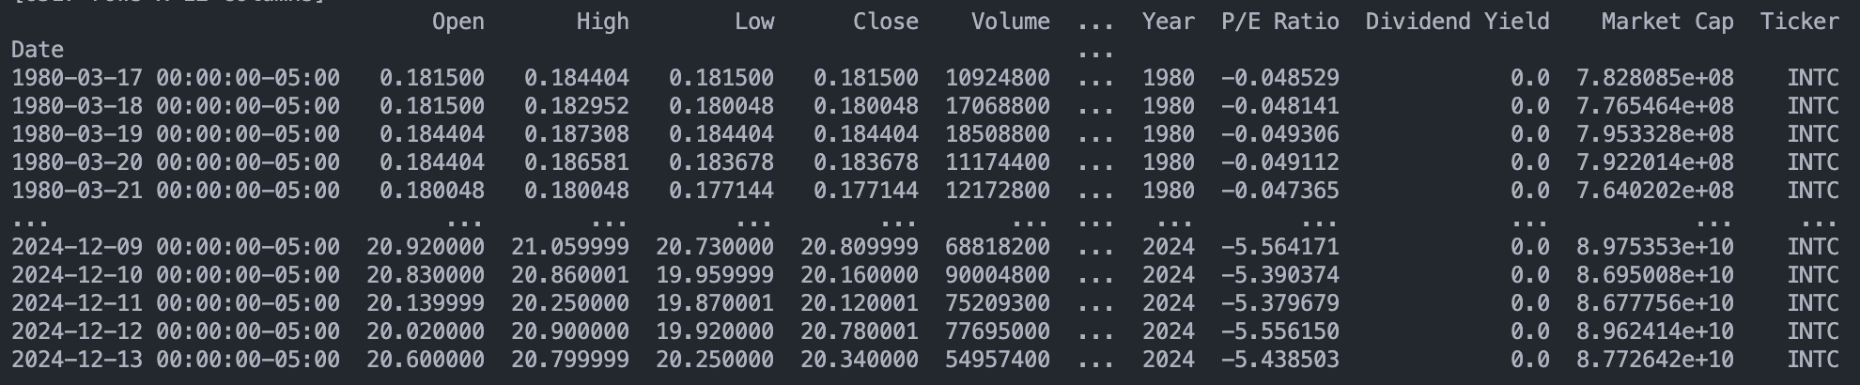
Data Exploration
Example Dataframe for
past data

Slide 8
Data Exploration
Example Dataframe for
current data

Slide 9


Data Exploration
Technical Indicators:
https://www.alphavantage.co/
RSI, ATR, MACD, ADX.
Sentiment Retrieval:
https://newsapi.org
Title, Description, Source, URL, and Sentiment Score
TextBlob library for sentiment analysis
ATR (Average True Range): Describes average range between high and low prices for volatility assessment.
RSI (Relative Strength Index): Identifies if stock is overbought (>70) or oversold (<30).
MACD (Moving Average Convergence Divergence): Shows relation between long term and short term prices, as well as trend direction.
ADX (Average Directional Index): Analyzes the strength of a trend in the market.

Slide 10
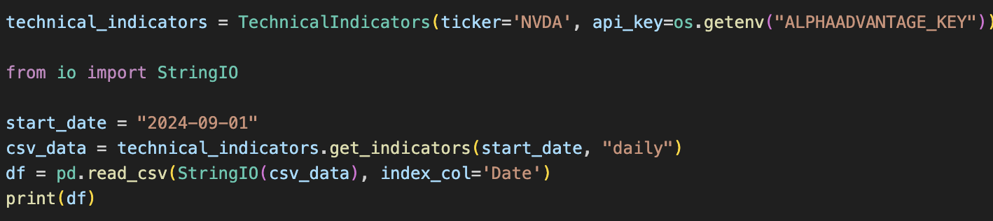
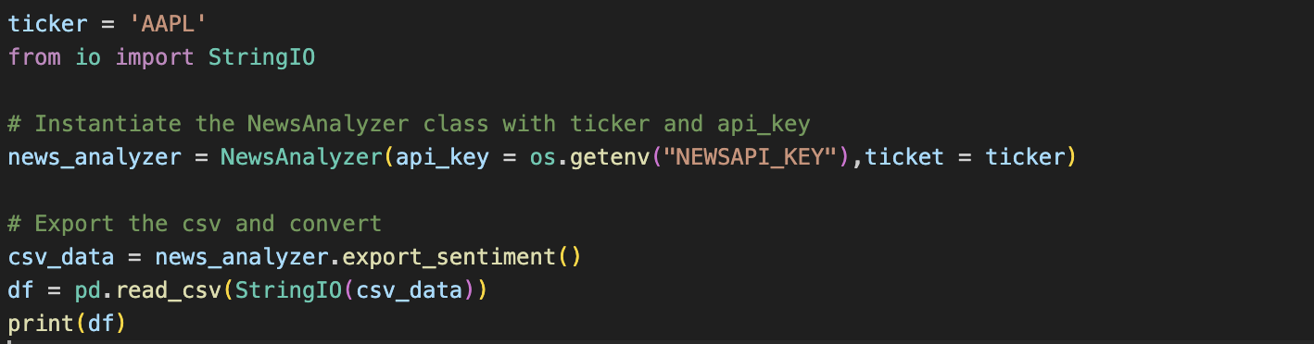
Data Exploration
Using Data Retrieval Classes

Slide 11
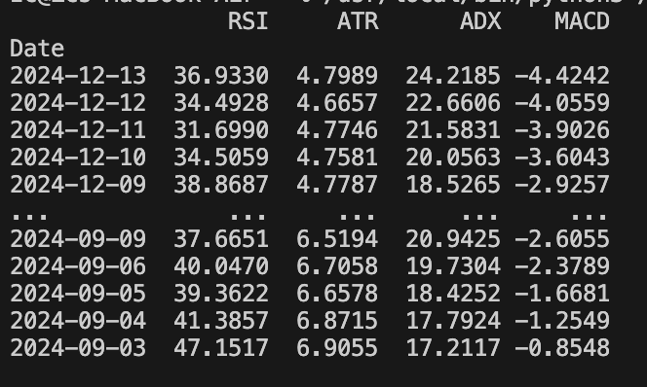
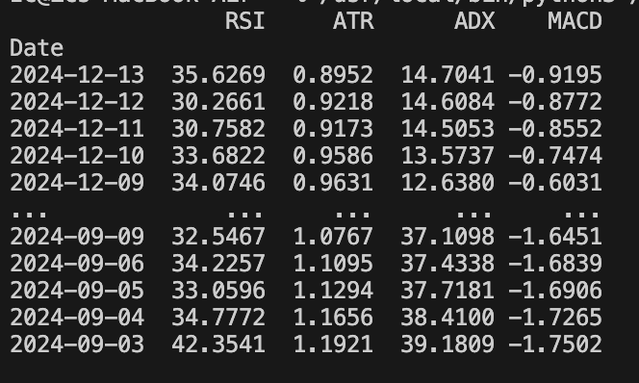
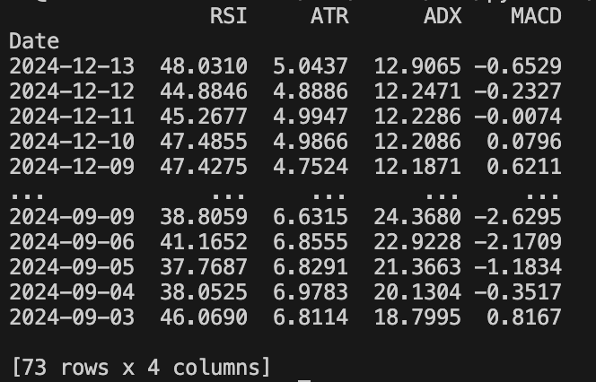
Data Exploration
Technical Indicators
AMD
INTC
NVDA

Slide 12
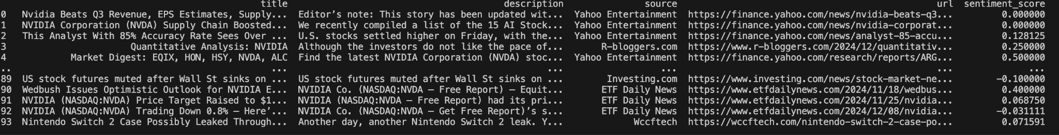
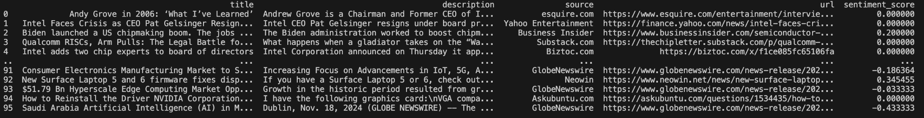
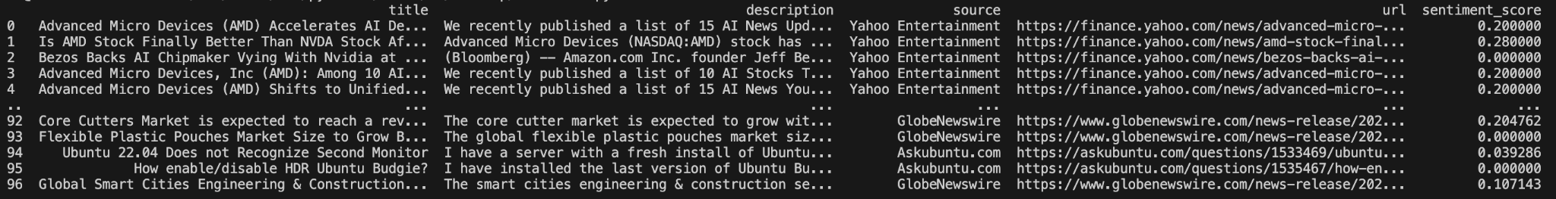
Data Exploration
Sentiment Analysis

Slide 13
2. The Process
Cleaning the data and evaluating

Slide 14
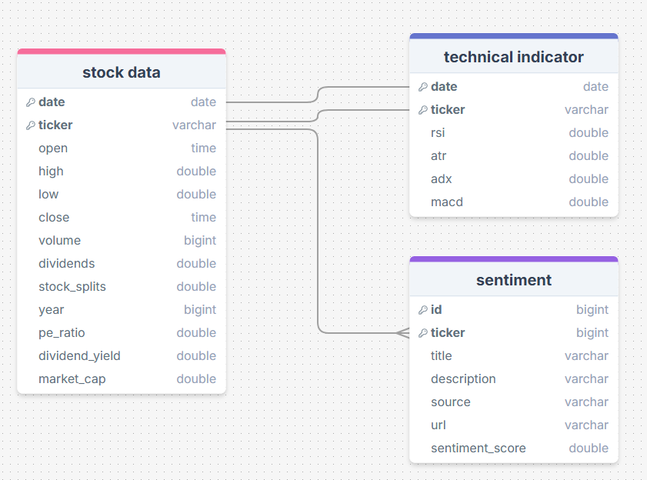
DIAGRAM

Slide 15
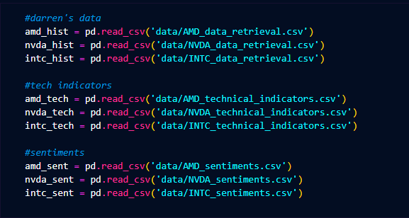
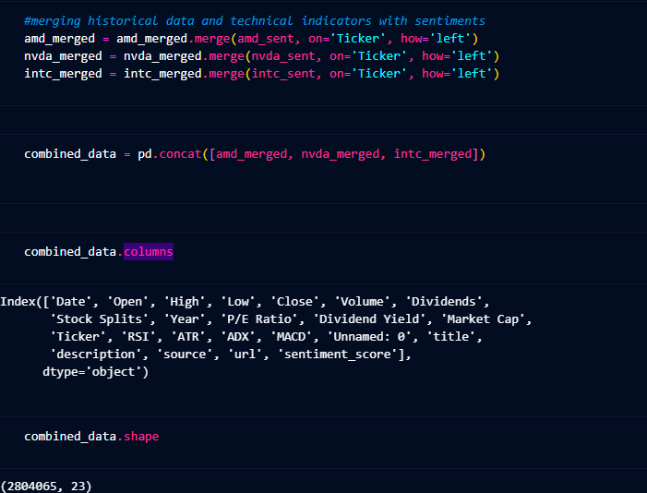
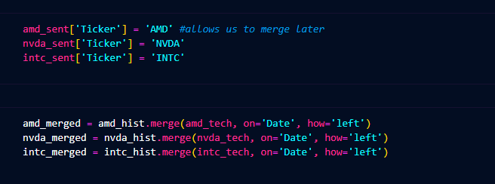
Combined data frame

Slide 16
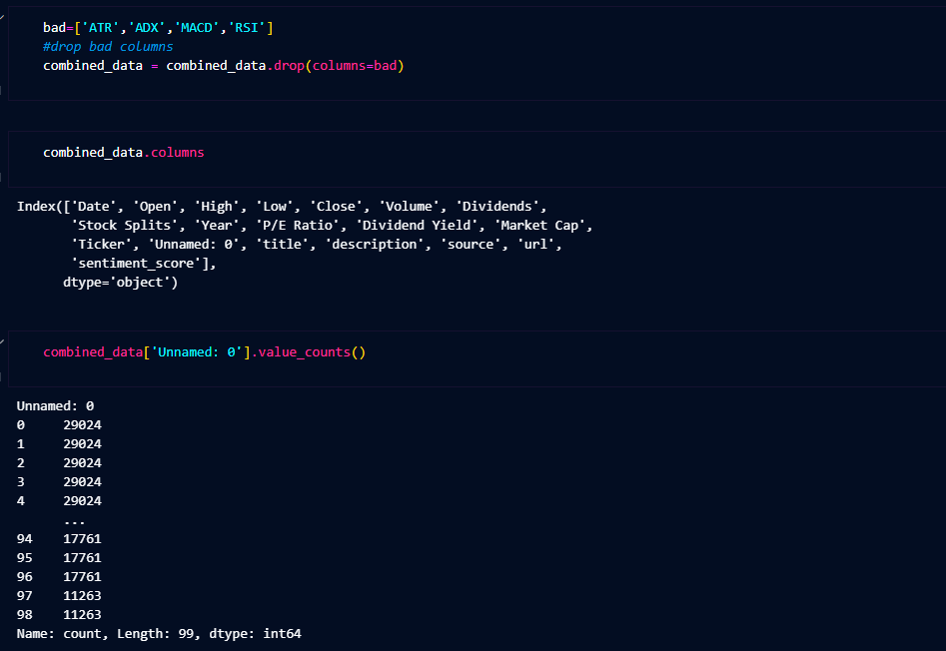
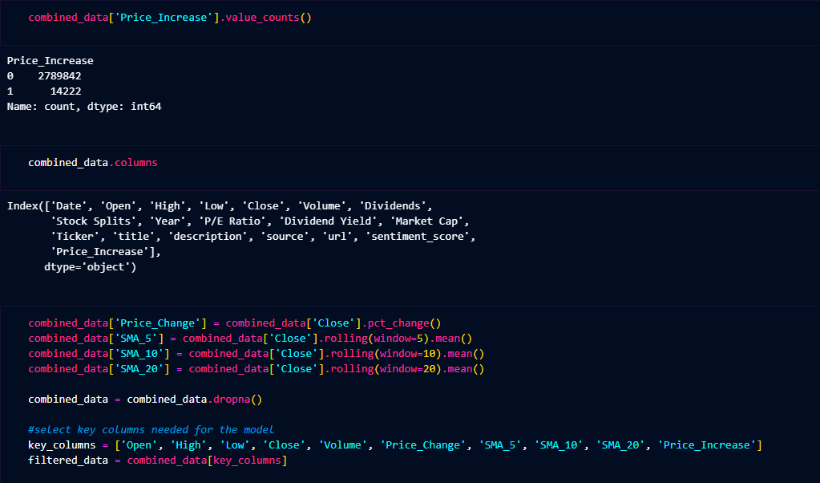

Cleansing the Dataframe

Slide 17
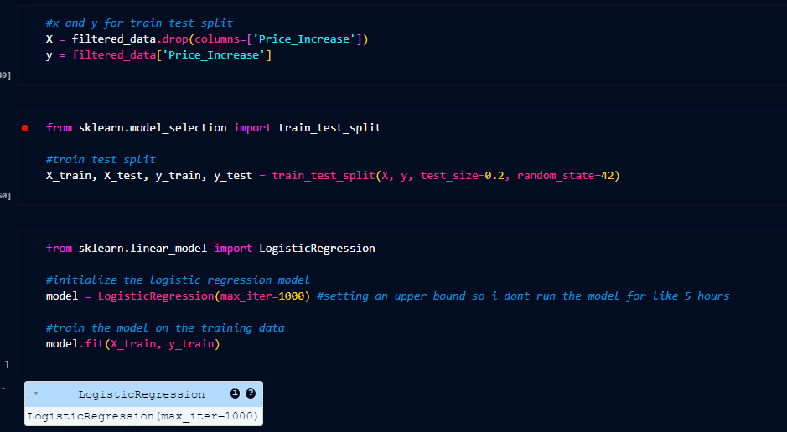
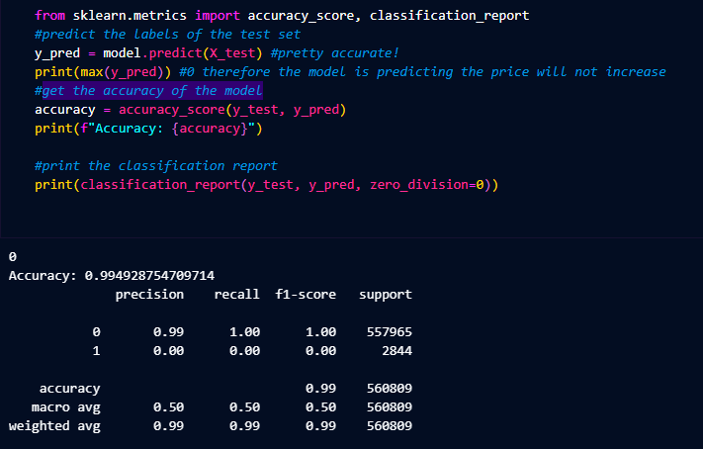
Running logistic regression

Slide 18
3. Visualizations
Displaying our insights via a graph

Slide 19
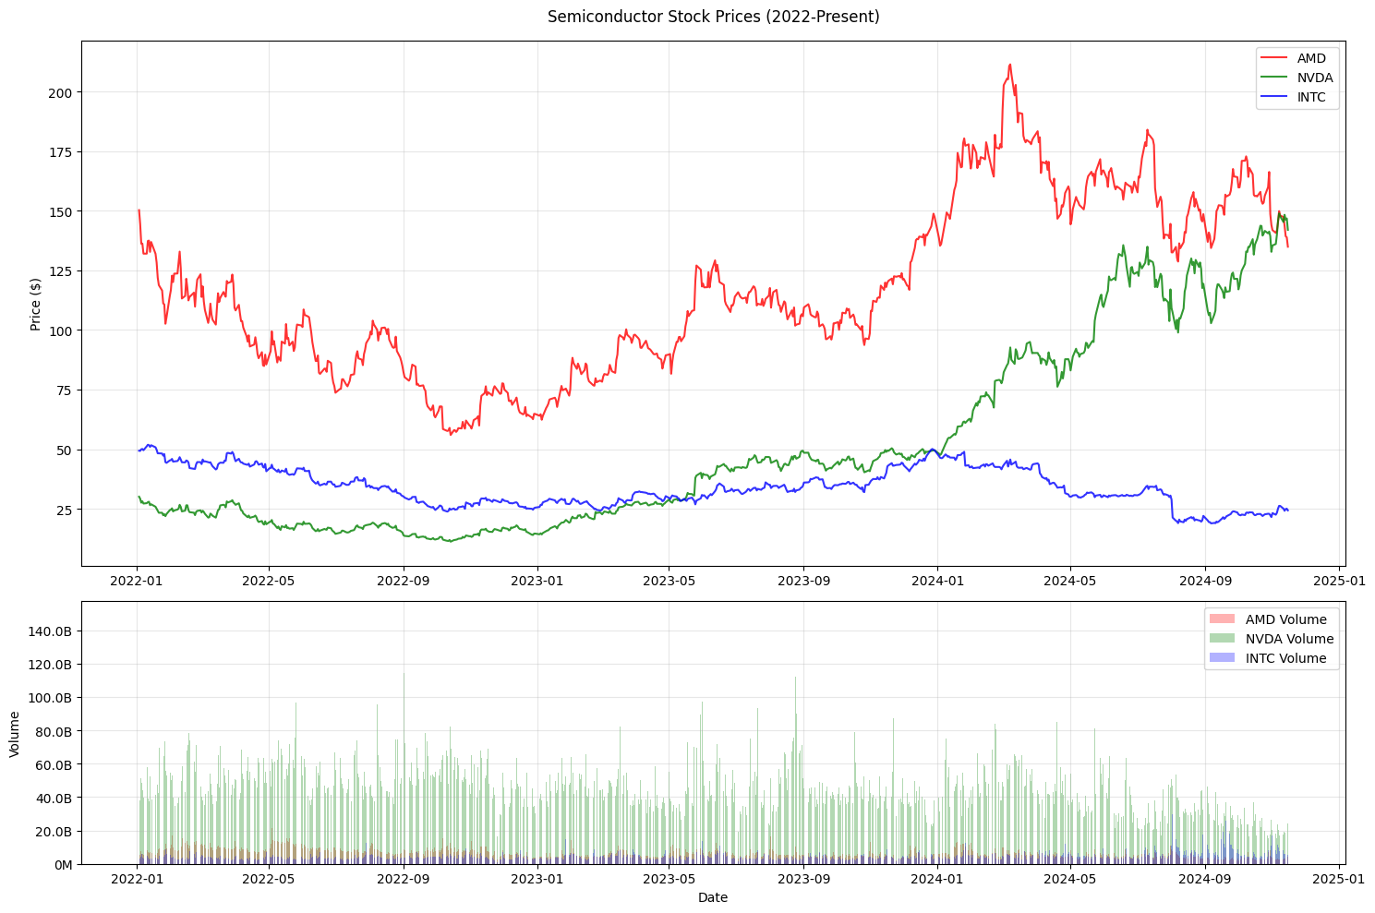
Visualizations

Slide 20
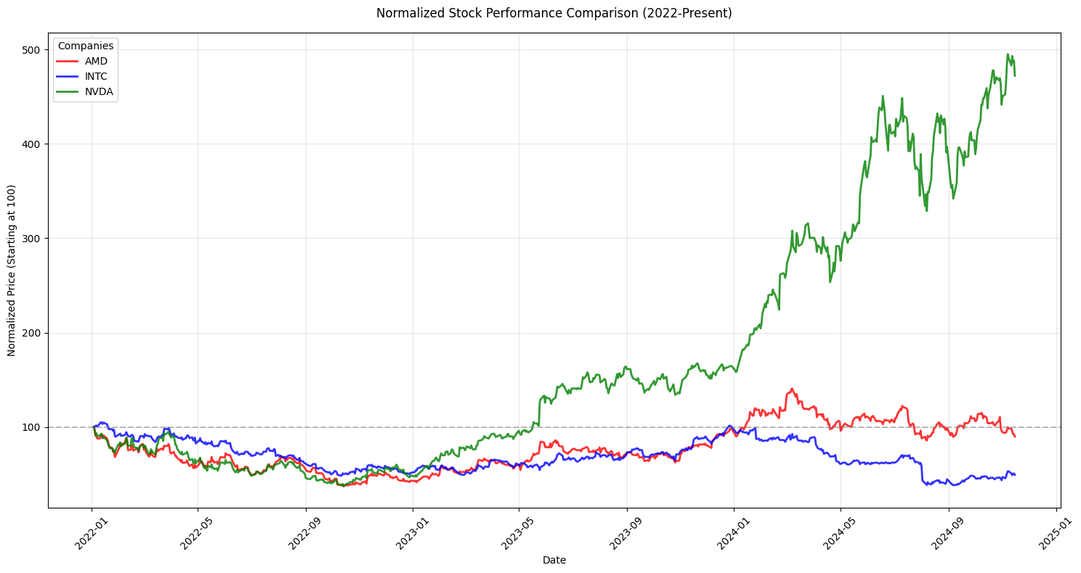
Visualizations

Slide 21
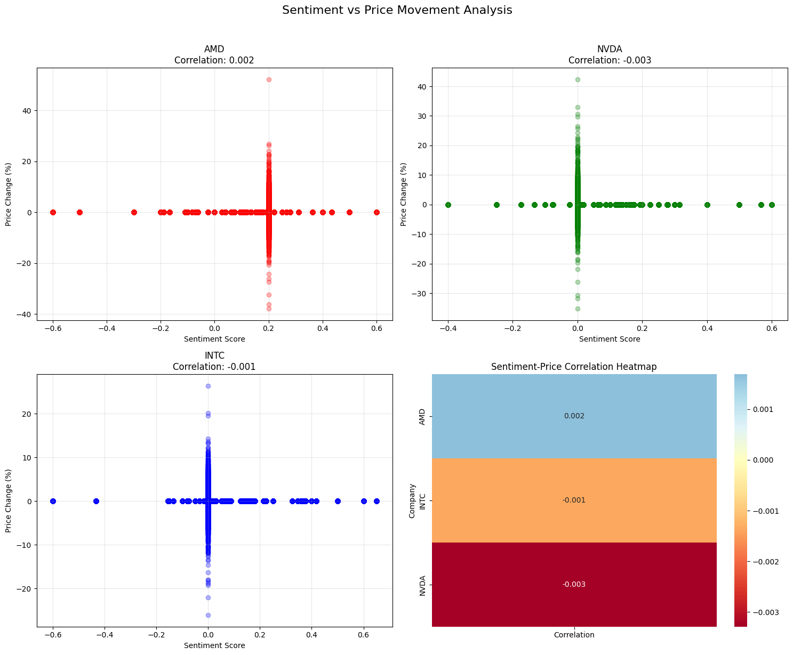
Visualizations

Slide 22
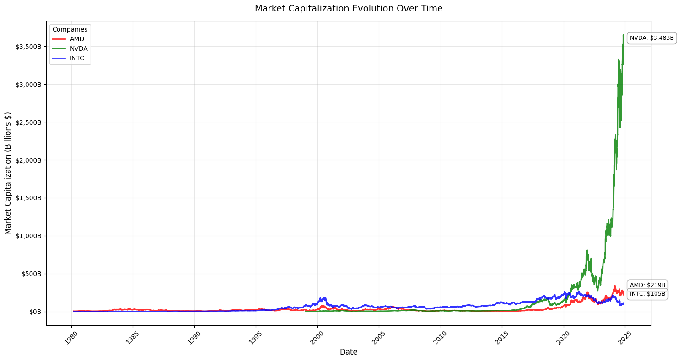
Visualizations

Slide 23
4.
Business Intelligence tool
Utilizing Tableau

Slide 24
Why use tableau in this scenario
Intuitive Interface: Easily create dashboards with no coding required.
Dynamic Exploration: Interactivity allows real-time comparisons and insights.
Customizable Visuals: Adapt dashboards to highlight key stock indicators.
Scalability: Analyze large datasets (e.g., historical stock data) efficiently.
Collaboration: Share dashboards with teams or clients through Tableau Server or Tableau Online.
Use case for Insights on …….
Best Performing Stocks: Identify top gainers over a specific time period.
Market Trends: Spot bullish or bearish trends across industries or indices.
Volume Spikes: Detect unusual trading activity that could indicate market-moving events.
Portfolio Analysis: Visualize the performance of a custom portfolio compared to benchmarks like the S&P 500.

Slide 25
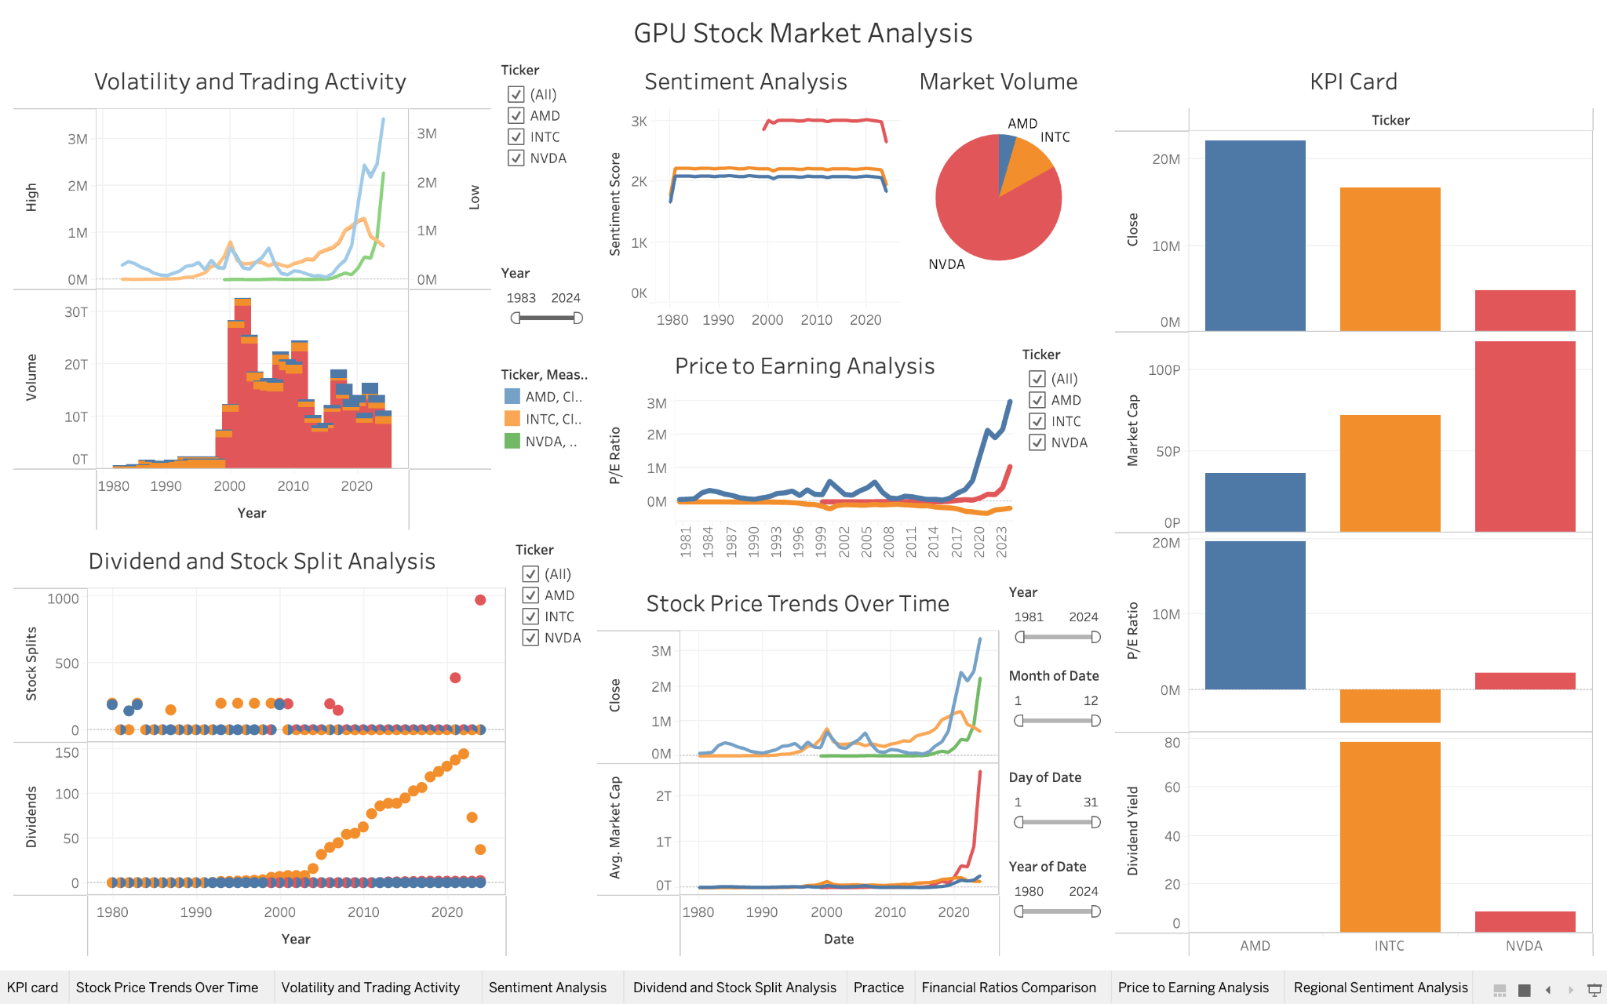
Tableau DasHBOARD

Slide 26

THANKS
Does anyone have any questions?
Small Data LLC

