Slide 1
Student Course Registration System
Team members: Kyle Gosine, Weijun Huang, Mohamed Kamagate, Xinfan Li, and Hector Santana.

Slide 2
Use Case 1: Course Search & Enrollment
User Journey
Student logs into the system
Student searches courses by department or keyword
System displays available sections
Student selects a section
System checks seat availability
Student enrolls successfully
System Actions
Retrieves course data from database
Updates enrollment table
Decrease available seats

Slide 3
Use Case 2: Waitlist System
User Journey
Student tries to enroll in a full class
System notifies the class is full
System offers waitlist option
Student joins waitlist
System records waitlist position
System Actions
Updates waitlist table
Notifies students when seats open

Slide 4
Use Case 3: Instructor Schedule Management
User Journey
Instructor logs into the system
Instructor creates a course section
Instructor sets schedule and capacity
System publishes the section for students
System Actions
Updates waitlist table
Notifies students when seats open

Slide 5
Students Table
Student ID (PK) | Name | Email | Phone
S001 | Diana Chen | diana.chen@ccny.edu | 555-987-6543
S002 | Emily Wang | emily.wang@ccny.edu | 123-456-7890
S003 | Alice Lee | alice.lee@ccny.edu | 575-987-6543
S004 | Carlos Rivera | carlos.rivera@ccny.edu | 987-654-3210

Slide 6
Instructors Table
Instructor ID (PK) | Name | Department | Email
I001 | Bob Smith | Computer Science | bob.smith@ccny.edu
I002 | John Kim | Business | john.kim@ccny.edu
I003 | Sarah Johnson | Psychology | sarah.johnson@ccny.edu
I004 | Betty Anderson | History | betty.anderson@ccny.edu

Slide 7
Courses Table
Course ID (PK) | Course Name | Credits | Department
C101 | Data Structures | 3 | Computer Science
C102 | Marketing Principles | 3 | Business
C103 | Psychology | 3 | Psychology
C104 | World History | 3 | History

Slide 8
Course Sections Table
Section ID (PK) | Course ID (FK) | Instructor ID (FK) | Semester | Capacity | Room | Schedule | Open Seats
SEC001 | C101 | I001 | Fall 2025 | 30 | Hall A | Mon/Wed 10 AM | 27
SEC002 | C102 | I002 | Fall 2025 | 40 | Hall B | Tue/Thu 2 PM | 31
SEC003 | C103 | I003 | Spring 2025 | 25 | Room 301 | Mon/Wed 2 PM | 24
SEC004 | C104 | I004 | Spring 2025 | 35 | Room 205 | Fri 10 AM - 1 PM | 30

Slide 9
Enrollments Table
Enrollment ID (PK) | Student ID (FK) | Section ID (FK) | Enrollment Date | Status
E001 | S001 | SEC001 | 2025-03-01 | Enrolled
E002 | S002 | SEC002 | 2025-03-02 | Enrolled
E003 | S003 | SEC001 | 2025-03-05 | Enrolled
E004 | S004 | SEC003 | 2025-03-06 | Enrolled
E005 | S001 | SEC003 | 2025-03-07 | Dropped
E006 | S002 | SEC004 | 2025-03-08 | Enrolled

Slide 10
Waitlist Table
Waitlist ID (PK) | Student ID (FK) | Section ID (FK) | Joined Date | Position
W001 | S001 | SEC002 | 2025-03-03 | 1
W002 | S002 | SEC001 | 2025-03-15 | 2
W003 | S003 | SEC004 | 2025-03-06 | 1
W004 | S004 | SEC002 | 2025-03-01 | 3
W005 | S003 | SEC002 | 2025-03-09 | 4
W006 | S001 | SEC004 | 2025-03-11 | 2

Slide 11
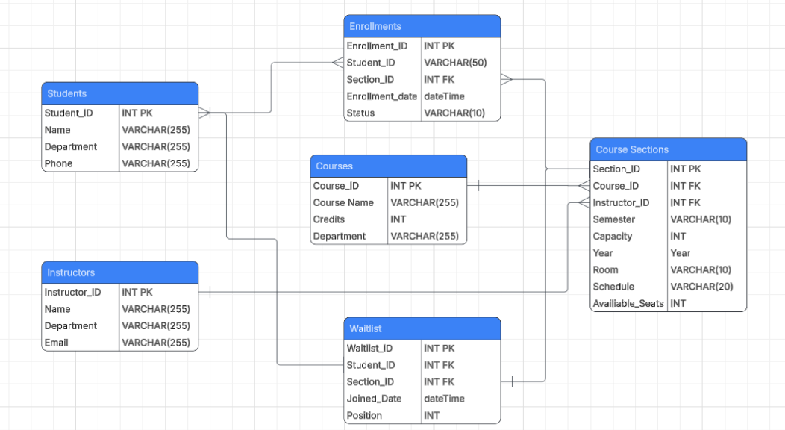
Data Model

Slide 12
Technology Stack
Backend
Frontend
Database
Node.js + Express.js
For handling course search, enrollment, waitlisting, authentication, and role-based access control.
React.js
Dynamic, real-time UI for students and instructors.
Fully responsive (mobile, tablet, desktop.)
MySQL
Relational database for Students, Instructors, Courses, Enrollments, Waitlist.
Supports complex queries and real-time seat updates.
GitHub (Private / Public)
Version control and team collaboration.
Secure code management.
RESTful APIs · JWT Authentication · Postman Testing · Docker

Slide 13
Revenue Model
1. Institutional Licensing
Annual software licenses for universities, colleges, and training centers
Setup fee + annual maintenance
2. Customization & System Integration
Tailored development based on client needs
Integration with existing systems (e.g., payment gateways)
3. Data Analytics Services
Premium dashboards for enrollment trends
Course demand forecasting
Student behavior insights

Slide 14
Competitive Advantage
1. Built to Scale
Powered by a high-performance Node.js and MySQL architecture, our platform is engineered to support thousands of simultaneous users across universities and training programs with reliability and speed.
2. Data-Driven Learning Insights
Our proprietary analytics engine tracks student progress, performance patterns, and engagement in real time, providing institutions with actionable insights to improve learning outcomes and personalize instruction.
3. Institutional-Ready Platform
Purpose-built for universities, training programs, and research labs, our platform combines curriculum tools, performance dashboards, and administrative controls in one unified ecosystem.

Slide 15
Thank You

