Slide 1

TradeConnect
CSC 33600 · FINAL DEMONSTRATION
TradeConnect
A two-sided marketplace for employers and tradespeople
Next.js 14
Flask
MySQL
15 Tables
12 Triggers
3NF
Final Team Project Demonstration

Slide 2

TradeConnect
AGENDA
DEMO WALKTHROUGH
Today's Agenda
Introduction
Stored Procedures & Triggers
01
06
Team, business idea, tech stack, profit model
Two live trigger demos from MVP flows
Use Cases & User Journey
2NF Relational Model
02
07
How employers, tradespeople, and juniors flow through the platform
Final ERD with all entities and relationships
MVP Demo 1 — Job Lifecycle
Takeaways
03
08
Posting → application → booking auto-creation
What we learned about relational databases
MVP Demo 2 — Endorsement
Extra Credit Work
04
09
Junior unlocks job access through senior approval
Above-spec features we shipped
Revenue Stream Reporting
Q&A · Submission
05
10
Admin dashboard, fee %, totals & breakdown
Discussion and GitHub Classroom hand-in
CSC 33600 · Spring 2026 · Final Presentation

Slide 3




TradeConnect
INTRODUCTION
Introduction
Team
Business Idea
Oliver P Israel
TradeConnect is a two-sided marketplace where employers post jobs and verified tradespeople apply, get booked, and get paid. Junior tradespeople earn credibility through senior endorsements.
1
Backend
2
Md Hasan
Database
Tech Stack
3
Aung Latt
Next.js 14 (TypeScript) on the front, Flask + native mysql-connector on the back, MySQL 8 as the source of truth. No ORM — direct SQL with parametrized queries.
Frontend
4
Nathan Chen
DevOps
Profit Model
5
Dario Haxhia
Reports
Two revenue streams: a 10% platform service fee on every paid booking, plus tiered tradesperson subscriptions (Free / Pro / Elite). Both flow into one revenue_streams table.
CSC 33600 · Spring 2026 · Final Presentation

Slide 4



TradeConnect
USE CASES
TWO USER JOURNEYS
How Value Flows Through the Platform
Employer journey — posting work and getting it done
1
Post a job
2
Review applicants
3
Accept application
4
Pay & review
Title, trade type, city, budget, and scheduled date.
Browse tradespeople by rating, experience, proposed price.
Trigger auto-creates the booking and closes the posting.
10% fee deducted server-side; trigger queues a review request.
Tradesperson / Junior journey — earning work and reputation
1
Register & list services
2
Apply / get endorsed
3
Get booked
4
Earn & subscribe
Set hourly rates and trade categories.
Juniors request a senior's endorsement to unlock jobs.
City-match and time-overlap triggers guard the calendar.
Pro / Elite plans lift the job cap; ratings update live.
CSC 33600 · Spring 2026 · Final Presentation

Slide 5
TradeConnect
MVP DEMO 1
LIVE DEMO · MVP #1
Job Lifecycle — From Posting to Booking
What we'll demo live
localhost:3000/employer/dashboard
The end-to-end job pipeline — from an employer creating a posting through to a booking being auto-generated by a database trigger.
Active Postings
Bathroom retile — Astoria
Plumbing · $800–$1,200 · 3 applicants
1
Employer logs in
Hits /employer/dashboard, opens 'New job posting'.
Kitchen rewire — Bronx
2
Submit a posting
Electrical · $1,500–$2,000 · 2 applicants
POST /api/job-postings — row lands in job_postings (status='open').
AC unit install — Brooklyn
3
Tradesperson applies
HVAC · $600–$900 · Booked ✓
POST /api/job-applications with a proposed price and message.
4
Employer accepts
PATCH on application status → 'accepted'.
Accept application → Trigger fires → Booking row created
5
Trigger fires
application_accept_creates_booking inserts the booking & closes the posting in one step.
CSC 33600 · Spring 2026 · Final Presentation

Slide 6
TradeConnect
MVP DEMO 2
LIVE DEMO · MVP #2
Junior Endorsement — Unlocking Job Access
What we'll demo live
triggers.sql · approve_endorsement_sets_endorse_id
A new junior tradesperson requests endorsement from a verified senior. When the senior approves, a trigger writes the endorse_id back — instantly unlocking the junior's ability to take jobs.
CREATE TRIGGER approve_endorsement_sets_endorse_id
AFTER UPDATE ON endorsement_requests
FOR EACH ROW
BEGIN
IF NEW.status = 'approved' AND OLD.status <> 'approved' THEN
UPDATE tradespeople
SET endorse_id = NEW.supervisor_tradesperson_id
WHERE tradesperson_id = NEW.junior_tradesperson_id;
END IF;
END;
1
Junior signs up
POST /api/auth/register with user_type='Junior'. endorse_id is NULL — they cannot book yet.
2
Upload proof
Multipart upload to /api/documents (path-traversal & MIME-spoof defenses applied).
3
Request endorsement
POST /api/endorsement-requests, status='pending'.
4
Senior approves
PATCH status → 'approved'.
Approval → endorse_id written → Junior can now be booked ✓
5
Trigger fires
approve_endorsement_sets_endorse_id writes the senior's tradesperson_id to the junior's row — instant unlock.
CSC 33600 · Spring 2026 · Final Presentation

Slide 7
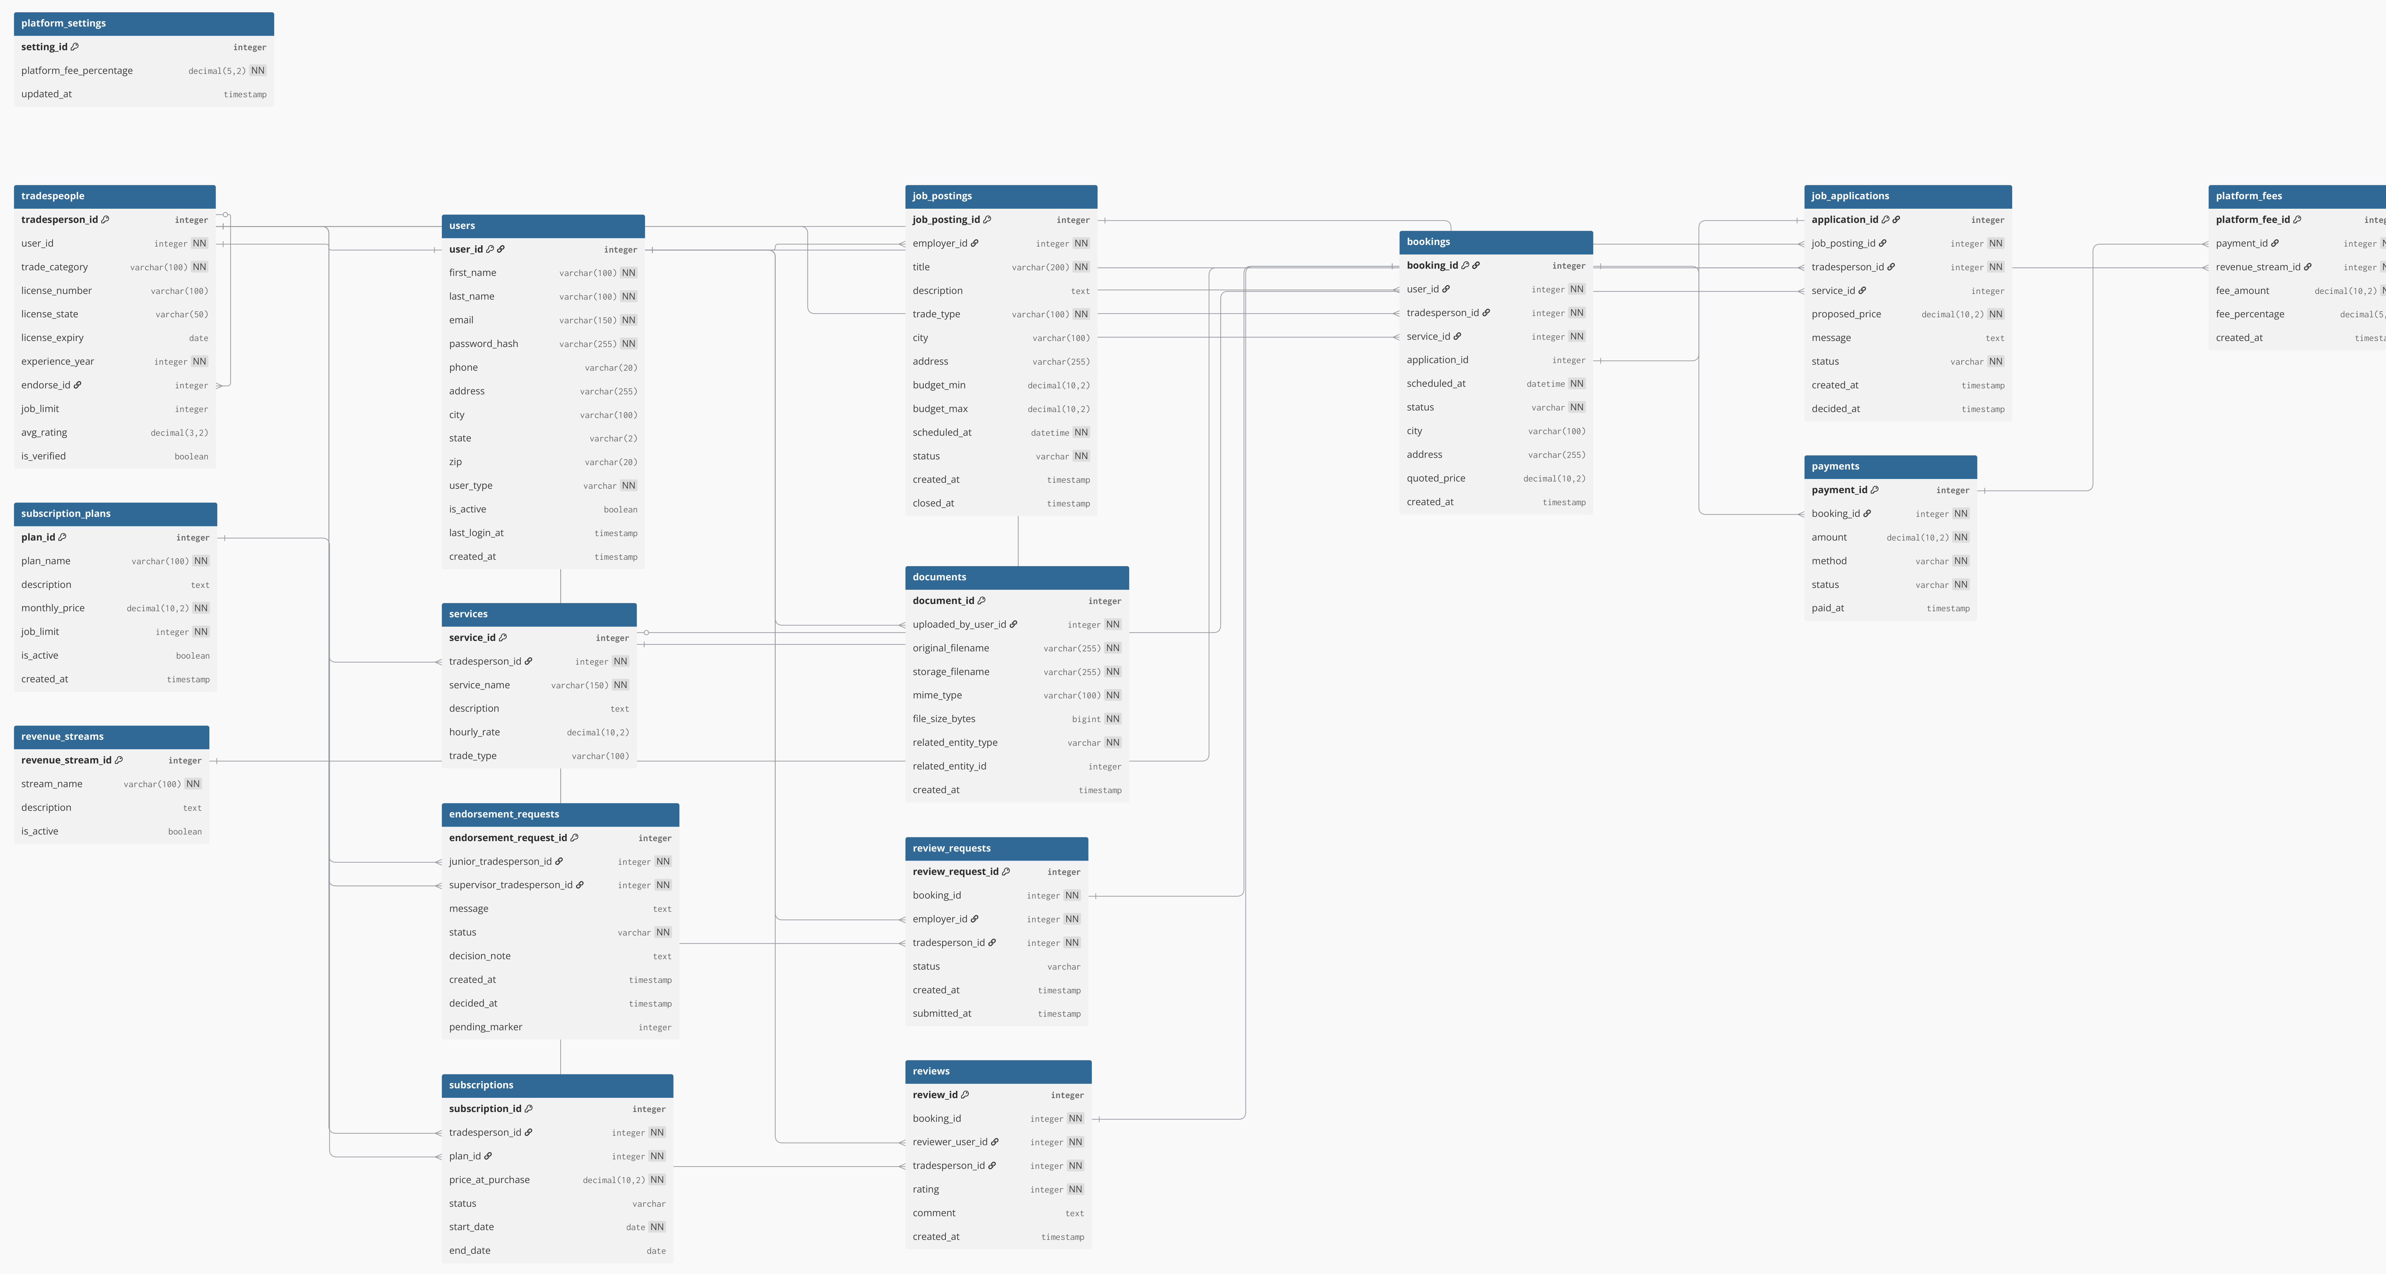
TradeConnect Relational Model Diagram
DATABASE DESIGN
FINAL SCHEMA · 2NF/3NF
users
tradespeople
services
subscription_plans
subscriptions
platform_settings
PK user_id
first_name
last_name
email
user_type
city, state, zip
is_active
PK tradesperson_id
FK user_id
trade_category
experience_year
FK endorse_id*
avg_rating
PK service_id
FK tradesperson_id
service_name
hourly_rate
trade_type
PK plan_id
plan_name (Free/Pro/Elite)
monthly_price
job_limit
is_active
PK subscription_id
FK tradesperson_id
FK plan_id
price_at_purchase
status
start_date / end_date
PK setting_id=1
platform_fee_pct
updated_at
endorsement_requests
job_postings
job_applications
bookings
documents
Legend
PK endorsement_request_id
FK junior_trade_id
FK supervisor_trade_id
status
decision_note
PK job_posting_id
FK employer_id (users)
trade_type
city, budget_min/max
scheduled_at
status
PK application_id
FK job_posting_id
FK tradesperson_id
FK service_id
proposed_price
status
PK booking_id
FK user_id (employer)
FK tradesperson_id
FK service_id
FK application_id*
scheduled_at
status
PK document_id
FK uploaded_by_user_id
storage_filename (UUID)
mime_type
related_entity_type
related_entity_id
Core entity
Revenue / config
15
tables
12
triggers
3NF
normalized
review_requests
reviews
payments
platform_fees
revenue_streams
PK review_request_id
FK booking_id (unique)
FK employer_id
FK tradesperson_id
status
PK review_id
FK booking_id (unique)
FK reviewer_user_id
FK tradesperson_id
rating (1-5)
comment
PK payment_id
FK booking_id
amount
method (card/cash/online)
status
paid_at
PK platform_fee_id
FK payment_id
FK revenue_stream_id
fee_amount
fee_percentage
PK revenue_stream_id
stream_name
description
is_active
(2 rows: Fee + Subs)
Relationships shown via FK columns. Diagram simplified — full ERD in repo /database/schema.sql.

Slide 8
TradeConnect
STORED PROCEDURES
DEMONSTRATION · MIN. 2
Stored Procedures & Triggers
We chose triggers — the project requirement allows "stored procedures (including triggers)". Both fire automatically inside MVP flows and prevent invalid state at the DB layer, not just the app layer.
1
application_accept_creates_booking
2
update_avg_rating_after_review
AFTER UPDATE on job_applications
AFTER INSERT on reviews
PURPOSE
PURPOSE
When an employer accepts a tradesperson's application, automatically insert the matching bookings row and close the posting — in one atomic step.
When an employer submits a star rating, recompute the affected tradesperson's avg_rating from their full review history and write it back.
MVP TIE-IN
MVP TIE-IN
Powers MVP #1 — the 'Accept' button can't forget to create the booking, because the DB does it.
Powers the rating shown on every browse card and tradesperson profile — always fresh, always correct.
IF NEW.status = 'accepted' AND OLD.status <> 'accepted' THEN
INSERT INTO bookings (...)
SELECT jp.employer_id, ja.tradesperson_id,
ja.service_id, NEW.application_id,
jp.scheduled_at, 'accepted'
FROM job_postings jp JOIN ja ON ...;
UPDATE job_postings SET status='filled'
WHERE job_posting_id = NEW.job_posting_id;
END IF;
UPDATE tradespeople
SET avg_rating = (
SELECT ROUND(AVG(rating), 2)
FROM reviews
WHERE tradesperson_id = NEW.tradesperson_id
)
WHERE tradesperson_id = NEW.tradesperson_id;
CSC 33600 · Spring 2026 · Final Presentation

Slide 9
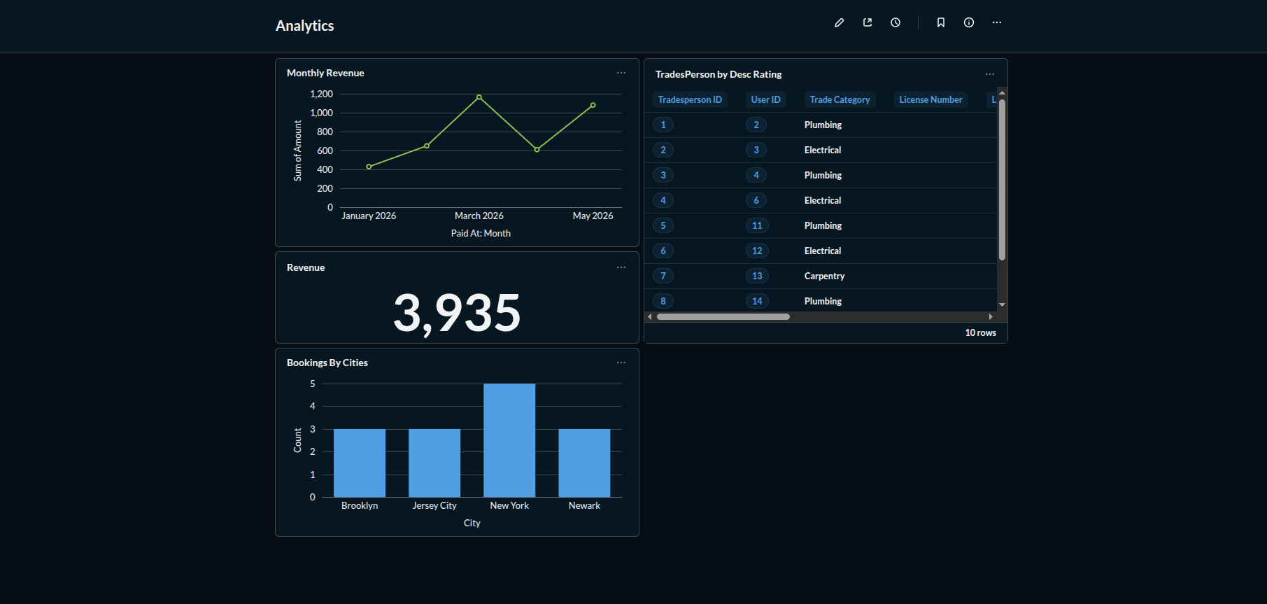
TradeConnect
REVENUE REPORTING

Slide 10



TradeConnect
TAKEAWAYS
WHAT WE LEARNED
Takeaways
NEW TECHNOLOGY
AHA MOMENT
WHAT WE'D TELL FUTURE STUDENTS
Triggers as a design tool
3NF isn't about purity — it's about avoiding silent bugs
Push invariants down to the DB
Before this project we thought of triggers as glorified audit logs. Building this app changed that. Once we moved 'accepting an application creates a booking' into a trigger, every code path that mutated applications automatically did the right thing — including a SQL console session. That's the kind of guarantee app-layer code can't give you.
Snapshotting subscription prices into price_at_purchase felt redundant until we realized: editing a plan price would have silently rewritten history for every past subscriber. Pulling the catalog out into subscription_plans and keeping a snapshot column was the single change that made the schema feel right.
City matching, time overlap, junior-without-endorsement — all of these started as if-statements in Flask. Every one of them ended up as a BEFORE INSERT/UPDATE trigger. The frontend got smaller, the API got simpler, and the rules can't be bypassed by a stray SQL UPDATE.
CSC 33600 · Spring 2026 · Final Presentation

Slide 11
TradeConnect
Extra Credit Work
Three categories of bonus work we did on top of the requirements.
01
02
03
UX-focused frontend
Query optimization & data integrity
Dockerized deployment workflow
Full app runs through Docker containers for consistent local setup.
Docker separates frontend, backend, and database services for easier testing and handoff.
Render deployment used for live hosting while Docker remains the main development/runtime environment.
22 typed Next.js 14 routes, four role-specific dashboards.
Reviews button auto-hides once a review is submitted (has_review flag joined server-side).
Tailwind design system with consistent card / badge / form primitives.
16 secondary indexes across the hottest join paths (bookings, applications, endorsements).
Generated column + unique key blocks duplicate pending endorsement requests at the DB layer.
All money math done with Python Decimal + ROUND_HALF_UP — never floats.
CSC 33600 · Spring 2026 · Final Presentation

Slide 12

TradeConnect
OPEN FLOOR
Questions & Examination
We've reserved 5–8 minutes for questions from the audience. Ask anything about the schema, the triggers, the revenue logic, the UI, or our team workflow — we'll happily pop open the live app or the SQL console to show you.
CSC 33600 · Spring 2026

