Slide 1
DataSHIELD BioSHaRE
DataSHIELD IT infrastructure
for BioSHaRE

Slide 2
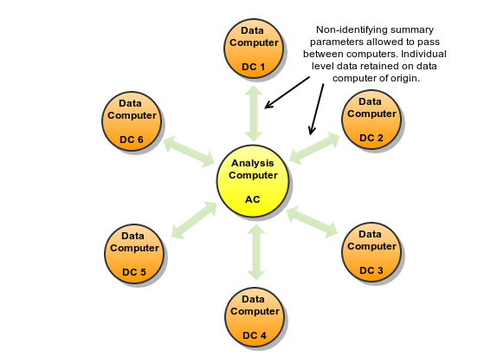
DataSHIELD IT
DataSHIELD basics

Slide 3
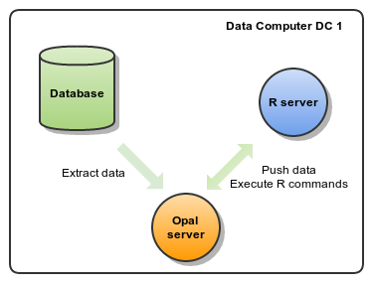
DataSHIELD IT
Data Computer = Opal + R

Slide 4
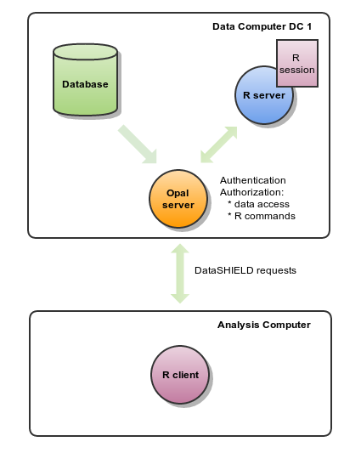
DataSHIELD IT
Data Computer + Analysis Computer

Slide 5
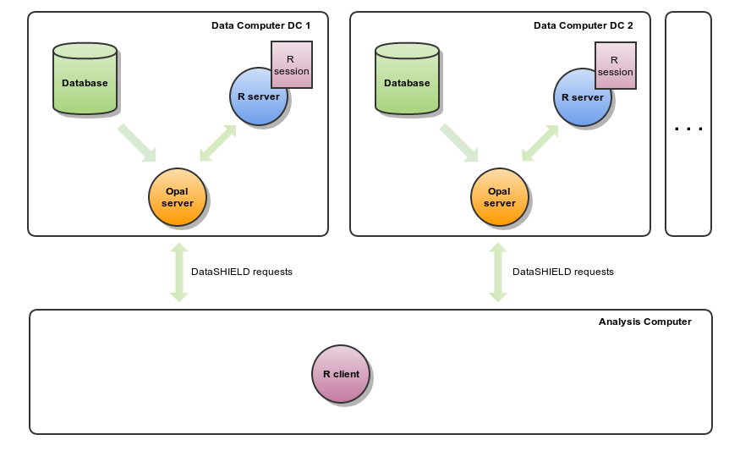
DataSHIELD IT
n Data Computers + Analysis Computer

Slide 6
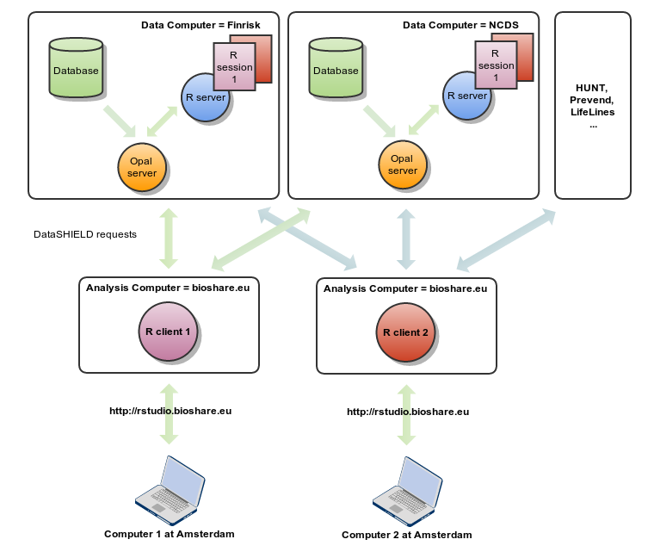
DataSHIELD BioSHaRE IT

Slide 7
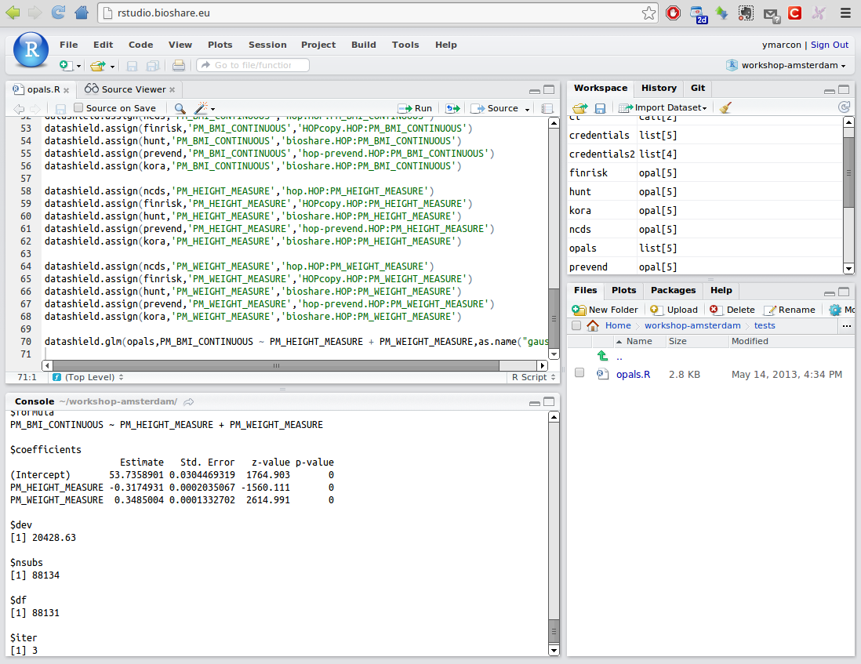
BioSHaRE Rstudio

Slide 8
Opal Data Structure
Table
    Column = variable (name, type, categories...)
    Row = data of a participant
Datasource1.Table1
 | VAR1 | VAR2 | ... | VARn
1 | 11 | a |  | x
2 | 23 | g |  | y
...

Slide 9
DataSHIELD Opal API
Opal R package: opal functions
    opal.login : opal connection
    opal.datasources : list the datasources
    opal.datasource : description of a datasource
    opal.tables : list the tables of a datasource
    opal.table : description of a table
    opal.variables : list the variables of a table
    opal.variable : description of a variable
    ...

Slide 10
DataSHIELD Opal API
Opal R package: datashield functions
    datashield.assign : assign a data (from Opal or result of a R expression) to a R symbol
    datashield.symbols : list all R symbols on server
    datashield.aggregate : returns result of an aggregation
    datashield.methods : list authorized aggregate and assign methods
    ...

