Slide 1
Beyond Syntax: Teaching Problem-Solving in R and Python through Real-Life Coding Challenges DEE2025 Conference
Ralf Becker (University of Manchester) Yichen Zhu (Aston University)

Slide 3
Agenda
Workshop objectives
Why This Workshop?
“Getting your hands dirty” instruction
Interactive Worksheet
Evaluation Evidence (Case Study: Aston, Manchester)
Interactive Activities
Group Reflection
Wrap-up & Takeaways

Slide 4
Workshop objectives (overlap with next slide, rethink)
Understand the shift from syntax memorisation to real-world problem-solving in coding instruction.
Explore examples of "authentic" coding challenges students face in real practice.
Trial interactive instructional materials that integrate real-world coding skills: data sourcing, package installation, debugging, searching etc.
Reflect on how to scaffold coding tasks for students with mixed ability levels.
Take away practical resources (in R or Python) that can be adapted for classroom use.

Slide 5
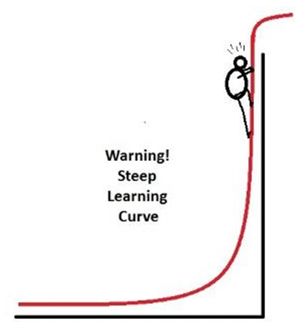

Why This Workshop?
Steep learning curve for beginners, particularly in grasping coding logic and syntax.
Need to foster independent coding and problem-solving skills.
How to adjust instruction in the presence of AI?
Here we think about how to …
help students understand the process of coding rather than know the correct code
design worksheets that encourage active engagement by students
encourage students to use resources (web searching or LLMs) in a productive manner

Slide 6

What changes because of AI?
Debate in the Computer Science (CS) pedagogy literature (e.g. Prather et al, 2023, for a review) on how to change CS education:
Increased focus on being able to read code (rather than write)
Increased focus on structuring through a problem
Consequences for assessment (not really discussed here)

Slide 7








“Getting your hands dirty” instruction
We think that the way we instruct students should reflect the way they will have to work on data after they leave our course.
Examples of typical real-life coding tasks students encounter:
Package Management
Interpreting Errors
Debugging
Using AI
Using Documentation
Using the Internet
Data Cleaning
Struggling
None of the typical activity involves being given a complete and correct code file.

Slide 8
“Getting your hands dirty” Worksheet
We want to design worksheets that incorporate these activities.
Setting:
Worksheets for students to go through by themselves at home, or
Worksheets for students to tackle during a computer lab
These worksheets will have the following components:
Scaffolded problem-solving using fill-in-the-blank exercises
find solutions by consulting documentation or the internet
LLM-enhanced exploration
Active recall and feedback via MCQs and instant feedback tools
Progress from guided to independent tasks, scaffolding
Intentional bugs and debugging activities

Slide 9


Implementation
In R: We use Rmarkdown, and in particular the Webexercises (Dale Barr and Lisa DeBruine) template/package to implement the interactive elements
In Python: We write jupyter notebooks using functionality of the pretty jupyter package (Jan Palasek)
Both produce html documents with interactive elements Here we will provide templates for both

Slide 10
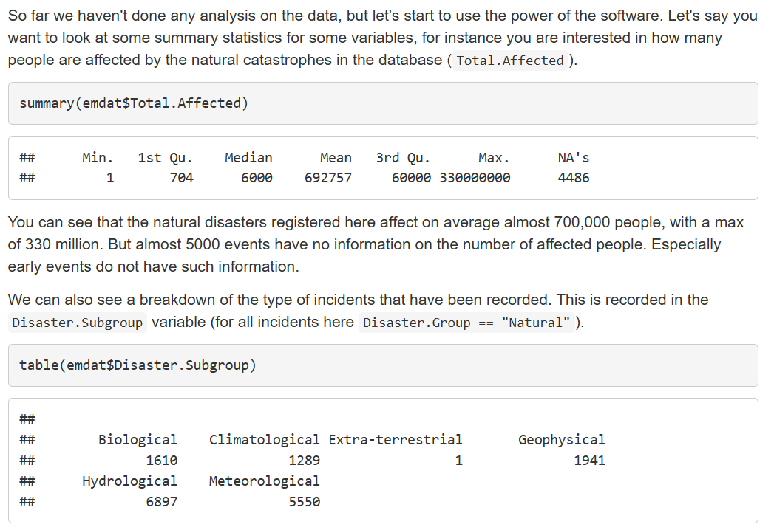
Rmarkdown documents
Combines
Text
Code
Output (could be plots)
Also:
Straightforward LaTeX integration
Flexible control of whether you wish to show code and/or output
This is an html file which you share with students. They can download it and work on it locally (also offline). Or you host it on a website, e.g. a github page.

Slide 11
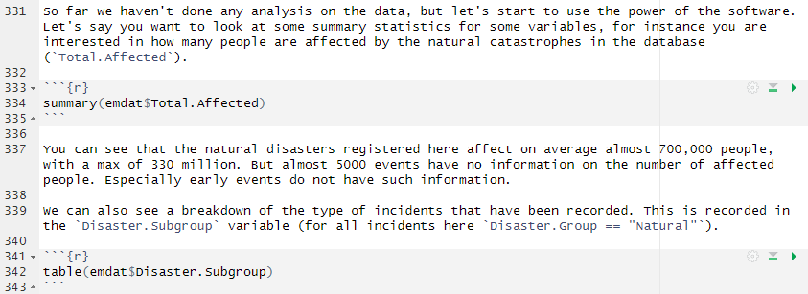
Rmarkdown documents
The Rmarkdown code
Code is enclosed in
```{r}
CODE GOES HERE
```
You can control whether code shows, executes, messages and errors are shown and how code output is shown
html file
To get from Rmarkdown to html you need to render or knit the file (done through Rstudio)

Slide 12
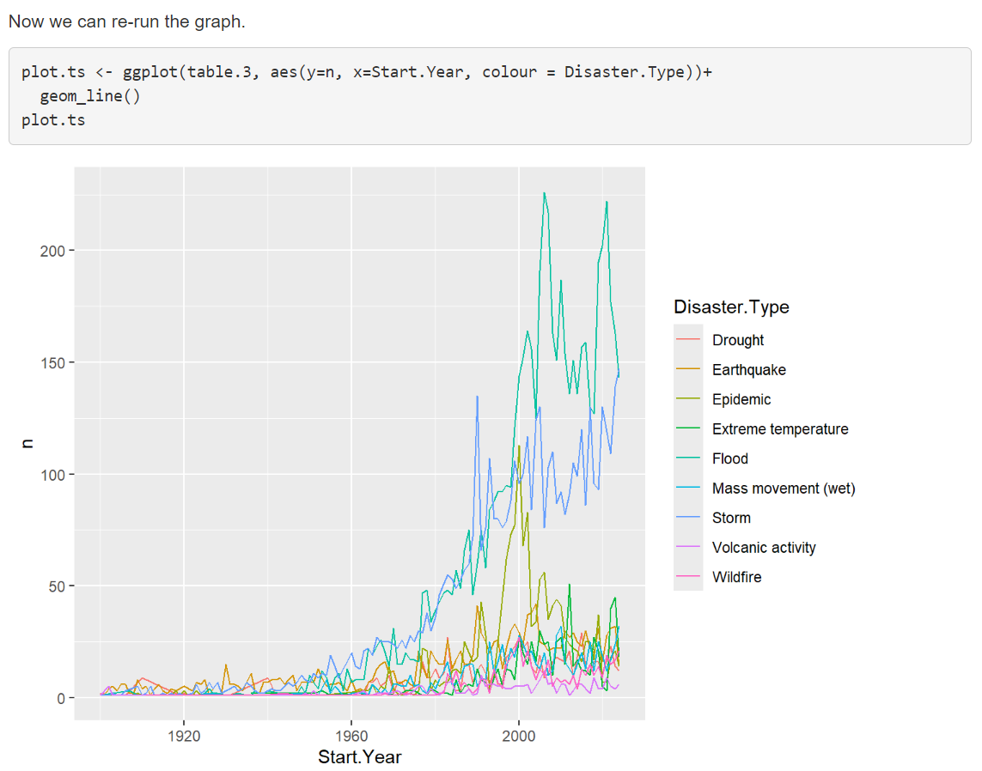
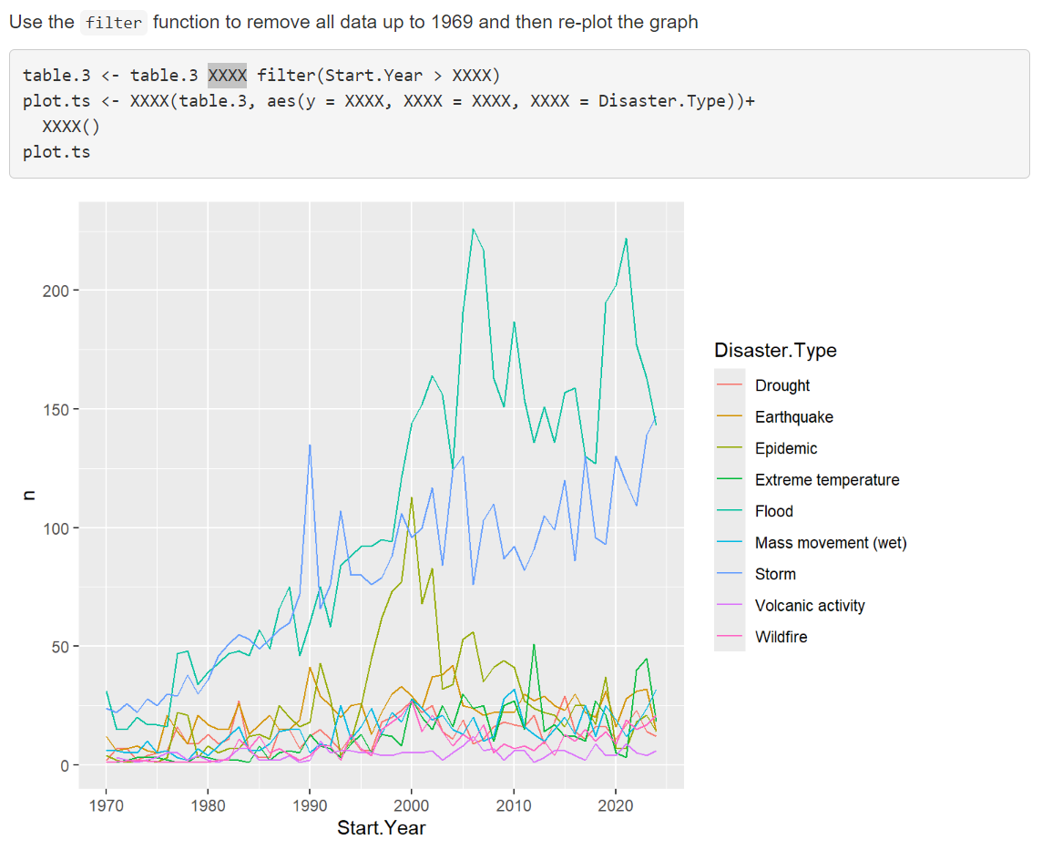
Rmarkdown interactive elements
Scaffolding and fill in the blank:

Slide 13
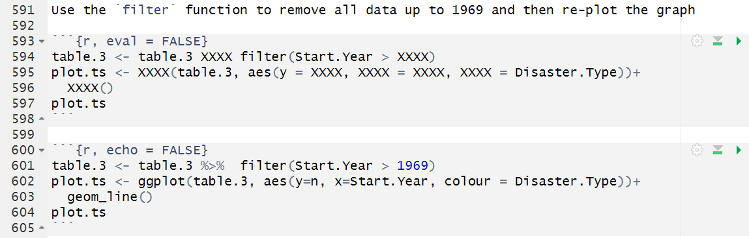


Rmarkdown interactive elements
eval (= TRUE is default) and echo (=TRUE) control whether code is executed and shown respectively
Scaffolding and fill in the blank:
The incomplete code is shown but not executed (eval = FALSE).
The correct code is executed but not shown (echo = FALSE)
Ensure learners can check that they got the right result (here replicate the picture)

Slide 14
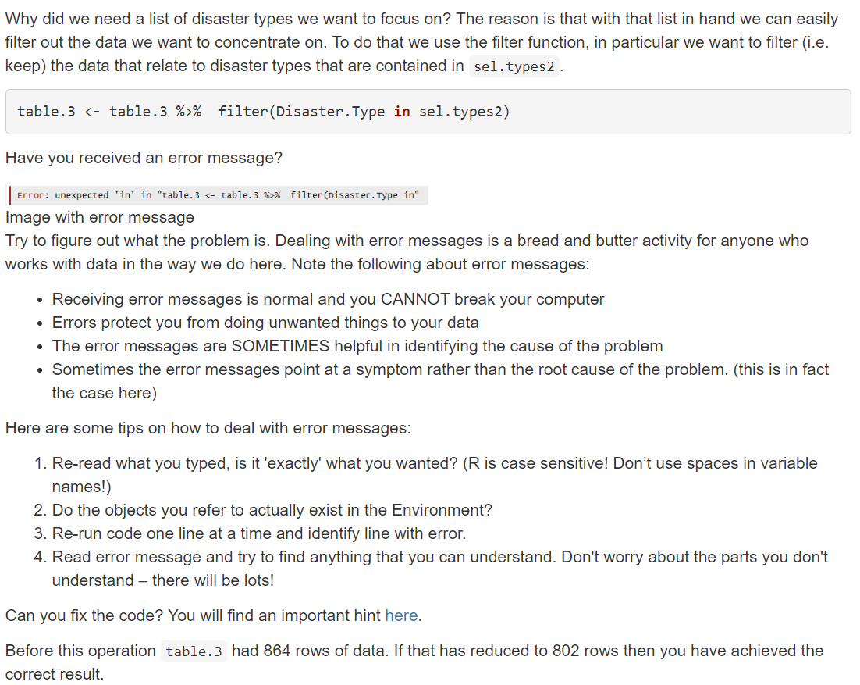
Rmarkdown interactive elements
Intentional error and guidance on rectifying error

Slide 15
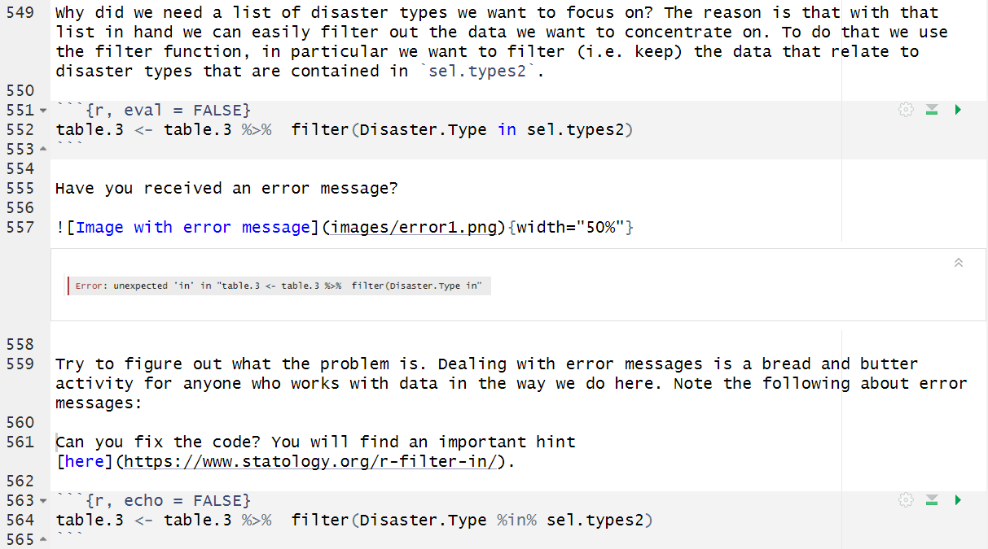


Rmarkdown interactive elements

Slide 16
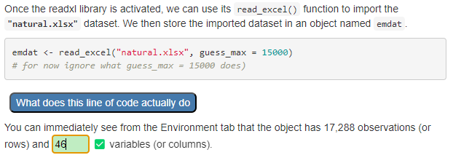
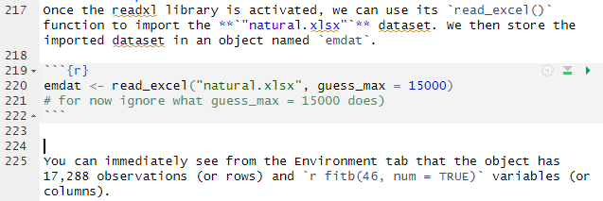

Webexercises additional functionality
Testing understanding of code and data structures (use of Fill in the Blank, fitb, functionality)
The fitb functionality also allows for a discrete list of correct text responses and numerical responses with a predetermined amount of tolerance

Slide 17
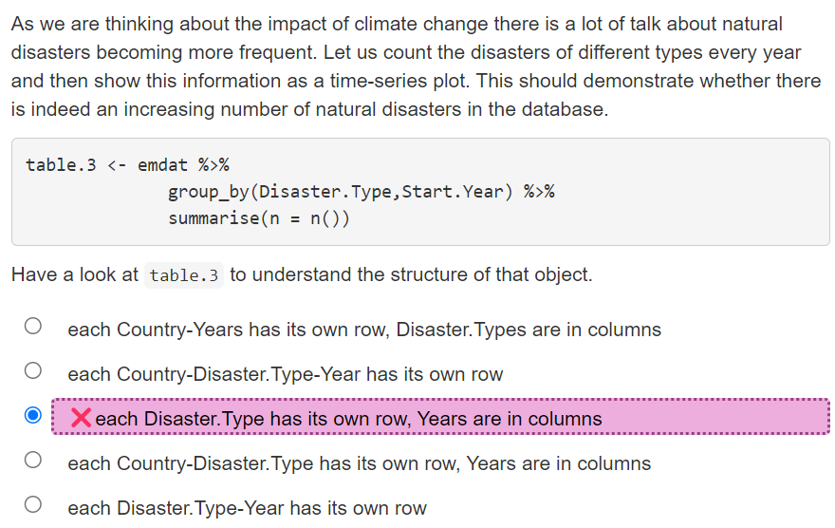
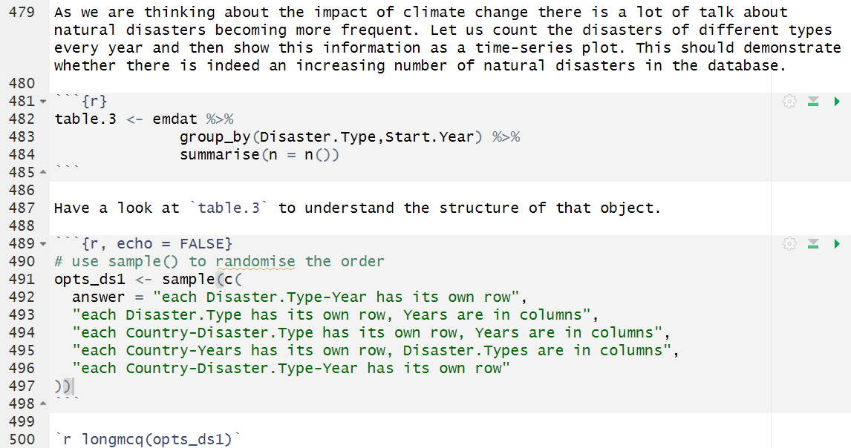
Webexercises additional functionality
Testing understanding of code and data structures (use of MCQ functionality)
The Rmarkdown code

Slide 18
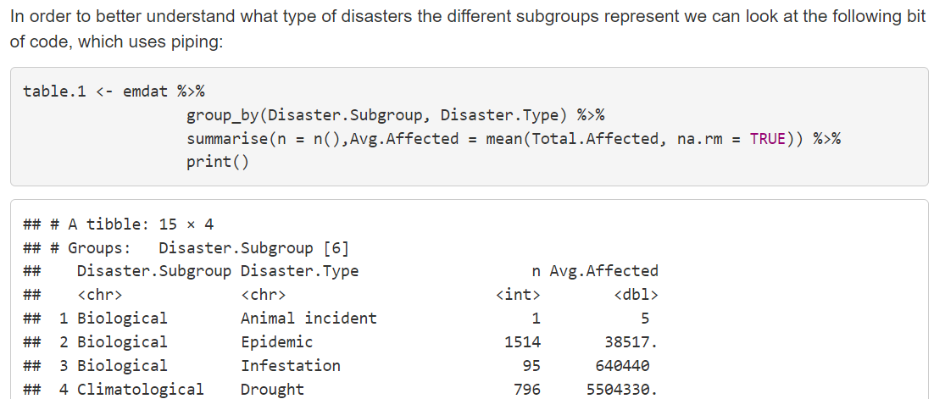
Webexercises additional functionality
Support code reading/understanding and using ChatGPT

Slide 19
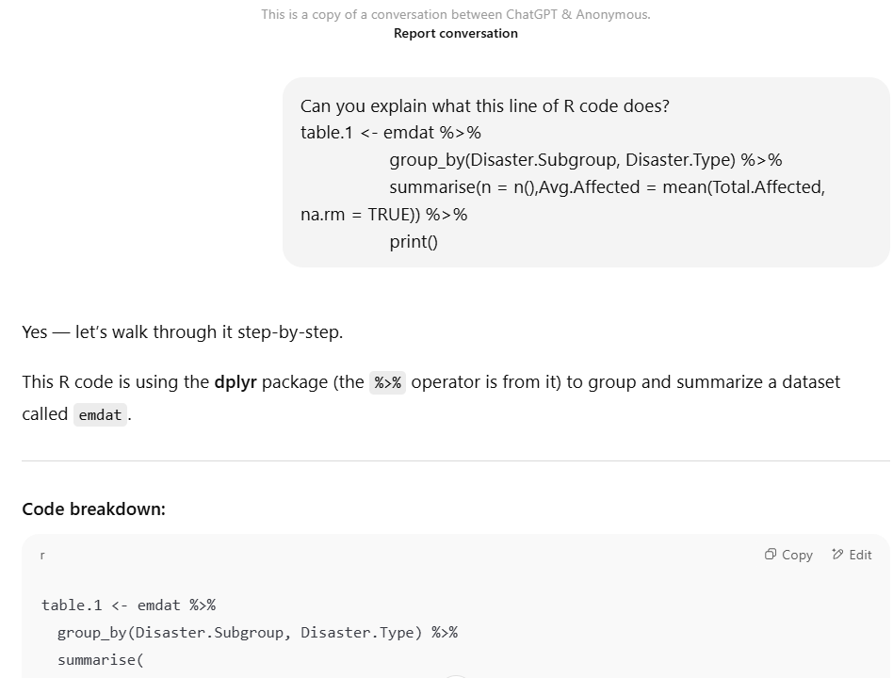
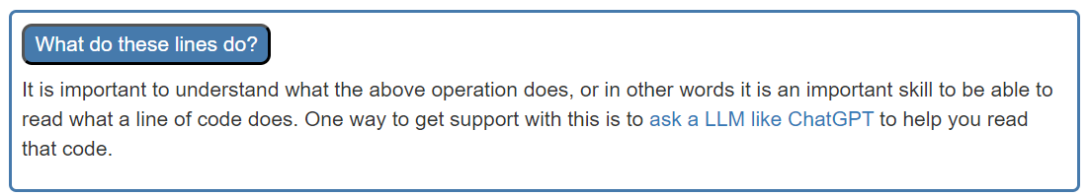
Webexercises additional functionality
Support code reading/understanding and using ChatGPT
Saved and linked ChatGPT conversation

Slide 20
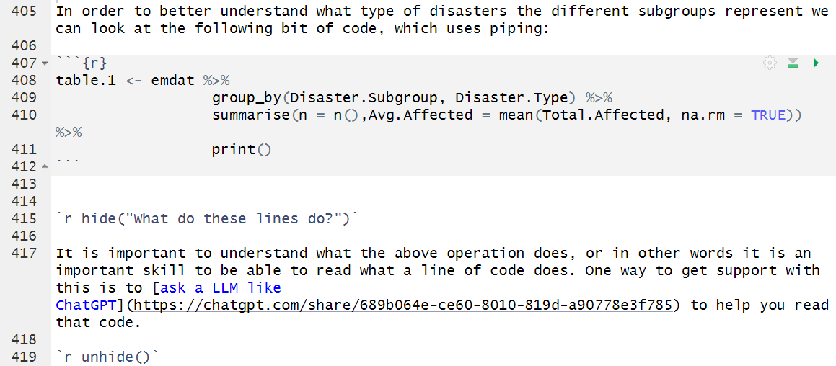


Webexercises additional functionality
Support code reading/understanding and using ChatGPT
hide and unhide create the box

Slide 21
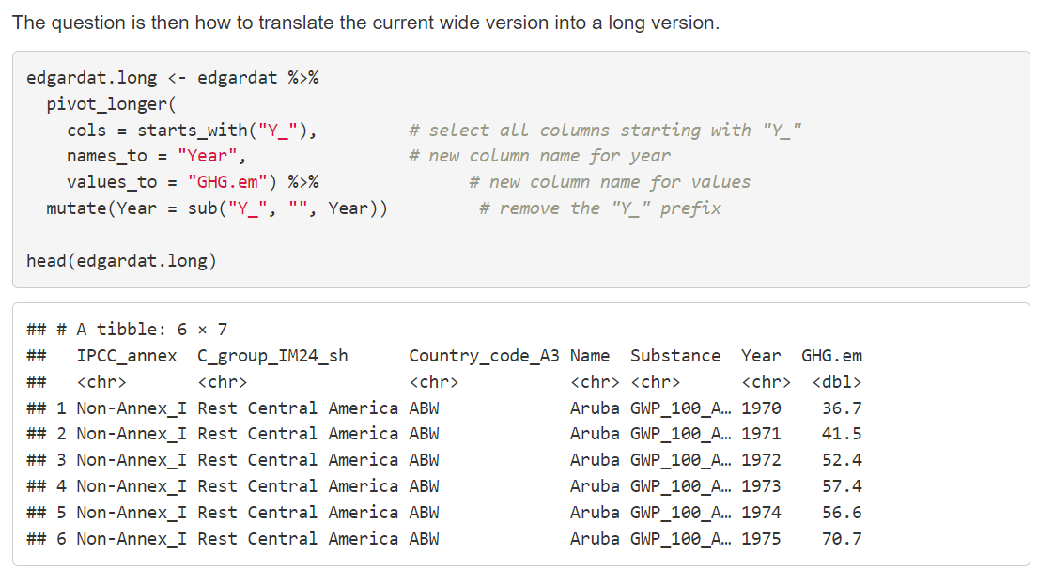
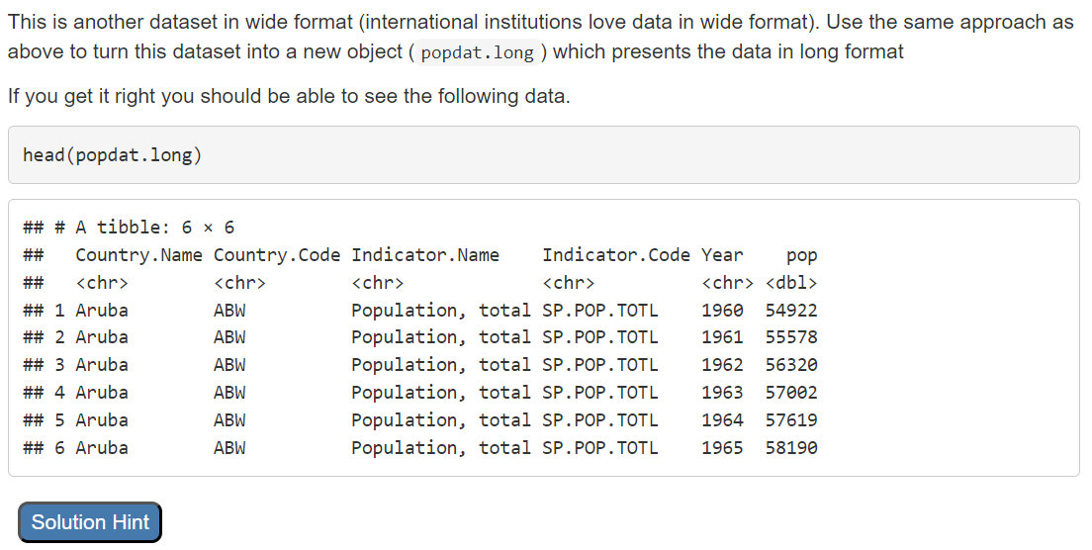
Webexercises additional functionality
Multi-level scaffolding
Show the correct code convert data from wide to long
A little later … same problem, no code

Slide 22
Webexercises additional functionality
Multi-level scaffolding

Slide 23
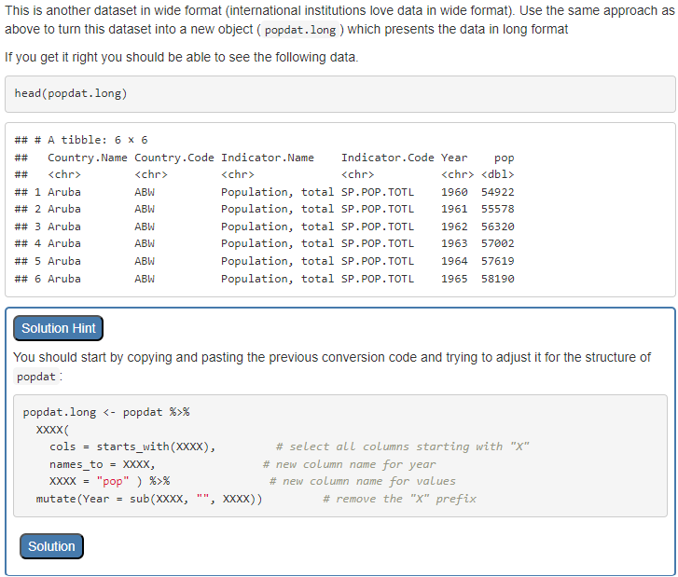
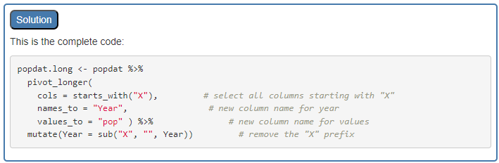
Webexercises additional functionality
Multi-level scaffolding

Slide 24
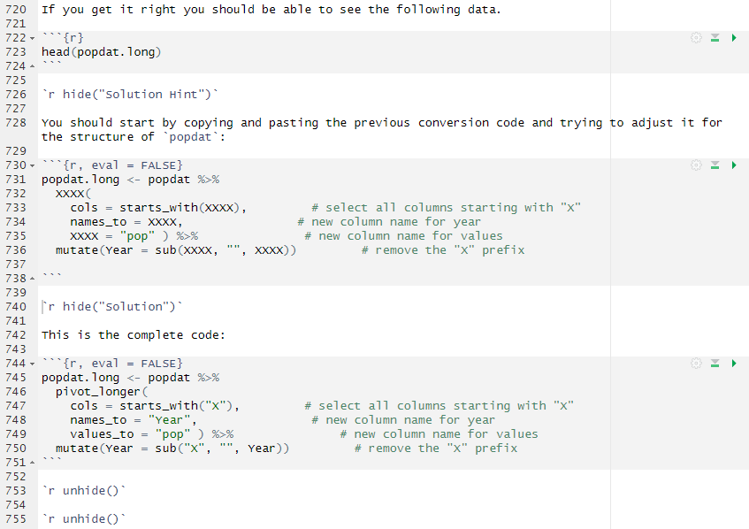




Webexercises additional functionality
Multi-level scaffolding
Nested hidden boxes can create the multi-level scaffolding

Slide 25
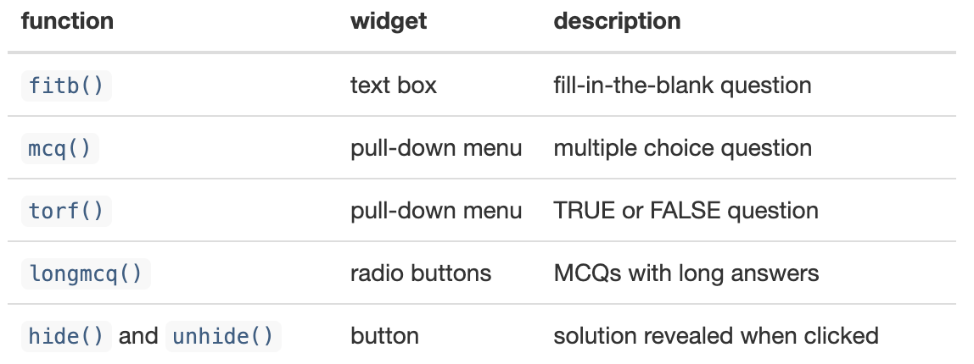
Interactive Worksheet
Fully worked example
Setting: A first intro to working as an applied economist in R. Designed as a two hour work through/demonstration.
Aim: Show how applied economists work and show some of the possibilities, not to teach techniques
Rmarkdown, rendered: html (from Github), datafiles are also available from here.
Types of Interactive Exercises You Can Create with Webexercises
The webexercises package provides functions that create HTML widgets using inline R code. These functions are:

Slide 26
Interactive Worksheet
What You Need to Design It?
R & R studio
RStudio – for developing and testing your worksheets
Output
HTML output – to publish the worksheets as interactive documents
The webexercises package – to embed interactive components within R Markdown
R needs to be installed on your computer
Write R Markdown files – to structure worksheets
These can be shared as files through VLEs
Students can download these and work on them (also offline), or
You can host them on a website (e.g. github)

Slide 27
Jupyter Notebook
To come

Slide 28
Evaluation Evidence (Case Study: Aston University)
Module overview
Econometrics I
A second-year module at Aston University focusing on econometric principles and practical applications using R programming.
Student demographics
Approximately 210 students are enrolled annually.
Students have mixed levels of coding experience, the majority encountering R for the first time
Teaching Structure
R workshops are held bi-weekly, totalling 5 R workshops.
Small group sessions, with approximately 40 participants per group.
Assessment
Two coursework assignments: 500 words (mid-term) + 1500 words (end-term)
500 words coursework: Emphasis on descriptive statistics, plots and coding
1500 words coursework: Focus on regression analysis, interpretation and coding

Slide 29
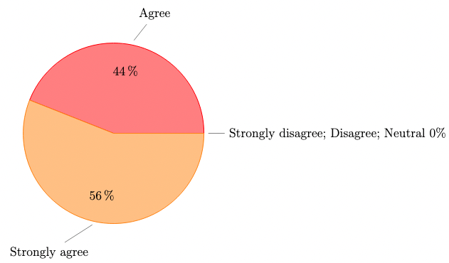
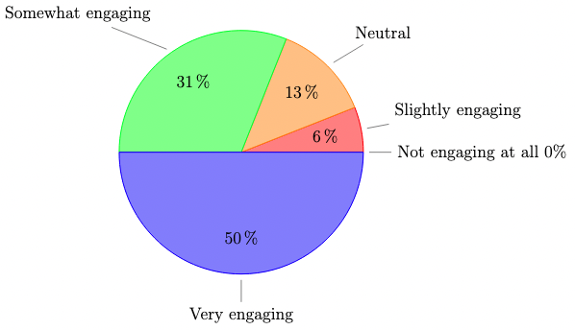
Evaluation Evidence (Case Study: Aston University)
To what extent do you agree that fill-in-the-blank worksheets in Econometrics I make it easier to understand R code logic and structure? | How engaging do you find the fill-in-the-blank worksheets in your econometrics module?
Note: Results are based on 32 survey participants.

Slide 30
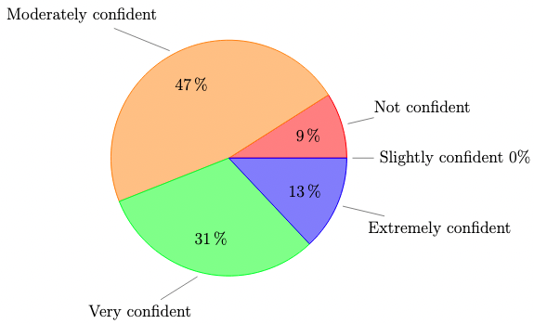
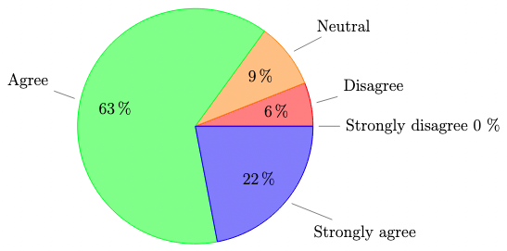
Evaluation Evidence (Case Study: Aston University)
To what extent do you agree that fill-in-the-blank worksheets in Econometrics I enhance your ability to solve coding problems independently? | How confident are you in applying skills from Econometrics I fill-in-the-blank worksheets to real-world data analysis?
Note: Results are based on 32 survey participants.

Slide 31
Evaluation Evidence (Case Study: Aston University)
What is going well in the fill-in-the-blank style R workshop?
1. Understanding and Clarity | “It is very easy to use and understand and keeps me engaged all the time to try and get the answer.” “It is easy to understand the code and the framework is provided.” “It provides examples on how the analysis is interpreted and applied in the correct format. Its interactivity is easy to understand.”
2.Problem-Solving and Critical Thinking | “It makes us put additional effort and think, not just copy and paste already ready codes.” “Understanding by doing it myself.” “It helps provide answers if I am stuck so that I can work out for myself why this answer is correct.”
3.Learning and Skill Development | “I think that it helps me to understand what I have to do in times when I don’t know where to start.” “Help with calculations of the example data given. Gives a good understanding of the use of each code.”
4. Engagement and Active Learning | We get to know the response immediately.” “You can easily see if your answers are correct or not.”

Slide 32
Evaluation Evidence (Case Study: Aston University)
The fill-in-the-blank style R workshop would be even better if …?
1. Learning and Engagement | “Maybe after filling in the blanks, there are some codes we have to do completely independently after.” “Include more examples.” “More possible answers as you could just try them all without being forced to learn.”
2. Format and Clarity | “That the answers weren’t directly exposed.” “There was less multiple choice as it made it easy to figure out.” “Better hints.”
3. Technical Issues | “The answers could save or be saved as a document to track progress.” “Sometimes rounding can be a problem.” “Sometimes filling in the blanks can have some issues when it comes to rounding.”

Slide 33
Interactive Activities
Climate Change Data
Idea:
Step 1: Present the complete climate change data walkthrough (HTML) with fill-in-the-blank code lines and interactive exercises. This gives the audience a clear picture of the final output we’re aiming for.
Step 2: Provide the incomplete version of the climate change data R Markdown file (without the fill-in-the-blank code lines or interactive exercises) via a GitHub link or Posit Cloud. This version skips the text like aim and preparation to save time, allowing participants to focus on building the interactive components.
Step 3: Guide the audience through adding the fill-in-the-blank code lines and creating the interactive exercises—hands-on practice.

Slide 34
Group Reflection
Discuss barriers, benefits, and possible modifications.
Share practical tips for integrating these strategies

Slide 35
Wrap-up & Takeaways
Summary of key points
Provide a link to GitHub/OneDrive folder with: Editable worksheet templates
Invitation to follow-up or collaborate

Slide 36
Literature
Prather J, et al. (2023), ITiCSE-WGR '23: Proceedings of the 2023 Working Group Reports on Innovation and Technology in Computer Science Education, 108 – 159, https://doi.org/10.1145/3623762.363349
Kyaw H.H.S, et al. (2021) A Study of Element Fill-in-Blank Problems for C Programming Learning Assistant System, International Journal of Information and Education Technology, 11, 255-261

