Slide 1


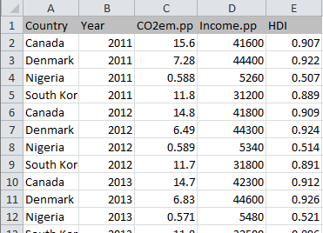
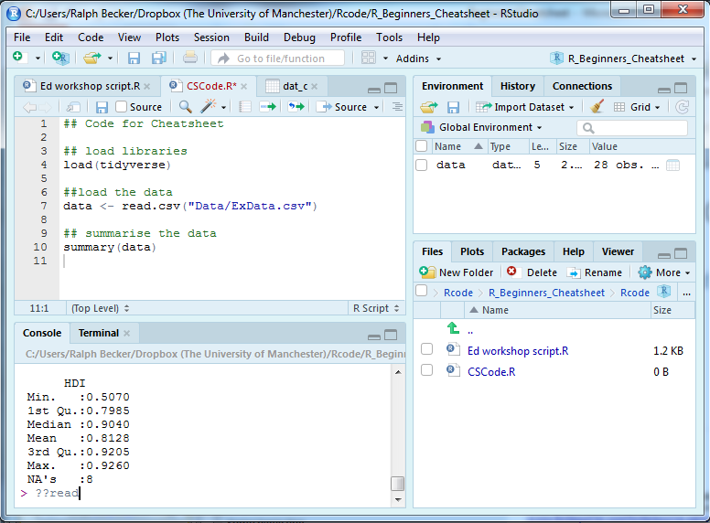


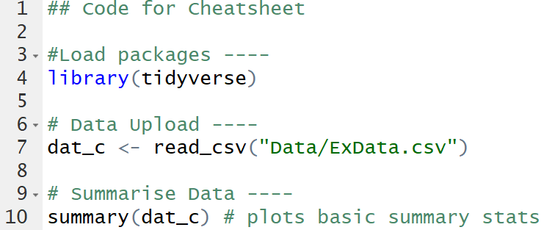
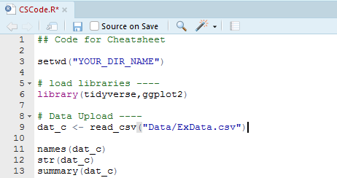
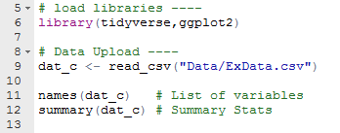


R/RStudio – First Steps : : CHEAT SHEET v1.0
Basic Workflow Tips
The RStudio Layout
How to treat datafiles
HISTORY
Leave your original data set unchanged. In this way you cannot make any changes that cannot be reversed!
Raw data are read-only!
CODE EDITOR
In this tab you can find a history of the commands you used.
In this window you will see your code/script files.
This is where you record what you want to do.
ENVIRONMENT
Instead we write commands/code in R which instructs R to import the data and make any changes and calculations required. This makes your work reproducible! These files are called script files.
Here you can see all objects/variables that have been loaded or created by your code.
Help
CONSOLE
Shows help files if you type “?read.csv” (or any other function name) into the console.
Here you will see any output produced by your code.
You can also enter individual commands to either test them before you include them into your script or because you are not planning to include these in your script.
PACKAGES
NEVER WRITE OVER YOUR ORIGINAL DATAFILE
In this tab you manage (install, update) your packages.
Save your work and make it reproducible
FILES
The way to work in R is by using scripts. These are files in which you collect all the actions you perform on the data (data cleaning, summary stats, graphing, etc.).
The files and folders in your working directory appear here.
File Management
Useful RStudio Shortcuts
Folders
What | Icon | Windows | Mac
Save script |  | CTRL+S | COMMAND+S
Run entire script |  | CTRL+ SHIFT+S | COMMAND+ SHIFT+S
Run current line/selection |  | CTRL+ ENTER | COMMAND+ ENTER
Clear Console |  | CTRL+L | CPMMAND+L
Undo |  | CTRL+Z | COMMAND+Z
Re-indent |  | CTRL+I | COMMAND+I
Clear Workspace
Piping operator. %>% |  | CTRL+ SHIFT+M | COMMAND+ SHIFT+M
This is a record of your work which you can pass on to others but also makes it easy to re-run the analysis, e.g. after fixing a mistake or after obtaining additional data.
Make sure you know where your files are. It is advisable to create a folder into which you save all files that you use for a particular project. If your project has many files you should consider creating sensible subfolders such as “code”, “data”, “images”, “documentation”. This will make you file management much easier.
Commenting
Everything after a “#” is a comment and only used to help you and others understand what the code intends to do.
Working Directory
You should let R know what directory you are working off.
We call this the working directory and you set it with the “setwd” command. Put the full file path inbetween the quotation marks.
By creating a comment line ending in “----” you create a “sort of chapter” in your code. Collapse a chapter by clicking on the little triangle on the left of that line.
RStudio Project files
Test your code as frequently as possible
You should consider using RStudio project files. This will facilitate file management and make references to data and other files more straightforward. In particular you will not have to set the working directory to your current folder as, when you open a project, Rstudio will automatically choses the project folder as its working directory. Hence there is no need to change the working directory if you are working on different computers. This is particularly useful if you want to share your work with others. But it also greatly facilitates the management folders.
Help on how to use them is available from RStudio or Softwarecarpentry.
When you write code make sure that you check every line of code straight after writing it. As you develop your code you will encounter many mistakes and if you wrote many lines of code without testing, then it may be difficult to figure out which line is faulty.
Closing RStudio
As you close RStudio you will be asked whether you want to save the Workspace. On most occasions there is no need.
RStudio® is a trademark of RStudio, Inc. • CC BY SA Ralf Becker • ralffbecker@gmail.com • https://datasquad.github.io/ECLR/index.html • Updated: 2025-10

Slide 2



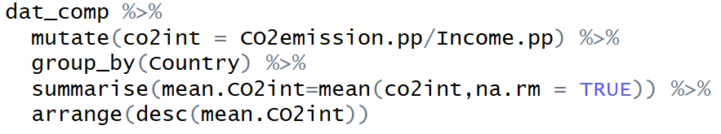
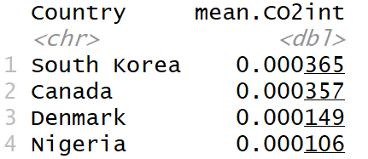
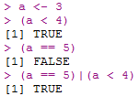

R/RStudio – First Steps : : CHEAT SHEET v1.0
Packages
Basic data management
Error Management
R is an open source software which has a lot of functionality build-in. However, a lot of very useful additional functions are provided by extra packages. TO be able to use these you need to:
Find the package you need (Google or check out CRAN Task view for starters).
The package needs to be installed on the machine you are using. Run (quotation marks need to be included) or use the interactive function in the packages tab:
In the script in which you use a function which is provided by a package you need to load that package by running the following line in your script:
Analyse the CO2 intensity of per capita income for some countries over a range of years.
When writing code you will encounter problems and error messages. This happened to everyone and is a normal part of code writing.
When you encounter an issue do this first:
Re-read what you typed, is it 'exactly' what you wanted? (R is case sensitive! Don’t use spaces in variable names!)
Re-run code one line at a time and identify line with error.
Read error message and try to find anything that you can understand. Don't worry about the parts you don't understand – there will be lots!
Common error messages
'No such file or directory‘ - R cannot find the file, Check the file really exists in the specified folder. This could be because it is looking in the wrong place or you have mis-typed. Check getwd() to see what R’s working directory is. Use setwd("yourdir") to change working directory.
'Error: object 'name' not found‘ - R cannot find the object `name`. This could be because you've mistyped, because you need quotes around the name or because you are referring to a variable that does not yet exist.
'Could not find function "name"‘ - R cannot find the function. This could be because you've mistyped or because you haven't used library() to load the package containing that function.
Searching for help
Possibly the most important programming skill (and everyone does it!). Either google an error code or a question you have (e.g. “R delete variable from dataframe”). You may have to look at a number of the first links to find useful info. You may need to copy some code and try to adjust it to your problem at hand.
AI models like (ChatGPT or Copilot) will also provide help. They are great at explaining code. Think carefully about supplying the right amount of information.
Also don’t forget to use the R help function. E.g. type ?lm into the Console to get help on using the regression function.
Start solving your problem step-by-step, meaning that you try to create the smallest possible problem first before you make your problem more complicated.
Upload packages (assuming that these are installed)
Load data (assumed to be in a “Data” folder)
Click install and search for package name
Check content of datafile
Datafile contains these variables
Some useful packages
Check variable types by clicking on in Environment tab
Package | What it does
tidyverse | This is the swiss army-knife for the R-analyst; helps with most data tasks
readxl | This will support the import of Excel spreadsheets
ggplot2 | Creates amazing plots
rmarkdown | Allows you to create Rmarkdown documents which produce excellent documents that mix code, output and text.
forecast | Provides a lot of time-series functionality
car | A package with plenty of functions for regression analysis
Drop incomplete observations (you need to think whether this is what you want to do!) and save in dat_comp.
Calculate new intensity variable (mutate), group data by country (group_by) and summarise (summarise) the grouped observations with their mean value (mean). Ensure that results are ordered from largest to smallest (arrange).
BOOLEAN VARIABLES
 | We see that income is generated with significantly more CO2 emissions in South Korea and Canada when compared to Denmark and Nigeria
 | Variables which take TRUE or FALSE as values. You can assign the result to a new variable. These variables have many uses. Combine conditions with “&” (and) or “|” (or).
REGRESSION
lm is the function to run a regression, summary prints the results and lht can be used to test simple or multiple hypotheses
Here we used the piping technology (%>%) facilitated by the tidyverse package.
RStudio® is a trademark of RStudio, Inc. • CC BY SA Ralf Becker • ralffbecker@gmail.com • https://datasquad.github.io/ECLR/index.html • Updated: 2025-10

