Slide 2
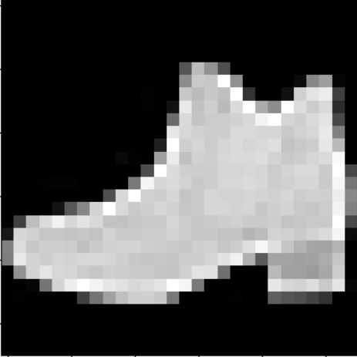



#0
#1
#2
#3
X₁
X₂
X₃
$${Lout}_{2}^{(1)}$$
…
$$Y_{3}^{}$$
…
512 x
512 x
…
…
Contains (28*28 =) 784 pieces of information
$${Lout}_{511}^{(2)}$$
X₇₈₂
X₇₈₃
X₇₈₄

