Slide 1

Predictive Analytics with Python (Regression)
Sridhar Palle, Ph.D.

Slide 2





Python – Data Science
Python: Core python, nuts and bolts
Data Wrangling:
Visualization:
Machine Learning:
Seaborn

Slide 3
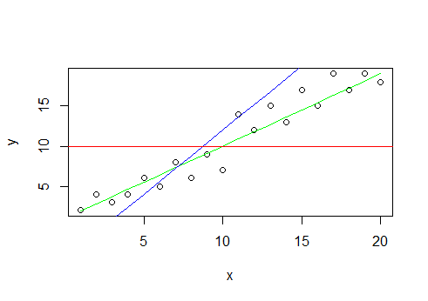
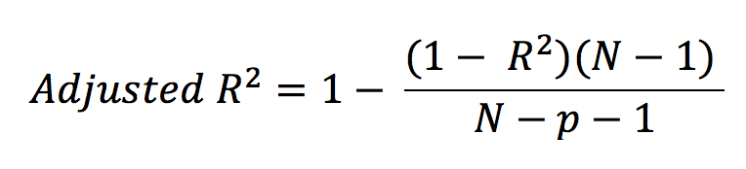
Linear Regression
R² = 0 (Implies no improvement over base line model)
R² = 1 (Perfect Model and Fit)

Slide 4
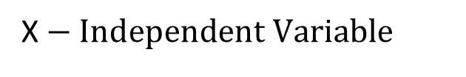
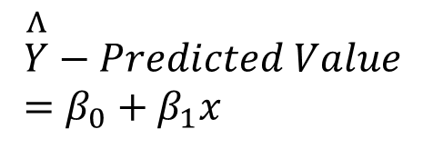

Linear Regression
In Regression, the goal is to predict a target variable which is continuous
Practical Housing Example: Predicting House Prices
X$− \text{Independent} \text{Variable}$
$$Y\text{ − }\text{Actual} \text{Target} \text{Variable}$$
$$\overset{Λ}{Y}−Predicted Value =β_{0}+β_{1}x$$
Sum of Square Errors (SSE)
should be small

Slide 5
Algorithm
Initialize
Loop over some iterations or until min SSE{
2. Compute SSE over all examples
3. Minimize SSE on
Gradient Descent
4. Repeat step 2
Source: Andrew Ng

Slide 6
Data Science - Procedure
Data Collection
Importing, gathering Data or Data Sets
Data Exploration
Examine the data set
Visualizations
Correlations, statistics
Data Preparation
Remove variables of non-importance
Remove outliers, clean-up
Normalization (do this after the step below)
Remove Missing Values (do this after the step below)
Train/Test split
Performance across models
Different ML-models (using default hyper parameters)
Tune hyper parameters
Test Models
Cross-Validation with k-fold splits
Report Average k-fold test scores

Slide 7
Scikit-Learn Basics
1. Load Data Sets a) Built-in datsets from sklearn import datasets dir(datasets) – will list the available data sets dset = datasets.load_diabetes() – this is a dictionary which contains actual data, target variable, feature names, and description b). Other datasets can be loaded in as Numpy arrays or data frames pd.read_csv(), pd.read_table(), pd.read_excel() 2. Data Preparation Train/test split from sklearn.model_selection import train_test_split X_train, X_test, y_train, y_test = train_test_split(X,y) Standardization from sklearn.preprocessing import StandardScaler scaler = StandardScaler() scaler.fit(X_train) X_train = scaler.transform(X_train) X_test = scaler.transform(X_test) Polynomial Features from sklearn.preprocessing import PolynomialFeatures poly = PolynomialFeatures() X_train_poly = poly.fit_transform(X_train) X_test_poly = poly.fit_transform(X_test) | 3. Training a model Few ML algorithms from sklearn.linear_model import LinearRegression from sklearn.linear_model import LogisticRegression from sklearn.tree import DecisionTreeClassifier from sklearn.svm import SVC from sklearn.ensemble import RandomForestClassifier Training & making predictions (Ex: linear regression) lr = LinearRegression() lr.fit(X_train, y_train) y_pred = lr.predict(X_test) – for predictions on test data y_prob = lr.predict_proba(X_test) – for probabilities on test data 4. Evaluation a) Regression from sklearn.metrics import r2_score, mean_squared_error r2_score(y_test,y_pred) mean_squared_error(y_test,y_pred) b) Classification from sklearn.metrics import accuracy_score, recall_score ,precision_score, confusion_matrix, roc_auc_score confusion_matrix(y_test,y_pred) accuracy_score(y_test,y_pred) recall_score(y_test,y_pred) precision_score(y_test,y_pred) roc_auc_score(y_test,y_prob)

