Slide 1

Predictive Analytics with Python (Classification)
Sridhar Palle, Ph.D.

Slide 2


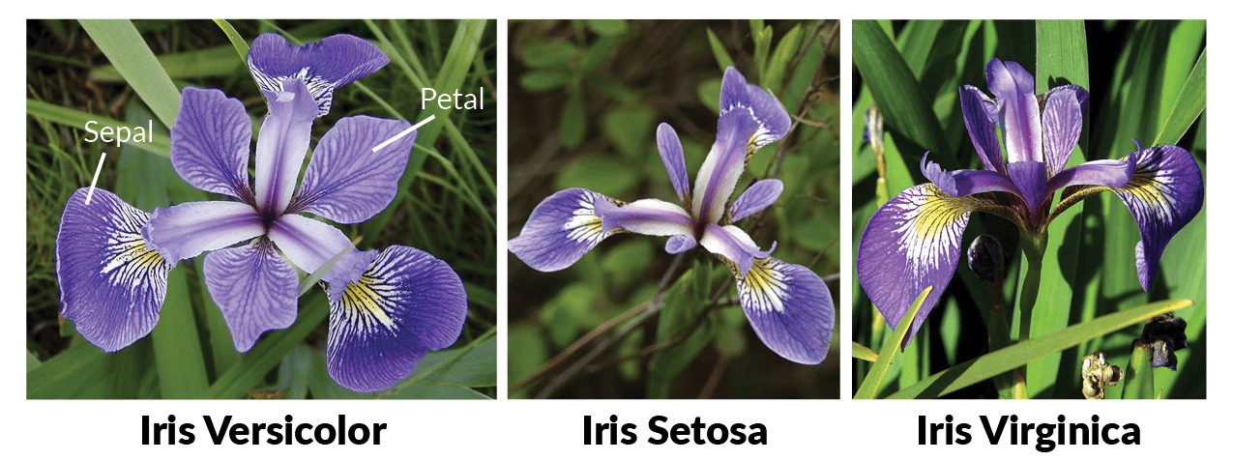
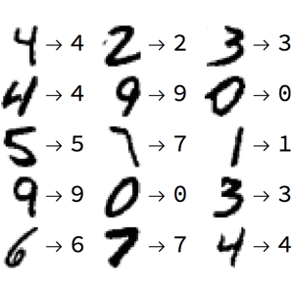
Classification
Goal is to predict a ‘label’ or (‘target variable’) which is discrete (not continuous)
Types of Classification
Binary Classification
Pass/fail
Yes/no
Customer selects a product or not
Disease or no disease
Multiclass classification
Identify types of flowers
Digits recognition
Predicting wine types
Classify several diseases

Slide 3
Classification Algorithms
There are a number of ML classification algorithms:
Classification
Logistic Regression
Decision Trees
Knn (k-nearest neighbors)
Naïve-Bayes
Support Vector Machines
Neural Networks
Random Forest

Slide 4
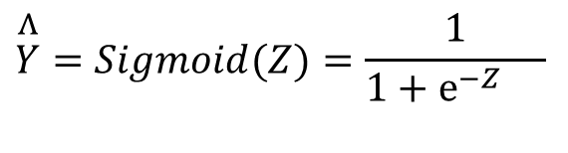
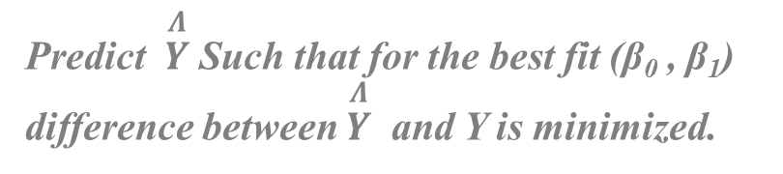



Classification: Logistic Regression
Ex: Predicting if a website link is Phishing or not
Y = 1 (Phishing ), Y = 0 (Normal)
$$Z=β_{0}+β_{1}X$$
$$\overset{Λ}{Y}=Sigmoid(Z)=\frac{1}{1+e^{−Z}{}}$$
Predict $\overset{Λ}{Y}$Such that for the best fit (β₀ , β₁) difference between $\overset{Λ}{Y}$ and Y is minimized.
If Sigmoid(Z )> 0.5, Predict
$$\overset{Λ}{Y}=1$$
If Sigmoid(Z) < 0.5, Predict
$$\overset{Λ}{Y}=0$$

Slide 5
Algorithm
Initialize
Loop over some iterations or until min Error or (Cost) {
2. Compute
3. Calculate Error
4. Minimize Error or (Cost) on
Gradient Descent
5. Repeat step 2
Source: Andrew Ng

Slide 6
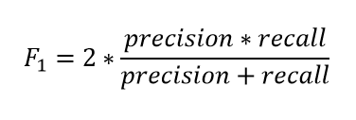
Interpreting Classification Model Output
Confusion Matrix (or Classification matrix or Error Matrix)
 | Predicted Negative | Predicted Positive
Actual Negative | TN | FP
Actual Positive | FN | TP
Overall Accuracy = (TN+TP)/(Total Observations)
Overall Error Rate = (FN + FP)/(Total Observations)
True Positive Rate (TPR) (Sensitivity, Recall) = TP/(FN+TP), Precision = TP/(TP+FP)
False Negative Rate (FNR ) = FN/(FN+TP) = 1-TPR
True Negative Rate (TNR) (Specificity) = TN/(TN+FP)
False Positive Rate (FPR) = FP/(TN+FP) = 1-TNR
Notes:
Lowering Threshold will increase recall. But will decrease Precision
Increasing Threshold will decrease recall, but will increase precision.

Slide 7
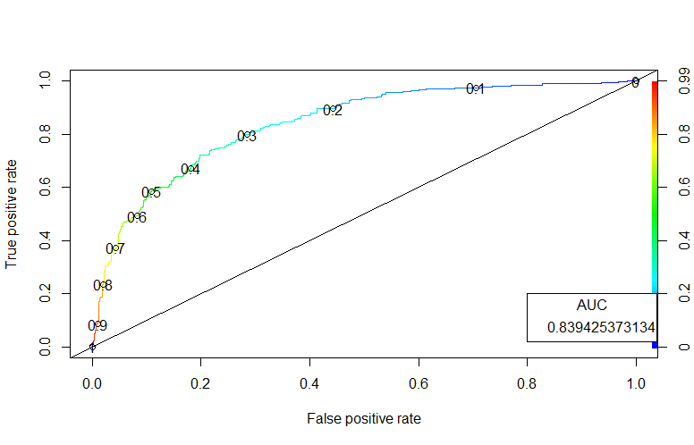
ROCR curves

Slide 8
Predictive Analytics with Python (Classification)
Please go to the link below
Tinyurl.com/ece-bdata-python/
Download the folder
SML-2
Open Jupyter notebooks related to Classification using Anaconda

Slide 9
Thank You ☺
Any questions?

