Slide 1
Tonglin Li, Xiaobing Zhou Illinois Institute of Technology, Chicago, U.S.A
ZHT:
A Light-weight Reliable Persistent Dynamic Scalable Zero-hop Distributed Hash Table
Development tutorial

Slide 2
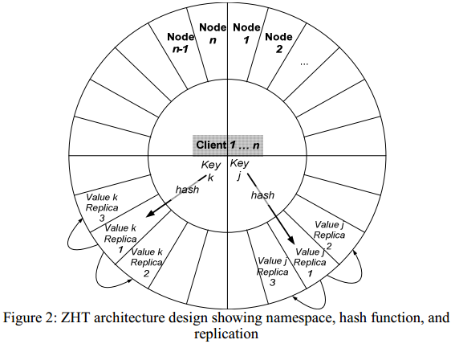
idea overview

Slide 3
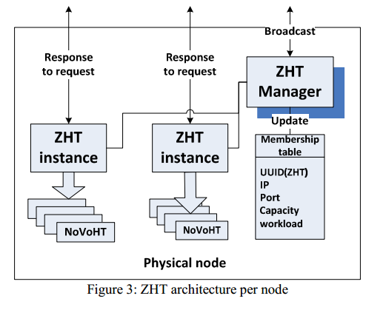
architecture overview

Slide 4
file structure and readme
See also <FILE_STRUTURE>
See also <README>
https://bitbucket.org/xiaobingo/iit.datasys.zht-mpi

Slide 5
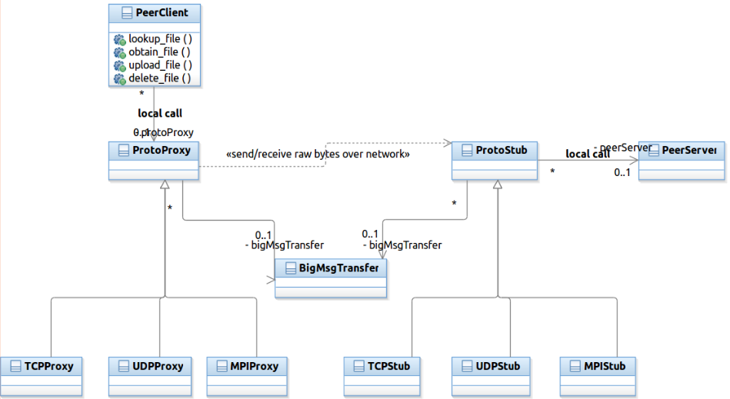
Protocol abstraction

Slide 6
How to choose Protocol
zht.conf
PROTOCOL TCP
PROTOCOL UDP
PROTOCOL MPI

Slide 7
How to build ZHT
Make executables for IP protocol family
make
Executables:
zht_cpptest/zht_ctest/zhtserver/c_zhtclient_lanl_threaded/c_zhtclient_threaded_test/cpp_zhtclient_threaded_test
Make executables for MPI protocol family
make mpi
Executables:
zht-mpibroker
zht-mpiserver

Slide 8
How to launch ZHT servers
For IP protocol family:
./zhtserver -z zht.conf -n neighbor.conf
For MPI protocl family:
mpiexec -np 4 ./zht-mpiserver -z zht.conf -n neighbor.mpi.conf : ./zht-mpibroker -z zht.conf -n neighbor.mpi.conf
The ZHT client and YOUR_OWN_APP are not aware of the protocols

Slide 9
ZHT Language bindings
C
C++
Recommendations
Always try the C++ binding since IT’S MORE CONVENIENT to pass user-defined composite data structure using OFFICIAL Google protocol buffer C++ binding
ZHT C binding depends on NON- OFFICIAL Google protocol buffer C binding, BUGS potentailly
ZHT C binding is built on top of C++ binding

Slide 10
How to dev your ZHT apps
Find C examples to call ZHT-client-API
See <c_zhtclient_test.c> for C example on how to call ZHT-client-API
See <c_zhtclient_threaded_test.cpp> and <c_zhtclient_lanl_threaded.c> for C example on how to call ZHT-client-API in multi-threaded context

Slide 11
How to dev your ZHT apps
Find C++ examples to call ZHT-client-API
See <cpp_zhtclient_test.cpp> for C++ example on how to call ZHT-client-API
See <cpp_zhtclient_threaded_test.cpp> for C++ example on how to call ZHT-client-API in multi-threaded context

Slide 12
How to dev your ZHT apps - walkthrough
Assume the directory:
iit.datasys.zht-mpi
iit.datasys.zht-mpi/src
iit.datasys.zht-mpi/tutorial
iit.datasys.zht-mpi/tutorial/zhtsample.cpp
See iit.datasys.zht-mpi/src/README to install < Google protocol buffers c binding, VERSION 0.15 > and < Google protocol buffers c++ binding, VERSION 2.4.1 >
for example, you got iit.datasys.zht-mpi/tutorial/zhtsample.cpp as your app
cd to iit.datasys.zht-mpi/src
make or make mpi
cd ../tutorial/

Slide 13
How to dev your ZHT apps - walkthrough
mkdir include #create dir to hold ZHT header files your app may need
mkdir lib #create dir to hold ZHT lib file your app needs to link to
cp ../src/*.h include/ #copy ZHT header files
cp ../src/libzht.a lib/ #copy ZHT lib file
vim comp.sh and enter
gcc –g –o zhtsample zhtsample.cpp -Iinclude/ -Llib/ -lzht -lstdc++ -lpthread -lprotobuf -lprotobuf-c

Slide 14
How to dev your ZHT apps - walkthrough
bash comp.sh #this will generate executable zhtsample
cd to ../src, and start ZHT server as
./zhtserver –z zht.conf –n neighbor.conf
cd ../tutorial
Run ZHT sample as
./zhtsample –z ../src/zht.conf –n ../src/neighbor.conf

Slide 15
How to dev your ZHT apps – passing composite datastructure
cd to iit.datasys.zht-mpi/tutorial/
Define your Google protocol buffer specification file, vim student.proto and enter
message Student {
required int32 id = 1;
required bool gender = 2;
required bytes firstname = 3;
required bytes lastname = 4;
required bytes address = 5;
required bytes phone = 6;
optional bytes hobbies = 7;
repeated bytes course = 8;
}
protoc –cpp_out=. student.proto #this will generate student.pb.h and student.pb.cc

Slide 16
How to dev your ZHT apps – passing composite datastructure
For example, you got iit.datasys.zht-mpi/tutorial/udtsample.cpp as app
Other steps same as others in previous case
vim comp.sh and append line as
gcc –g –o udtsample udtsample.cpp student.pb.cc -Iinclude/ -Llib/ -lzht -lstdc++ -lpthread -lprotobuf -lprotobuf-c
launch zhtserver as mentioned before
Run udtsample as
./udtsample –z ../src/zht.con –n ../src/neighbor.conf

Slide 17
How to dev your ZHT apps – passing composite datastructure
To define relationship between student and enrollment, see https://developers.google.com/protocol-buffers/ for details

Slide 18
How to dev your ZHT apps – define your persistent storage
When you launch zhtserver, it prompts:
Usage:
./zhtserver -z zht.conf -n neighbor.conf [-p port] [-f novoht_db_file] [-h(help)]
Using -f option, you specify the file to persist items you opeated, e.g. novoht_db_file

Slide 19
How to dev your ZHT apps – run ZHT over MPI protocol(standalone mode)
vim iit.datasys.zht-mpi/src/zht.conf, set
PROTOCOL MPI
make mpi
Launch 4 ZHT servers as
mpiexec -np 4 ./zht-mpiserver -z zht.conf -n neighbor.mpi.conf : ./zht-mpibroker -z zht.conf -n neighbor.mpi.conf
Run your ZHT apps

Slide 20
How to dev your ZHT apps – run ZHT(cluster mode)
see iit.datasys.zht-mpi/README

Slide 21
How to customize ZHT- augment client API
Declare and define new C++ binding API in < cpp_zhtclient.h > and < cpp_zhtclient.cpp >,
Declare and define your operation code in < Const.h > and < Const.cpp >, e.g. Const::ZSC_OPC_YOURS, like Const::ZSC_OPC_LOOKUP
Learn from the existing API, e.g. ZHTClient::lookup, the stack looks like:
int ZHTClient::lookup(const char *key, char *result)
int ZHTClient::lookup(const string &key, string &result)
int ZHTClient::commonOp(const string &opcode, const string &key, const string &val, const string &val2, string &result, int lease)
string ZHTClient::commonOpInternal(const string &opcode, const string &key, const string &val, const string &val2, string &result, int lease)
Declare and define delegation for new API in < c_zhtclientStd.h > and < c_zhtclientStd.cpp >

Slide 22
How to customize ZHT- augment client API
Declare and define C binding for new API in < c_zhtclient.h > and < c_zhtclient.cpp >

Slide 23
How to customize ZHT- augment server implementation
Declare and define server implementation for new client API in < HTWorker.h> and < HTWorker.cpp >
Learn from existing impl, e.g. lookup, the stack looks like:
string HTWorker::run(const char *buf)
Be sure to add the operation dispatch code like:
if (zpack.opcode() == Const::ZSC_OPC_YOURS)
string HTWorker::lookup_shared(const ZPack &zpack)

Slide 24
How to dev your ZHT apps- thread safe
ZHT client thread safe
ZHT client API is thread-safe at operation level
ZHT client API is thread-safe at socket level
We will explore making it thread safe at MPI rank level
ZHT server is thread safe

Slide 25
How to dev your ZHT apps- configration
zht.conf
PROTOCOL TCP #communication protocol for ZHT client and server
PORT 50000 #zhtserver port to listen on, overrides by -p option
MSG_MAXSIZE 1000000 #max size of message for a single trip
SCCB_POLL_INTERVAL 100 #the interval in milliseconds to resume polling a status of a item
INSTANT_SWAP 1 #set if instantly swap in-memory data to disk

Slide 26
How to dev your ZHT apps- configration
neighbor.conf, for non-MPI standalone deployment
localhost 50000
localhost 50001
You MUST actually launch two ZHT servers at port 50000 and 50001, otherwise errors prompt.
neighbor.conf, for non-MPI cluster deployment
192.168.1.100 50000
192.168.1.101 50000

Slide 27
How to dev your ZHT apps- configration
neighbor.mpi.conf, for MPI standalone deployment
localhost
Only localhost for multiple ZHT servers launched
neighbor.mpi.conf, for MPI cluster deployment, no port needed
192.168.1.100
192.168.1.101
192.168.1.102

Slide 28
How to dev your ZHT apps- configration
launch your applications always with zht.conf and neighbor.conf(or neighbor.mpi.conf) as startup arguments
Be careful the path for configuration files

Slide 29
How to dev your ZHT apps- TWO special API(s)
int c_state_change_callback(const char *key, const char *expeded_val, int lease), in C
int state_change_callback(const string &key, const string &expected_val,int lease), in C++
monitor the value change of the key, block or unblock ZHT client
EXPECDED_VAL: the value expected to be equal to what is lookuped by the key, if equal, return 0(zero), or keep polling in server-side and block ZHT client
LEASE: the lease in milliseconds after which ZHT client will be unblocked.
See <c_zhtclient_threaded_test.cpp> for C example and <cpp_zhtclient_threaded_test.cpp> for C++ example

Slide 30
How to dev your ZHT apps- TWO special API(s)
int c_zht_compare_swap(const char *key, const char *seen_value, const char *new_value, char *value_queried), in C
int compare_swap(const string &key, const string &seen_val, const string &new_val, string &result)
Return 0(zero), if SEEN_VALUE equals to value lookuped by the key, and set the value to NEW_VALUE returned
Return non-zero, if the above doesn’t meet, and VALUE_QUERIED
SEEN_VALUE: value expected to be equal to that lookuped by the key
NEW_VALUE: if equal, set value to NEW_VALUE
VALUE_QUERIED: if equal or not equal, get new value queried
See <c_zhtclient_lanl_threaded.c> for example

Slide 31
How to dev your ZHT apps- Prototype
Prototype by customizing ZHT
iit.cs550.pa1
https://bitbucket.org/xiaobingo/iit.cs550.pa1

Slide 32
How to dev your ZHT apps- max size of item
Max size of item can be transferred by ZHT
60MB, see the configuration in zht.conf
MSG_MAXSIZE 1000000 #max size of message for a single trip

Slide 33
How to dev your ZHT apps
Demo

Slide 34
Questions?
Tonglin Li, Xiaobing Zhou
tli13@hawk.iit.edu, xzhou40@hawk.iit.edu
http://datasys.cs.iit.edu/projects/ZHT/
https://bitbucket.org/xiaobingo/iit.datasys.zht-mpi

