Slide 1
Tonglin Li, Xiaobing Zhou Illinois Institute of Technology, Chicago, U.S.A
ZHT:
A Light-weight Reliable Persistent Dynamic Scalable Zero-hop Distributed Hash Table
Development tutorial

Slide 2
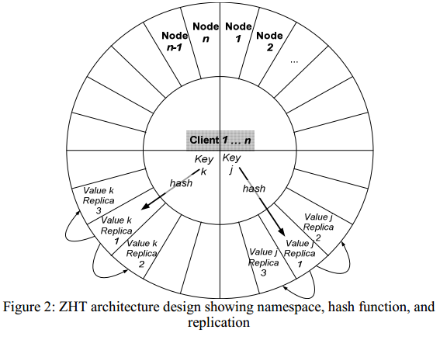
idea overview

Slide 3
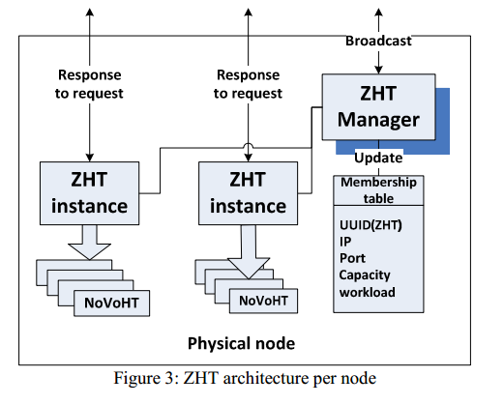
architecture overview

Slide 4
file structure and readme
See also <FILE_STRUTURE>
See also <README>
https://bitbucket.org/xiaobingo/iit.datasys.zht-mpi

Slide 5
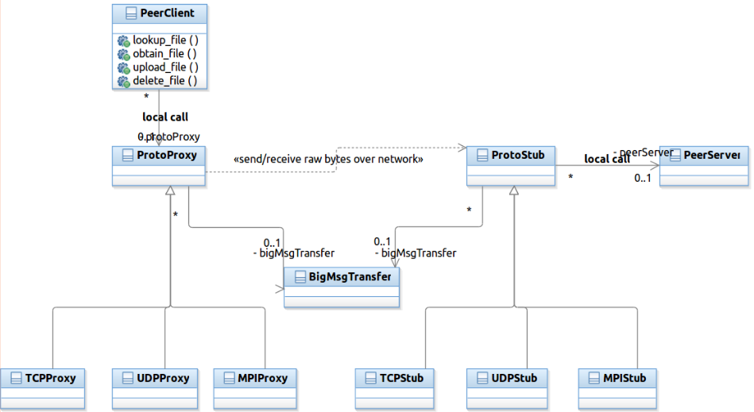
Protocol abstraction

Slide 6
How to choose Protocol
zht.conf
PROTOCOL TCP
PROTOCOL UDP
PROTOCOL MPI

Slide 7
How to build ZHT
Make executables for IP protocol family
make
Executables:
zht_cpptest/zht_ctest/zhtserver/c_zhtclient_lanl_threaded/c_zhtclient_threaded_test/cpp_zhtclient_threaded_test
Make executables for MPI protocol family
make mpi
Executables:
zht-mpibroker
zht-mpiserver

Slide 8
How to launch ZHT servers
For IP protocol family:
./zhtserver -z zht.conf -n neighbor.conf
For MPI protocl family:
mpiexec -np 4 ./zht-mpiserver -z zht.conf -n neighbor.mpi.conf : ./zht-mpibroker -z zht.conf -n neighbor.mpi.conf
The ZHT client and YOUR_OWN_APP are not aware of the protocols

Slide 9
ZHT Language bindings
C
C++
Recommendations
Always try the C++ binding since IT’S MORE CONVENIENT to pass user-defined composite data structure using OFFICIAL Google protocol buffer C++ binding
ZHT C binding depends on NON- OFFICIAL Google protocol buffer C binding, BUGS potentailly

Slide 10
How to dev your ZHT apps
Find C examples to call ZHT-client-API
See <c_zhtclient_test.c> for C example on how to call ZHT-client-API
See <c_zhtclient_threaded_test.cpp> and <c_zhtclient_lanl_threaded.c> for C example on how to call ZHT-client-API in multi-threaded context

Slide 11
How to dev your ZHT apps
Find C++ examples to call ZHT-client-API
See <cpp_zhtclient_test.cpp> for C++ example on how to call ZHT-client-API
See <cpp_zhtclient_threaded_test.cpp> for C++ example on how to call ZHT-client-API in multi-threaded context

Slide 12
How to dev your ZHT apps - walkthrough
Assume the directory:
iit.datasys.zht-mpi
iit.datasys.zht-mpi/src
iit.datasys.zht-mpi/tutorial
iit.datasys.zht-mpi/tutorial/zhtsample.cpp
See iit.datasys.zht-mpi/src/README to install < Google protocol buffers c binding, VERSION 0.15 > and < Google protocol buffers c++ binding, VERSION 2.4.1 >
for example, you got iit.datasys.zht-mpi/tutorial/zhtsample.cpp as your app
cd to iit.datasys.zht-mpi/src
make or make mpi
cd ../tutorial/

Slide 13
How to dev your ZHT apps - walkthrough
mkdir include #create dir to hold ZHT header files your app may need
mkdir lib #create dir to hold ZHT lib file your app needs to link to
cp ../src/*.h include/ #copy ZHT header files
cp ../src/libzht.a lib/ #copy ZHT lib file
vim comp.sh and enter
gcc –g –o zhtsample zhtsample.cpp -Iinclude/ -Llib/ -lzht -lstdc++ -lpthread -lprotobuf -lprotobuf-c

Slide 14
How to dev your ZHT apps - walkthrough
bash comp.sh #this will generate executable zhtsample
cd to ../src, and start ZHT server as
./zhtserver –z zht.conf –n neighbor.conf
cd ../tutorial
Run ZHT sample as
./zhtsample –z ../src/zht.conf –n ../src/neighbor.conf

Slide 15
How to dev your ZHT apps – passing composite datastructure
cd to iit.datasys.zht-mpi/tutorial/
vim student.proto and enter
message Student {
required int32 id = 1;
required bool gender = 2;
required bytes firstname = 3;
required bytes lastname = 4;
required bytes address = 5;
required bytes phone = 6;
optional bytes hobbies = 7;
repeated bytes courses = 8;
}
protoc –cpp_out=. student.proto #this will generate student.pb.h and student.pb.cc

Slide 16
How to dev your ZHT apps – passing composite datastructure
For example, you got iit.datasys.zht-mpi/tutorial/udtsample.cpp as app
Other steps same as others in previous case
vim comp.sh and append line as
gcc –g –o udtsample udtsample.cpp student.pb.cc -Iinclude/ -Llib/ -lzht -lstdc++ -lpthread -lprotobuf -lprotobuf-c
launch zhtserver as mentioned before
Run udtsample as
./udtsample –z ../src/zht.con –n ../src/neighbor.conf

Slide 17
How to dev your ZHT apps – define your persistent storage
When you launch zhtserver, it prompts:
Usage:
./zhtserver -z zht.conf -n neighbor.conf [-p port] [-f novoht_db_file] [-h(help)]
Using -f option, you specify the file to persist items you opeated, e.g. novoht_db_file

Slide 18
How to dev your ZHT apps – run ZHT over MPI protocol(standalone mode)
vim iit.datasys.zht-mpi/src/zht.conf, set
PROTOCOL MPI
make mpi
Launch 4 ZHT servers as
mpiexec -np 4 ./zht-mpiserver -z zht.conf -n neighbor.mpi.conf : ./zht-mpibroker -z zht.conf -n neighbor.mpi.conf
Run your ZHT apps

Slide 19
How to dev your ZHT apps – run ZHT(cluster mode)
see iit.datasys.zht-mpi/README

Slide 20
How to customize ZHT- augment client API
Declare and define new C++ binding API in < cpp_zhtclient.h > and < cpp_zhtclient.cpp >,
Declare and define your operation code in < Const.h > and < Const.cpp >, e.g. Const::ZSC_OPC_YOURS, like Const::ZSC_OPC_LOOKUP
Learn from the existing API, e.g. ZHTClient::lookup, the stack looks like:
int ZHTClient::lookup(const char *key, char *result)
int ZHTClient::lookup(const string &key, string &result)
int ZHTClient::commonOp(const string &opcode, const string &key, const string &val, const string &val2, string &result, int lease)
string ZHTClient::commonOpInternal(const string &opcode, const string &key, const string &val, const string &val2, string &result, int lease)
Declare and define delegation for new API in < c_zhtclientStd.h > and < c_zhtclientStd.cpp >

Slide 21
How to customize ZHT- augment client API
Declare and define C binding for new API in < c_zhtclient.h > and < c_zhtclient.cpp >

Slide 22
How to customize ZHT- augment server implementation
Declare and define server implementation for new client API in < HTWorker.h> and < HTWorker.cpp >
Learn from existing impl, e.g. lookup, the stack looks like:
string HTWorker::run(const char *buf)
Be sure to add the operation dispatch code like:
if (zpack.opcode() == Const::ZSC_OPC_YOURS)
string HTWorker::lookup_shared(const ZPack &zpack)

Slide 23
How to dev your ZHT apps
demo

Slide 24
Questions?
Tonglin Li
tli13@hawk.iit.edu
http://datasys.cs.iit.edu/projects/ZHT/

