Slide 1
1
Introduction to the Internet

Slide 2
Learning Outcomes
Describe the Evolution of the Internet and the Web
Explain the Need for Web Standards
Identify Networking Protocols
Define Addressing and Domain Names
Describe HTML, XHTML, and HTML5

Slide 3
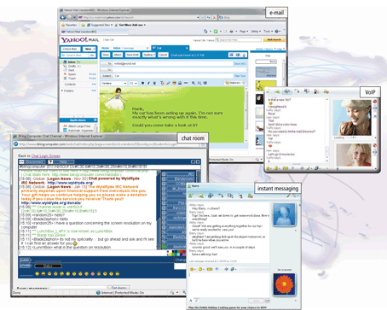
The Internet
Worldwide Collection of Networks
Links Millions of:
Businesses
Government Agencies
Educational Institutions
Individuals

Slide 4
Internet Services
World Wide Web
E-mail
File Transfer
Message Board
Instant Messaging

Slide 5
History of the Internet
Origination
Originated as ARPANET in September 1969
Goals
Allow Scientists in Different Places to Collaborate
Function Even if Part of Network Disabled
Renamed Internet in the Late 1980s
World Wide Web Proposed In 1989
Tim Berners-Lee

Slide 6
Reasons for Internet Growth in the 90’s
Removal of the Ban on Commercial Activity
Development of the World Wide Web
By Tim Berners-Lee at CERN
Development of Mosaic
First Graphics-based Web Browser at NCSA
PCs Were Increasingly Available and Affordable
ISPs Offered Low-cost Connections to the Internet

Slide 7
Growth of the Internet
Internetworldstats.com 6/2020

Slide 8
World Internet Usage
Internetworldstats.com 6/2020

Slide 9
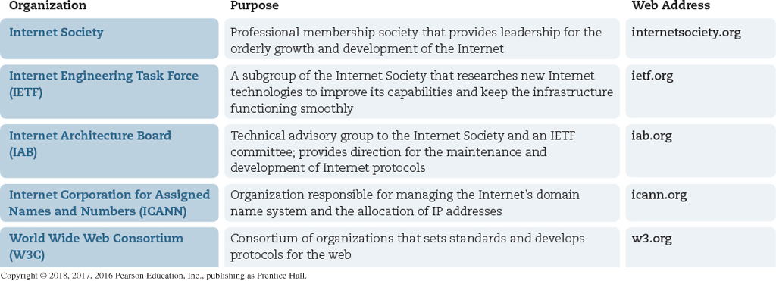
Internet Standards & Coordination

Slide 10
Internet Standards & Coordination
World Wide Web Consortium (W3C)
Develops Prototype Technologies Related to the Web
Produces Recommendations
Specifications to Standardize Web Technologies
Tim Berners-Lee, Director

Slide 11
Internet & Accessibility
Web Accessibility Initiative (WAI)
Major Area of Work by W3C
Facilitate Use by Those with Special Needs
Produce Web Content Accessibility Guidelines (WCAG)
Americans with Disability Act
Section 508 of Federal Rehabilitation Act
Universal Design
Make Things Usable to Most Diverse Range of People

Slide 12
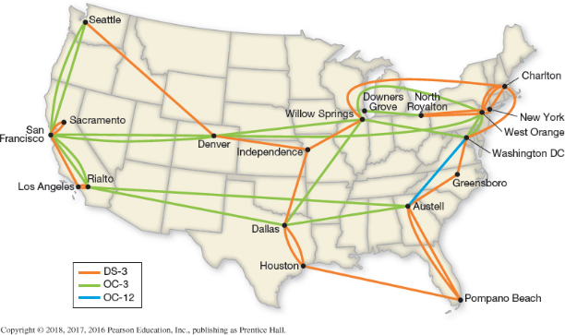
Internet Mechanics
Internet Backbone
Main Communication Pathways
Data Travels the Fastest
Large National / International Networks
Access Providers
ISP (Internet Service Provider)

Slide 13
Internet Mechanics
Web Client
Connected to the Internet when Needed
Usually Runs Web Browser (Client) Software
e.g., Chrome, Internet Explorer, Firefox, Safari
Uses HTTP (Hypertext Transfer Protocol)
Requests Web Pages from Server
Receives Web Pages & Files from Server

Slide 14
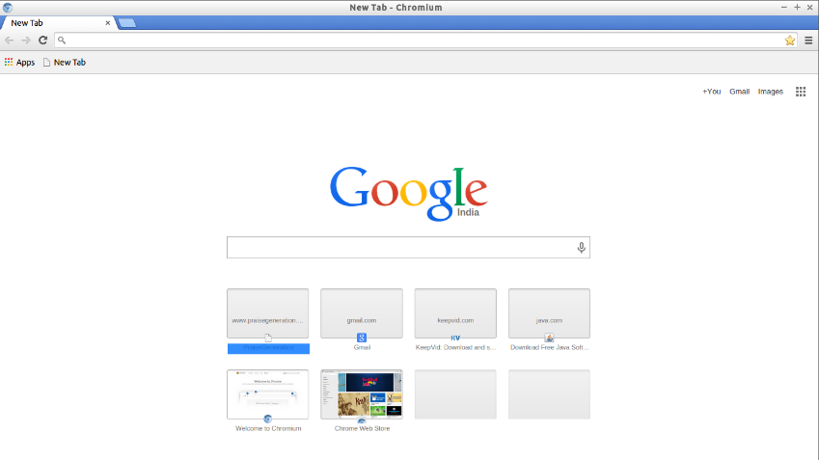
Internet Mechanics
Web Browser (Navigator)
Program that Allows Access to Web Pages
Netscape
Internet Explorer
Spent $1.25 B
Mozilla
Firefox
Safari
Chrome
Microbrowser
Mobile Devices

Slide 15
Internet Mechanics
Web Server
Continually Connected to the Internet
Runs Web Server Software
e.g., Apache, Internet Information Server
Uses HTTP (Hypertext Transfer Protocol)
Receives Request for Web Page
Transmits Status Code, Web Page, & Associated Files

Slide 16
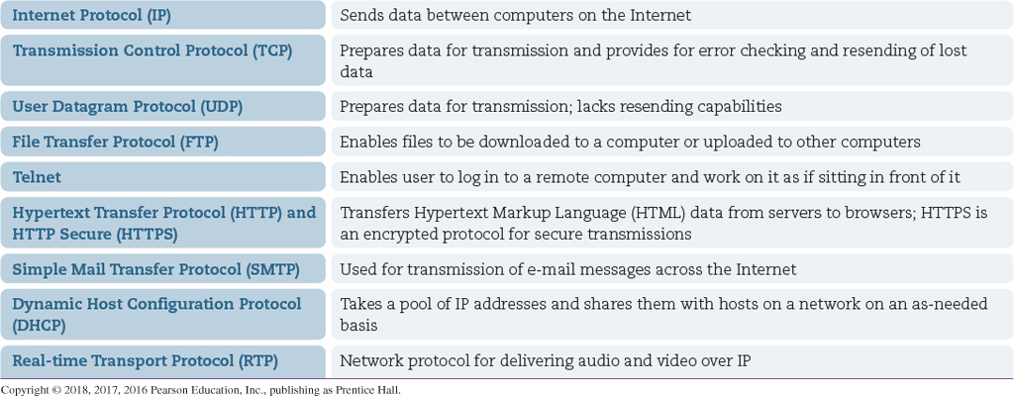
Protocols
Rules Used for Clients & Servers to Communicate

Slide 17
Protocols
E-Mail
Sending
SMTP (Simple Mail Transfer Protocol)
Receiving
POP / POP3 (Post Office Protocol)
IMAP (Internet Mail Access Protocol)

Slide 18
Protocols
FTP
Allows Exchange of Files Over the Internet
Commonly used by Web Developers
Transfer Web Pages From Their Computers to Web Servers
HTTP (Hypertext Transfer Protocol)
Rules for Exchanging Files on the Web
Text, Graphics, Sound, Video, Other Multimedia Files

Slide 19
Protocols
TCP/IP (Transmission Control Protocol/Internet Protocol)
Official Communication Protocol of the Internet
TCP
Ensure Integrity of Communication
Breaks Files and Messages into Individual Units (Packets)
IP
Controls How Data is Sent Between Computers on the Internet
Routes a Packet to the Correct Destination Address
Packet Gets Forwarded to Next Closest Router
Until Destination is Reached

Slide 20
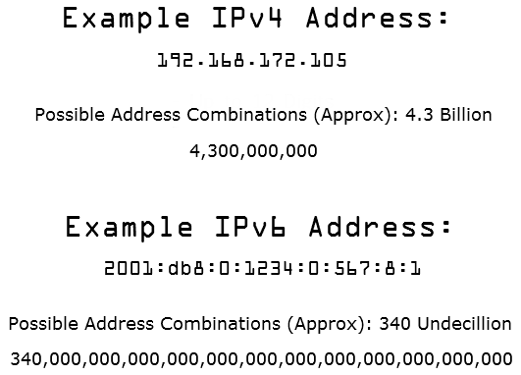
Addressing
IP Address
Identifies Each Device Connected to Internet
Unique Number
IPv6
8 Groups of 4 Hex Digits Separated by Colons
Benefits
Increased Address Space
More Efficient Routing
Better Mobility Support
Multi-homing

Slide 21
Addressing
Domain Name
Text Version of IP Address
TLD (Top Level Domain)
Identifies Type of Organization
ICANN Assigns & Controls TLDs
DNS (Domain Name System)
DNS Server
Translates Domain Name to IP Address

Slide 22
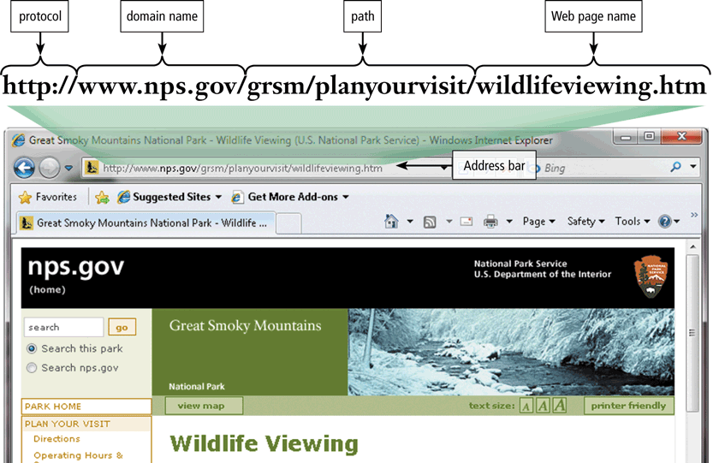
Addressing
Web
URL (Uniform Resource Locator)
Unique Address for Page Located on Server

Slide 23
Markup Languages
SGML (Standard Generalized Markup Language)
Standard for Specifying a Markup Language or Tag Set
HTML (Hypertext Markup Language)
Set of Markup Codes Used to Display Pages in a Web Browser
Interpret and Compose Text, Images, and Other Material
Into Visual or Audible Web Pages

Slide 24
Markup Languages
XML (eXtensible Markup Language)
Designed to Describe, Deliver, & Exchange Structured Data
e.g., Display Data from Databases on Web Pages
XHTML (eXtensible Hypertext Markup Language)
Developed by the W3C
Reformulation of HTML 4.0 as an Application of XML
Formatting Strengths of HTML 4.0
Data Structure & Extensibility Strengths of XML

Slide 25
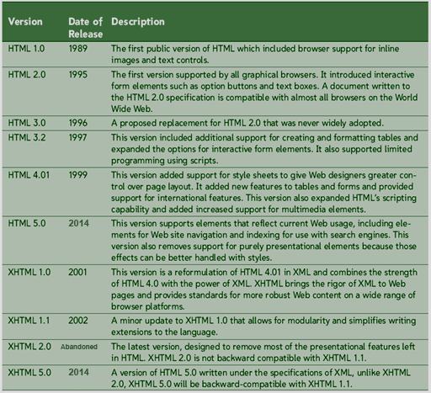
Markup Languages History

Slide 26
HTML5 Status
HTML Living Standard
WHATWG
Web Hypertext Application Technology Working Group
Authoritative
Founded by Individuals from Apple, Mozilla, Opera
Steering Group
Apple, Google, Microsoft, Mozilla

Slide 27
HTML5 Status
W3C Ceded Authority Over HTML DOM to WHATWG
May 28, 2019
Recognized Having 2 Standards Is Harmful
W3C Will Still Participate in Development of HTML
HTML 5.1 (2016)
Introduced New Elements, Attributes, and Features
HTML 5.2 (2017)
Modal Capability, Restriction to Paragraph Children

