Slide 1
2
HTML Basics

Slide 2
Learning Outcomes
Describe Polyglot Coding
Identify Markup Language in Web Pages
Use Elements to Code a Template for a Web Page
Configure the Body of a Web Page
Code Special Characters
Create Absolute, Relative, & E-mail Hyperlinks
Test a Web Page for Valid Syntax

Slide 3
HTML Elements
Each Markup Code Represents an HTML Element
Elements Are Enclosed in Angle Brackets
"<" & ">" Symbols
Normal Elements are Coded in Pairs
Opening Element & Closing Element
Designates Where Something Begins & Ends
Coded as <element> … </element>

Slide 4
HTML Elements
Void (AKA Empty, Null, Single-sided) Elements
Just Are; Do Not Begin & End
area, br, col, embed, hr, img, input, link, meta, param
Coded as <element />
Deprecated
Obsolete Elements or Syntax
Future Support Not Guaranteed
blink, center, font, frame, frameset

Slide 5
Syntax
Starting Element
First Character Must Be "<"
Next Characters Must Be Element's Name
If There Are Any Attributes
There Must First Be a Space Character
Multiple Attributes
Must Be Separated from Each Other by a Space Character
If Element Is a Void Element
Must Be a Space Character Followed by a "/" Character
Last Character Must Be ">"

Slide 6
Syntax
Ending Element (if not Void)
First Character Must Be "<"
Second Character Must Be "/" Character.
Next Characters Must Be Element's Name
Last Character Must Be ">"
White Space
Multiple Spaces Are Not Rendered
Tab, Enter Are Not Rendered
Use Non-breaking Space for Multiple Spaces
&#xA0;

Slide 7
Syntax
Attributes
Controls Behavior or Appearance of Element
<tagName attrib#1=“Value” attrib#2=“Value” />
Nesting
Placing Sets of Tags Within Each Other
FILO (First In, Last Out)
<b><i>…</i></b> instead of <b><i>…</b></i>
Comments
<!-- . . . -->
<!-- This is a comment. -->

Slide 8
Polyglot Markup
HTML that Conforms to Both HTML & XHTML
Can be Parsed as Either HTML or XML
Can be Served as Either HTML or XHTML
Depending on Browser Support & MIME Type

Slide 9
Web Page Structure
Document Type Definition (DTD)
!DOCTYPE Statement
Identifies Version of HTML Used in Document
Coded at the Top of a Web Page Document

Slide 10
Polyglot Web Page Structure
Example HTML 5 Web Page
<!DOCTYPE html>
<html xmlns="http://www.w3.org/1999/xhtml" lang="en" xml:lang="en">
<head>
<title>Page Title Goes Here</title>
<meta charset="utf-8" />
</head>
<body>
... body text and more HTML5 elements go here ...
</body>
</html>

Slide 11
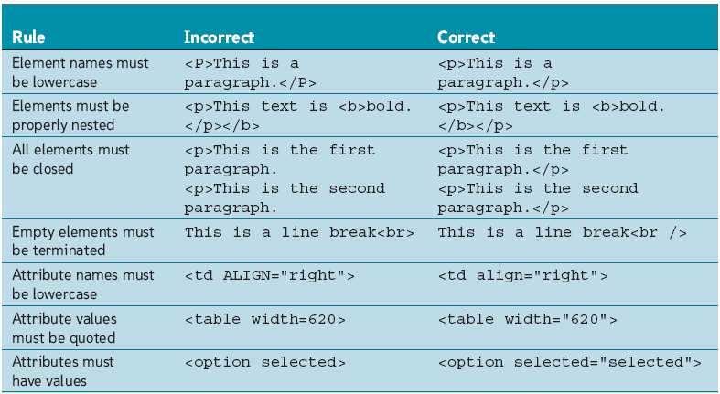
Well-formed Polyglot Documents

Slide 12
Polyglot Code Examples
Elements Must Be Lowercase
Correct
<strong>This text appears bold.</strong>
Incorrect
<STRONG>This text appears bold.</STRONG>
<Strong>This text appears bold.</Strong>
Elements Must Be Properly Nested
Correct
<strong><em>This text appears bold.</em></strong>
Incorrect
<strong><em>This text appears bold.</strong></em>

Slide 13
Polyglot Code Examples
ALL Elements Must Be Closed
Correct
<p>Here is some text.</p><p>Here is more text.</p>
Incorrect
<p>Here is some text.<p>Here is more text.
Correct
<p>Here is some text.<br />More text on next line.</p>
Incorrect
<p>Here is some text.<br>More text on next line.</p>
<p>Here is some text.<br></br> More text on next line.</p>

Slide 14
Polyglot Code Examples
ALL Elements Must Be Closed
Correct
<meta charset="utf-8" />
Incorrect
<meta charset="utf-8">
<meta charset="utf-8"></meta>
Correct
<link rel="stylesheet" href=“test.css" type="text/css" />
Incorrect
<link rel="stylesheet" href=“test.css" type="text/css">
<link rel="stylesheet" href=“test.css" type="text/css"></link>

Slide 15
Polyglot Code Examples
ALL Elements Must Be Closed
Correct
<img src="photo.jpg" alt="Logo" height="99" width="99" />
Incorrect
<img src="photo.jpg" alt="Logo" height="99" width="99">
<img src="photo.jpg" alt="Logo" height="99" width="99"></img>
Correct
<input id="Name" name="Name" type="text" size="30" />
Incorrect
<input id="Name" name="Name" type="text" size="30">
<input id="Name" name="Name" type="text" size="30"></input>

Slide 16
Polyglot Code Examples
Attribute Names Must Be Lowercase
Attribute Values Must Be Quoted
Attributes Must Have Values
Correct
<option value="green" selected="selected">Green</option>
Incorrect
<option VALUE="green" Selected="selected">Green</option>
<option value=green selected="selected">Green</option>
<option value="green" selected>Green</option>

Slide 17
<html>
<html>…</html>
Surround All Markup & Text
Required
Used to Begin & End Every HTML Document
Attributes
<html xmlns="http://www.w3.org/1999/xhtml" lang="en" xml:lang="en">

Slide 18
Global Attributes
accesskey
Specifies Shortcut Key to Activate/Focus an Element
class
Specifies One or More classnames for an Element
contenteditable
Specifies Whether Content of an Element is Editable
contextmenu
Specifies a Context Menu for an Element
Appears When a User Right-clicks on Element

Slide 19
Global Attributes
data-*
Store Custom Data Private to Page or Application
dir
Specifies the Text Direction for Content in an Element
draggable
Specifies Whether an Element is Draggable
dropzone
Specifies Whether Dragged Data is Copied, Moved, or Linked

Slide 20
Global Attributes
hidden
Specifies Whether an Element is Viewable
id
Specifies a Unique ID for an Element
lang
Specifies the Language of the Element's Content
spellcheck
Specifies Whether Element has its Spelling Checked

Slide 21
Global Attributes
style
Specifies an Inline CSS Style for an Element
tabindex
Specifies the Tabbing Order of an Element
title
Specifies Extra Information About an Element
translate
Specifies Whether Content of Element Is Translated

Slide 22
<head>
<head>…</head>
Contains the Document's Header Information
Required
Important Information
Document Title
META Elements
Text Included Does Not Render

Slide 23
<title>
<title>…</title>
Supplies the Title for the HTML Document
Appears in the Browser Window Title Bar
Title Should be 7 – 10 Words
Descriptive Rather Than General
Many Search Engines List Pages by Title
Often the First Impression a User Gets of Your Page

Slide 24
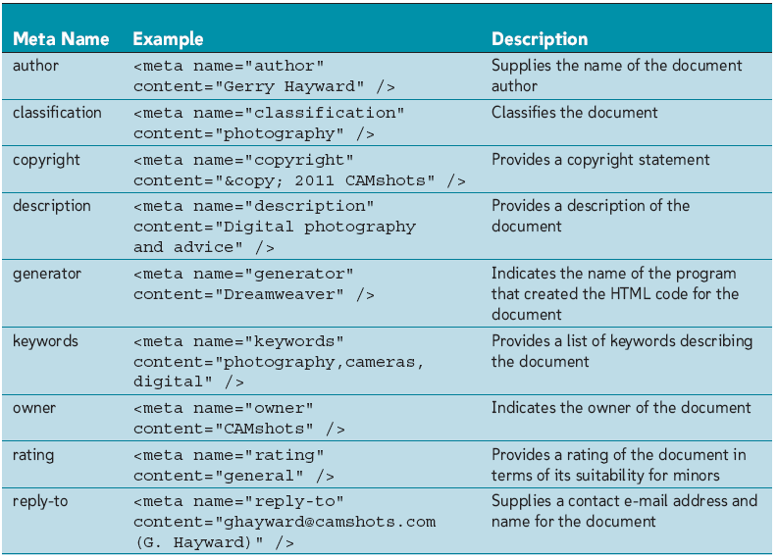
<meta>
<meta … />
Information Used to Describe Data on Web Page
Appears in the <head>

Slide 25
<body>
<body>…</body>
Contains All Content to be Rendered
Styles
style=“color: colorName | #rrggbb | rgb(#,#,#);”
Specifies the Color of the Regular Text
style=“background-color: colorName | #rrggbb | rgb(#,#,#);”
Specifies the Background Color

Slide 26
<body>
Styles
style=“background-image: url(filename.ext);”
Points to Location of Image that is Used as Background
Image is Tiled
style=“background-position: horizontal vertical;”
Specifies the Positioning of the Background Image
Can Specify Keywords or Percentages

Slide 27
<body>
Styles
style=“background-repeat: repeat | repeat-x | repeat-y | no-repeat;”
Specifies the Tiling of the Background Image
style=“background-attachment: scroll | fixed;”
Background Image Scrolls with Page or Acts as Watermark

Slide 28
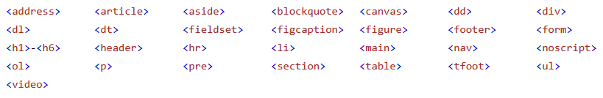
Block Level Elements
Always Starts on New Line
Takes Up Full Width Available
Stretches Out Left and Right as Far as It Can
Do Not Contain Other Block Level Elements
Except <div>

Slide 29
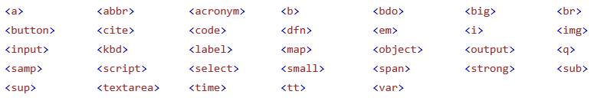
Inline Elements
Do Not Start on a New Line
Only Takes Up as Much Width as Necessary
Must Reside Inside Block Level Element

Slide 30
Structural Elements
Block Level Elements
Used to Contain Other HTML Elements
<div>…</div>
Generic Block Level Element
Sized & Floated to Create Page Layouts
Displayed Discretely from the Rest of the Document
Rendered as Paragraphs Above & Beneath <div> Contents
<header>…</header>
Contain Heading for a Document

Slide 31
Structural Elements
<hgroup>…</hgroup>
Contains Two or More Heading Elements
<header>
<hgroup>
<h1>Lighthouse&#xA0;Island&#xA0;Bistro</h1>
<h2>the best coffee on the coast</h2>
</hgroup>
</header>
<nav>…</nav>
Defines a Section for Navigation Links

Slide 32
Structural Elements
<main>…</main>
Contains Main Content of a Document
Should Have Only One Visible main Element
<section>…</section>
Defines a Section in the Document
<article>…</article>
Defines an Article in the Document
<aside>…</aside>
Defines Content Aside from Main Content
Typically Used for Sidebars

Slide 33
Structural Elements
<footer>…</footer>
Defines a Footer for the Document
Typically At Bottom of Page
<time>…</time>
Represents Date or Time (e.g., Date Articles or Blogs)
Inline Element
<span>…</span>
Inline Element Used to Format Content
Used within Text Blocks

Slide 34
<h#>
<h#>…</h#>
Create a Heading
Numbered from h1 through h6
h1 is the Top Head Level While h6 is the Bottom
Should not be Used for Text Formatting
Convey Page & Content Organization
Should be Used in Descending Order
Style
style=“text-align: left | center | right | justify;”
Specifies the Alignment of the Heading Text

Slide 35
<p> & <br>
<p>…</p>
Separates Paragraphs of Text
Inserts Blank Line Above & Below Contnent
<br />
Causes Text to Break Wherever Element is Placed

Slide 36
<blockquote>
<blockquote>…</blockquote>
Indents a Block of Text on Both Margins
For Special Emphasis
Long Quotes

Slide 37
Phrase Elements
Element | Example | Usage
<b> | bold text | Text that has no extra importance but is styled in bold font by usage and convention
<em> | emphasized text | Causes text to be emphasized in relation to other text; usually displayed in italics
<i> | italicized text | Text that has no extra importance but is styled in italics by usage and convention
<mark> | mark text | Text that is highlighted in order to be easily referenced (HTML5 only)
<small> | small text | Legal disclaimers and notices (“fine print”) displayed in small font-size
<strong> | strong text | Strong importance; causes text to stand out from surrounding text; usually displayed in bold
<sub> | _{sub} text | Displays a subscript as small text below the baseline
<sup> | ^{sup} text | Displays a superscript as small text above the baseline

Slide 38
Lists
<ul>…</ul>
Unordered List Renders a Bulleted List
Use Where Order or Rank is Unimportant
Style
style=“list-style-type: disc | square | circle;”
Changes Style of Bullet Before Item
style=“list-style-image: url(filename.ext);”
Image Used as Bullet

Slide 39
Lists
<ol>…</ol>
Ordered List Element Renders a Numbered List
Style
style=“list-style-type: decimal | upper-roman | . . .;”
Changes Number / Letter Style Before Item
start=“value”
Sets Initial Counter
reversed=“reversed”
Reverses Counter

Slide 40
Lists
<li>…</li>
Defines an Item in a List
<dl>…</dl>
Definition List
<dt>…</dt>
Defined Term
<dd>…</dd>
Definition

Slide 41
List Properties
list-style-type: disc | circle | square | decimal | decimal-leading-zero | lower-roman | upper-roman | lower-greek | lower alpha | lower-latin | upper-alpha | upper-latin | hebrew | armenian | georgian | cjk-ideographic | hiragana | katakana | hira-ganairoha | katakana-iroha | none
Default = disc
Allows Customization of the List Marker
Syntax:
ul {list-style-type: circle;}

Slide 42
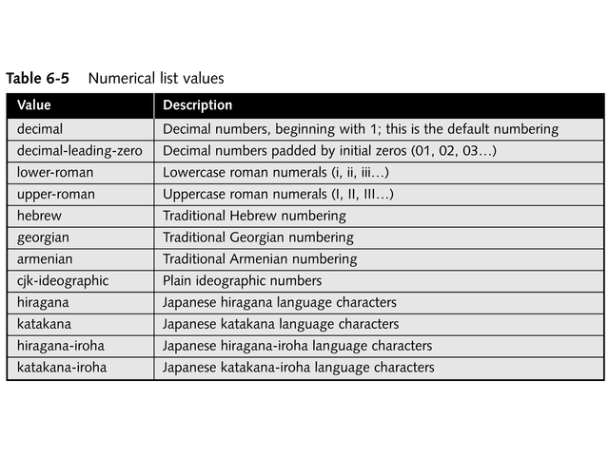
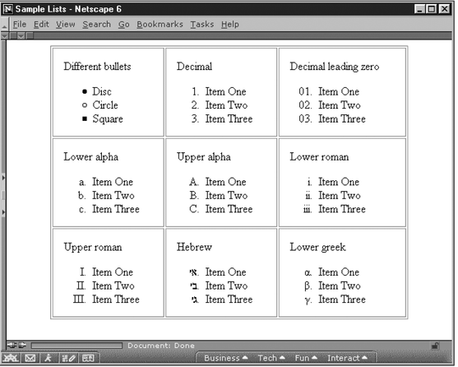
List Properties
list-style-type

Slide 43
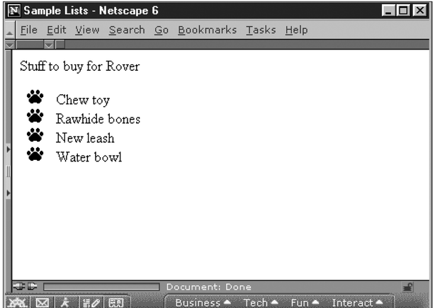
List Properties
list-style-image: url(filename.ext)
Allows Use of Image as List Marker
Syntax:
ul {list-style-image: url(paw.gif);}

Slide 44
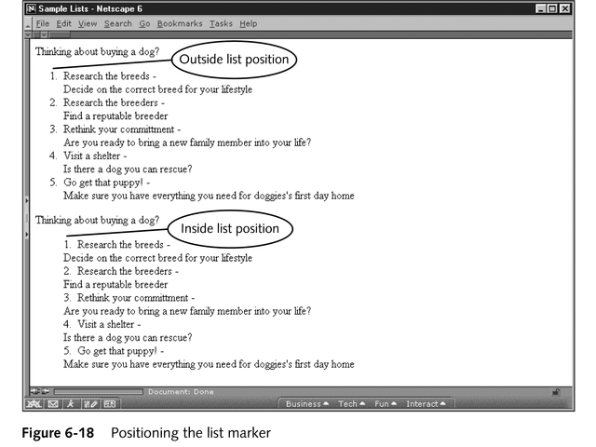
List Properties
list-style-position: inside | outside
Default = inside
Allows Placement of the List Marker
Syntax:
ul {list-style-position: outside;}

Slide 45
<a>
<a>…</a>
Used to Create Links to Other Resources
Named Anchor
AKA Bookmark
Used to Name Specific Locations within a Page
id Attribute
Defines Destination

Slide 46
<a>
Attributes
href=“URL”
Specifies Location of Linked Resource
Typically Another HTML File
Can Also Specify Other Internet Resources
Files, E-mail, FTP
Named Anchor or Bookmark URLs are Preceded By #
id=“text”
Marks Specific Place Within an HTML Document
AKA Named Anchor or Bookmark

Slide 47
<a>
Attributes
media=“media_query”
Specifies Media/Device the Linked Document is Optimized for
rel=“text”
Indicates Relationship Between Documents
rel=“stylesheet”
Tells Browser that Linked Document is a Style Sheet
target=“_blank | _parent | _self | _top”
Specifies Where to Open Linked Document

Slide 48
<a>
Attributes
title=“text”
Global Attribute
Provides Supplemental Information Regarding a Link
Behaves Like a Tooltip
Should be Less Than 60 Characters
Example
<a href="http://www.mysite.com/">A link to a site.</a>

Slide 49
<a>
E-Mail
Mailto
<a href=“mailto:losacco@cod.edu”>Send Mail</a>
Can Automatically Include Subject Line
“mailto:losacco@cod.edu?subject=text”
Other Options
“mailto:losacco@cod.edu?cc=another@cod.edu &bcc=secret@cod.edu&subject=subscribe &body=Send me your newsletter right away”

Slide 50
Special Characters
Begin with Ampersand & End with Semicolon
Named Entities
&amp; &lt; &gt; &apos; &quot;
Character References
https://dev.w3.org/html5/html-author/charref

Slide 51
Special Characters
Character References
Uses the Format &#xhhhh;
Where hhhh is Code Point in Hexadecimal Form
x Must be Lowercase in XML Documents
hhhh May be Any Number of Digits & Include Leading Zeros
If hhhh Has Letters, Uppercase is Used
&#xA9; is Copyright Symbol
&#xA0; is Non-breaking Space
&#x2014; is Em Dash

Slide 52
Paths
URL (Uniform Resource Locator)
Location of Document on Web
www.cod.edu
Path
Location of Document on Server
http://www.cod.edu/people/faculty/losacco/index.htm

Slide 53
Paths
Absolute
Exact Location on Server
Begins with a /
/student/index.htm
Relative
Location Relative to Current Document
Current — Nothing
page.htm
Child — Separated by /
images/background.gif
Parent — Two Periods (..)
../page.htm

Slide 54
URL
http://www.cod.edu/people/faculty/losacco/index.htm
Communication Protocol
http://
Domain
www.cod.edu
Path
/people/faculty/losacco/
Document
index.htm

Slide 55
Validation
Checks Code for Syntax Errors
CSS HTML Validator
https://www.htmlvalidator.com/cse-html-validator-160405personal-setup.exe
Free
Older Version of Program I Use

