Slide 1
Cost Cut
- Cost Cut ?
1. Reason for this Project
2. Environment
Notes:
Simple Mean, Simple Moving, Weighted Moving, Exponential Smoothing

Slide 2
Layers
Data Collection
Data Quality
EDA
Modeling

Slide 3
Data Collection
Collection of Data
OpenNMS
Grafana
MS Excel
Data Quality

Slide 4
Sample Data

Slide 5
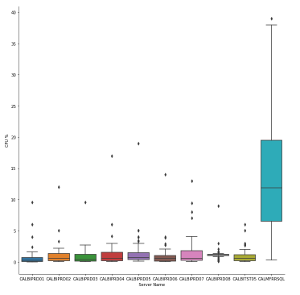
EDA

Slide 6
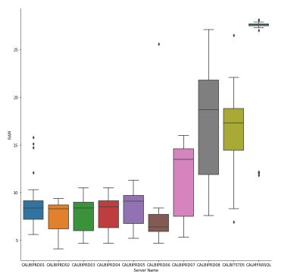
EDA

Slide 7
EDA

Slide 8
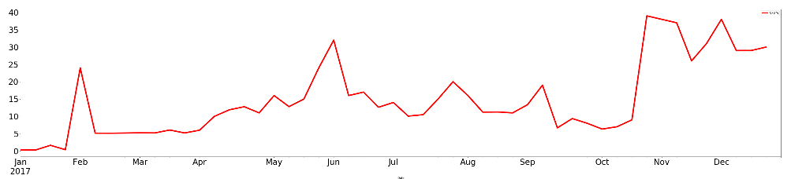
EDA BIPRDSQL CPU%

Slide 9
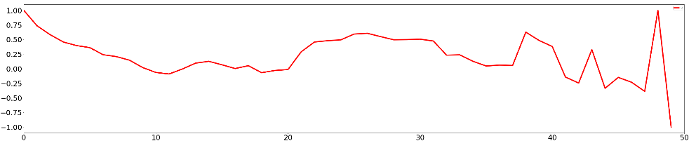
EDA BIPRDSQL CPU%
BIPRDSQL CPU % Autocorrelation - Week Lag 1 to 51

Slide 10
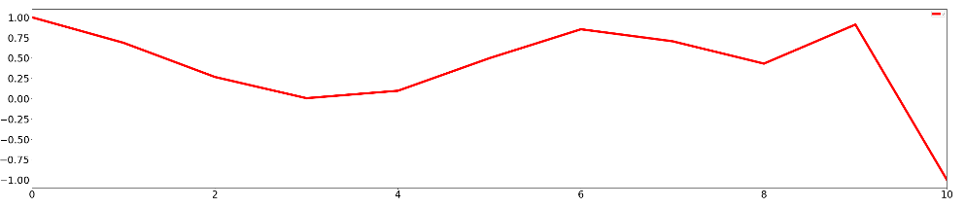
EDA BIPRDSQL CPU%
BIPRDSQL CPU % Autocorrelation - Month Lag 1 to 11

Slide 11
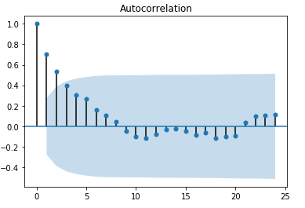
EDA BIPRDSQL CPU%
BIPRDSQL CPU % Statsmodels Autocorrelation

Slide 12
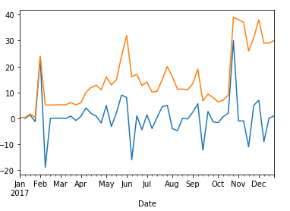
EDA BIPRDSQL CPU%
BIPRDSQL CPU % Statsmodels Autocorrelation (diff =1)

Slide 13
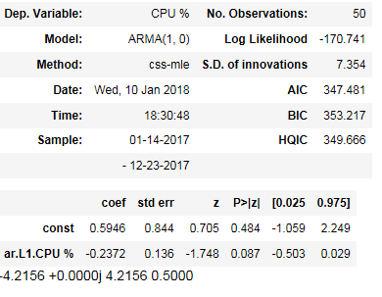
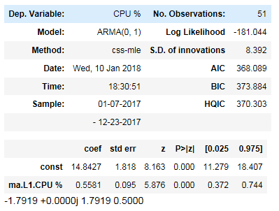
Model BIPRDSQL CPU%
BIPRDSQL CPU % Statsmodels Autocorrelation (diff =1) ARMA

Slide 14
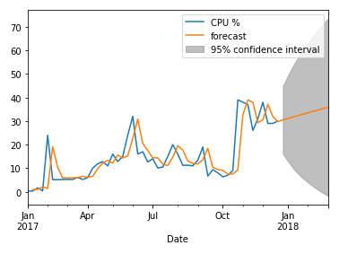
Model BIPRDSQL CPU%
BIPRDSQL CPU % ARIMA (1,1,0)

Slide 15
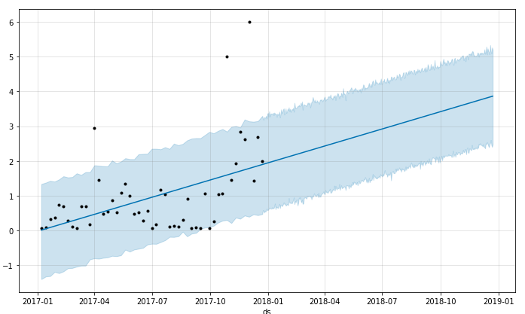
Model BITST01 CPU%
BITST01 CPU % Face Book Prophet Model

Slide 16
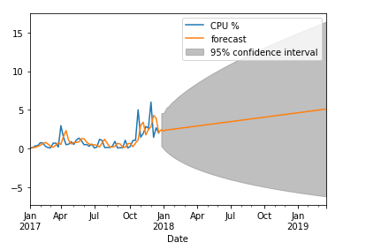
Model BITST01 CPU%
BITST01 CPU % FB Prophet Model ARIMA (1,1,0)

Slide 17
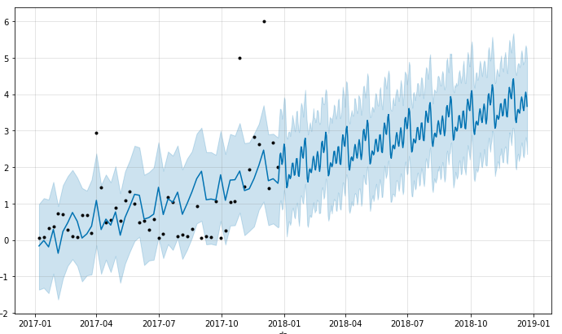
Model BITST01 CPU%
BITST01 CPU % FB Prophet Model - Monthly prediction

Slide 18
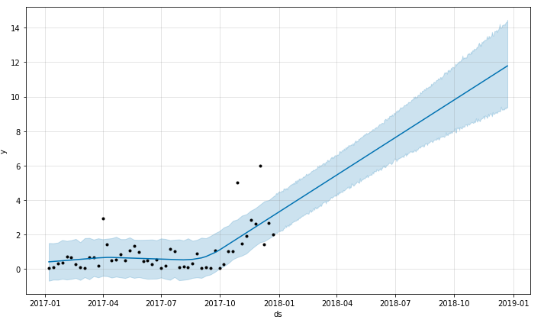
Model BITST01 CPU%
BITST01 CPU % FB Prophet Model - Change Point Scale

Slide 19
Summary
- Predictions and Recommendations
- Constrains

