Slide 1


Novidades de Performance no SQL Server 2019

Slide 2

Quem Somos?
Fundamos a Data Tuning com o intuito de:
Disseminar o conhecimento que possuímos por meio de: meetups, palestras, treinamentos, workshops, blog, etc…
Ajudar pessoas a conhecer mais sobre bancos de dados;
Ajudar empresas a alcançar seus objetivos, ajudando-as na resolução de seus problemas em bancos de dados e apoiando-as em seu crescimento exponencial e transformação digital;
Site: https://www.datatuning.com.br/
Blog: https://blog.datatuning.com.br/

Slide 3
AGENDA
Novidades de performance no SQL Server 2019 (Intelligent Query Processing)
Intelligent Query Processing
Memory Grant Feedback
Table Variable
Batch Mode on Row Store
T-SQL Scalar In-Line Function
Dúvidas

Slide 4
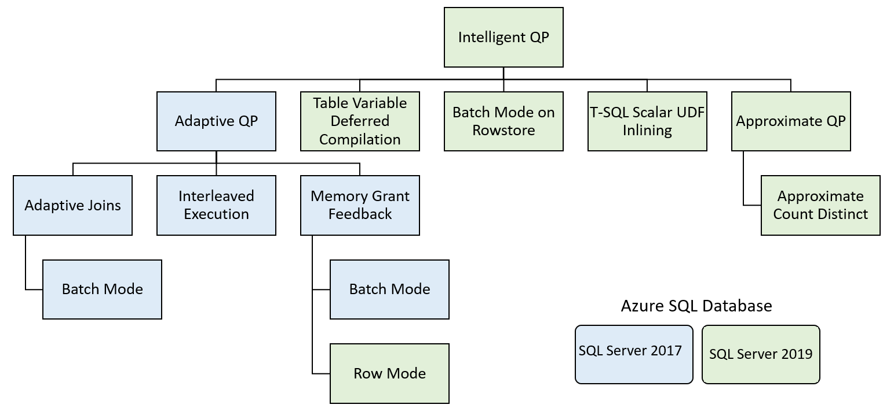
Intelligent Query Processing

Slide 5
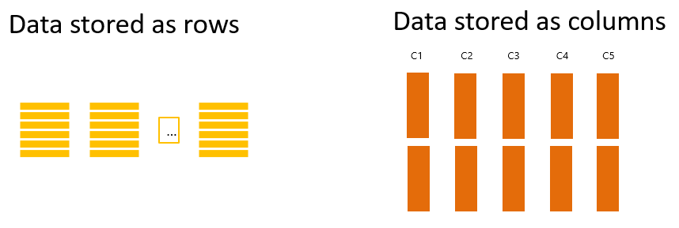
Memory Grant Feedback
Batch Mode (Já disponível no SQL Server 2017)
Row Mode (Lançado no SQL Server 2019)
If a row mode query has operations that spill to disk, add more memory for consecutive executions.
If a query wastes > 50% of the memory allocated to it, reduce the memory grant side for consecutive executions.
https://docs.microsoft.com/en-us/sql/relational-databases/performance/intelligent-query-processing?view=sql-server-2017#row-mode-memory-grant-feedback

Slide 6
Table Variable
Table Variable???
declare @SalesOrderID as table (SalesOrderID int)
insert into @SalesOrderID
values (43662),(43663),(43664),(43665),(43666)
Select *
From Sales.SalesOrderHeader oh inner join
@SalesOrderID tv on oh.SalesOrderID = tv.SalesOrderID
Use the actual cardinality of the table variable encountered on first compilation instead of a fixed guess.
This feature propagates cardinality estimates that are based on actual table variable row counts
https://docs.microsoft.com/en-us/sql/relational-databases/performance/intelligent-query-processing?view=sql-server-2017#table-variable-deferred-compilation

Slide 7
Batch Mode on Rowstore
Batch mode on rowstore enables batch mode execution for analytic workloads without requiring columnstore indexes.
With batch mode processing, query operators process data more efficiently. They work on a batch of rows instead of one row at a time.
Obs: Batch mode on rowstore helps only by reducing CPU consumption.
https://docs.microsoft.com/en-us/sql/relational-databases/performance/intelligent-query-processing?view=sql-server-2017#batch-mode-on-rowstore

Slide 8
Scalar UDF Inlining
Scalar VS Inlining Functions
Scalar UDFs are transformed into equivalent relational expressions that are “inlined” into the calling query, often resulting in significant performance gains.
select object_name(object_id) as Name, is_inlineable
from sys.sql_modules
where object_name(object_id) = 'sfSubTotalRate’
Name is_inlineable
------------------- -------------
sfSubTotalRate 1
https://docs.microsoft.com/en-us/sql/relational-databases/performance/intelligent-query-processing?view=sql-server-2017#scalar-udf-inlining

Slide 9
REFERENCIAL
https://docs.microsoft.com/en-us/sql/relational-databases/performance/intelligent-query-processing?view=sql-server-2017
https://blogfabiano.com/2018/12/18/ignite-the-tour-sp-ppt-e-scripts/
https://www.dataplatformgeeks.com/intelligent-query-processing-sql-server-2019-joe-sack-recorded-webinar-resources/

Slide 10
PERGUNTAS?

Slide 11
Muito Obrigado!
https://www.datatuning.com.br/
https://blog.datatuning.com.br/
contato@datatuning.com.br

