Slide 1
Troubleshooting your SQL Server
SQL Saturday #900 – Vitória ES

Slide 2
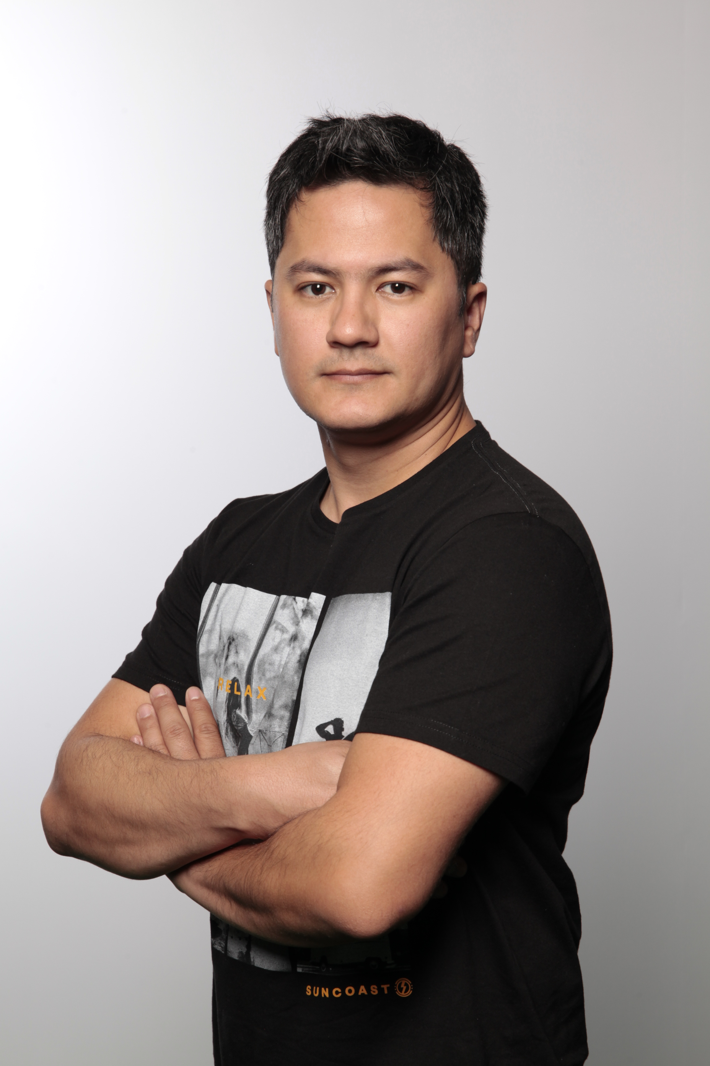






Get-Help Marcel-Inowe -Detailed
DESCRIPTION
Consultor de Banco de Dados SQL Server
Co-Founder @
CONTACTS
/in/marcelinowe/
marcel@datatuning.com.br
blog.datatuning.com.br/
Data Tuning Group/
DataTuning

Slide 3
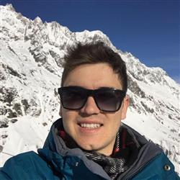
Get-Help Guilherme-Torres -Detailed
DESCRIPTION
Consultor de Banco de Dados SQL Server
Co-Founder @
CONTACTS
/guilherme-torres-dba/
guilherme@datatuning.com.br
blog.datatuning.com.br/
Data Tuning Group/
DataTuning

Slide 4
Patrocinadores

Slide 5
Parceiros

Slide 6
Agenda
ERRO 666 - Erro do bilhão
PAGELATCH - Last Page Insert Contention

Slide 7
Hands ON

Slide 8
Referências
https://blogs.msdn.microsoft.com/psssql/2018/02/16/uniqueifier-considerations-and-error-666/
https://www.youtube.com/watch?v=bHREV13xLCk&t=2951s
https://techcommunity.microsoft.com/t5/SQL-Server/Behind-the-Scenes-on-OPTIMIZE-FOR-SEQUENTIAL-KEY/ba-p/806888
https://support.microsoft.com/pt-br/help/982441/fix-you-receive-error-666-when-you-rebuild-an-index-online-on-a-partit

