Slide 1



EUROPYTHON 2023, 17th JULY
INTRODUCTION TO
MACHINE LEARNING
WITH SCIKIT-LEARN
Nabanita Roy, Liliya Akhtyamova, Bhawna Singh

Slide 2

Agenda
Introduction to Machine learning
Machine Learning Concepts
Machine Learning Process Flow
Linear Regression and Gradient Descent
Classification Algorithms and Evaluation Techniques
Try yourself!

Slide 3


Slide 4


Slide 5
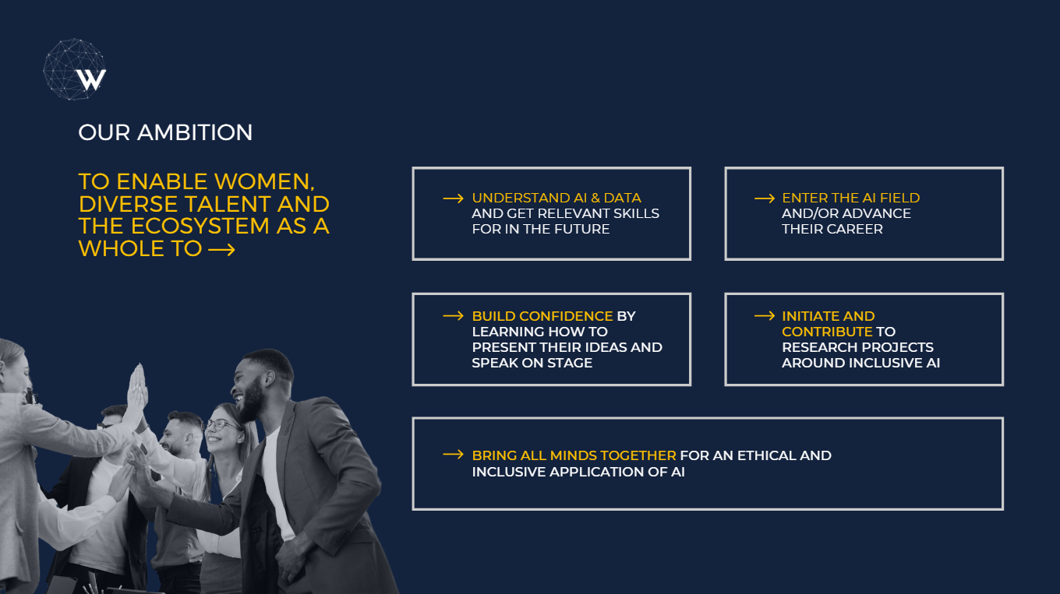

Slide 6



The WAI TEAM today!
Nabanita Roy
Women in AI Ireland
Data Scientist at EY
https://www.linkedin.com/in/nabanita-roy/
Liliya Akhtyamova
Women in AI Ireland
Senior Data Scientist & ML Engineer
iCIMS
https://www.linkedin.com/in/datawhizette/
Bhawna Singh
Women in AI Ireland
Data Scientist at CeADAR Ireland
https://www.linkedin.com/in/bhawna-singh-7ab813140/

Slide 7
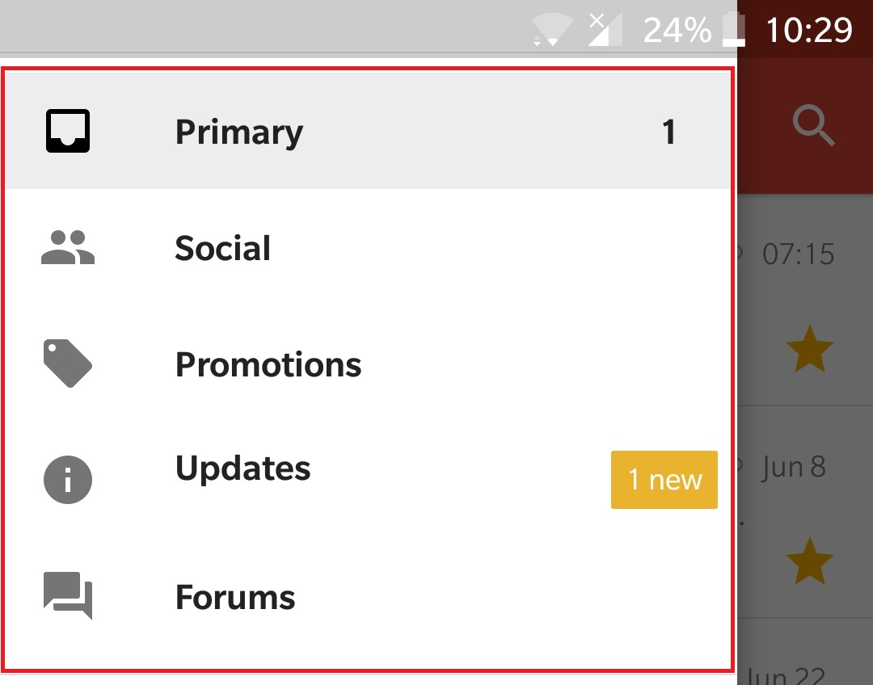
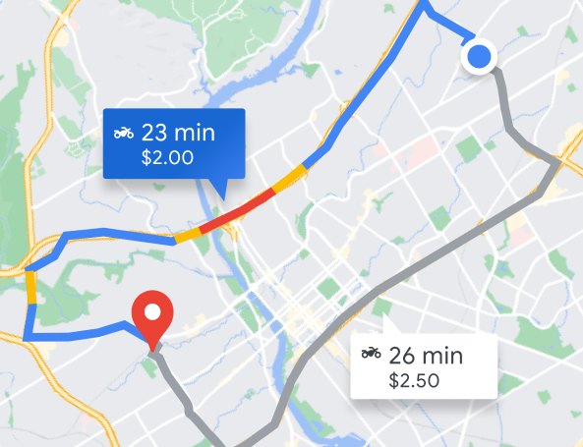
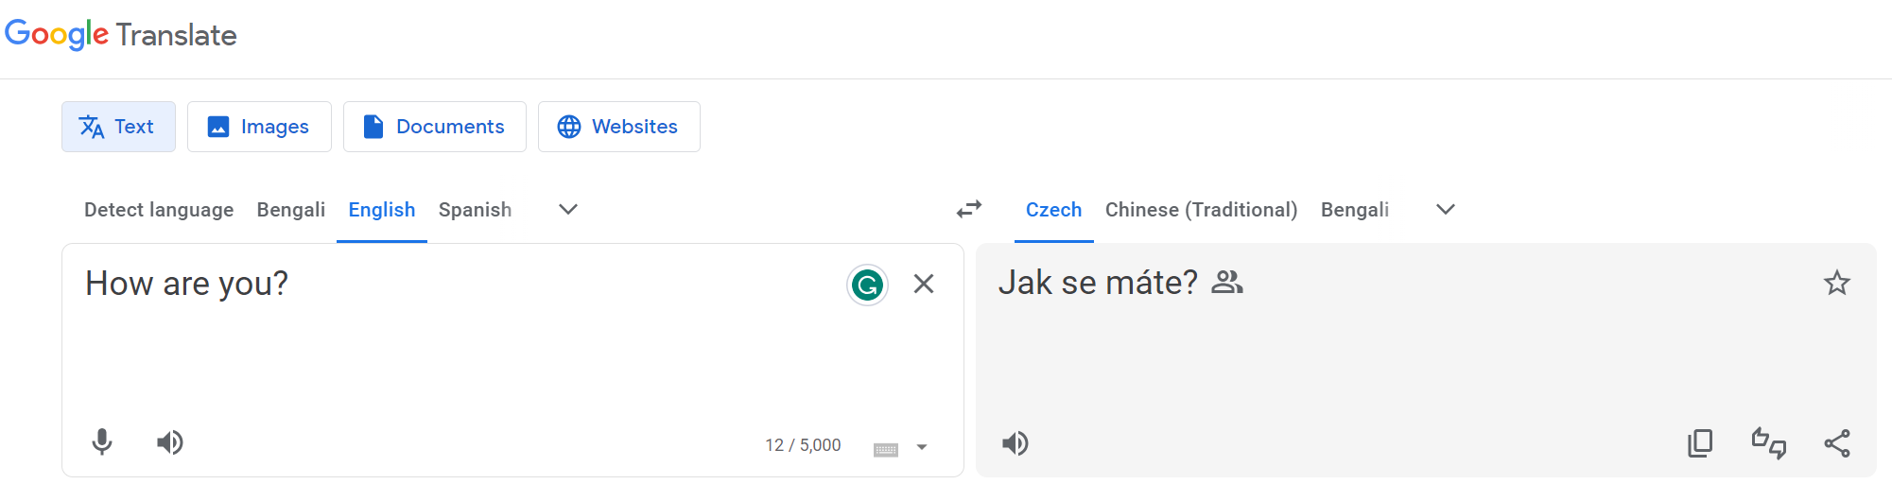
Not Promoting Google but…
Google Mail
Google Maps
Google Translate
Image Sources: Google

Slide 8
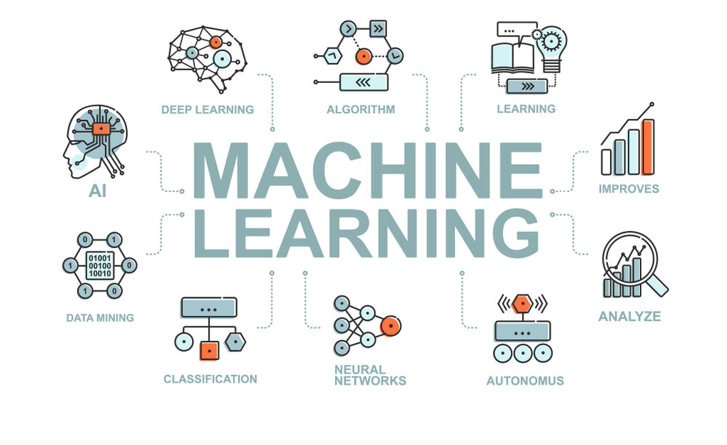
Image Source: https://www.fsm.ac.in/blog/an-introduction-to-machine-learning-its-importance-types-and-applications/

Slide 9
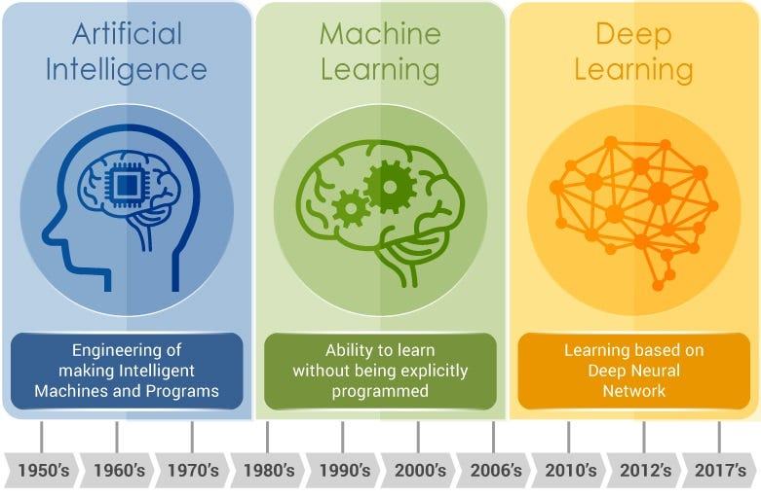
Artificial Intelligence & Machine Learning
Image Source: https://www.fsm.ac.in/blog/an-introduction-to-machine-learning-its-importance-types-and-applications/, https://medium.com/@mail2princeyadav/machine-learning-vs-deep-learning-b5c5a4fc5c

Slide 10
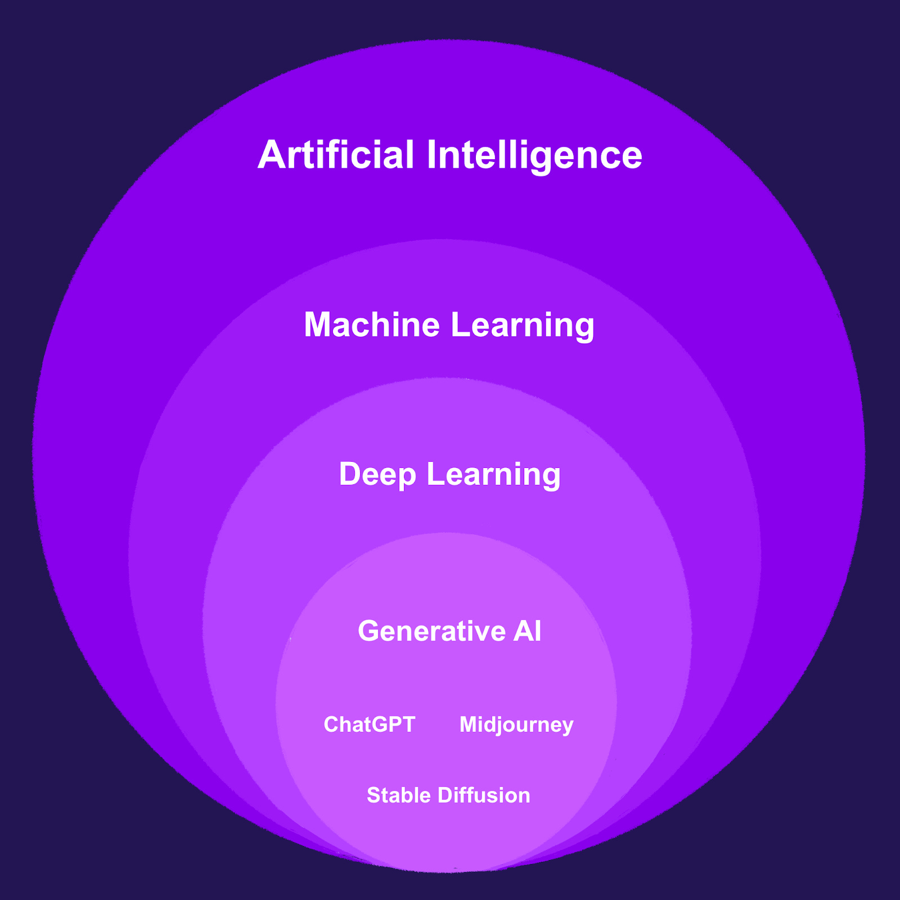
… Can’t Have a Slide Without ChatGPT, duh!
Image Source: https://blog.nami.gg/p/how-generative-ai-can-charge-web3,
https://medium.com/@mail2princeyadav/machine-learning-vs-deep-learning-b5c5a4fc5c

Slide 11
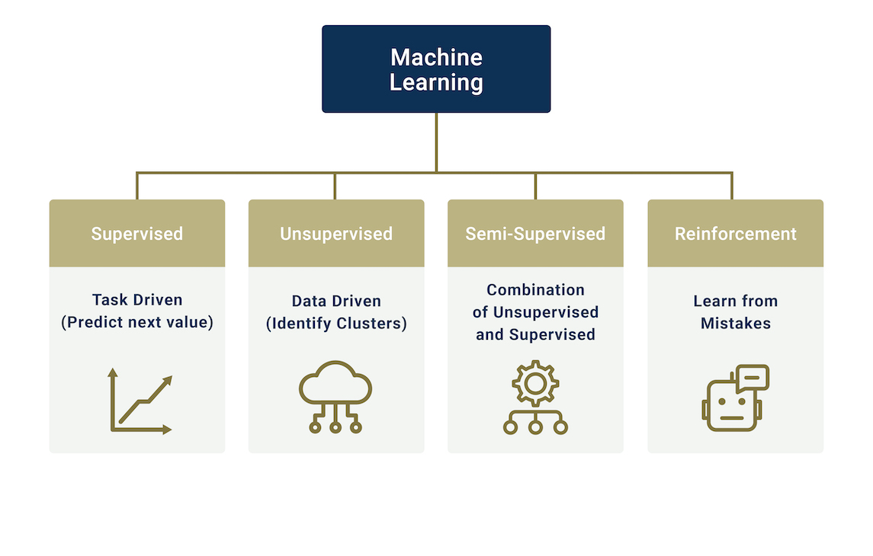
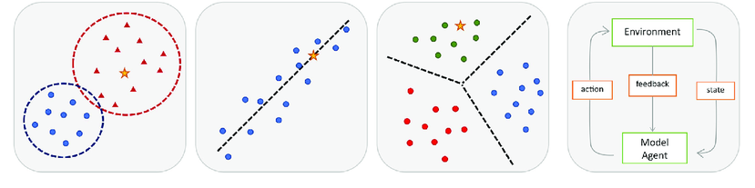
TYPES
OF MACHINE LEARNING
Classification
Regression
Clustering
Image Source: https://www.researchgate.net/figure/The-main-types-of-machine-learning-Main-approaches-include-classification-and_fig1_354960266,
https://bootcamp.pe.gatech.edu/blog/introduction-to-machine-learning-and-three-common-algorithms/

Slide 12
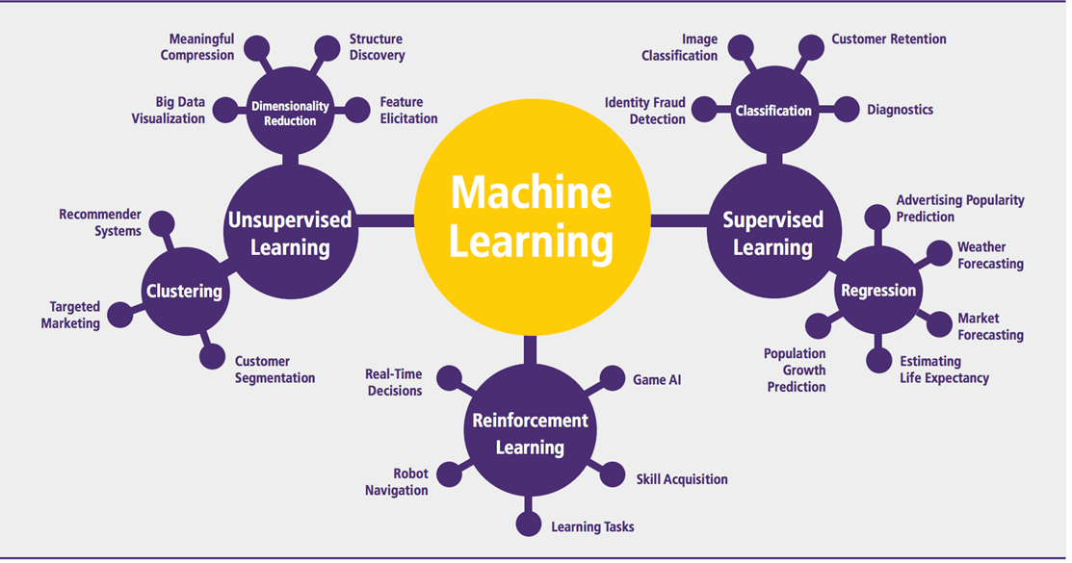
VAST RANGE OF APPLICATIONS
Image Source: https://medium.com/analytics-vidhya/which-machine-learning-algorithm-should-you-use-by-problem-type-a53967326566

Slide 13
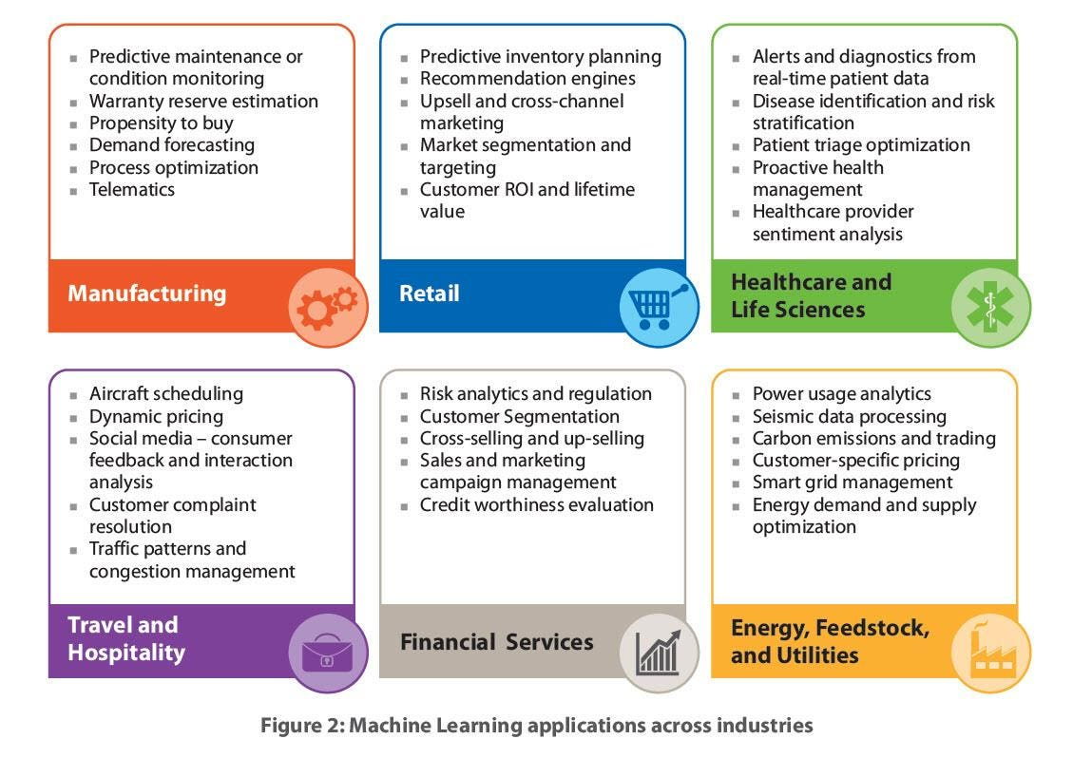
ML Revolutionizing Industries Across the World
Image Source: https://www.forbes.com/sites/louiscolumbus/2016/06/04/machine-learning-is-redefining-the-enterprise-in-2016/

Slide 14
Think About It…
Explore customer demographic data to identify patterns
Analyze sentiment to assess product perception in the market.
Predicting Loan Repayment
Organizing the genes and samples from a set of microarray experiments so as to reveal biologically interesting patterns.
Predict if a skin lesion is benign or malignant based on its characteristics (size, shape, color, etc)
Provide a decision framework for hiring new employees
Recommend news articles a reader might want to read based on the article she or he is reading

Slide 15

Any Questions?

