Slide 1
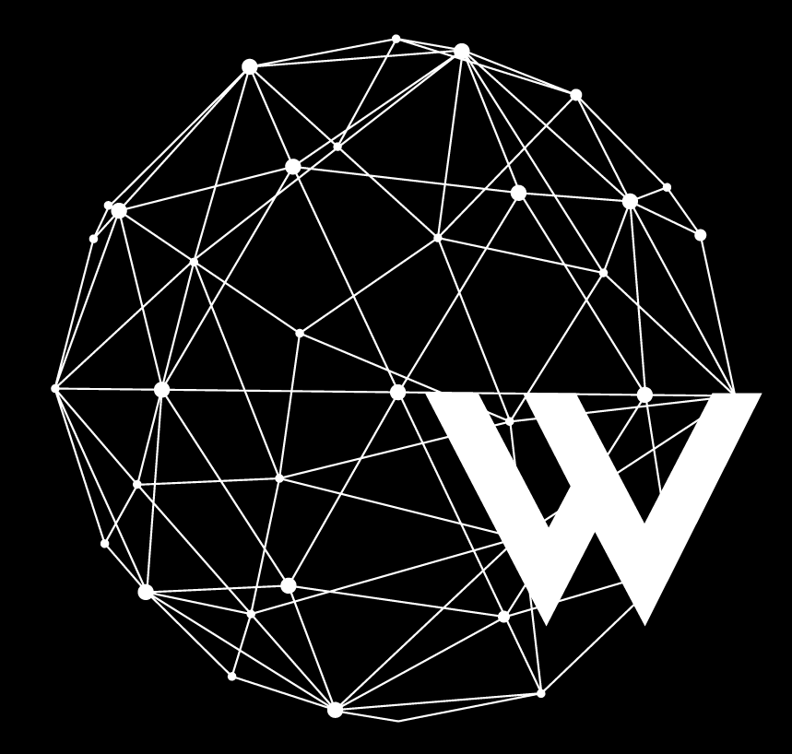
Hello World! It’s Linear Regression
Concept Code Practice Feature Scaling

Slide 2

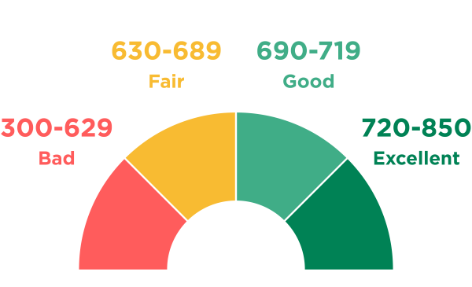
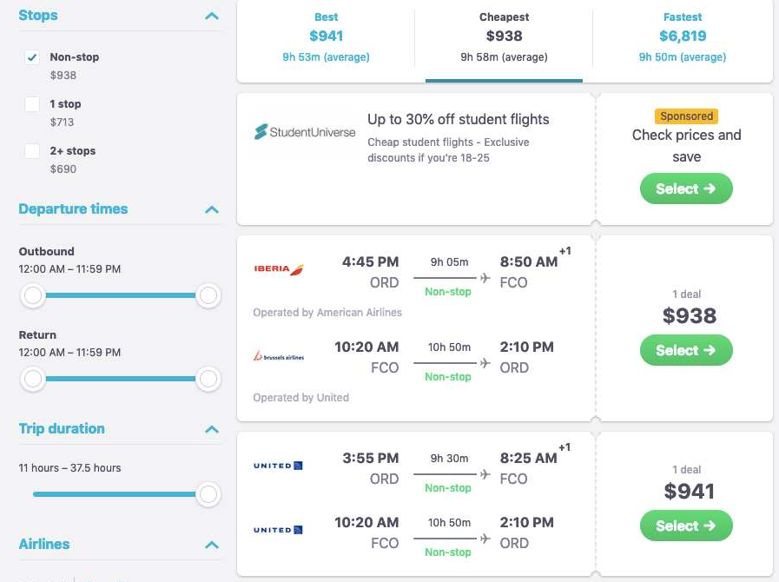
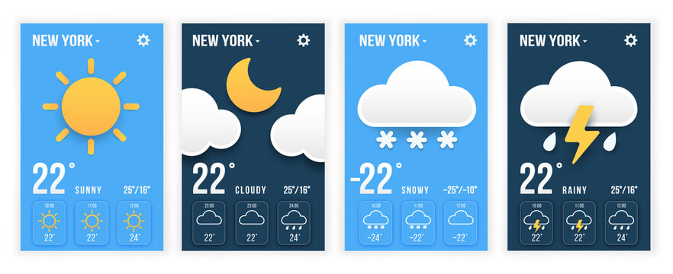
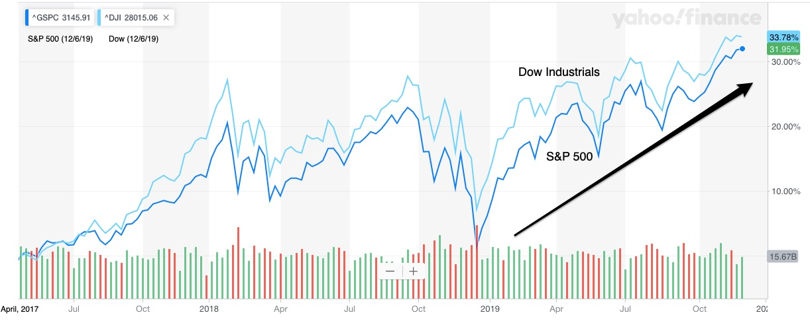
What’s common?
Image Sources: https://www.going.com/guides/how-to-use-skyscanner-to-find-cheap-flights, https://www.nerdwallet.com/article/finance/credit-score-ranges-and-how-to-improve,
https://stock.adobe.com/cz/images/weather-forecast-widget-sunny-cloudy-snow-rainy-weather-app-templates-in-paper-style/446403857, https://econlife.com/2019/12/stock-market-predictions-2/

Slide 3
Linear Regression
Line of Regression
The target variable is a continuous number
Regression is used for determining the relationship between an independent variable or one or more dependent variables
The value to be predicted – Dependent Variable
The value used to predict – Independent Variable
Applications:
Stock Price Forecasting
Sports performance predictions
Dependent Variable
Independent Variable

Slide 4
Linear Regression
Line of Regression
The target variable is a continuous number (y)
Regression is used for determining the relationship between an independent variable or one or more dependent variables
The value to be predicted – Dependent Variable (y)
The value used to predict – Independent Variable (x)
Applications:
Stock Price Forecasting
Sports performance predictions
y = mx + b
Dependent Variable
Slope (m)
Intercept (b)
Independent Variable

Slide 5
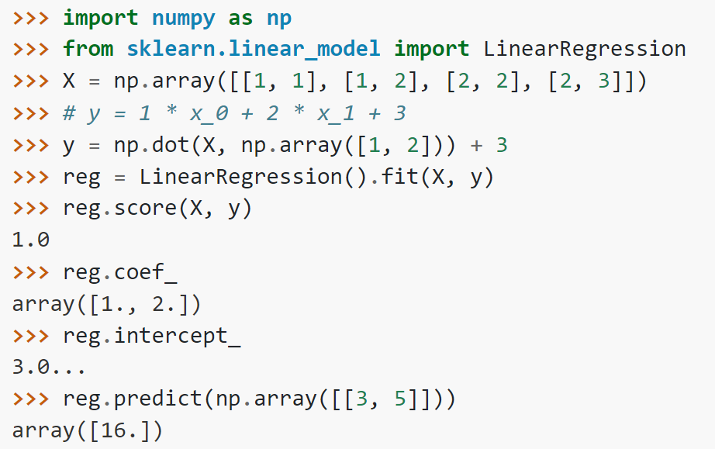
Linear Regression
The target variable is a continuous number (y)
Regression is used for determining the relationship between an independent variable or one or more dependent variables
The value to be predicted – Dependent Variable (y)
The value used to predict – Independent Variable (x)
Coefficient – Estimated coefficients for the linear regression problem (m)
Intercept - Independent term in the linear model (b)
LinearRegression(fit_intercept = False) will set the intercept to 0.
Image Source: https://scikit-learn.org/stable/modules/generated/sklearn.linear_model.LinearRegression.html

Slide 6
Loss Function
(Residuals)
Deviation from the fitted regression line, i.e. the expected value.
Lower the averaged deviation, better is the model.
Line of Regression
Dependent Variable
Error
Independent Variable

Slide 7
Loss Function
(Residuals)
MAE (Mean Absolute Error)
Average magnitude of errors in predictions.
MSE (Mean Squared Error)
Average squared magnitude of errors in predictions.
RMSE (Root Mean Squared Error)
Squared average squared magnitude of errors in predictions.
Line of Regression
Dependent Variable
Error (e)
Independent Variable

Slide 8
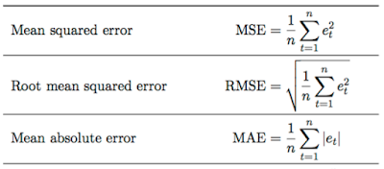
Loss Function
Or Cost Function
MAE (Mean Absolute Error)
Average magnitude of errors in predictions.
MSE (Mean Squared Error)
Average squared magnitude of errors in predictions.
RMSE (Root Mean Squared Error)
Squared average squared magnitude of errors in predictions.
Line of Regression
Dependent Variable
Error (e)
Independent Variable

Slide 9
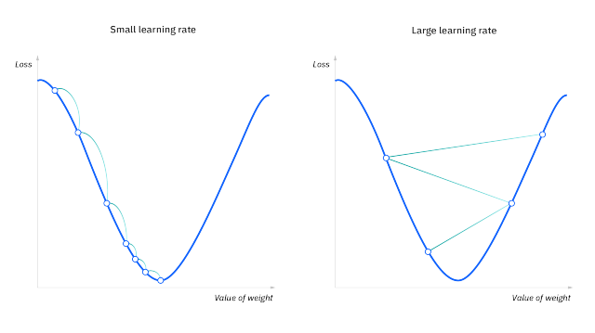
Learning rate (also referred to as step size or the alpha) is the size of the steps that are taken to reach the minimum
Gradient Descent
To Minimize Cost Function
Gradient descent is an optimization algorithm which is commonly used to train machine learning models
Until the cost function is close to or equal to zero, the model will continue to adjust its parameters to yield the smallest possible error
point of convergence
High learning rates result in larger steps but risks overshooting the minimum
Image Source: https://www.ibm.com/topics/gradient-descent

Slide 10
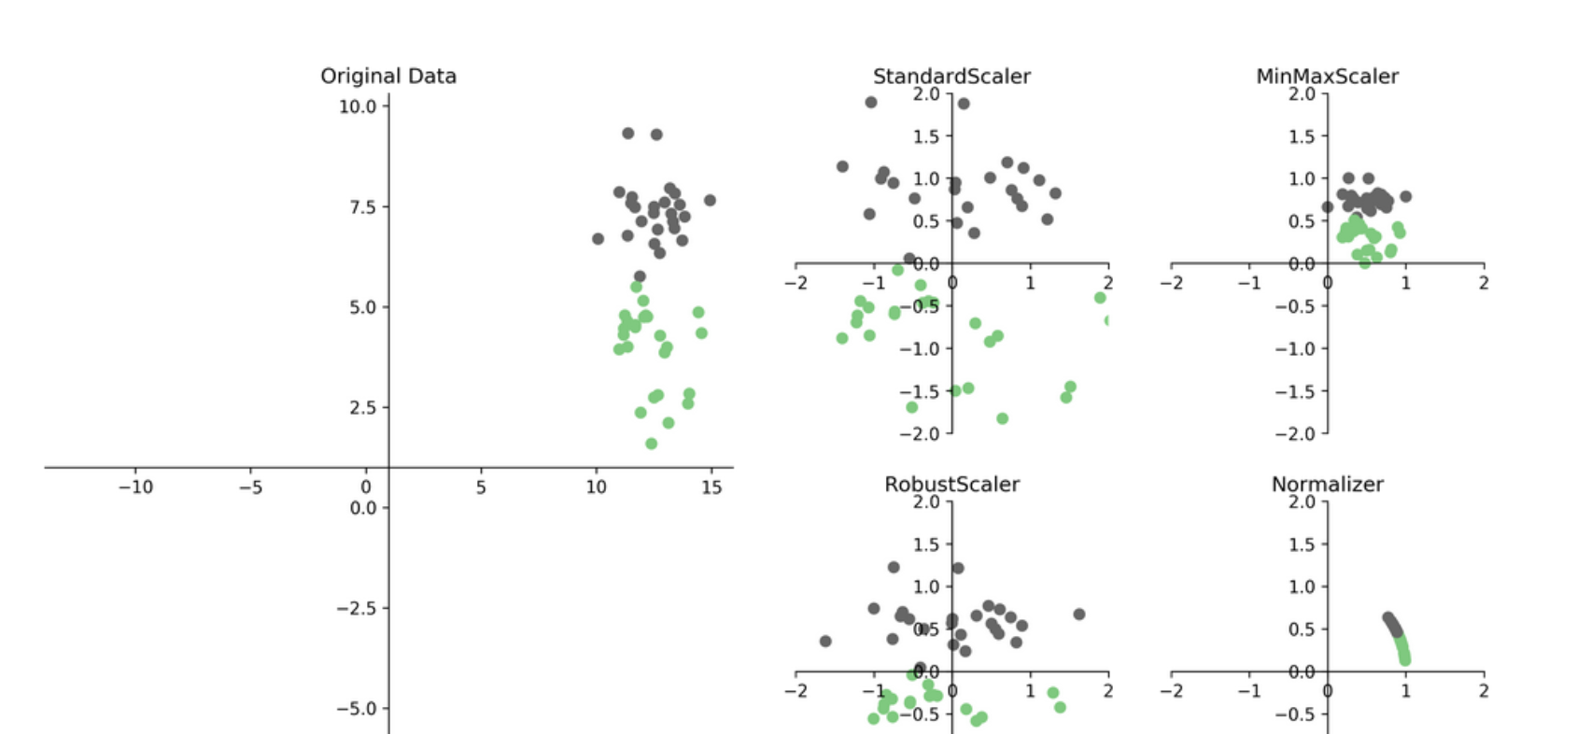
Scaling
Numeric
Data
Transforming data so that it fits within a specific scale, like 0-100 or 0-1 or around a specific value (like the mean).
Image Source: https://amueller.github.io/ml-workshop-1-of-4/slides/03-preprocessing.html

Slide 11
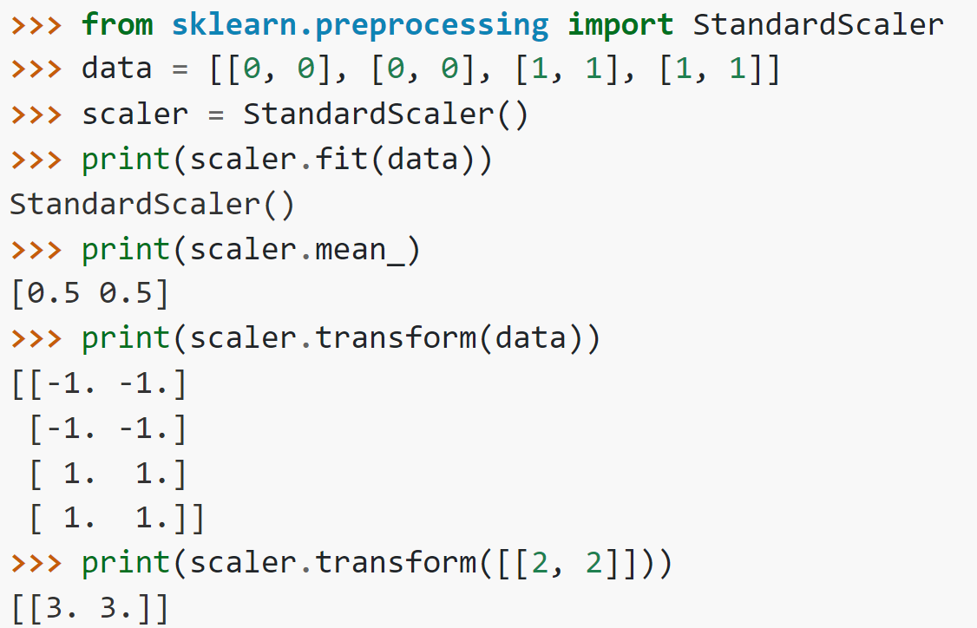
Scaling
Numeric
Data
Transforming data so that it fits within a specific scale, like 0-100 or 0-1 or around a specific value (like the mean).
Image Source: https://scikit-learn.org/stable/modules/generated/sklearn.preprocessing.StandardScaler.html

Slide 12
Let’s Practice Now!

