Slide 1


Slide 2
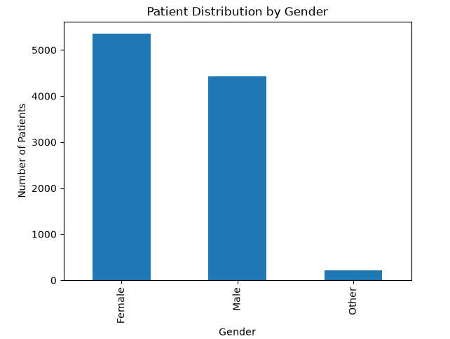
Patient Distribution by Gender

Slide 3
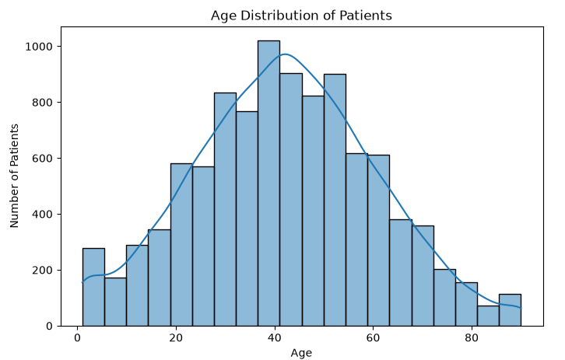
Age Distribution of Patients

Slide 4
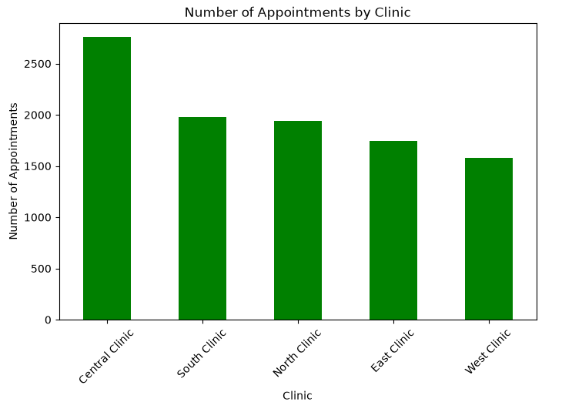
Number of Appointments by Clinic

Slide 5
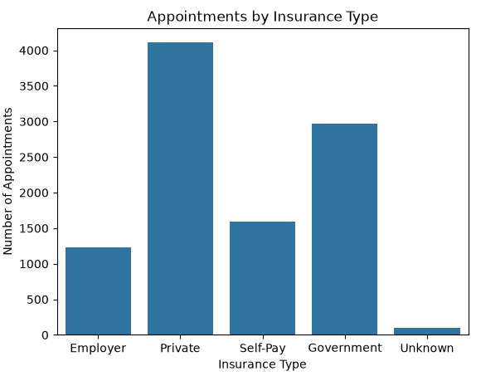
Appointments by Insurance Type

Slide 6
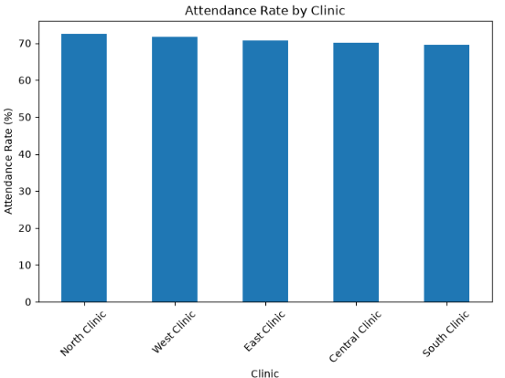
Attendance Rate by Clinic

Slide 7
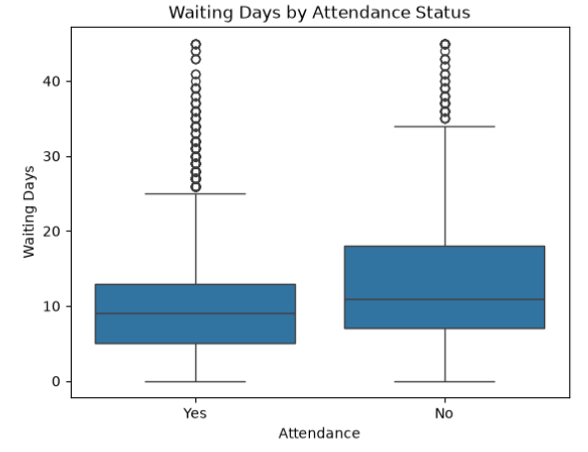
Waiting Days by Attendance Status

Slide 8
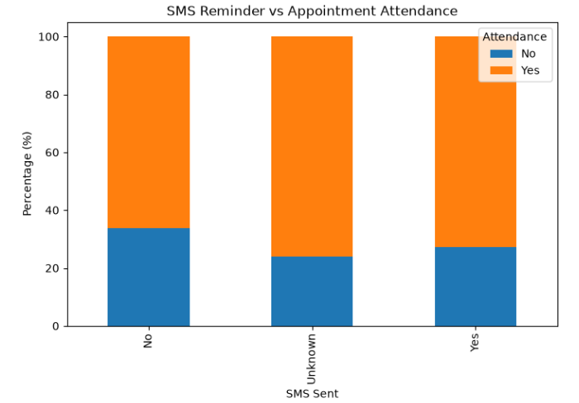
SMS Reminder vs Appointment Attendance

Slide 9
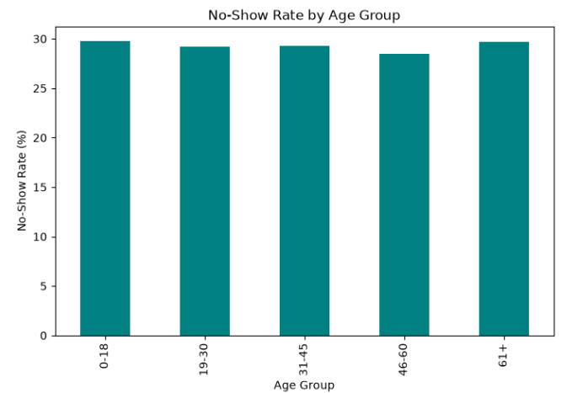
No-Show Rate by Age Group

Slide 10
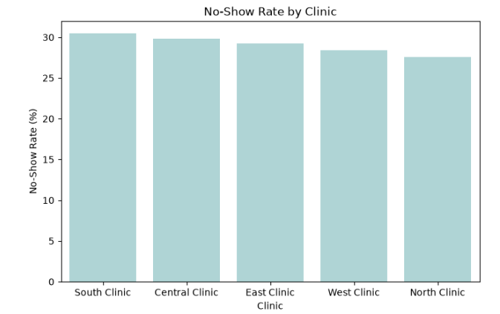
No-Show Rate by Clinic

Slide 11
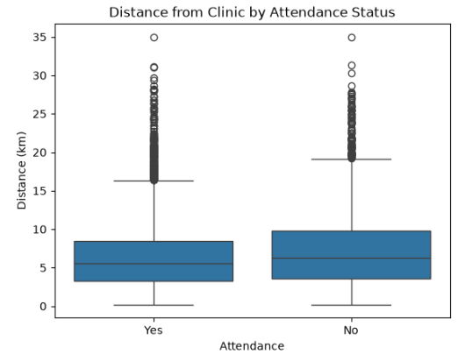
Clinic Distance by Attendance Status

Slide 12
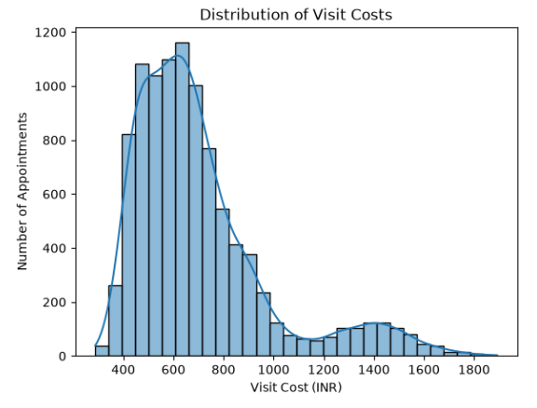
Distribution of Visit Costs

Slide 13
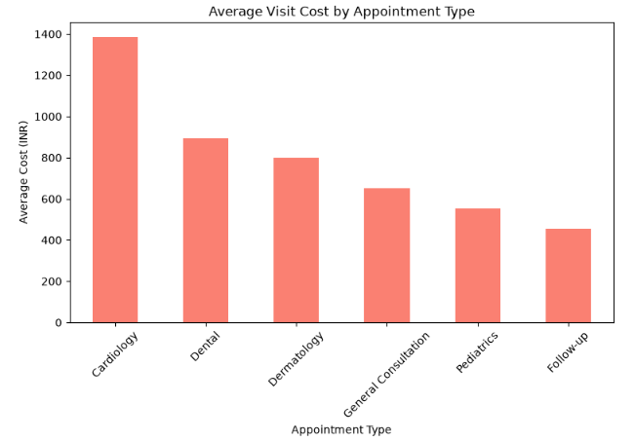
Average Visit Cost by Appointment Type

Slide 14
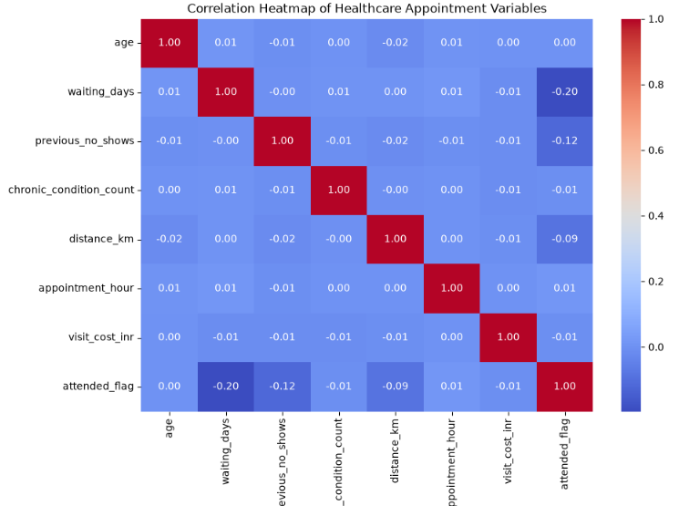
Correlation Heatmap of Healthcare Appointment Variables

Slide 15


