Slide 1

Introduction
Jan Kinne
Web Data Science

Slide 2

Instructor Jan Kinne
PhD in Geographic Data Science
Co-founder of start-up 🧙 ISTARI.AI
Part-time researcher at ZEW Centre for European Economic Research in Germany
Python user since 2013

Slide 3
Aim of the course
Hands on introduction to Python.
Focus on data analysis, not on classical programming.
Overview of the many fields of application from data manipulation and analysis to visualization to web scraping.
Mix of self-study/learning-by-doing and presentations with live coding.
Creating a solid basis for further self-study.
Give you as many practical suggestions as possible.

Slide 4
Agenda
Day 01 – Introduction to Python I
Jupyter Notebooks
Python basics 🐍
Loading and handling data with Pandas 🐼
Descriptive statistics
Data plotting
Day 02 – Introduction to Python II
More Pandas 🐼🐼
More plotting
Day 03 – Mapping
Mapping with Geopandas 🗺️🐼
Geodata basics
Geocoding
Day 04 – Web Scraping
HTML basics
Web crawling and web scraping 🕷️
Day 05 – Text Mining
Machine learning basics 🤖
Building a text mining pipeline
Day 06 – Student Project Presentations 😱

Slide 5

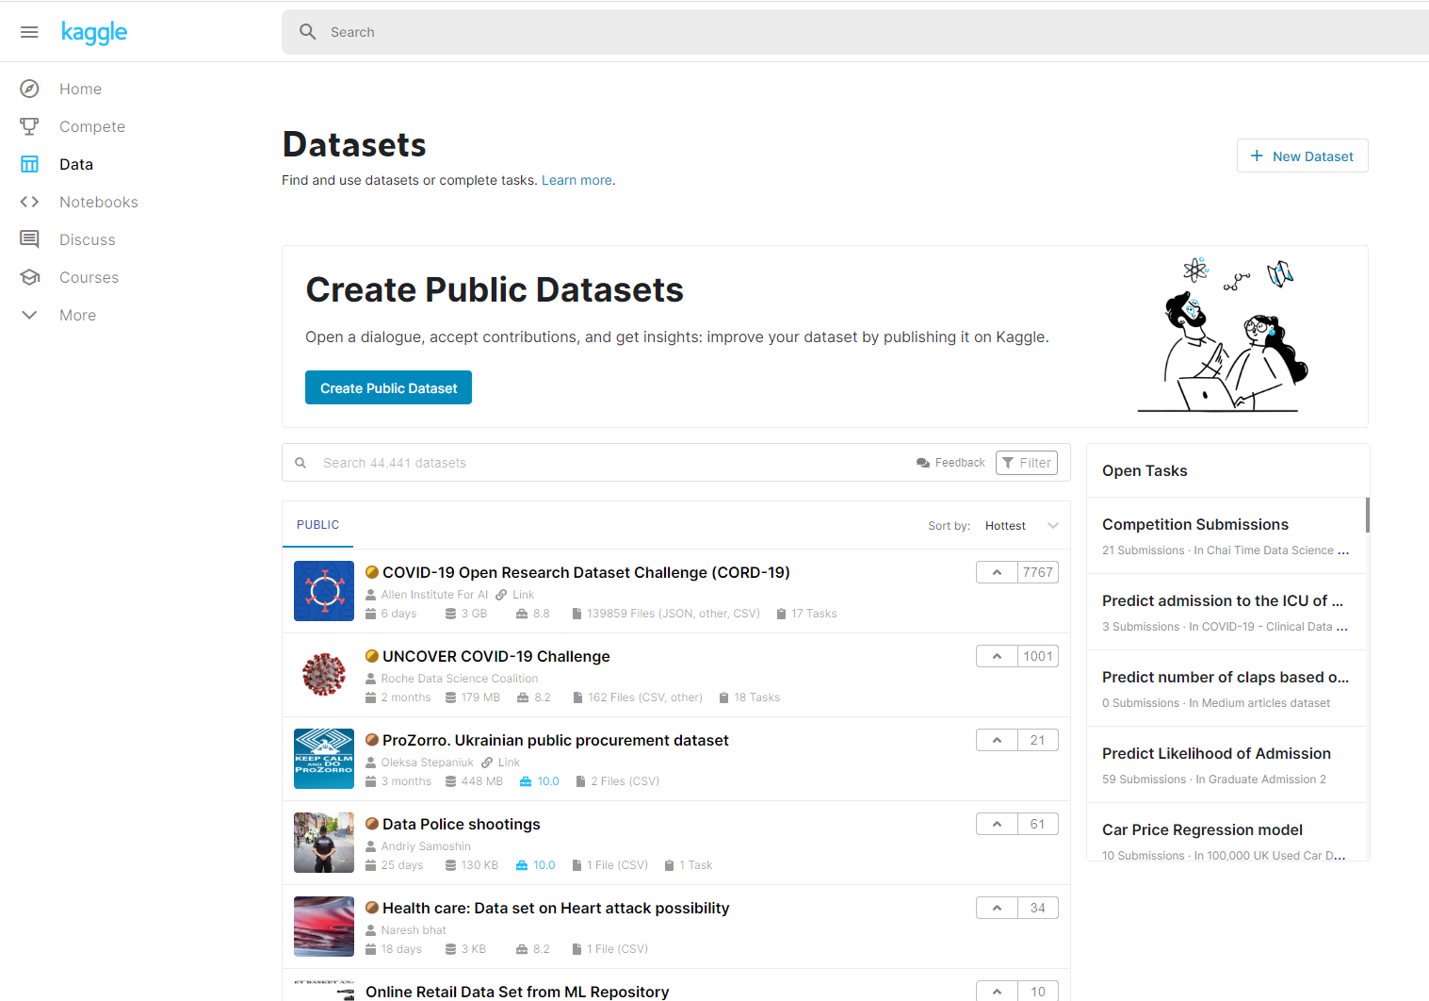
Student Projects And Grading
Students will:
conduct an independent Exploratory Data Analysis (EDA).
choose one or several datasets from the Kaggle open database.
apply the learned skills to explore the dataset.
present and discuss intermediate results at the beginning of day 02 to day 05.
present their final results on day 06.
Grading will be based on these projects.

Slide 6
Student Projects And Grading
Your quest 💬: Your supervisor asks you to explore a data set. A week later, your supervisor wants to see your results. Present your results in the form of a clearly formatted, commented and structured Jupyter Notebook. Make sure your supervisor understands your main working steps and how you achieved your results, without getting lost in unnecessary detail.
Rewards💯:
max 1XP: Loading and preprocessing data (e.g. fixing wrong data types). Data exploration with descriptive statistics and plots.
max 1XP: Scraping a Web data source of your choice.
max 1XP: Mapping your dataset.
max 1XP: Apply a machine learning model to your data.
max 1XP: Executive summary with the main findings of your data science project and presentation (10 mins) day 06.
6 – XP = Grade 👩‍🎓

Slide 7
The Tools

Slide 8
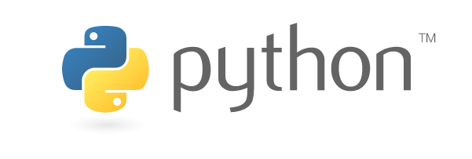
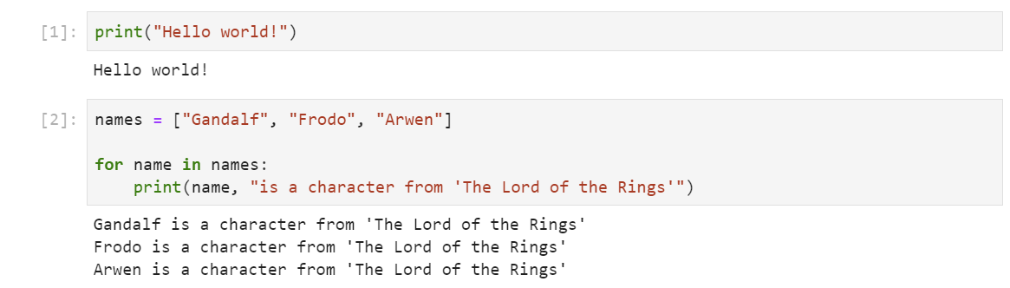
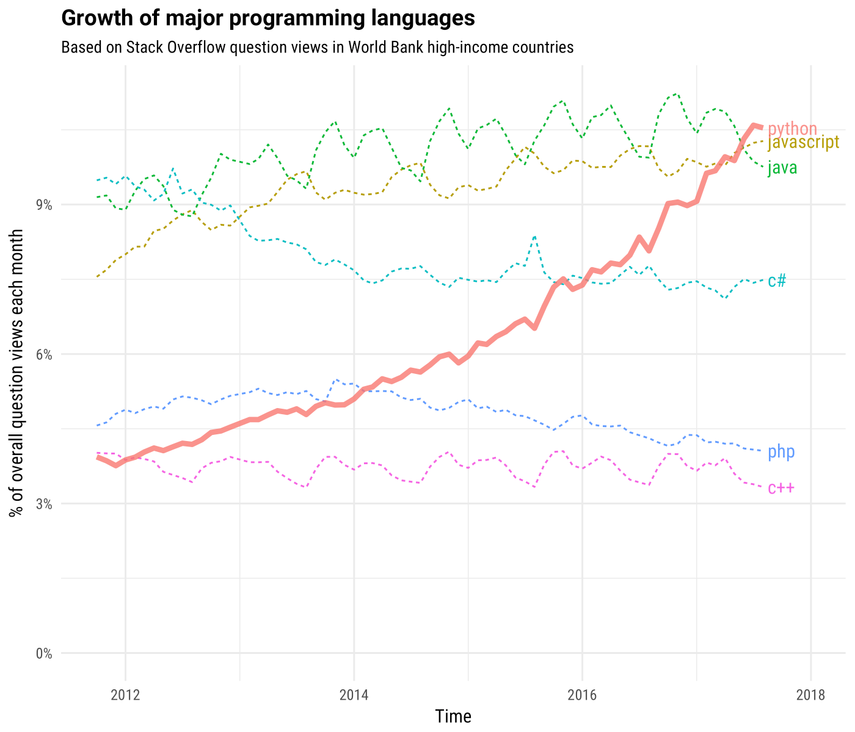
High-level, general-purpose programming language.
High code readability.
Great for quick prototyping.
Over 200,000 packages for extended functionality.
Great for consistent data science workflows from data acquisition to data analysis to visualization.
Very high and increasing popularity.

Slide 9

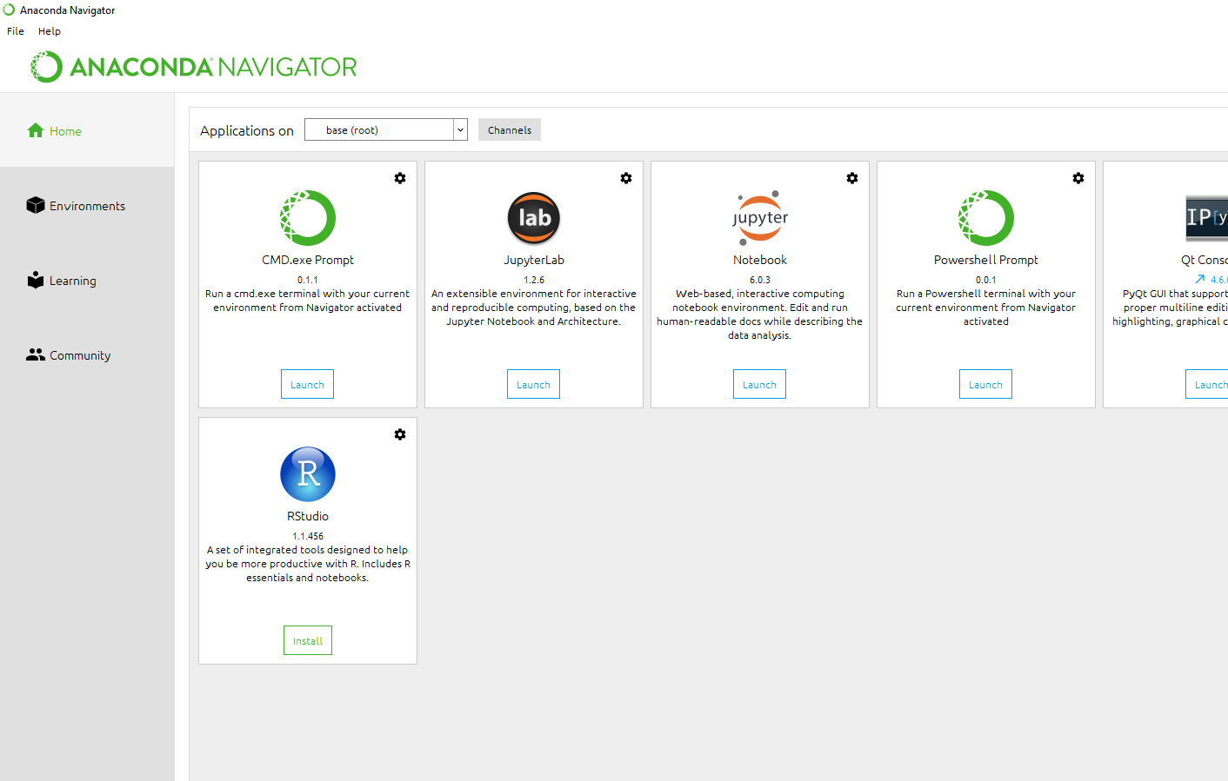
Anaconda Python
Free and open-source distribution of Python.
Aims to simplify package management.
Includes the most important Python data science packages out-of-the-box.
Available for Windows, Linux, and Mac.
Includes the Anaconda Navigator graphical user interface for launching applications and manage packages and environments.

Slide 10

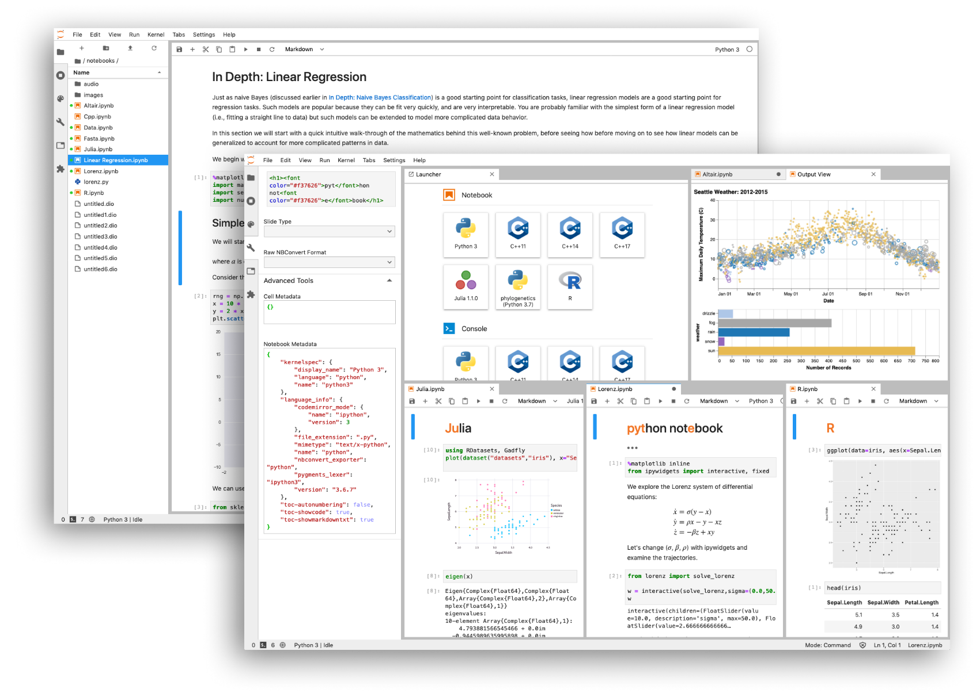
Jupyter Notebook
Open-source, web-based and interactive application.
Create and share documents that contain code, equations, visualizations, and text.
Perfect for Exploratory Data Analysis.
Great for structuring the workflow of a whole data science project.
Works with over 40 programming languages.
We will use JupyterLab as our interface to work with Jupyter notebooks.

Slide 11
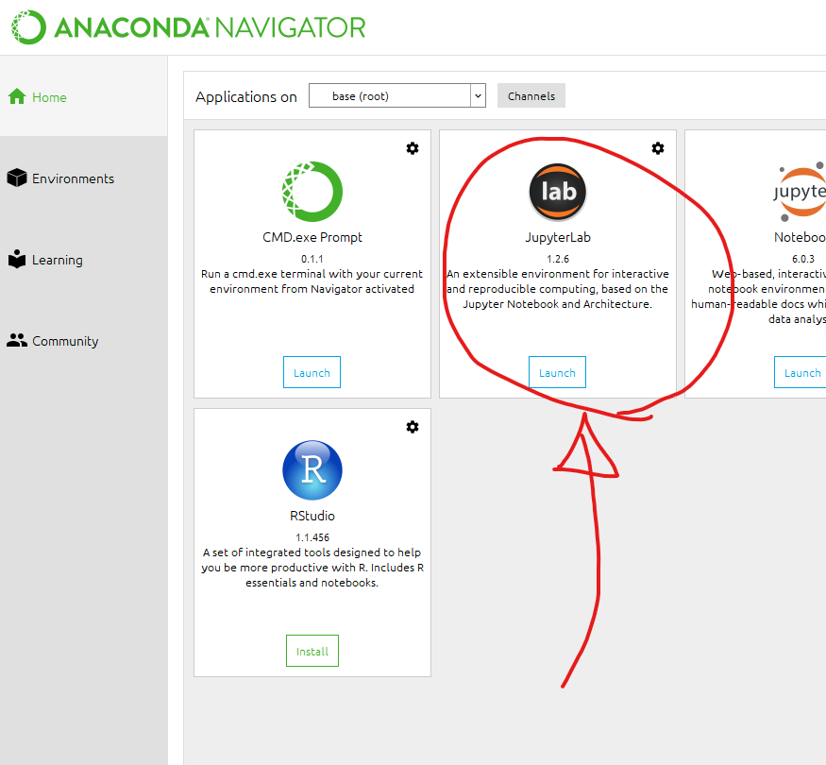
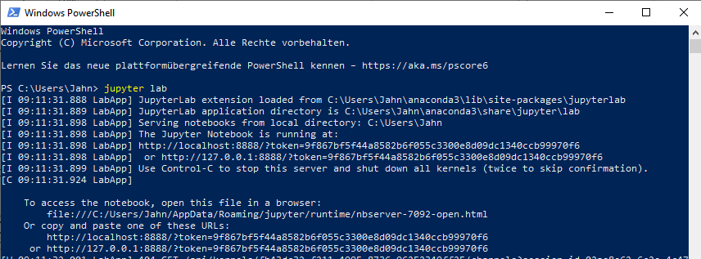
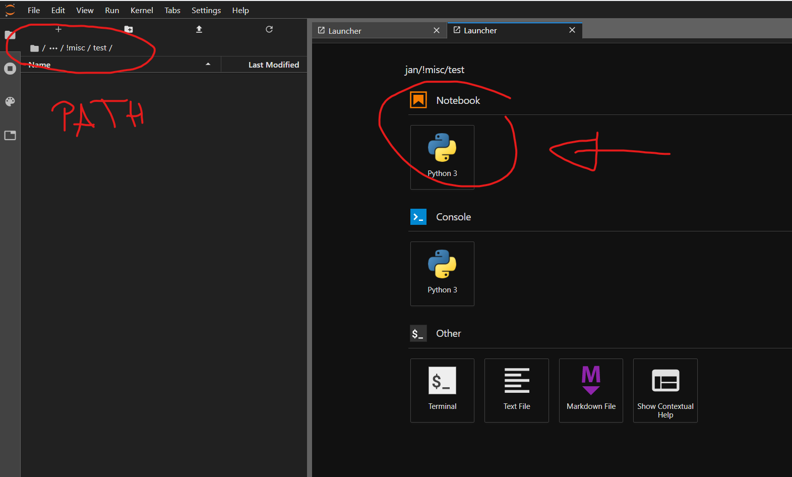
Starting Jupyter lab
LAB (!) not Notebook!
Launch from Anaconda Navigator
Launch from shell/command prompt:
Launch Windows PowerShell, Linux Shell, or macOS Terminal
Navigate to directory
Type jupyter lab and hit enter
JupyterLab server will be started
Default browser opens up
If not: use address shown in JupyterLab server window

Slide 12
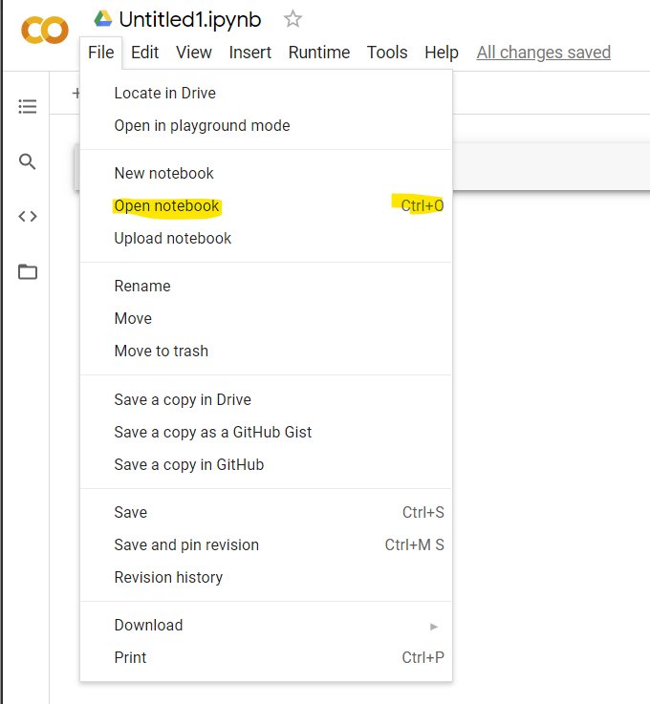
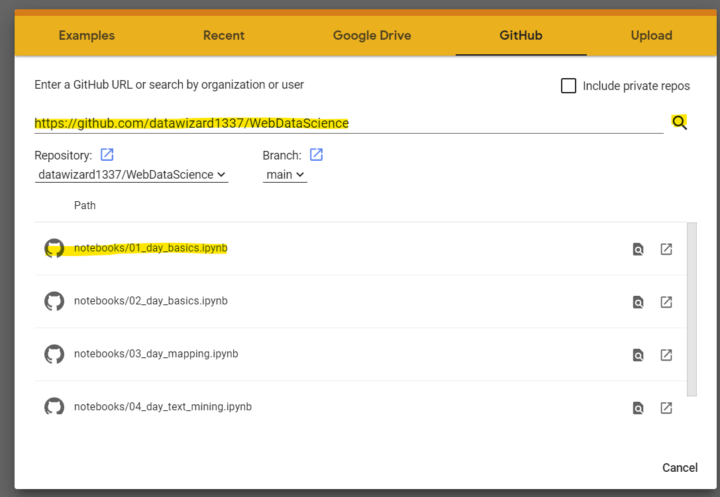
Alternative Google Colab
asd

Slide 13
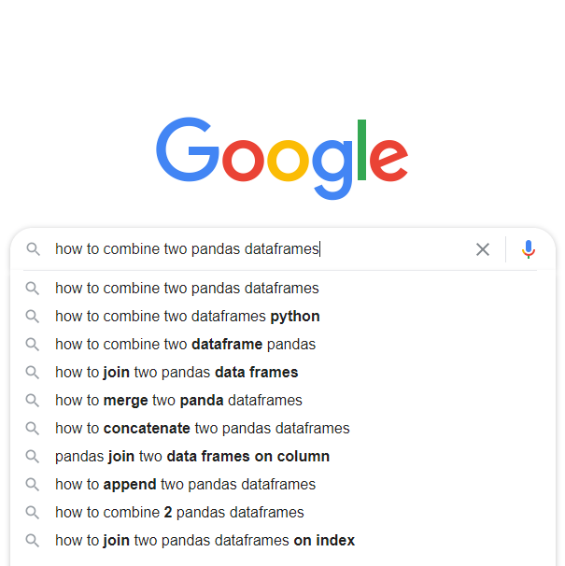

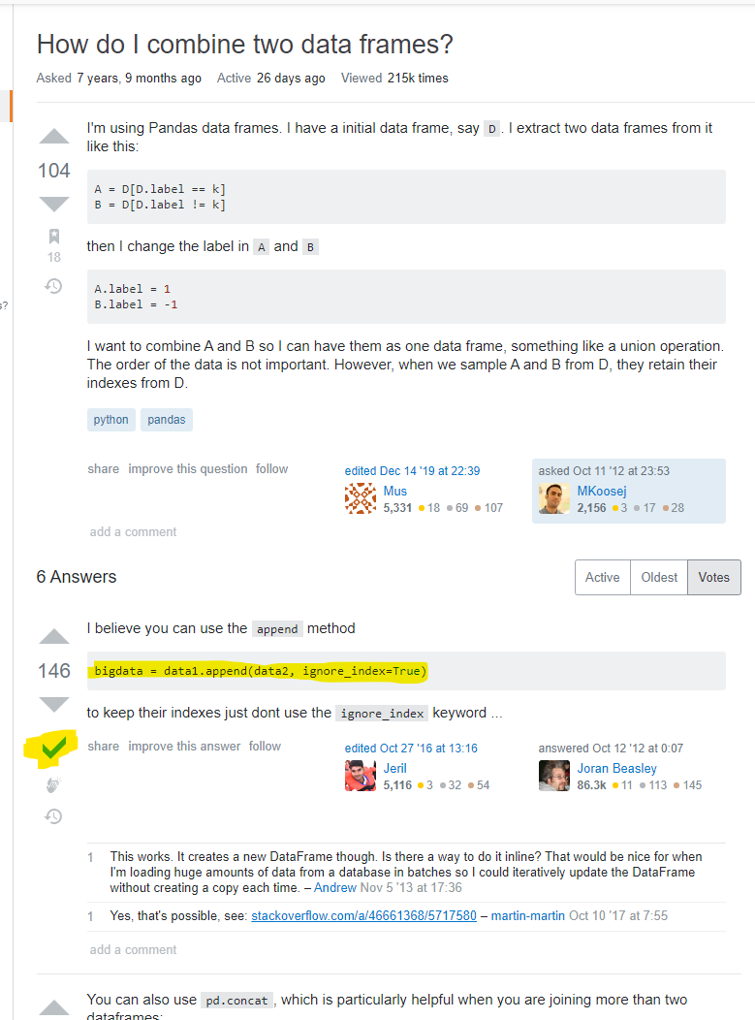
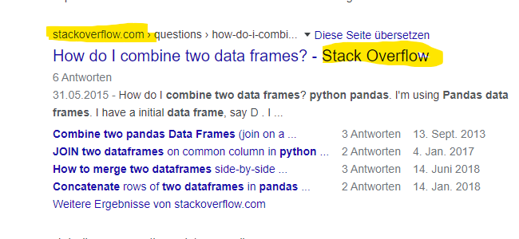
Get Help
Use Google and include the Python package you are working with in the search string.
Look for stackoverflow search results (usually top hit).
Check out the top answers and the correct answers (marked with a green tick)

