Slide 1
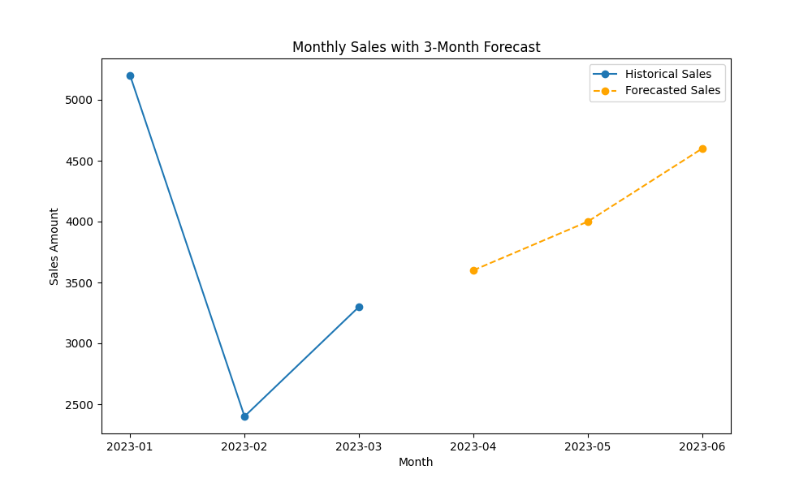
Sales Forecast Visualization
Including 3-month forecast based on Exponential Smoothing Model

Slide 2
Sales Forecast Visualization – Q1 with 3-Month Projection
This chart combines historical sales with a short-term 3-month forecast using exponential smoothing.
Highligh insights: We observed a dip in February, but the model suggests steady growth from April to June.
Next steps: We can adjust campaign strategy or inventory levels accordingly.
Business impact: Anticipated growth in Q2 may support increased marketing investment or revised sales targets.
Recommendation: Monitor March sales closely to validate the projected recovery.

