Slide 1

KAFKA
REAL-TIME DATA AND STREAM PROCESSING
Cao Nhu Dat
Rocket Game Studio, 14th December 2022

Slide 2
What is Kafka?
Key concepts
Why Kafka?
Hands on

Slide 3
1. What is Kafka?

Slide 4

1. What is Kafka - Origin
2010 – Linkedin developed Kafka to solve problems:
low-latency ingestion of large amounts of event data from the
LinkedIn website and infrastructure into a lambda architecture
that harnessed Hadoop and real-time event processing systems
Main purpose: Real-time processing
Today, Apache Kafka is an open source, used by thousands of companies including over 80% of the Fortune 100: Amazon, Netflix, Pinterest, Airbnb, ...

Slide 5
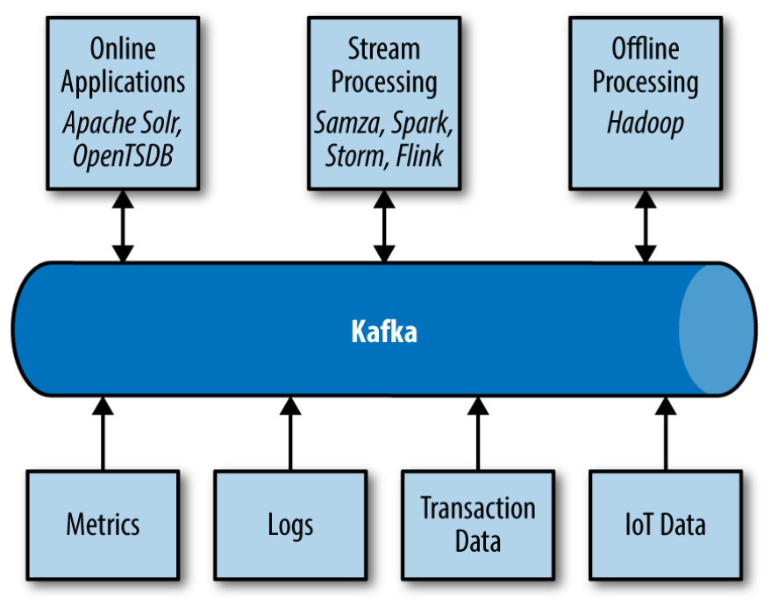
1. What is Kafka - Origin
Big Data Ecosystem with Kafka

Slide 6
1. What is Kafka – Views on Kafka
Realtime version of Hadoop?
Messaging system? (publish and subscribe messages like ActiveMQ, RabbitMQ, ...)
ETL or data integration tools?
Streaming Platform: publish and subscribe to streams of data, store them, and process them

Slide 7
2. Key concepts

Slide 8
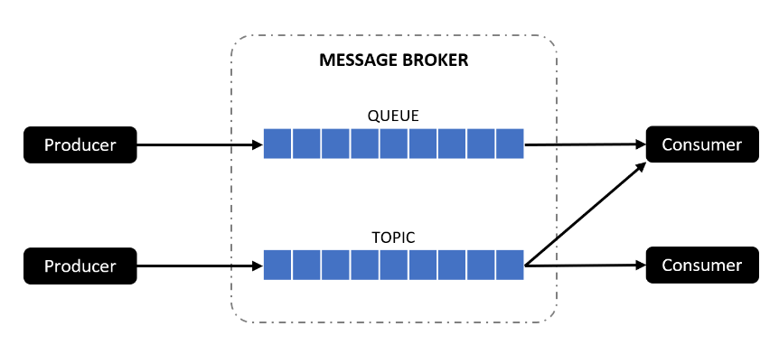
2. Key concepts
Message Broker Model:
Broker: validate, store, route, and delivery messages
Producer: an endpoint that sends (publishes) any type of data to be stored and distributed by the message broker
Consumer: an endpoint that requests data (subcribes) from the message broker
Point-to-Point Messaging → Queue (1 consumer group)
Publish/Subscribe Messaging → Topic

Slide 9
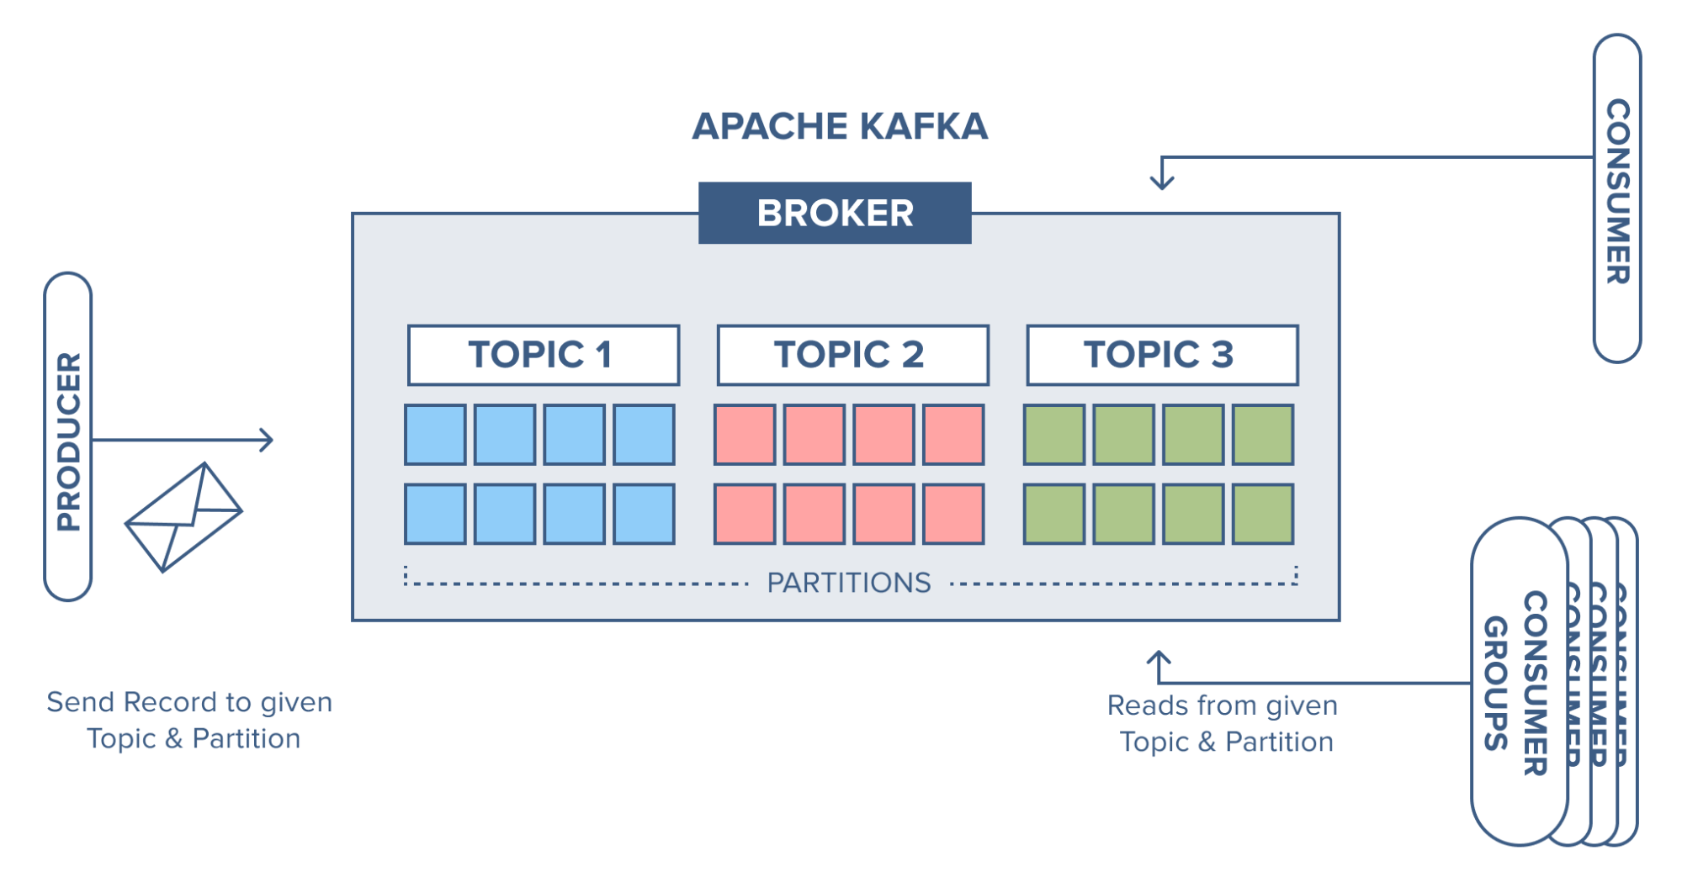
2. Key concepts
Cluster: one or more Kafka brokers
Consumer group: each partition is only consumed by one member
Message location
= Topic + Partition + Offset

Slide 10

2. Key concepts
Kafka Topic:
Categories used to organize messages, unique
Producers → Topic → Consumers
Can have zero or many consumers - consumer groups
Topics are partitioned:
Partition: basic data building blocks, immutable data
→ redundancy & scalability (replicated to multiple brokers)
Offset : assigned to each message in a partition to keep track
of the messages
Topic “__consumer__offsets” : allows processing to continue from
where it last left off if the stream application is turned off or if
there is an unexpected failure.

Slide 11
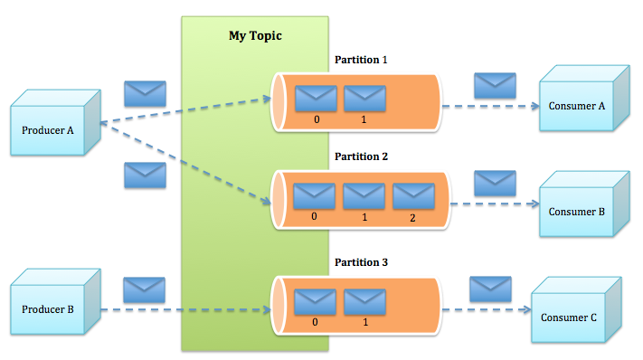
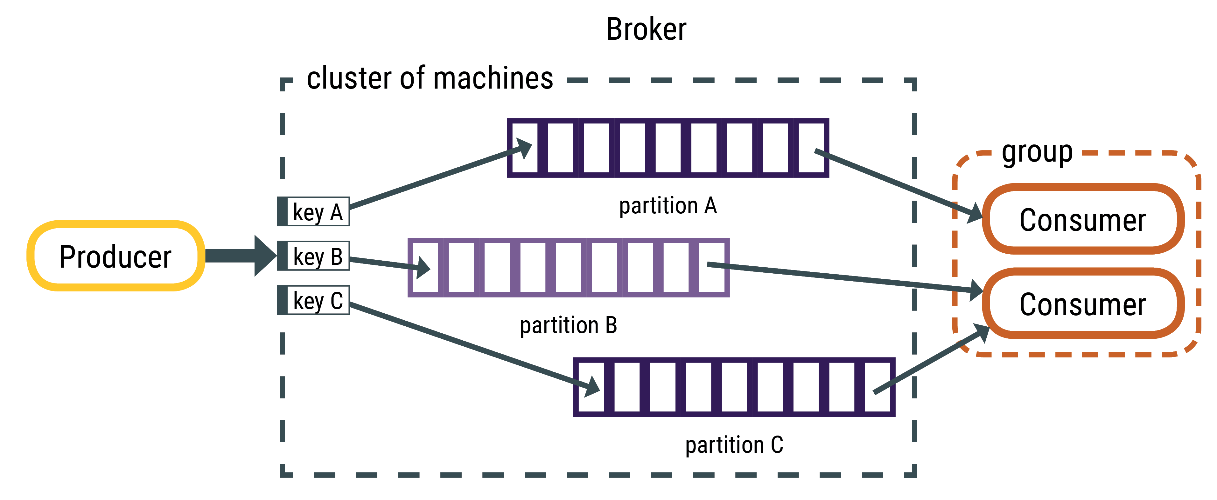
2. Key concepts
Messages to Topic: have keys
key = null: round robin
Key != null: same key, same partition
Read messages:
Message ordering: order by offset, not by partition
(Ex: read from offset 3 after read from offset 2,
but can read from partition 2 before partition 1 )

Slide 12
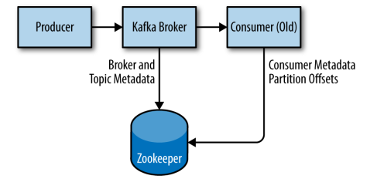
2. Key concepts
Zookeeper: acts a Kafka cluster
Store metadata about the Kafka cluster, consumer client details
Leadership election of Kafka Broker and Topic Partition pairs
Send info to Kafka:
- New Broker join, Broker died, etc.
- Topic removed, Topic added, etc.

Slide 13
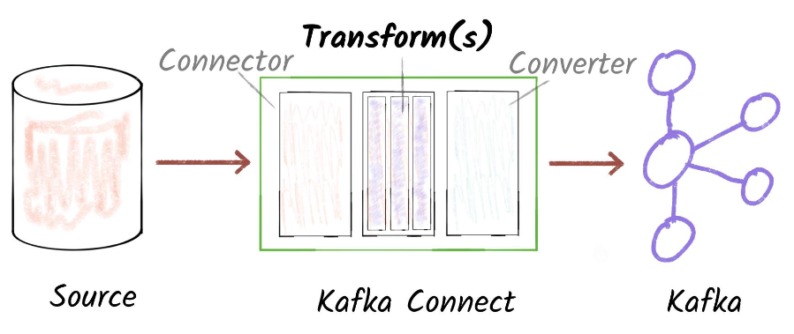
Kafka Connect
Kafka Connect is a part of Apache Kafka, provides a scalable and
reliable way to move data between Kafka and other datastores
(HDFS, MongoDB, Elasticsearch, S3,…)
Source connector: Datastores → Kafka,
Sink connector: Kafka → Datastores
Transform: modify message (filter, cast, ...)
Converter: change data formats
(Avro, JSON, Parquet, ... )

Slide 14
3. Why Kafka?

Slide 15
3. Why Kafka?
1. Multiple Producers, Consumers
2. Disk-Based Retention
3. Scalable
4. High Performance
5. High availability and fault tolerance

Slide 16
3. Why Kafka?
Scalabe:
Many brokers if needed
High throughput:
Sequential writes to filesystem are fast
(700 MB or more a second)
Zero copy I/O using sendfile
(sends messages from the file directly to the net‐work channel without any intermediate buffers)

Slide 17
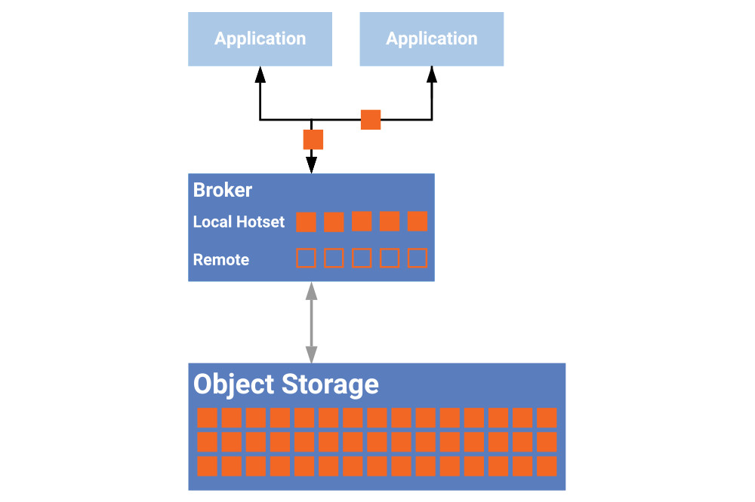
3. Why Kafka?
Disk-Based Retention:
Messages are committed to disk, and will be stored with configurable retention rules (deleted before expired).
Maintenance can be performed on consumers, with no concern about
messages backing up on the producer
or getting lost.

Slide 18
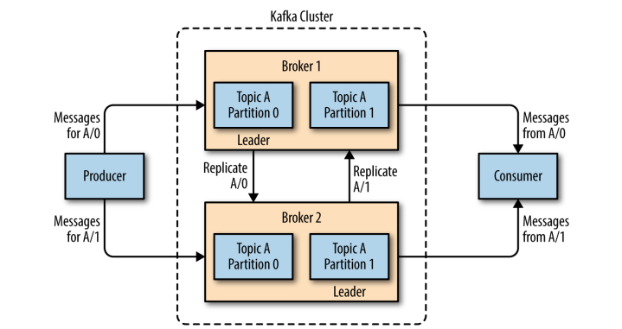
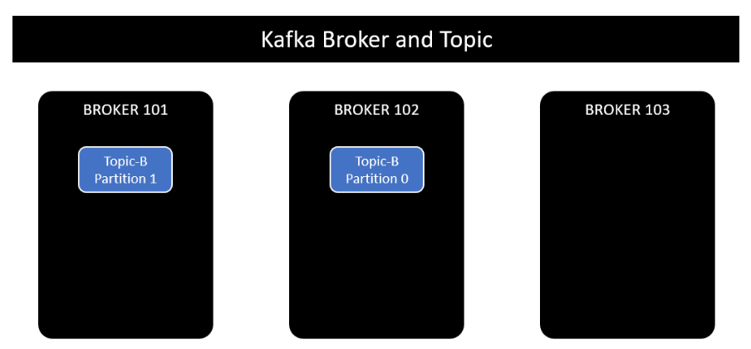
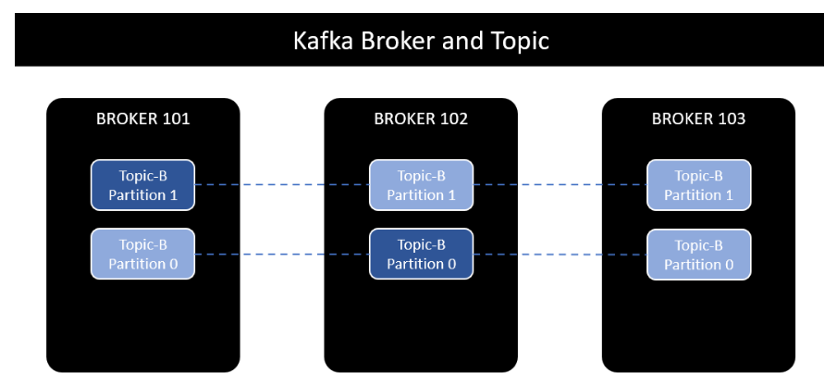
3. Why Kafka?
High availability and fault tolerance – Replication:
Leader: each partition has 1 leader.
All produce and consume requests go through the leader → consistency
Follower: replicate (fetch leader), don’t serve client requests, can promoted to become a leader.

Slide 19
4. Hands on

Slide 20
4. Hands on - Ubuntu
1. Start Zookeeper service: $ bin/zookeeper-server-start.sh config/zookeeper.properties
2. Start the Kafka broker service: $ bin/kafka-server-start.sh config/server.properties
3. Create a topic: $ bin/kafka-topics.sh --create --topic dat1
--bootstrap-server localhost:9092
(with number of partirions: --partitions)
4. Write events into the topic: $ bin/kafka-console-producer.sh --topic dat1
--bootstrap-server localhost:9092
5. Read the events: $ bin/kafka-console-consumer.sh --topic dat1
--from-beginning --bootstrap-server localhost:9092
(read from specific partition: --partition)

Slide 21
4. Hands on - Ubuntu
6. Write to different partition: $ bin/kafka-console-producer.sh --broker-list
localhost:9092 --topic dat2 --property parse.key=true --property key.separator=,
7. Consumer group:
Create consumer group: $ bin/kafka-console-consumer.sh --bootstrap-server
localhost:9092 --topic dat1 --group test_group
Check info: bin/kafka-consumer-groups.sh --describe --group test_group
--bootstrap-server localhost:9092
List all group: $ bin/kafka-consumer-groups.sh --bootstrap-server
localhost:9092 --list
8. Demo code NodeJS

Slide 22
THANK YOU
Cao Nhu Dat, Rocket Games Studio
Contact: canada2k1@gmail.com

