Slide 1
GeoFuse-RNA
Confidence-aware fusion and motif-conditioned geometric refinement for RNA 3D prediction
Supervisor progress update 14 July 2026
Stanford RNA 3D Folding thesis update • 14 Jul 2026 1

Slide 2
Executive summary
Reproducible temporal-safe RNA 3D pipeline built around the Stanford Kaggle challenge.
Strongest local result: 0.3072 mean best-of-5 TM on 12 CASP15 targets.
Kaggle: 0.60084 public / 0.60175 private, versus reported TBM-only 0.59298.
Main empirical win: +0.0955 TM from better template recall.
Geometry v1 improves clashes/backbone spacing, but is TM-neutral and increases sharp kinks.
Next contribution: segment-level TBM/pretrained fusion plus motif-conditioned geometry v2.
Stanford RNA 3D Folding thesis update • 14 Jul 2026 2

Slide 3
Problem and benchmark
Input: RNA sequence, MSA, template structures and release-date metadata.
Output: five C1′ coordinate structures per target, each with shape [L, 3].
Competition score: best TM among five predictions, averaged over targets/references.
TM rewards the global fold and can tolerate local geometric artifacts.
Thesis evaluation therefore separates fold accuracy from structural validity.
Stanford RNA 3D Folding thesis update • 14 Jul 2026 3

Slide 4
Data and EDA snapshot
Train v1: 844 / 137k residues; train v2: 5,135 / 3.68M residues.
Local validation/test: 12 CASP15 targets, 2,515 residues total.
Lengths span 30–720 nt (median 129.5 nt); R1138 is a 720-nt stress case.
Template resource: 8,670 RNA CIF files, 56.89 GiB.
Historical parse: 23,869 chains, 10.86M residues, 99.9% modelled C1′, zero errors.
MSA and MSA_v2 add target-specific evolutionary context.
Stanford RNA 3D Folding thesis update • 14 Jul 2026 4

Slide 5
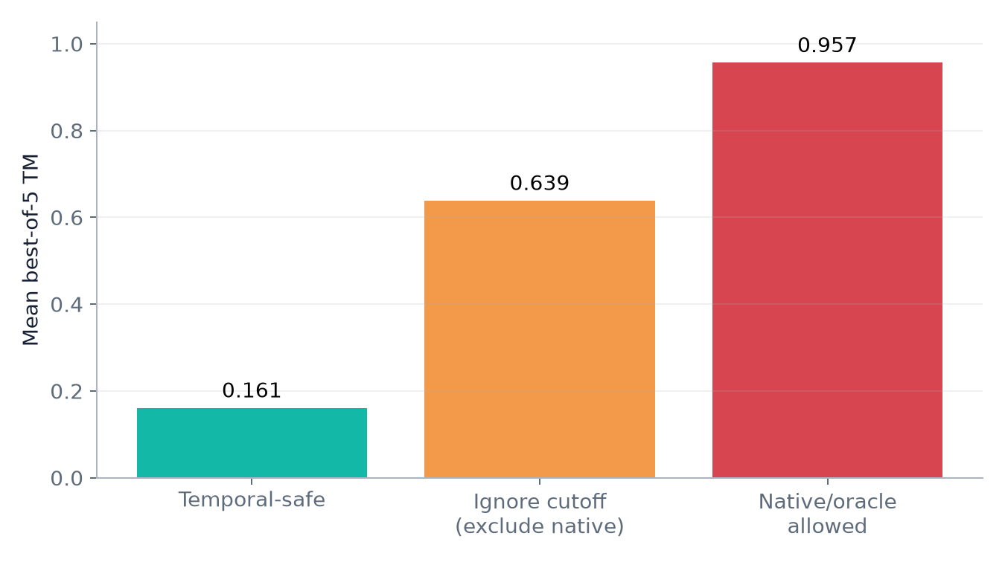
Leakage is the central evaluation risk
Same earlier TBM pipeline under three template-availability regimes
Ignoring time can inflate TM by +0.48 to +0.80. Oracle results are diagnostics, not scientific performance.
Stanford RNA 3D Folding thesis update • 14 Jul 2026 5

Slide 6
Implemented pipeline
One code path for local evaluation and Kaggle inference
Sequence + cutoff
Search
Temporal filter
Transfer + gap fill
Candidate pool
Final five
MMseqs + exhaustive composite similarity
Leakage guard before ranking
TBM + de novo hedge + optional geometry refinement
Quality/diversity selection produces five C1′ structures
Stanford RNA 3D Folding thesis update • 14 Jul 2026 6

Slide 7
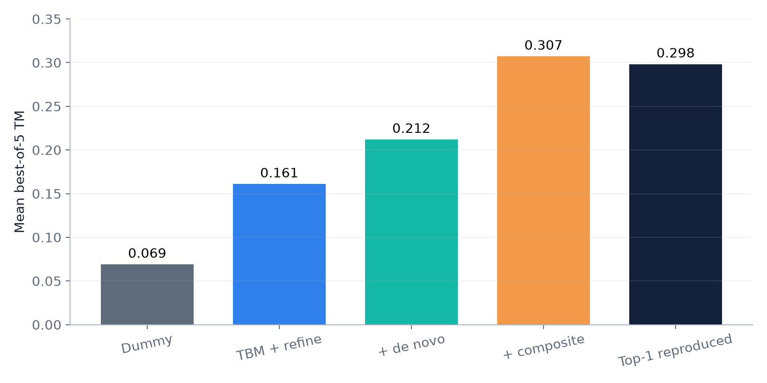
How performance evolved
Candidate generation dominates. The largest jump came from search recall, not coordinate optimisation.
Stanford RNA 3D Folding thesis update • 14 Jul 2026 7

Slide 8
Bottleneck diagnosis: candidate recall
Only 5/12 targets originally had an MMseqs temporal-safe hit; 7/12 fell back to de novo.
A faithful top-1 reproduction scored 0.2983 temporal-safe using exhaustive composite similarity.
This diagnosed search—not refinement—as the main accuracy bottleneck.
Composite search lifted our pipeline from 0.2117 to 0.3072.
It improved 11/12 targets and beat reproduced top-1 on 9/12.
Stanford RNA 3D Folding thesis update • 14 Jul 2026 8

Slide 9
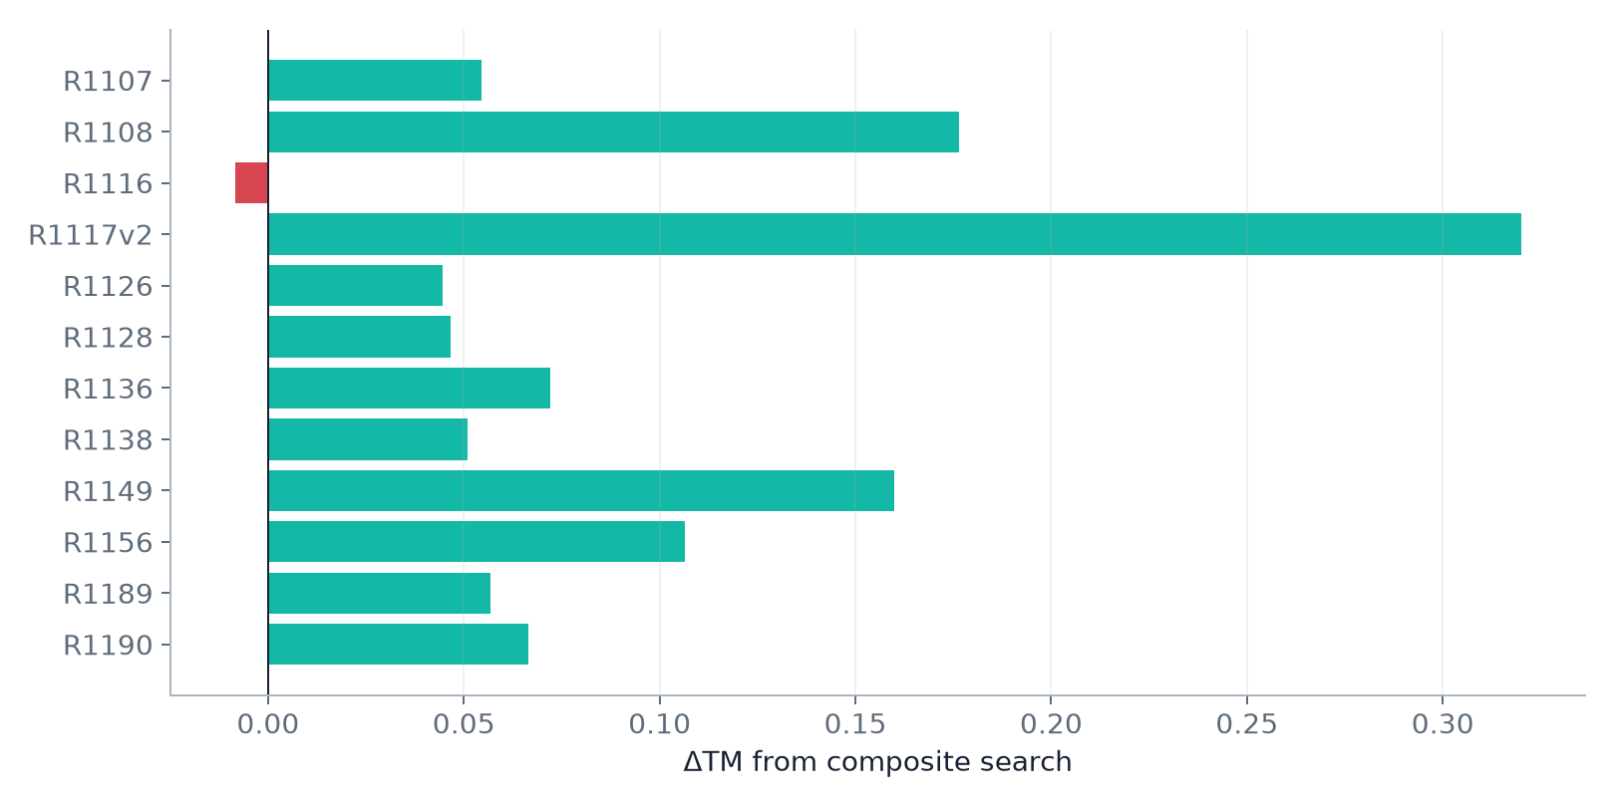
Composite-search ablation
Mean gain: +0.0955 TM Largest: R1117v2 +0.320 Runtime: ~8 s/target
Stanford RNA 3D Folding thesis update • 14 Jul 2026 9

Slide 10
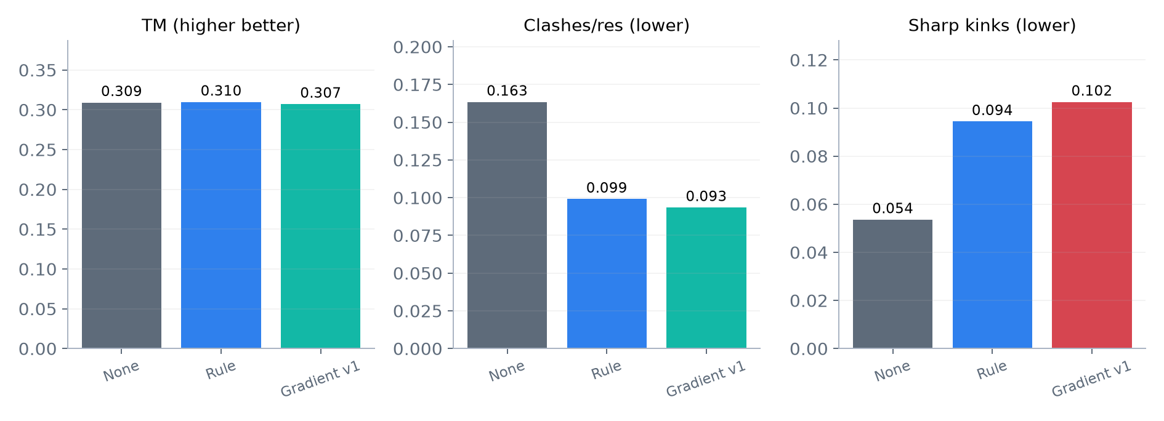
Geometry refinement v1: an honest negative result
Auxiliary metrics averaged over all five structures and 12 targets
−42% clashes −47% backbone deviation TM: −0.002 Kinks: ~2×
Stanford RNA 3D Folding thesis update • 14 Jul 2026 10

Slide 11
What is already a contribution?
A reproducible temporal-safe benchmark with explicit leakage quantification.
A search diagnosis and composite-recall improvement over the reproduced top-1 baseline.
Adversarial refinement evaluation using an unoptimised sharp-kink metric.
Reusable accuracy, geometry and diversity evaluation in one codebase.
However, generic ‘TBM + pretrained + refinement’ remains too close to leaderboard practice.
Stanford RNA 3D Folding thesis update • 14 Jul 2026 11

Slide 12
Proposed thesis extension: GeoFuse-RNA
TBM candidates
Segment fusion
Fold clustering
Residue/segment confidence
Quality-diversity final five
Pretrained candidates
Geometry v2 projection
Novelty is the adaptive integration layer — not another large RNA foundation model.
Stanford RNA 3D Folding thesis update • 14 Jul 2026 12

Slide 13
Geometry v2: directly answer the v1 failure
Retain adjacent-distance, clash and size terms.
Add context-conditioned angle/curvature distributions to prevent kink trading.
Use signed pseudo-torsion only when the required atom representation is retained.
Optimise in stages: stitch/fuse → local repair → weak global prior.
Success gate: preserve TM and geometry gains without exceeding the no-refine kink rate.
Stanford RNA 3D Folding thesis update • 14 Jul 2026 13

Slide 14
Confidence-aware segment fusion
Estimate source reliability at residue/segment level, not only one score per structure.
TBM features: identity, coverage, completeness, gap mask, date and local agreement.
Pretrained features: model confidence and agreement among predicted folds.
Align and cluster candidates before fusion; never blend incompatible global folds.
Use segment smoothing and seam penalties to avoid ‘Frankenstein’ switching.
Train/evaluate on real held-out predictions, not synthetic corruptions alone.
Stanford RNA 3D Folding thesis update • 14 Jul 2026 14

Slide 15
Experiments that isolate the contribution
B0
Current TBM + composite
Strong reference baseline
B1
+ raw pretrained union
Does oracle candidate TM rise?
B2
+ confidence-aware fusion
Fusion vs whole-candidate selection
B3
+ geometry v2
Repair without kink artifacts
B4
+ fold-aware final-five
Quality/diversity and selection regret
Stanford RNA 3D Folding thesis update • 14 Jul 2026 15

Slide 16
Current engineering status
WSL Conda env ‘rna-fold’ installed; RTX 3060 Ti CUDA and MMseqs2 verified.
Four core numerical/temporal tests pass.
Clean rebuild: 23,869 chains / 10.87M residues / zero parser errors in 4.6 minutes.
Clean rerun: dummy 0.0687, top-1 0.2983 and current pipeline 0.3072.
Offline Kaggle kernel v4 completed; its exact 2,515-row output passed validation.
Late submission 54662648 completed: 0.60084 public / 0.60175 private.
WSL cap configured to 18 GB RAM + 8 GB swap; restart is required to apply it.
Stanford RNA 3D Folding thesis update • 14 Jul 2026 16

Slide 17
Compute strategy and laptop handoff
RTX 3060 Ti / 8 GB: artifact builds and DRfold2/RibonanzaNet-scale experiments.
GTX 1650 / 4 GB laptop: code, unit tests, cached-candidate analysis, slides and thesis writing.
Do not rebuild 57 GB CIFs or run AF3-style models on the laptop.
Kaggle GPU: final offline notebook and heavier pretrained candidates where feasible.
Cache candidate coordinates so fusion/refinement ablations remain cheap and reproducible.
Stanford RNA 3D Folding thesis update • 14 Jul 2026 17

Slide 18
Immediate next steps and decision gates
1. Harden fail-closed cutoff parsing and explicit self-PDB exclusion.
2. Add pretrained candidates and first measure oracle-pool TM.
3. Proceed to fusion only if candidate sources are complementary.
4. Require geometry v2 to eliminate the kink regression.
5. Run paired family/time-aware ablations and freeze the final holdout.
Stanford RNA 3D Folding thesis update • 14 Jul 2026 18

Slide 19
Questions for the supervisor
Should the primary claim centre on segment fusion, with geometry v2 as projection/repair?
Is 12-target temporal-safe CASP15 evaluation sufficient when paired with Kaggle private validation?
Should the frozen final holdout be family-based, time-based, or target-based?
Is a learned confidence gate necessary, or can a well-ablated heuristic gate suffice?
Should success be framed as TM uplift, geometry validity, or an explicit two-axis claim?
Stanford RNA 3D Folding thesis update • 14 Jul 2026 19

Slide 20
Appendix: evidence map
Pipeline results: reports/thesis_notes/results_summary.md
Kaggle 0.60175 audit: reports/thesis_notes/kaggle_submission_analysis.md
Composite ablation: reports/thesis_notes/composite_ablation.md
Refinement truthfulness: reports/thesis_notes/refine_ablation.md
Top-1 reproduction and leakage: reproduce_top1.md + leakage_demo.md
Full chronology: LOG.md; extension: PLAN.md + research_plan_review.md
External papers and official Kaggle workflow: sources.md
Stanford RNA 3D Folding thesis update • 14 Jul 2026 20

